Slide 1
Stars and spectral analysis:
WHAT THE COLORS CAN TELL US

Slide 2
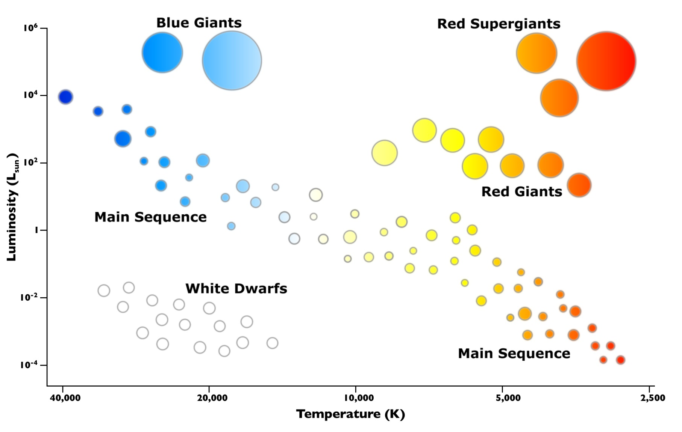
Color Temperature

Slide 3
Color Size

Slide 4
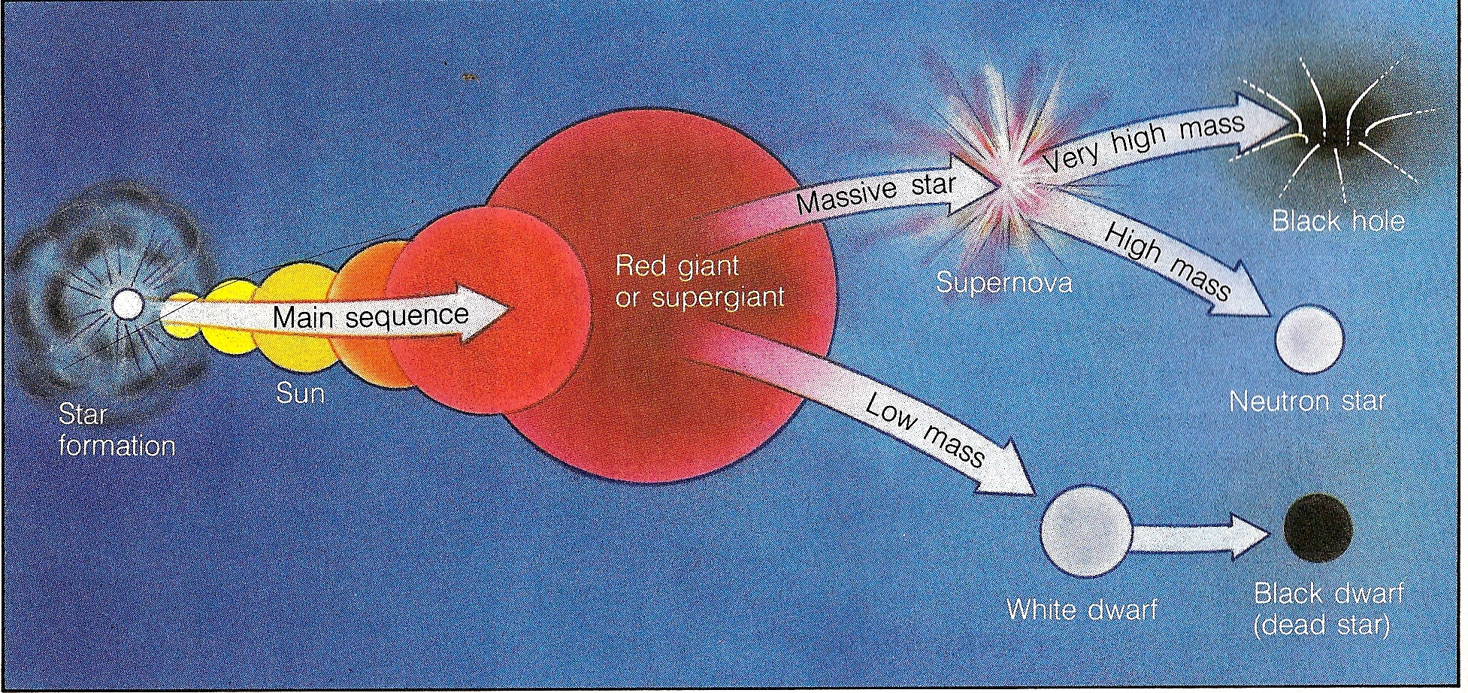
Color age

Slide 5
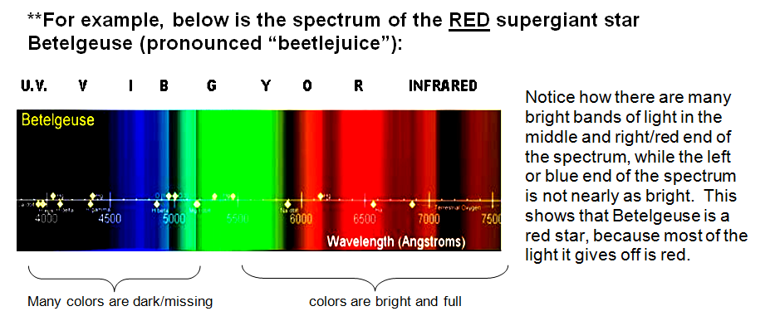
WHAT COLOR IS THAT STAR?
READING THE SPECTRUM OF A STAR

Slide 6
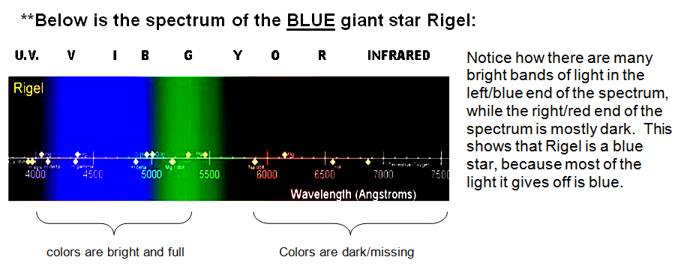
WHAT COLOR IS THAT STAR?
READING THE SPECTRUM OF A STAR

Slide 7
HOW TO IDENTIFY THE COMPOSITION OF STARS
Hydrogen
Helium
Carbon
Iron
When heated, each element emits its own unique and distinct pattern of wavelengths of light. This is known as a SPECTRAL FINGERPRINT.
By using a database of these “fingerprints”, astronomers can identify the composition of a distant object.
For example, the spectral pattern produced by a star is shown below.
It matches the spectral fingerprint of Hydrogen – therefore, we now know that the star is composed of Hydrogen gas!

Slide 8
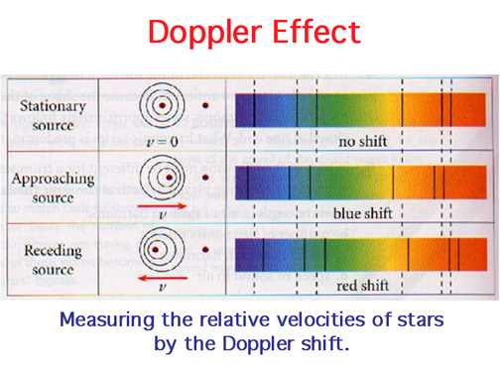
RED AND BLUE SHIFTS: How light is used to determine the movement of stars

Slide 9
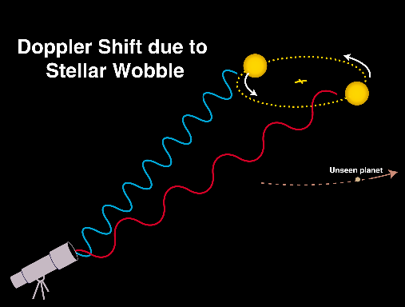
How light is used to detect “invisible” alien planets BY OBSERVING STARS:
By measuring the cyclical Doppler shift of a star, astronomers can figure out how far the star is wobbling, which allows them to figure out THE MASS OF ITS ORBITING PLANET, AND ITS DISTANCE FROM THE STAR

