Slide 1
Westpoint bridge: getting started

Slide 2
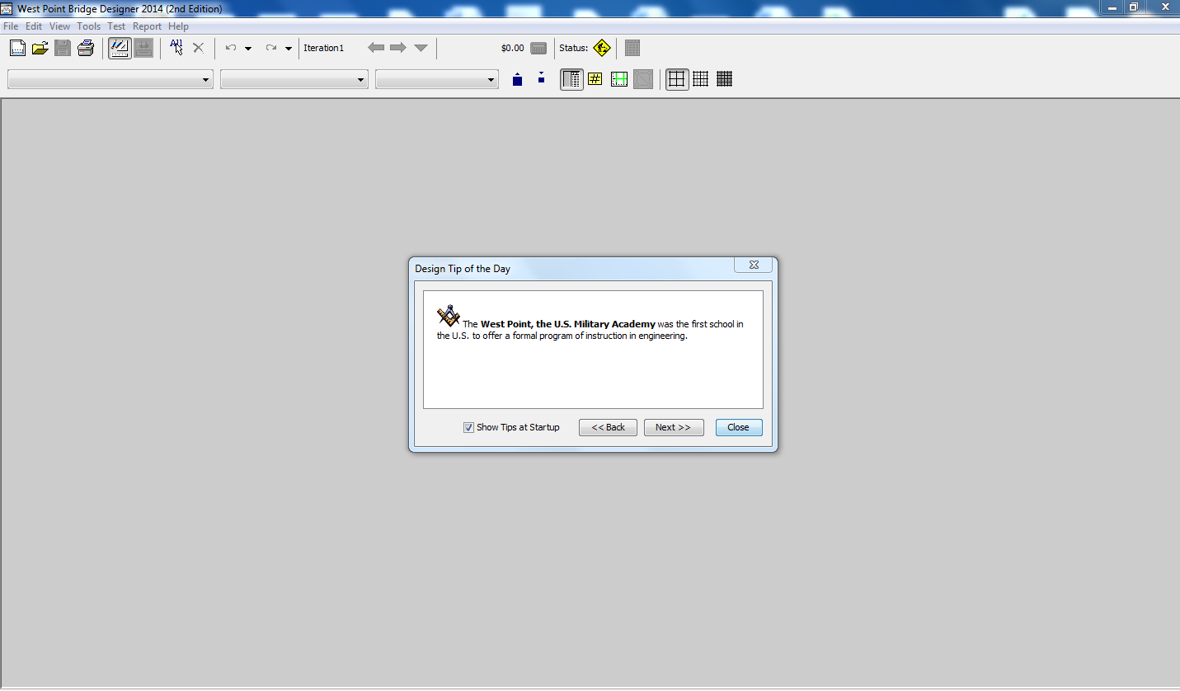

Slide 3
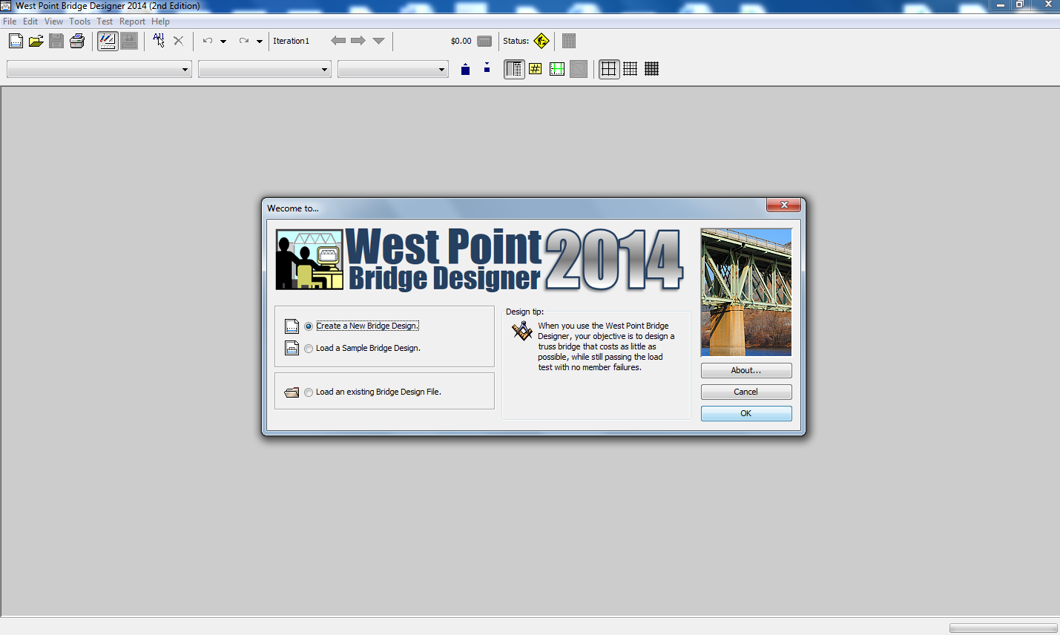

Slide 4
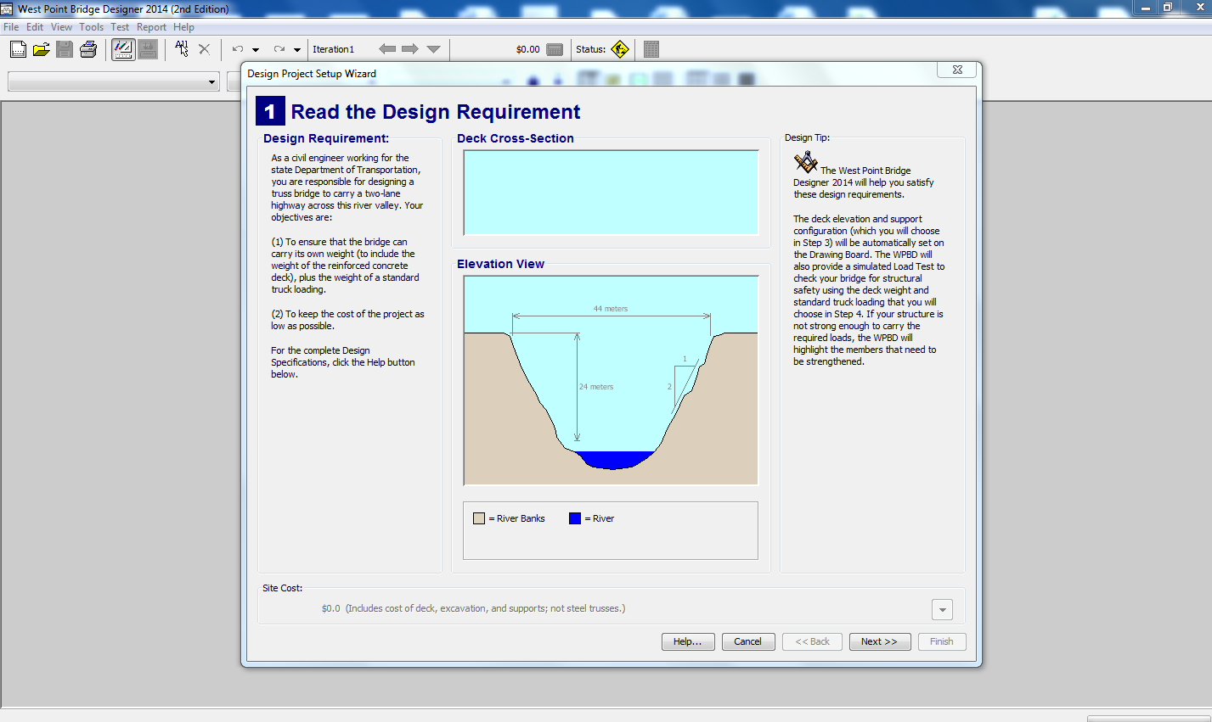

Slide 5
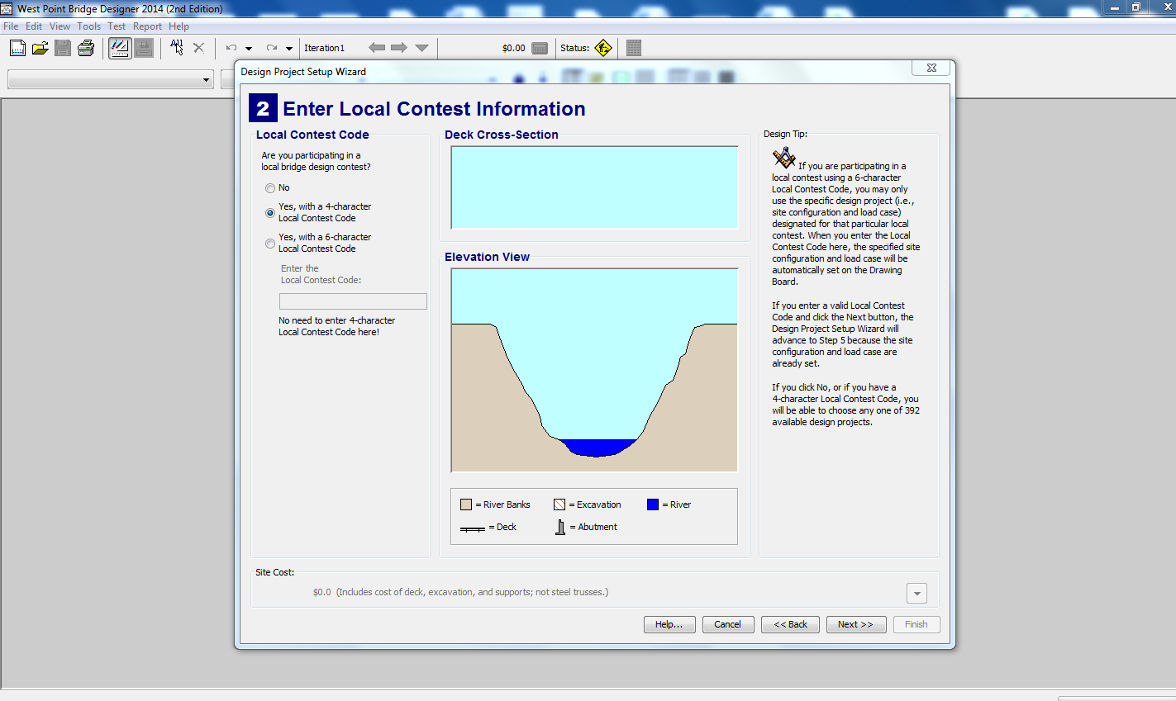

Slide 6
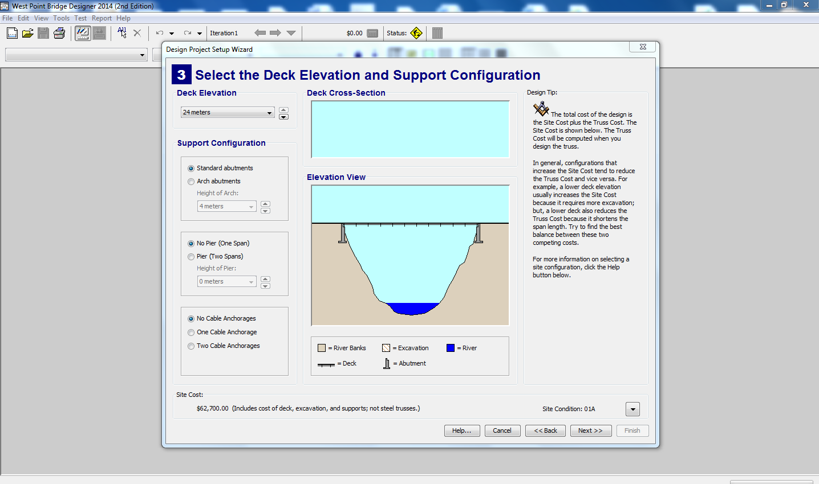

Slide 7
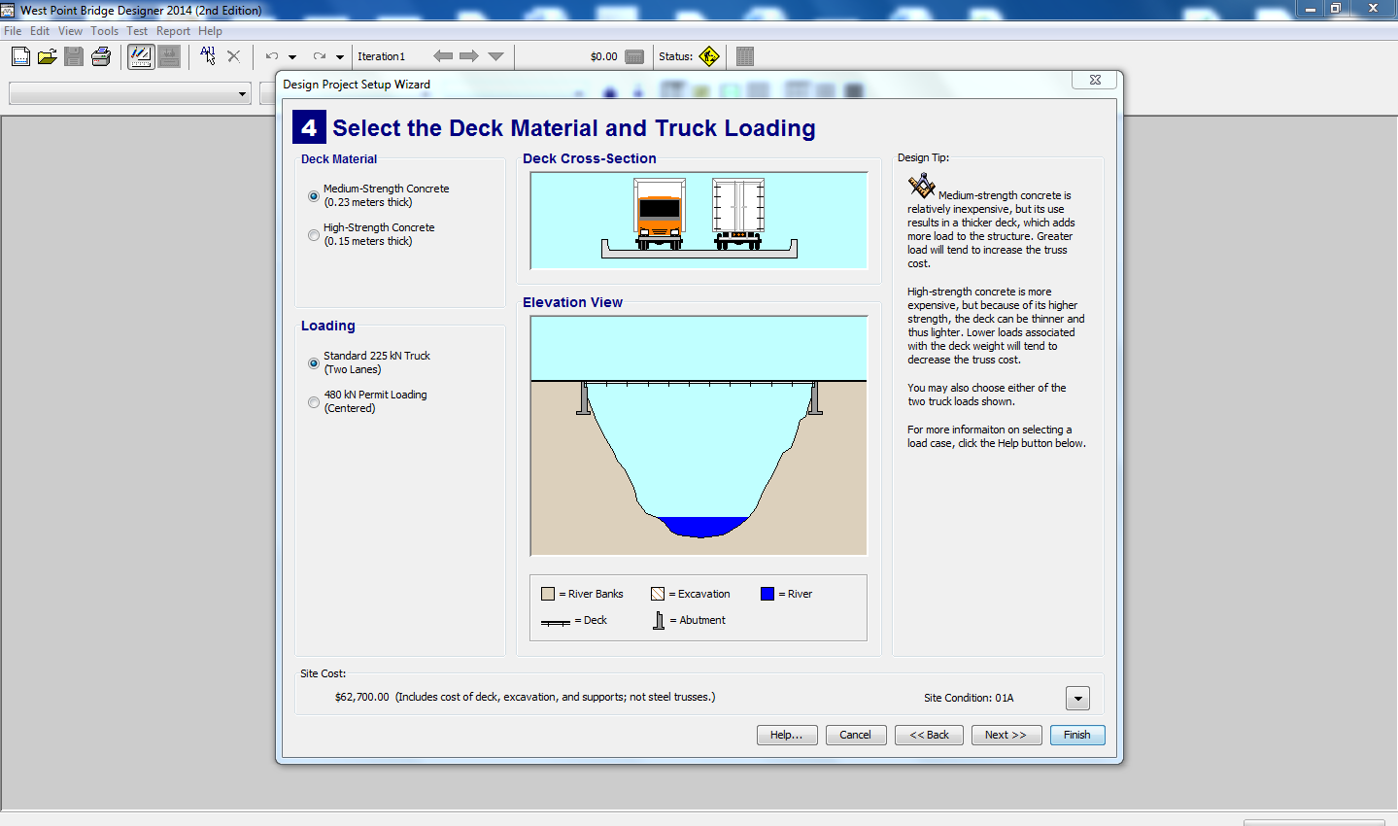

Slide 8
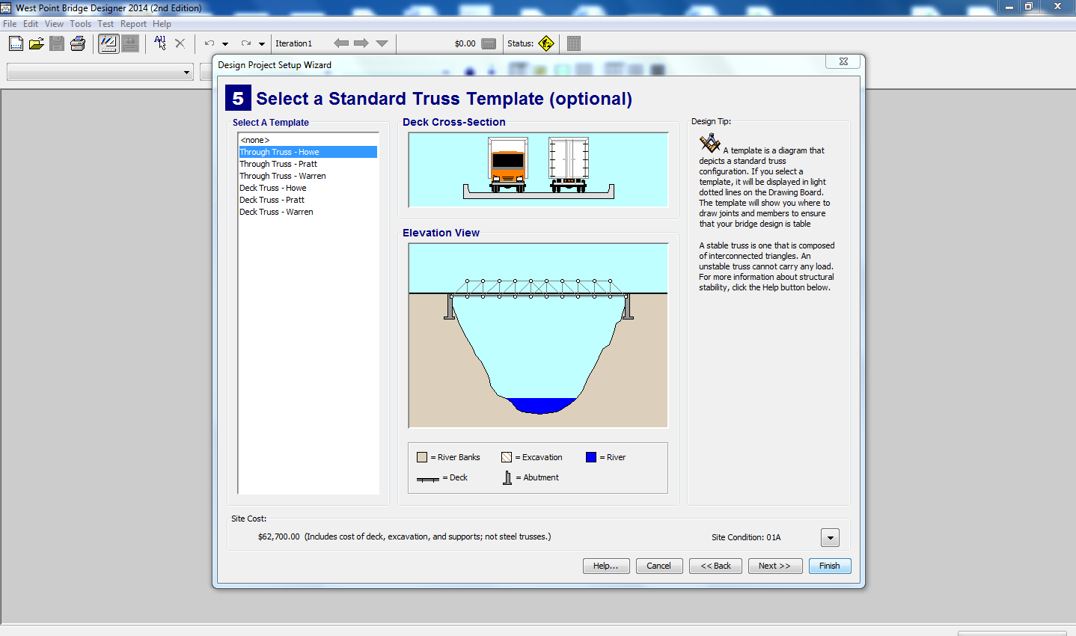

Slide 9
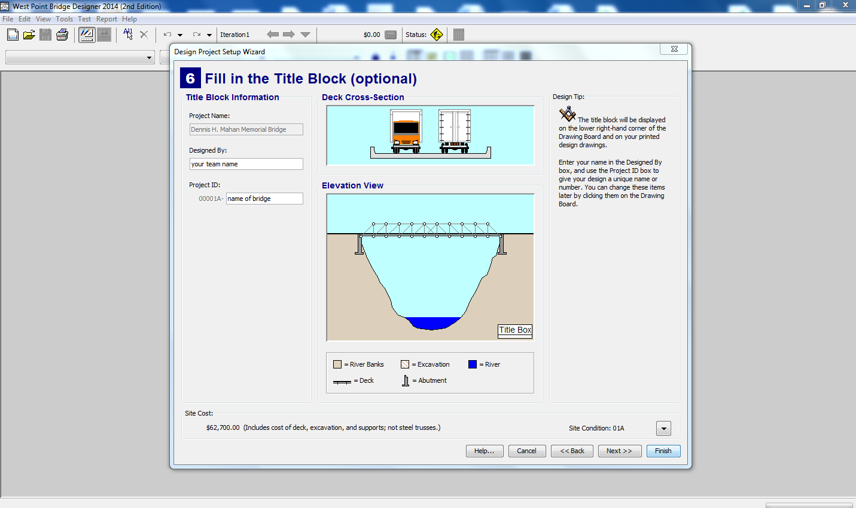

Slide 10
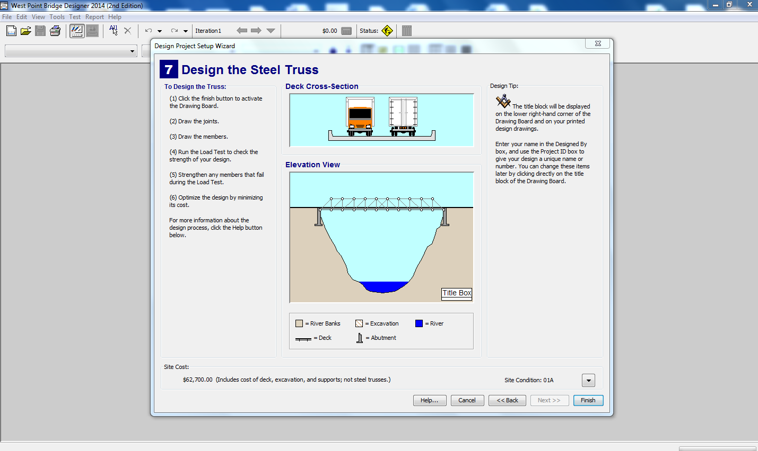

Slide 11
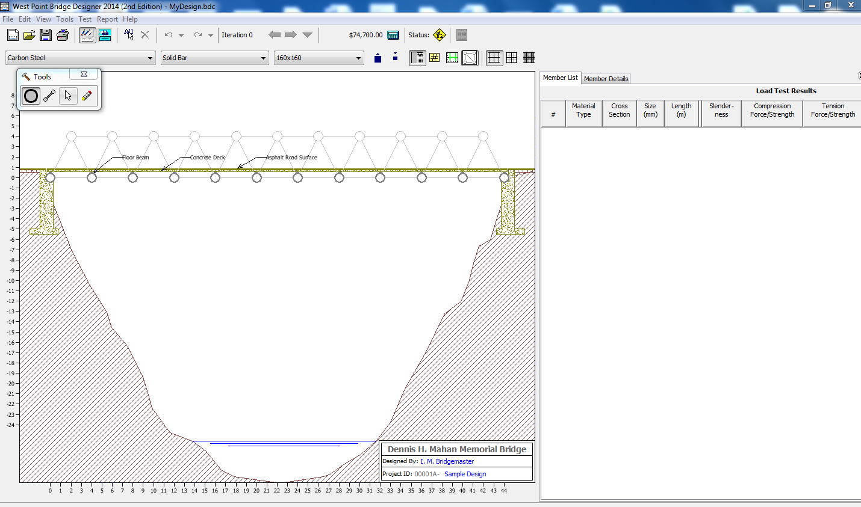

Slide 12
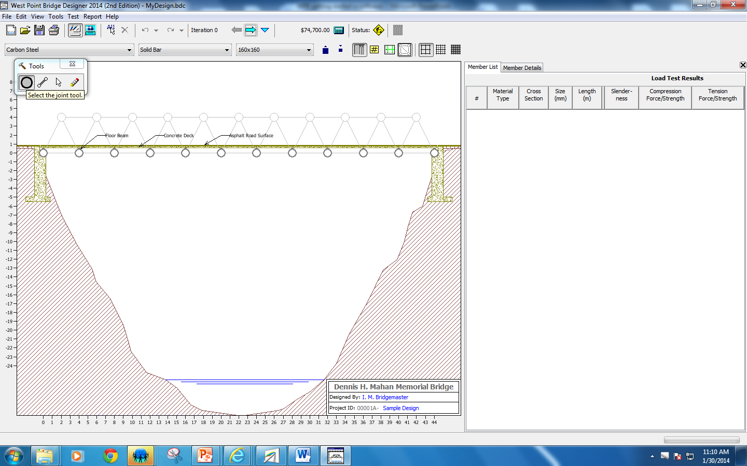

Slide 13
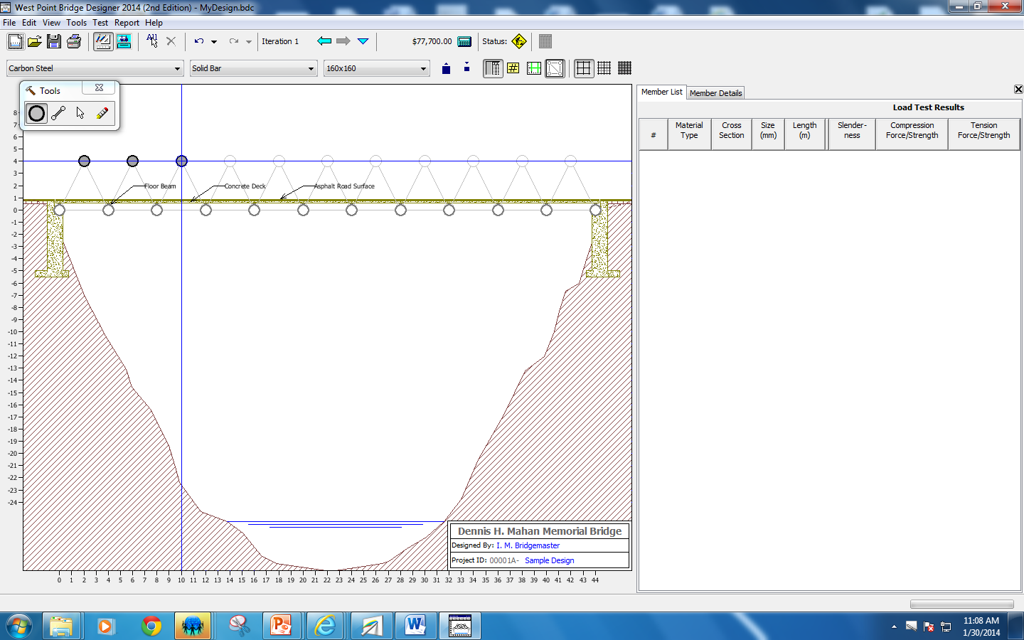

Slide 14


Slide 15
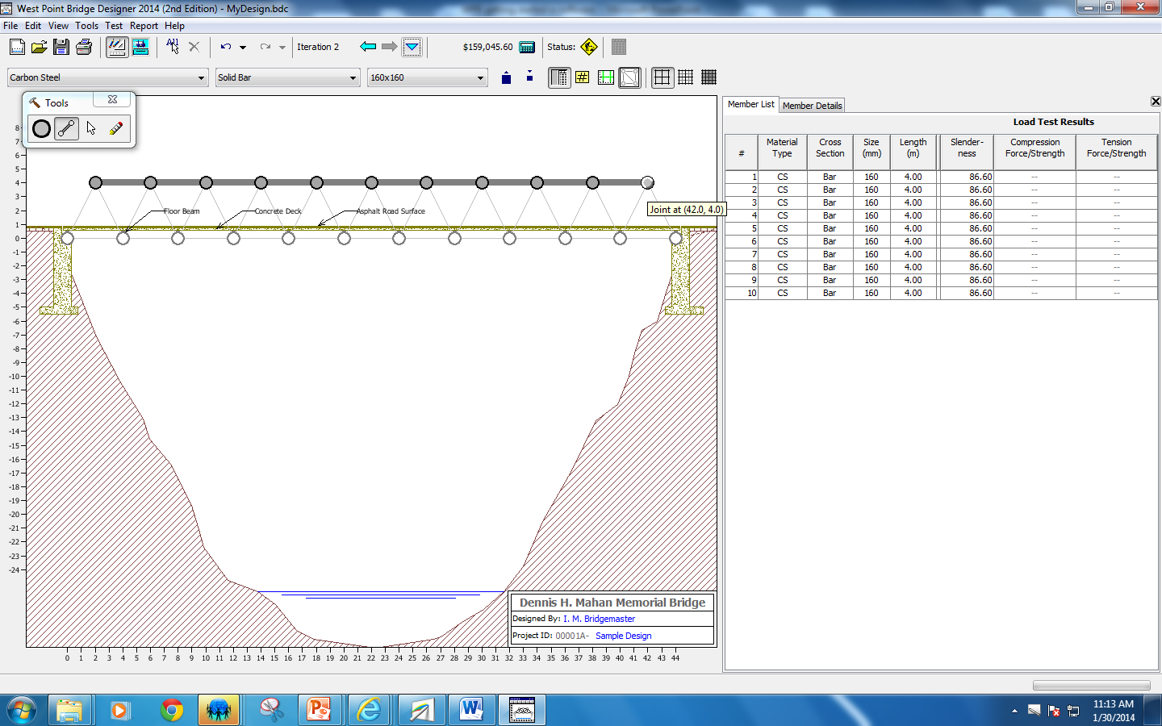

Slide 16
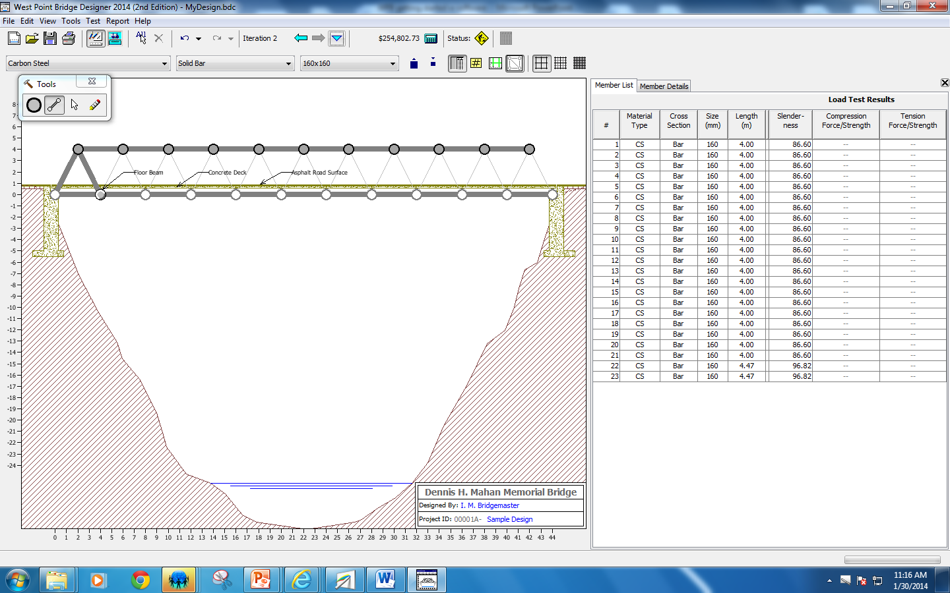

Slide 17
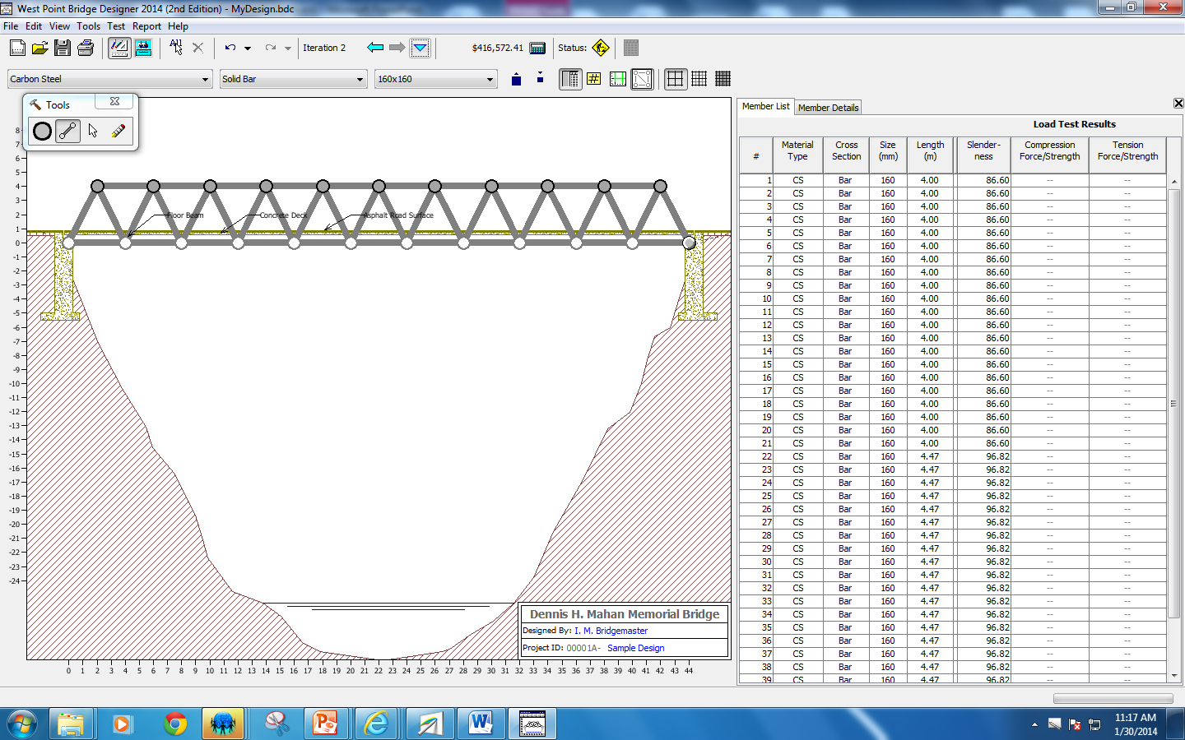

Slide 18


Slide 19
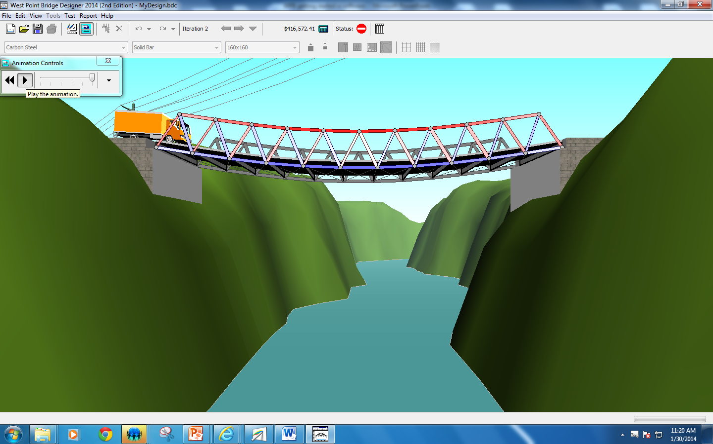

Slide 20
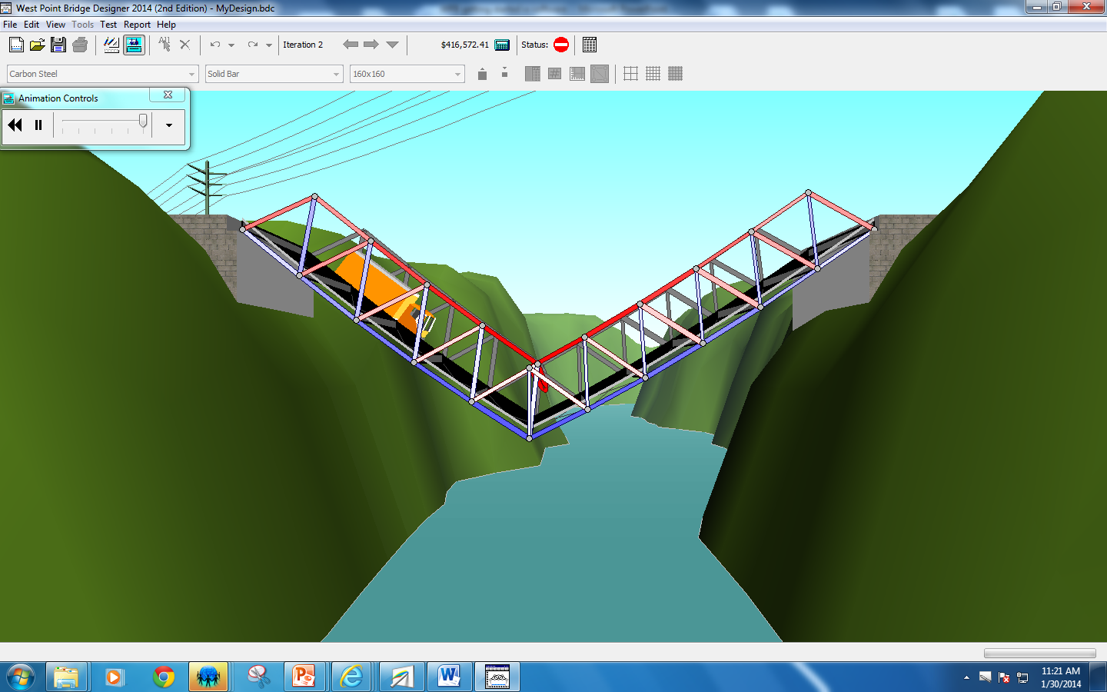

Slide 21
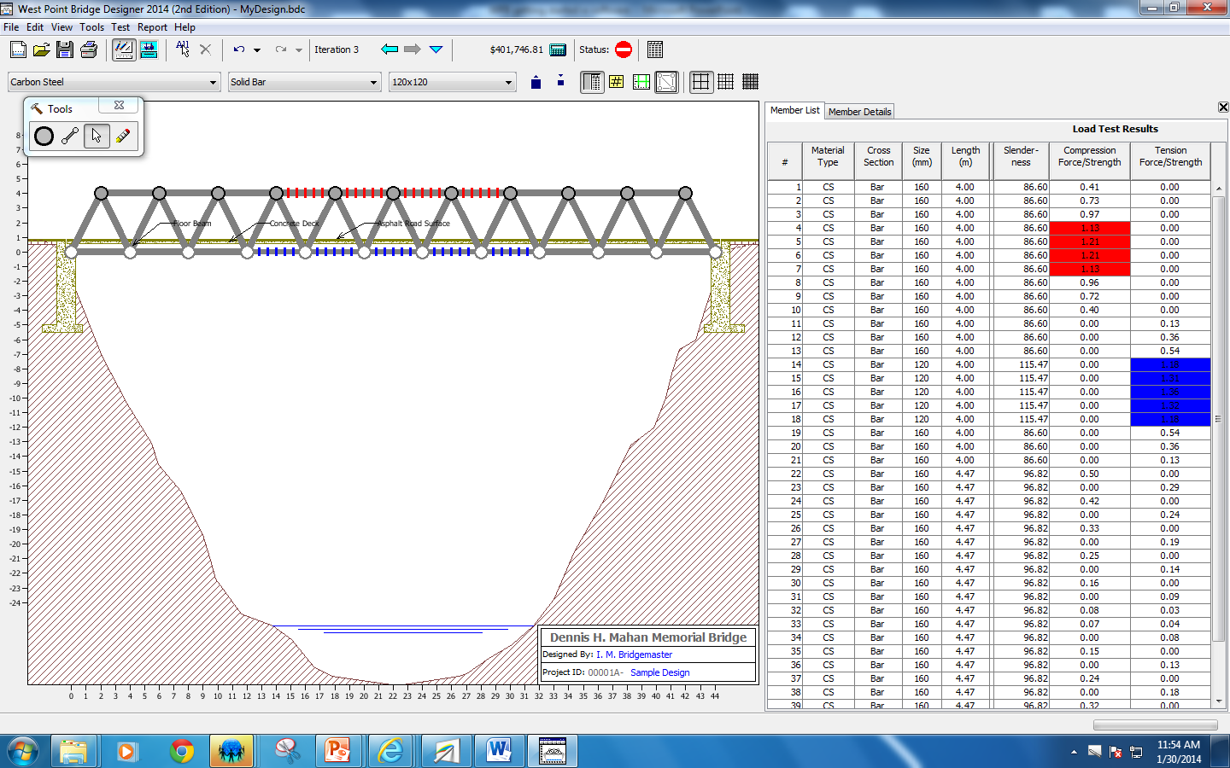

Slide 22
FORCE/STRENGTH RATIO
WEIGHT: FORCE = 110 KILOGRAMS
SHELF: STRENGTH = 100 KILOGRAMS
FORCE/STRENGTH RATIO = 110kg/100kg = ?
What will happen to the shelf?

Slide 23
FORCE/STRENGTH RATIO
WEIGHT: FORCE =
99 KILOGRAMS
SHELF: STRENGTH = 100 KILOGRAMS
FORCE/STRENGTH RATIO = 99kg/100kg = ?
What will happen to the shelf?

Slide 24
HOW TO FIX THE BRIDGE
MAKE ALL MEMBERS HIGHLIGHTED THICKER, SO THAT THEY HAVE A FORCE/STRENGTH RATIO LESS THAN 1.00
  This way, the members will have a strength greater than the force of the load (truck) so that they don’t break

Slide 25
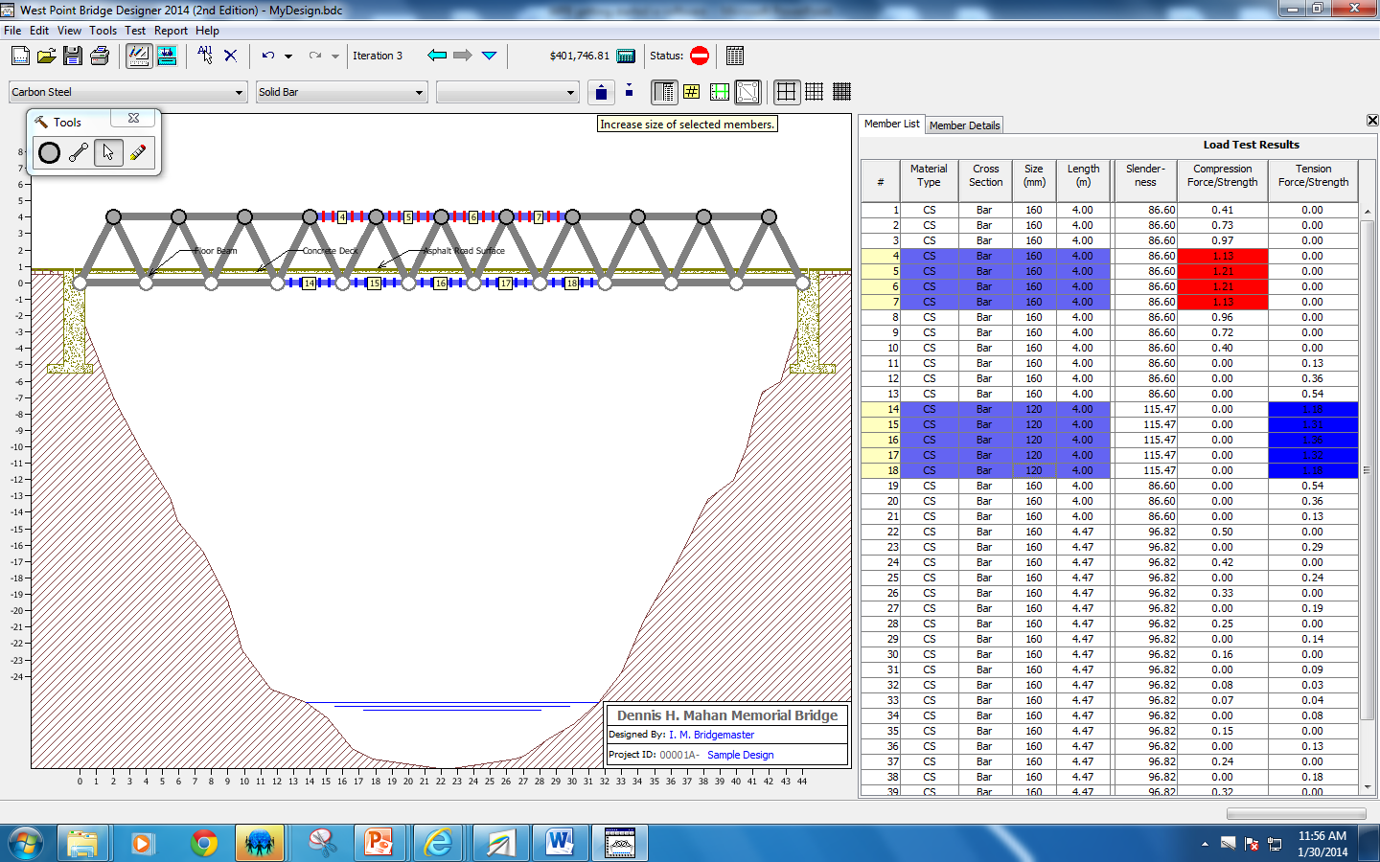

Hold the CONTROL BUTTON as you click to select MULTIPLE members

Slide 26
HOW TO MAKE A CHEAP BRIDGE
MAKE ALL MEMBERS SO THIN, THAT THEY HAVE A FORCE/STRENGTH RATIO AS CLOSE TO .99 AS POSSIBLE:
  This way, the members are so thin (and cheap) that they ALMOST break, but don’t

Slide 27
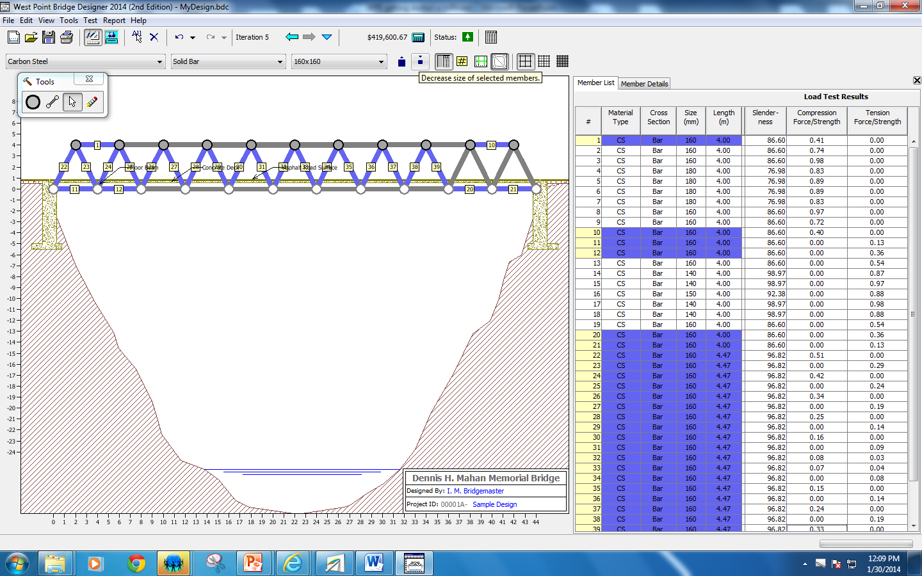
Hold the CONTROL BUTTON as you click to select MULTIPLE members

Slide 28
For the 4 required bridges
REPEAT THE PROCESS UNTIL THE BRIDGE WORKS, and is below the cost on your rubric

Slide 29
For the contest bridge
REPEAT THE PROCESS UNTIL THE BRIDGE WORKS, and is AS CHEAP AS POSSIBLE

