Slide 1
Practice exercise #1: graphing density

Slide 2
Getting started: how to graph data from a data table

Slide 3
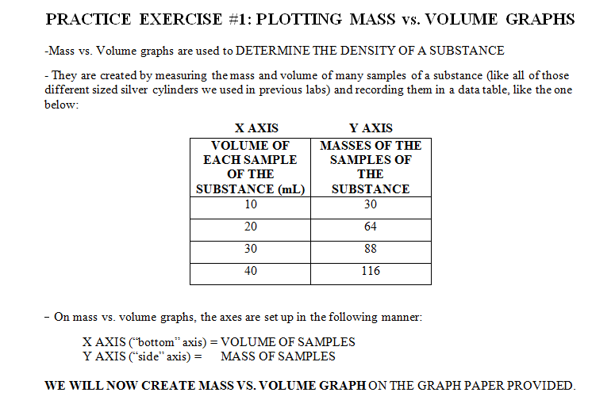
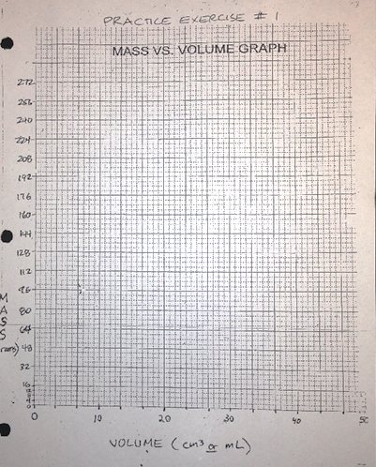

Slide 4
GOING OVER THE HOMEWORK ASSIGNMENT

Slide 5
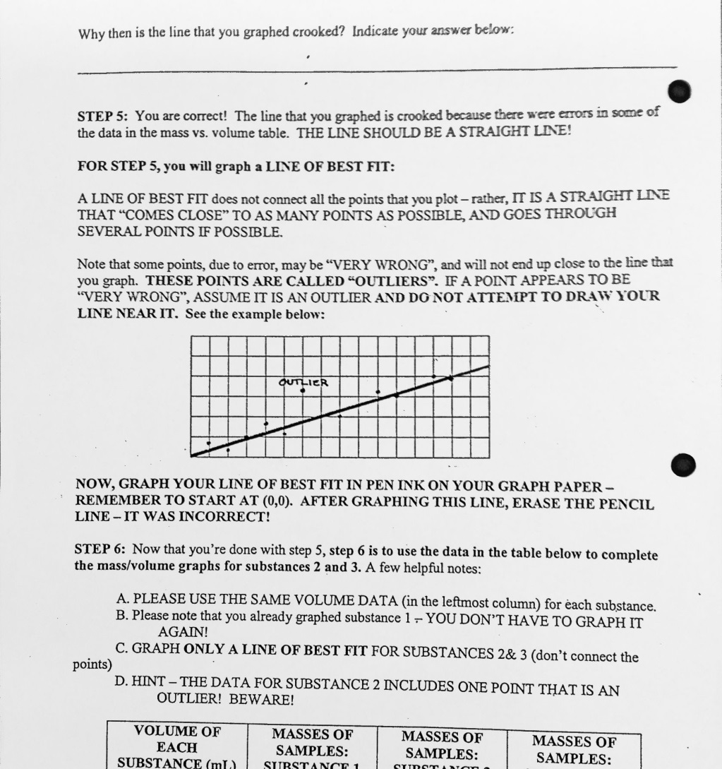

Slide 6
