Slide 1
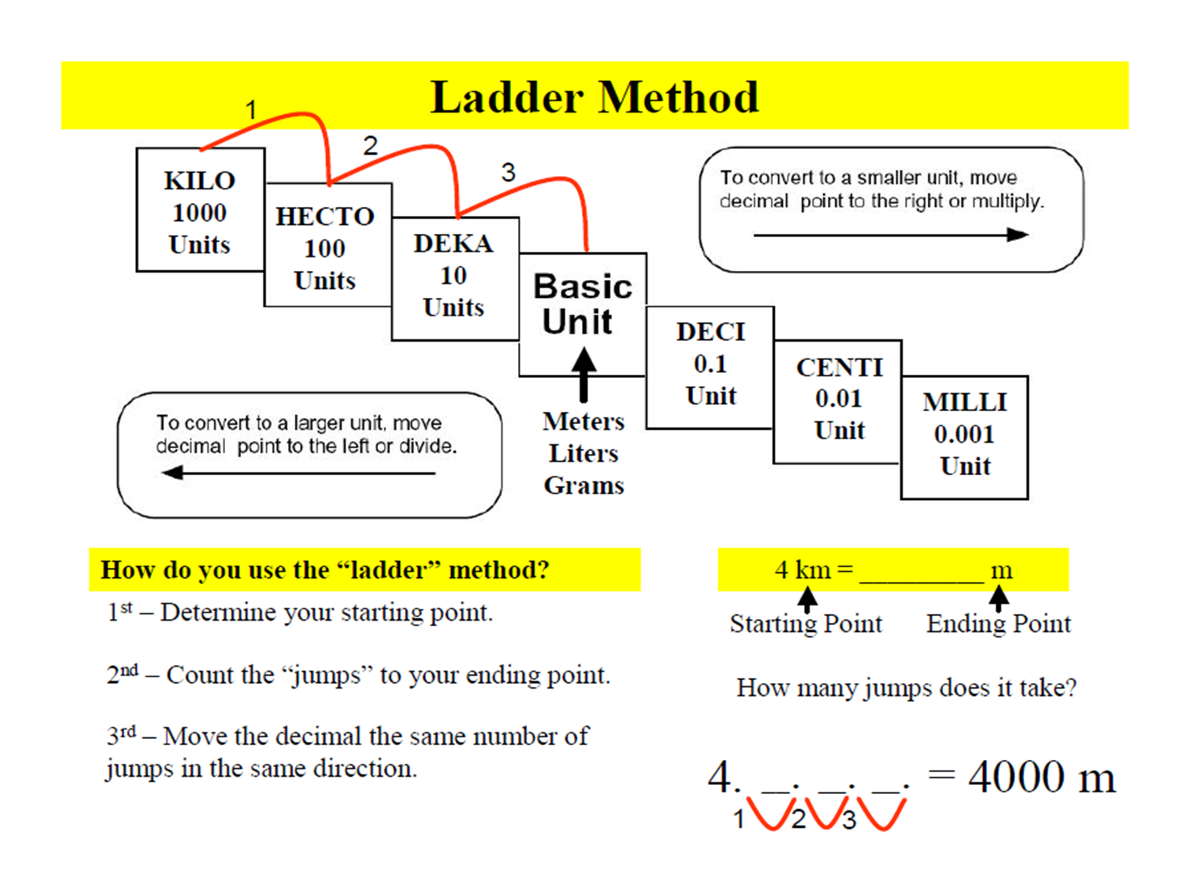
Metric conversions

Slide 2
