Slide 1
TIDES NOTES - DIAGRAMS

Slide 2
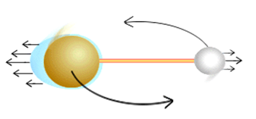
Why do we have tides at all?
The gravitational pull of the MOON on the EARTH pulls on the ocean waters ON BOTH SIDES OF THE EARTH!!!

Slide 3
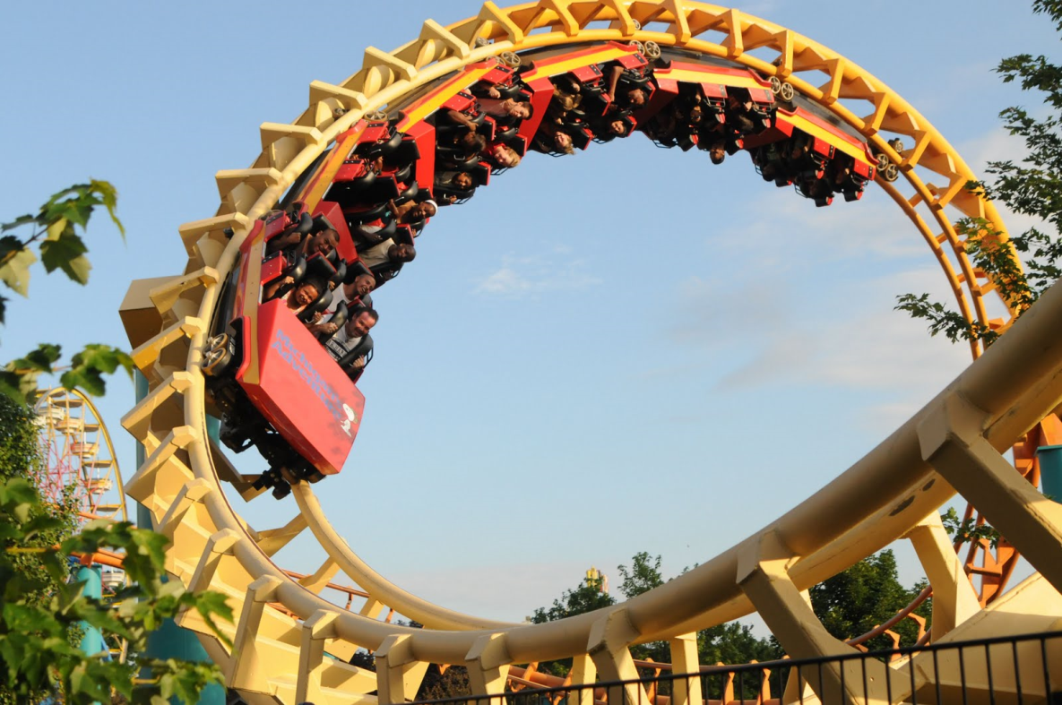
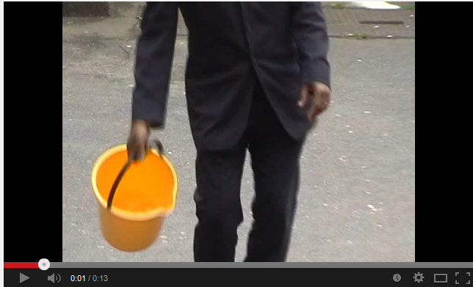

Slide 4
Why do we have tides at all?
The gravitational pull of the MOON on the EARTH pulls on the ocean waters ON BOTH SIDES OF THE EARTH!!!
Like the passengers in a loop rollercoaster, or swinging a bucket full of water, the water on the “back” of the earth is forced away from the moon, but does not “fall out / off” of the earth (gravity) even though it is forced that way by inertia

Slide 5
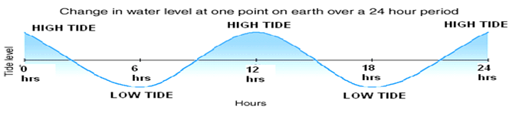
Theory: the ocean acts as one enormous sine wave….

Slide 6
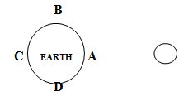
HIGH TIDES
HIGH TIDES are at locations A & C: they are located directly beneath (A) and directly opposite (C) the moon:

Slide 7
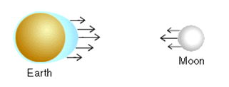

Slide 8
LOW TIDES
LOW TIDES are at locations B & D: they are located at 90º angles to the moon:

Slide 9
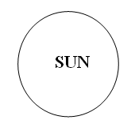
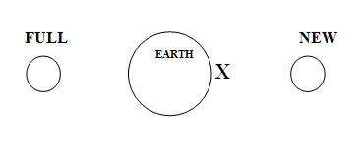
SPRING TIDES are higher than normal high tides, and lower than normal low tides – they occur during NEW AND FULL MOON PHASES, when the sun, moon and earth are in a straight line – in this position the sun’s gravity “boosts” the moon’s gravity, creating “extreme”
tides.

Slide 10
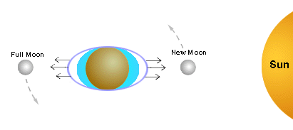
Spring tides

Slide 11
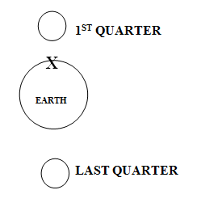
NEAP TIDES are lower than normal high tides, and higher than normal low tides – they occur during FIRST AND LAST QUARTER MOON PHASES, when the sun, moon and earth are in at 90º angles – in this position the sun’s gravity “works against” the moon’s gravity, creating “ less extreme” tides.

Slide 12
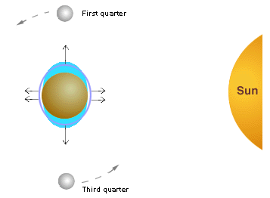
Neap tides

Slide 13
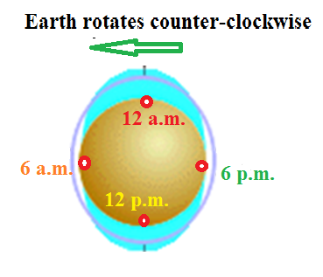
Over the course of 24 hours, each coastal location on Earth experiences 2 HIGH TIDES AND 2 LOW TIDES:
Locations on Earth rotate into 2 high tidal bulges and 2 low tidal bulges per day

