Slide 1
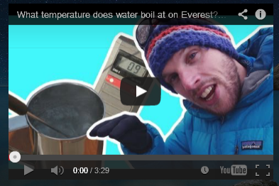
Boiling Temperature depends on altitude and air pressure

Slide 2
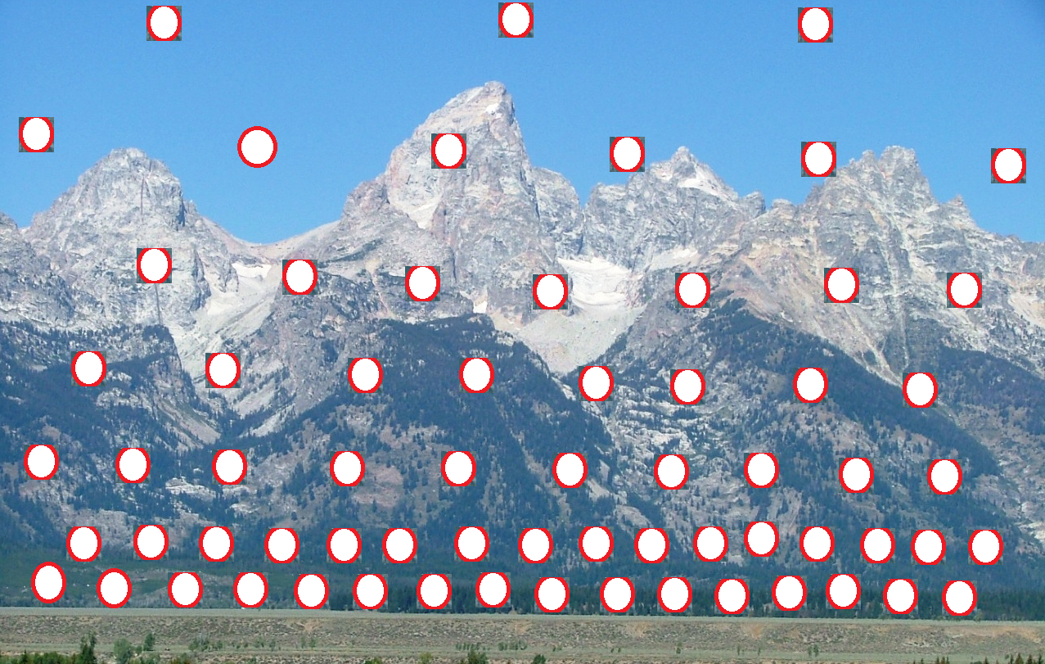
DENSER AIR = HIGHER AIR PRESSURE
WHERE WOULD AIR PRESS. BE LOWER – HIGHER ELEVATIONS OR AT SEA LEVEL?

Slide 3
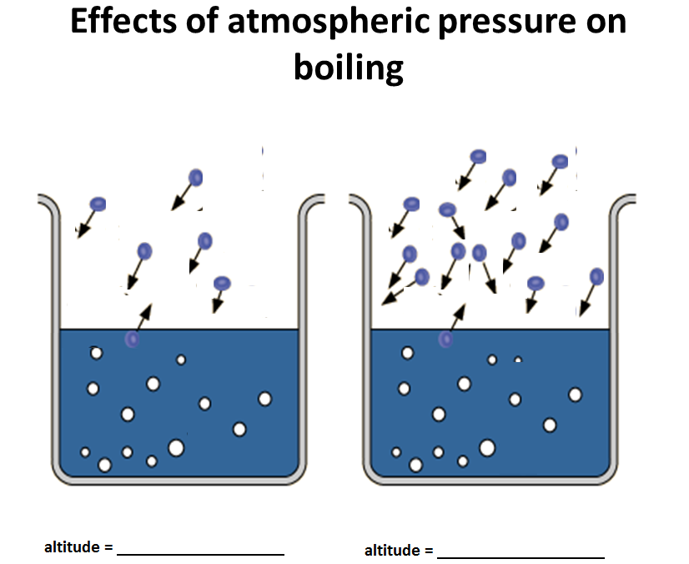
Two Types of Vaporization: Evaporation vs. Boiling
Effects of atmospheric pressure on boiling

Slide 4
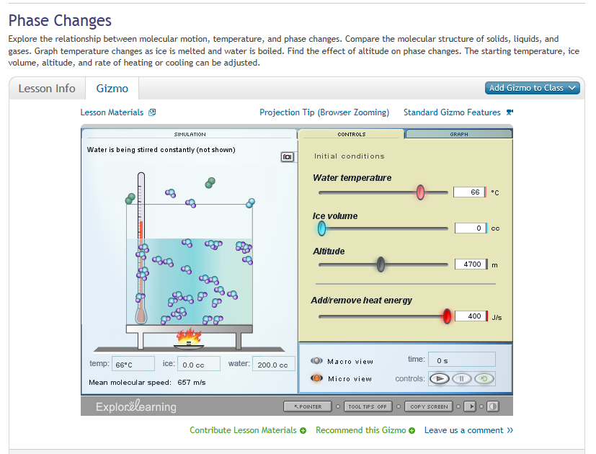
Boiling Temperature depends on altitude and air pressure
Click to utilize gizmo

Slide 5
Two Types of Vaporization: Evaporation vs. Boiling

