Slide 1
The Poetry Essay
How to Succeed on the AP LITERATURE and composition exam
Dr. MH Daon

Slide 2
What is the AP English Literature Exam asking student-writers to master?
Notes:
Every single essay prompt that ever was or will be asked on the AP English Literature exam is a version of the universal prompt, or, “uni-prompt”:

Slide 3
The “uni-prompt”:
How do writers (authors, poets, or playwrights) use literary techniques to communicate or explore (complex) meanings?
Notes:
In other words, what’s the MOWAW

Slide 4
The Classic Essay Question: The Uni-Prompt
Read the following work carefully. Then, write a well-organized essay in which you discuss the manner in which the author/poet conveys ideas and meaning. Discuss the techniques the author/poet uses to make this passage/poem effective. Avoid plot summary.
Notes:
Whether you are working on a prose or poetry passage, there is a classic essay question that you will be asked to address. Here is that uni- prompt in its most basic form. “Read the following work carefully…”

Slide 5
It’s obvious that Poetry is different from prose.
College Board wants to determine your facility in reading and interpreting literature:
In poetry:
You are required to understand the poem and analyze those techniques and devices the poet uses to achieve his/or her purpose.
Notes:
It’s obvious that poetry is different from prose and writing about each is different also. The level of your writing should be a direct reflection of your critical thinking.

Slide 6
College Board is looking for your ability to make connections between analysis and interpretation.
Remember:“uni-prompt”:
How do writers use literary techniques to
communicate or explore (complex) meanings.
Notes:
For example when you find a metaphor, you should identify it and connect it to the poet’s intended purpose or meaning

Slide 7
What kinds of questions are asked for the poetry essay?
Notes:
Let’s look at several typical questions that have been used as prompts for the poetry essay on the AP Lit exam in the past.

Slide 8
Some questions asked on Poetry Essay:
How does the language of the poem reflect the speaker’s perceptions, and how does that language determine the reader’s perception?
Discuss the similarities and differences between the two poems. Consider style and theme.
Contrast the speakers’ views toward a subject in two poems. Refer to form, tone, and imagery.
Discuss how poetic elements, such as language, structure, imagery and point of view, convey meaning in a poem.
Analyze a poem’s extended metaphor and how it reveals the poet’s or speaker’s attitude.
Discuss how the form of the poem affects its meaning.
Discuss the poet’s changing reaction of the subject developed in the poem.

Slide 9
Review the Prompt for 2010 Q1
Read carefully the following poem by Marilyn Nelson Waniek. Then write an essay analyzing how Waniek employs literary techniques to develop the complex meanings that the speaker attributes to “The Century Quilt”. You may wish to consider such elements as structure, imagery, and tone.

Slide 10
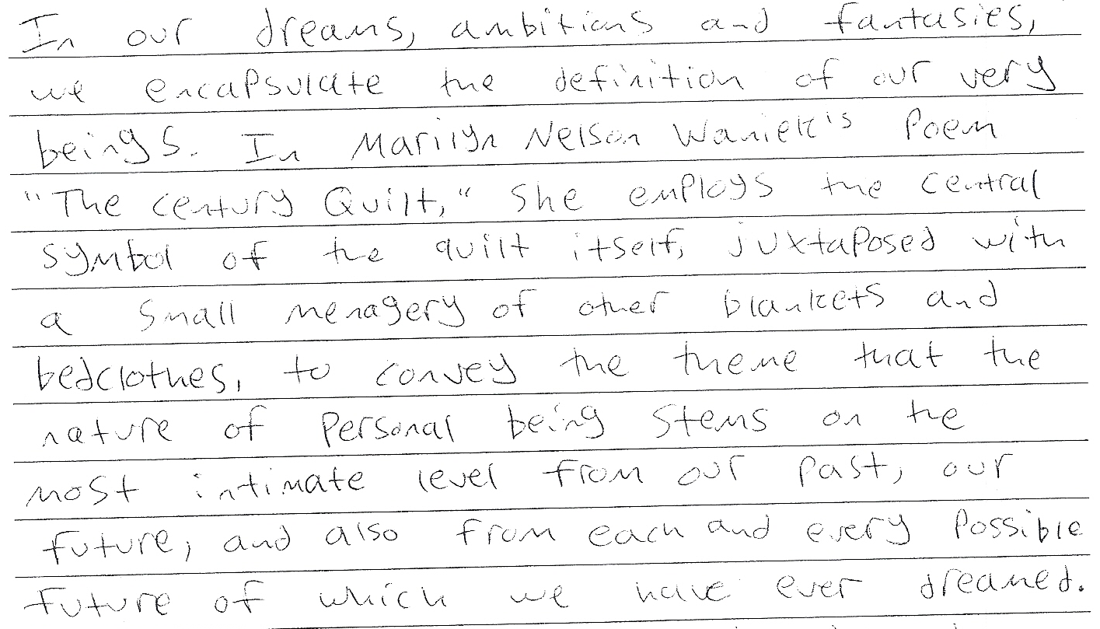
An adequate response:
Sample YYY; score: 9

Slide 11
What strategies does this successful student-writer use?
The first paragraph has a thesis which defines the complex meanings attributed to the quilt.
The description of the quilt’s theme or meanings respects that fact that the poem’s meaning is not static but “develops” as we read and as we deepen our understanding of the work.

Slide 12
What is this successful student-writer NOT doing?
The student does not repeat the prompt.
There is no laundry list of technical terms for literary techniques.
There is not much of a distracting “grabber”-type introduction. Nearly all of this first paragraph is about the poem; there is a brief “grabber” sentence, but it is seamlessly related to the statement of the poem’s theme (i.e.“complex meanings”).

Slide 13
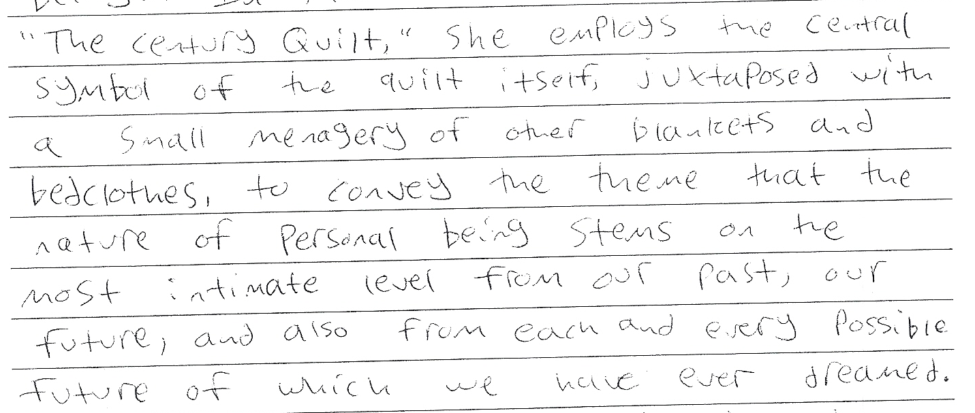
How does the successful writer introduce the “literary techniques”?
The one “technique” mentioned in ¶ 1, “symbol”, is not from the list of suggested techniques in the prompt; moreover, it is embedded in a meaningful statement about a specific idea:

Slide 14
The Always-Never List
Always PLAN – Connect to the poem – Interpret how you feel about the poem: Don’t read poem unless you know what you are required to do – what’s your purpose.
Always spend as much time as possible writing; never begin writing until you have a thesis.
Always respond directly to the prompt; never repeat the prompt.
Always begin with an interesting and clear thesis; never begin with a paragraph-long “grabber”-type introduction.
Always focus on how the writer’s use of literary techniques communicates the meaning of the text; never discuss one literary device if the prompt asks for literary devices.
Always use many short quotations to support your analysis; never use a quotation from the poem/passage/work unless it is first introduced and then fully explained in relation to the prompt and thesis.

Slide 15
How Should I plan to spend my time writing the poetry essay?
1 -3 minutes reading and “working the prompt”
5 minutes reading and making marginal notes about the poem. Annotation – Try to identify 3 references that strike you.
10 minutes preparing to write:
Use STIFS or TPCSTT
Highlight, underline, circle - list rhetorical/literary/poetic devices
Cluster ideas
Key words
20 minutes to write your essay, based on your preparation
3 minutes to proofread
Notes:
Try to always include TONE – if possible: since it’s there in every piece both prose and poetry.

Slide 16
STIFS
S= Speaker
T = Tone
I = Imagery
F = Figurative Language
S = Sound
Notes:
Use this device of STIFS: Let’s review:

Slide 17
S = Speaker
Identify the speaker and any particular character traits of the speaker (especially his or her point of view)
Who is the speaker addressing?
What is the speaker’s topic, argument, etc.

Slide 18
T = Tone
What is the dominant tone in the poem?
If so, where is it and why do you think the shift occurs?

Slide 19
I = Imagery
Isolate the major images: what do you see, smell, hear, taste, feel?
What is suggested by the imagery? Emotion? Idea?

Slide 20
F = Figurative Language
Find and understand the figurative language evident in the poem: metaphor, simile, apostrophe, personification, hyperbole, and more.
Determine what’s really being said in each example and how that relates to other elements in the poem.

Slide 21
S= Sound
What sound elements are most striking and why?
You should be looking for sound repetition, cacophony/euphony,* or any element of sound that reinforces meaning
Cacaphony: harsh, discordant, or unpleasing sounds
Euphony: pleasing, melodious, pleasant sounds

Slide 22
Most importantly connect to the poem
Experience
Analyse
Extend

