Slide 1
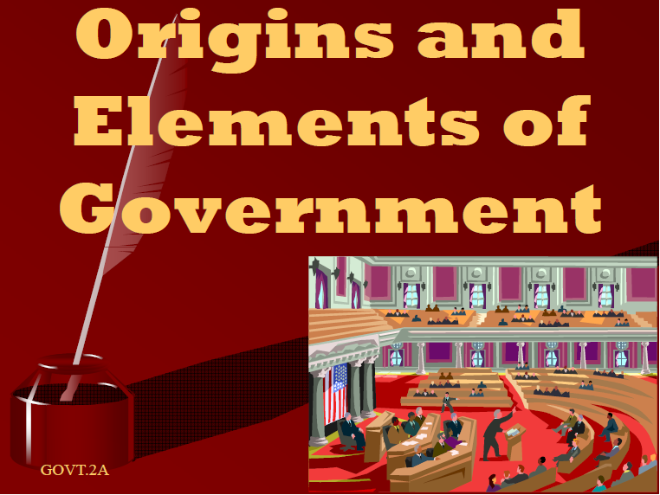

Slide 2


Slide 3


Slide 4


Slide 5


Slide 6


Slide 7


Slide 8


Slide 9


Slide 10

SECTION 2: The Coming of Independence
Until the mid-1700s, the colonies were allowed a great deal of freedom in their governments by the English monarchy.
In 1760, King George III imposed new taxes and laws on the colonists.
The colonists started a confederation, proposed an annual congress, and began to rebel.

Slide 11
Growing Colonial Unity
Early Attempts
In 1643, several New England settlements formed the New England Confederation.
The Albany Plan
In 1754, Benjamin Franklin proposed the Albany Plan of Union, in which an annual congress of delegates (representatives) from each of the 13 colonies would be formed.
The Stamp Act Congress
In 1765, a group of colonies sent delegates to the Stamp Act Congress in New York.
These delegates prepared the Declaration of Rights and Grievances against British policies and sent it to the king.

Slide 12
The Continental Congresses
First Continental Congress
The colonists sent a Declaration of Rights to King George III.
The delegates urged each of the colonies to refuse all trade with England until British tax and trade regulations were repealed, or recalled.
Second Continental Congress
In 1775, each of the 13 colonies sent representatives to this gathering in Philadelphia.
The Second Continental Congress served as the first government of the United States from 1776 to 1781.

Slide 13
American Independence
On July 4, 1776, the Second Continental Congress adopted the Declaration of Independence.
Between 1776 and 1777, most of the States adopted constitutions instead of charters.

Slide 14
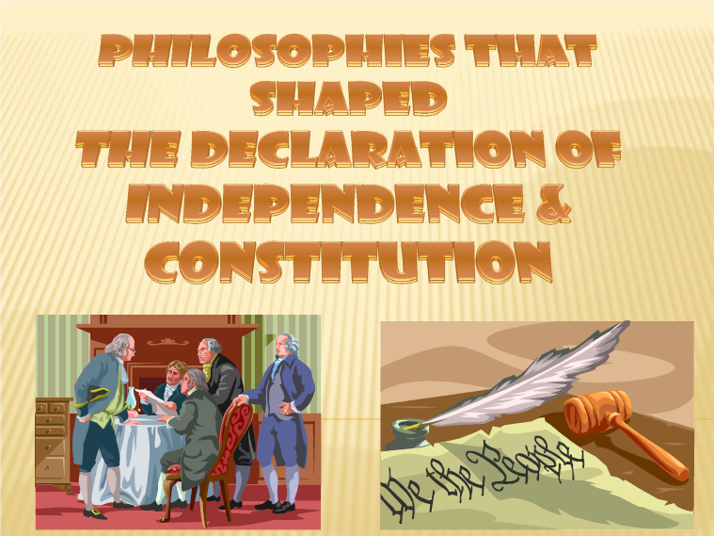

Slide 15
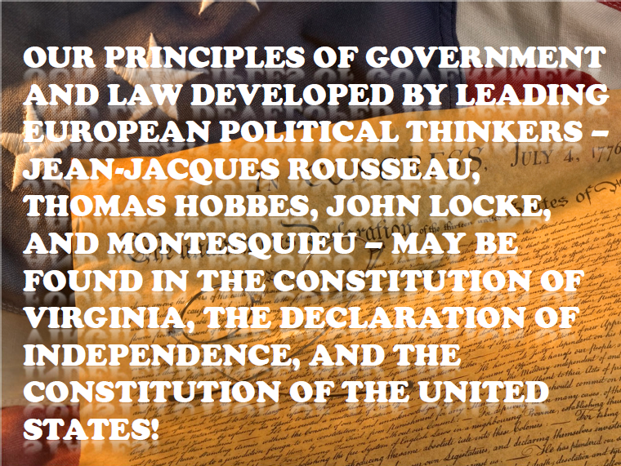

Slide 16
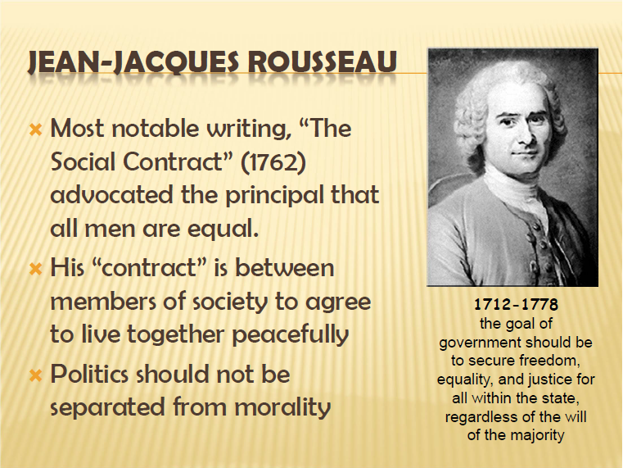

Slide 17


Slide 18
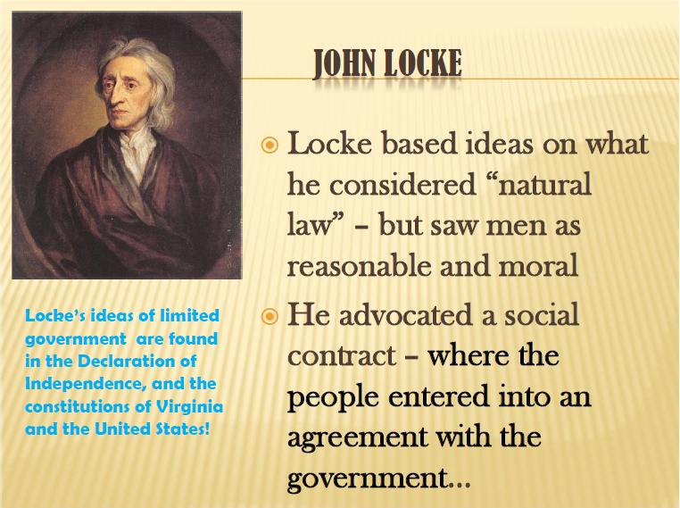

Slide 19
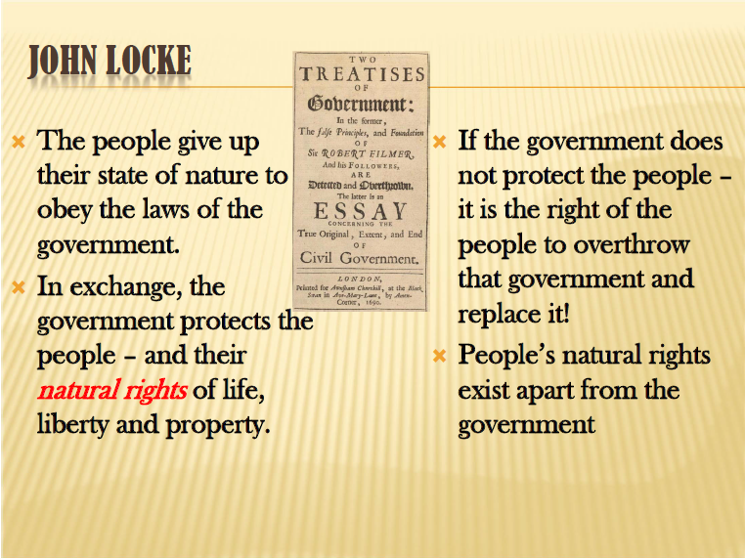

Slide 20


Slide 21
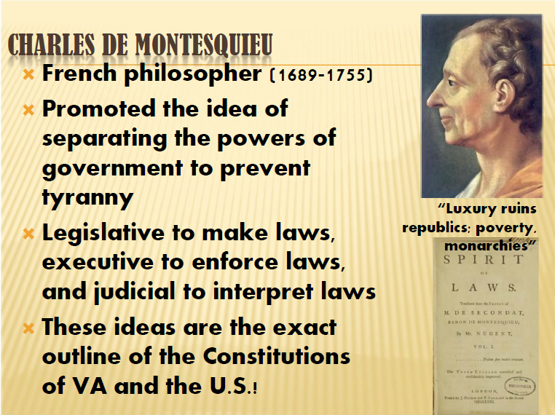

Slide 22
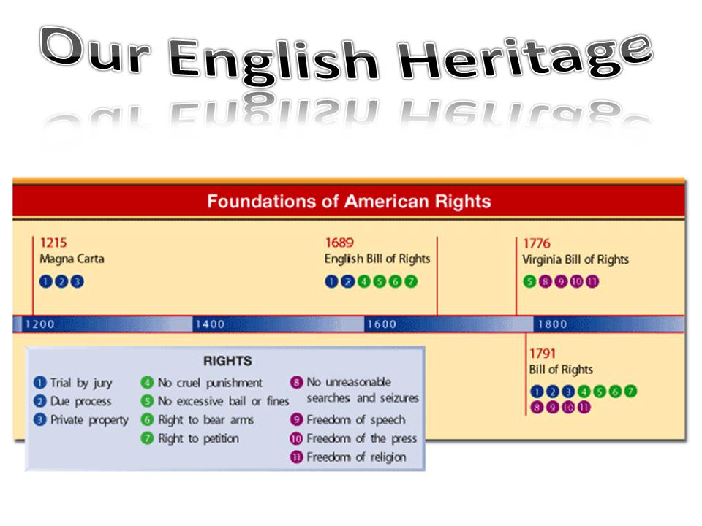

Slide 23
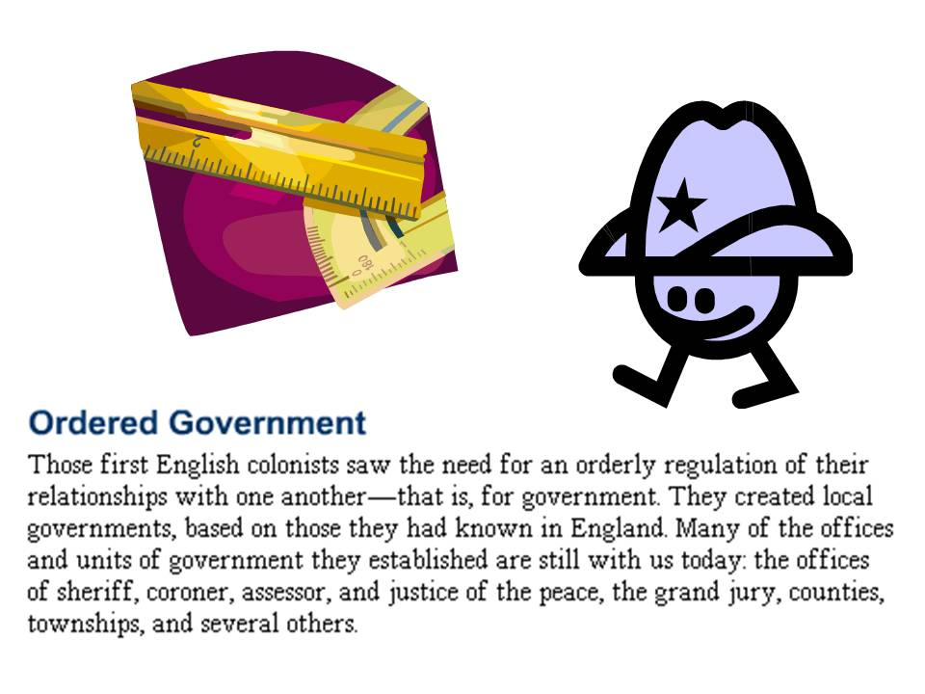

Slide 24
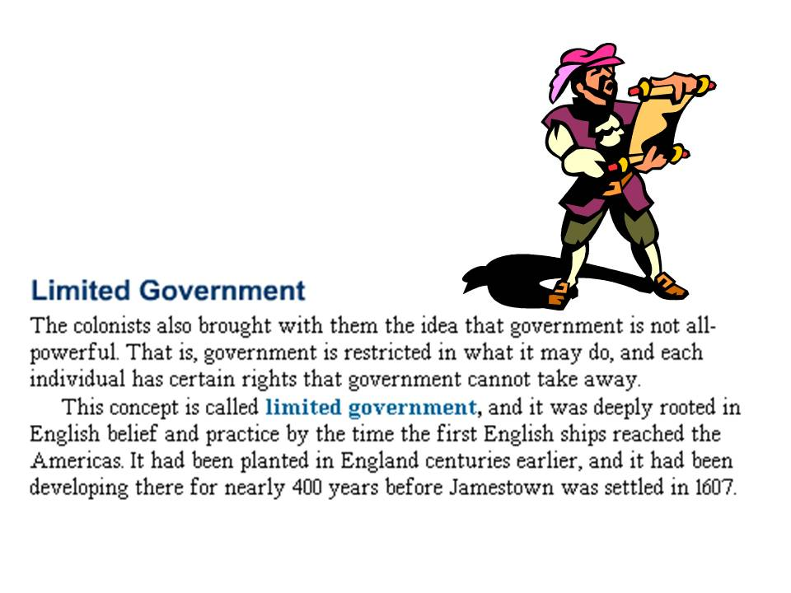

Slide 25
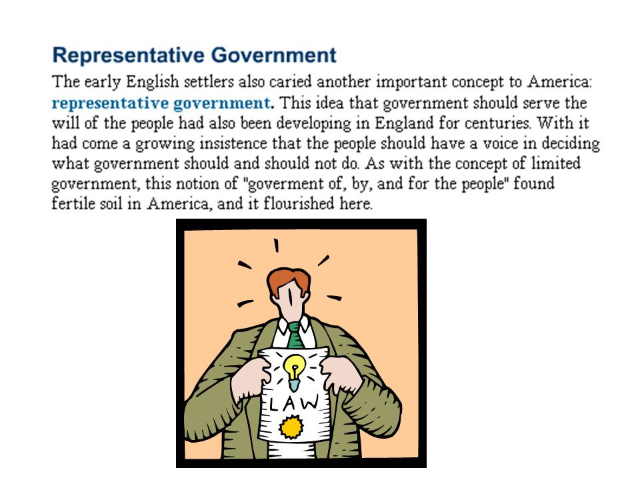

Slide 26
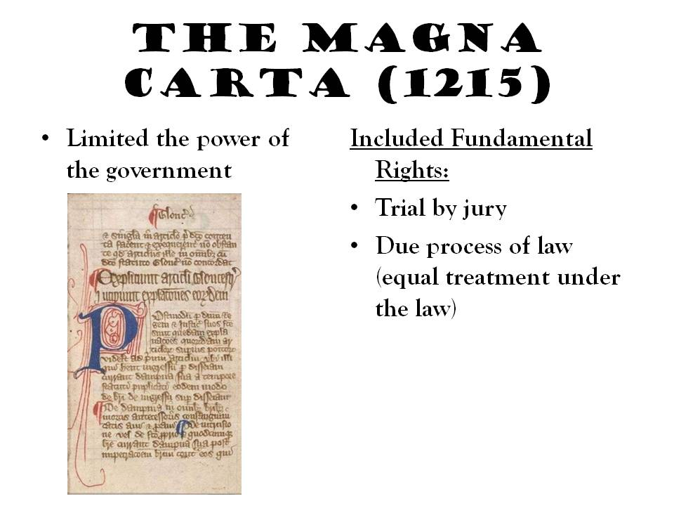

Slide 27
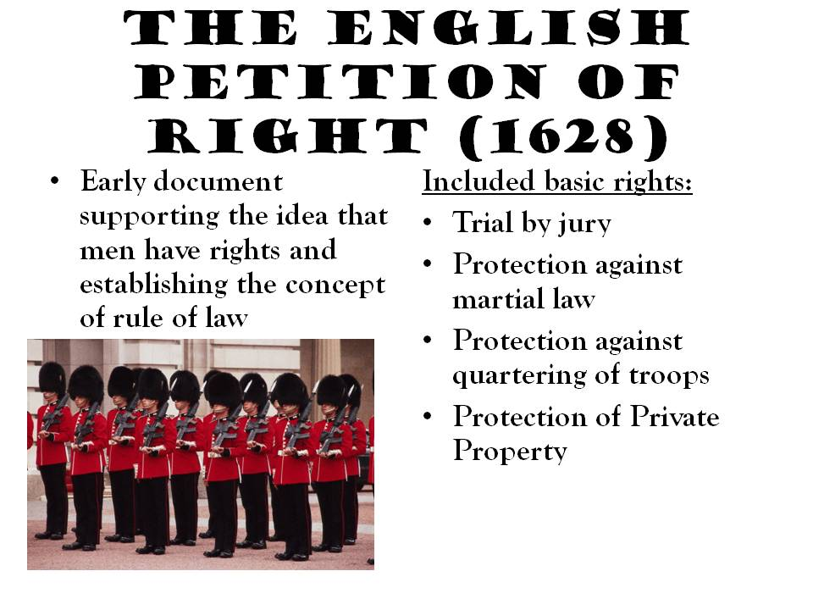

Slide 28
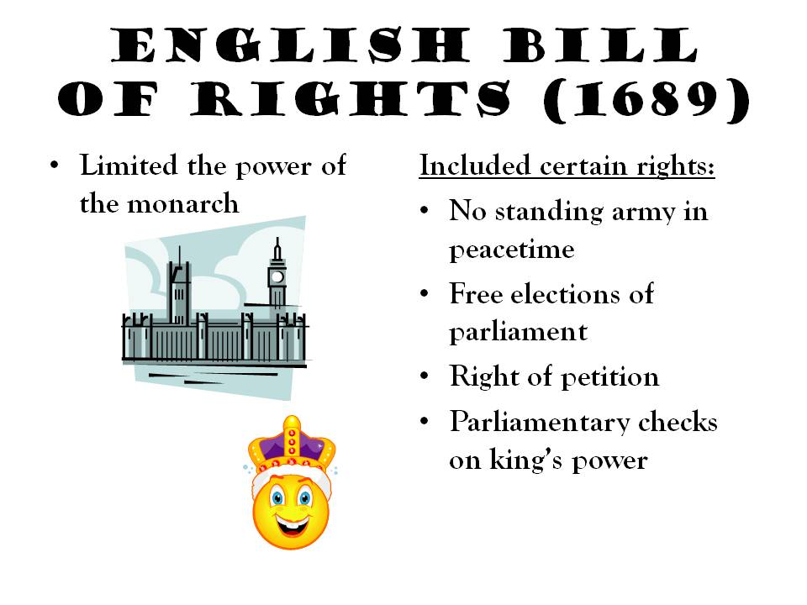

Slide 29
The Critical Period
Articles of Confederation

Slide 30
The Articles of Confederation established “a firm league of friendship” among the States.
Powers Congress was given the power to declare war, deal with national finance issues, and settle disputes among the States.
Obligations The States promised to obey Congress, and to respect the laws of the other States. Most other powers were retained by each State.

Slide 31


Slide 32
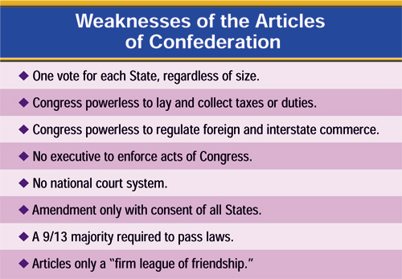

Slide 33
Framers of the Constitution

Slide 34
Leaders of the Philadelphia Convention
  James Madison was the co-author of the Articles of Confederation.
  Gouverneur Morris was a lawyer who helped develop the U.S. system of money.
  Alexander Hamilton was a lawyer who favored a strong central government.
  George Washington was the successful leader of the Continental Army.
Some famous leaders who were NOT at the Convention
  Patrick Henry said he “smelt a rat” and refused to attend.
  Samuel Adams and John Hancock were not selected as delegates by their states.
  Thomas Jefferson and Thomas Paine were in Paris.
  John Adams was on diplomatic missions to England and Holland.

Slide 35


Slide 38
Other Constitutional Compromises
The Three-Fifths Compromise
  The Framers decided to count a slave as three-fifths of a person when determining the population of a State.
The Commerce and Slave Trade Compromise
  Congress was forbidden from taxing exported goods, and was not allowed to act on the slave trade for 20 years.

Slide 39
Reactions to the Constitution
Reactions
  When the Constitution was complete, the Framers’ opinions of their work varied. Some were disappointed, like George Mason of Virginia, who opposed the Constitution until his death in 1792.
  Most agreed with Ben Franklin’s thoughts when he said, “From such an assembly [of fallible men] can a perfect production be expected? It…astonishes me, Sir, to find this system approaching so near to perfection as it does…”

Slide 40
Ratifying the Constitution

Slide 41
The Federalists and Anti-Federalists
The Constitution was very controversial at first, with some groups supporting it, and others attacking it.
Federalists thought that the Articles of Confederation were weak, and argued for the ratification of the Constitution.
Anti-Federalists objected to the Constitution for many reasons, including the strong central government and the lack of a bill of rights.

Slide 42
Nine States ratified the Constitution by June 21, 1788, but the new government needed the ratification of the large States of New York and Virginia.
Great debates were held in both States, with Virginia ratifying the Constitution June 25, 1788.
New York’s ratification was hard fought. Supporters of the Constitution published a series of essays known as The Federalist.

Slide 43
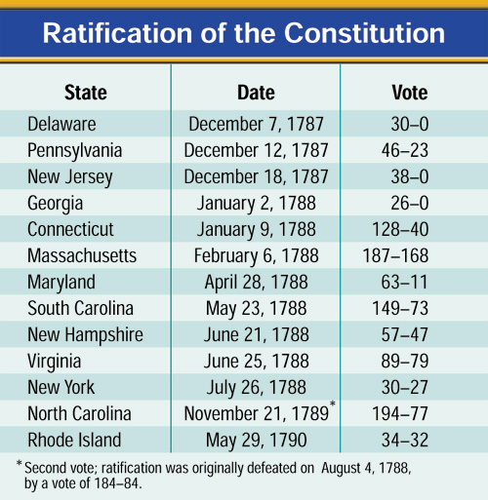

Slide 44


Slide 45
The new Congress met for the first time on March 4, 1789.
Congress finally attained a quorum (majority) on April 6 and counted the electoral votes. Congress found that George Washington had been unanimously elected President. He was inaugurated on April 30.

