Slide 1
NOCTI
Electrical Construction
Study Guide

Slide 2
Written Assessment Breakdown
DUTY | Percent of Test
Introduction to the Electrical Career | 3%
OSHA Regulations and Safety | 7%
Meters, Measurements, and Testing | 8%
Tools, Materials, and Components | 9%
National Electric Code | 9%
Blueprints, Specifications, and Estimations | 7%
AC Theory, Conductors, and Magnetic Theory | 8%
Motors, Motor Control Circuits, and PLCS | 9%
DC: Basic Electric and Electron Theories | 5%
Circuit Theorems and Conversions | 3%
Wiring, Circuits and Installation | 15%
Transformers | 5%
Motors | 12%

Slide 3
Electrical Construction Careers
Match electrical positions and responsibilities
Identify professional organizations and their purpose

Slide 4
Electrical Positions and Responsibilities
Helper - a beginning tradesman not enrolled in a formal training program
Apprentice - a beginning tradesman who is currently working towards completing a formal training program
Journeyman - a tradesman who completed an apprenticeship
Licensed - a tradesman or who passed the state exam, and can stamp permits

Slide 5
Professional Organizations and Their Purpose
OSHA - Occupational Safety and Health Administration, a federal agency of the United States that regulates workplace safety and health
ANSI - The American National Standards Institute is a private non-profit organization that oversees the development of products, services, processes, systems, and personnel
UL - Underwriters Laboratories is an independent product safety certification organization. UL develops standards and test procedures for products, materials, components, assemblies, tools and equipment, chiefly dealing with product safety.
NEMA - The National Electrical Manufacturers Association sets many common standards used in electrical products among its over 400 members, and helps to develop and promote the International Electrotechnical Commission's standards in the U.S.

Slide 6
OSHA Regulations and Electrical Safety Practices
Identify proper use of personal protective equipment
(PPEs)
Identify procedures for fire and environmental safety
Define procedures for ladder safety
Identify correct protocol for working on live circuits
Explain the purpose of OSHA and how it relates to
electrical construction

Slide 7
Identify Proper Use of Personal Protective Equipment (PPEs)
PPE should be used whenever a you could come into contact with exposed electrical parts
PPE must be designed for the work being performed
Always inspect your electrical tools and PPE before each use to make sure they are in good condition and will work properly
You must wear non-conductive head protection if you are working in a location that present a possible electrical hazard to your head
You must wear eye and face PPE, such as face shield and safety glasses, whenever there is a possibility of electrical arcs or explosion

Slide 8
Identify Procedures for Fire and Environmental Safety
Class A - extinguishers are for ordinary combustible materials such as paper, wood, cardboard, and most plastics.
Class B - fires involve flammable or combustible liquids such as gasoline, kerosene, grease and oil.
Class C - fires involve electrical equipment, such as appliances, wiring, circuit breakers and outlets. Never use water to extinguish class C fires - the risk of electrical shock is far too great! Class C extinguishers do not have a numerical rating. The C classification means the extinguishing agent is non-conductive.
Class D - fire extinguishers are commonly found in a chemical laboratory. They are for fires that involve combustible metals, such as magnesium, titanium, potassium and sodium.

Slide 9
Procedures for Ladder Safety
Ladder angle is 1/4th of the height at point of contact the base must be away from the surface
The Three Point-of-Contact Climb
If working near sources of electricity, a metal ladder should be rejected since aluminum is an electrical conductor
Use a ladder leveler when positioning on uneven surfaces
Always face the ladder and never stand on the top rung

Slide 10
Identify Correct Protocol for Working on Live Circuits
Always de-energizing electrical equipment before working on it, if it is not an option, make sure you follow the proper safety procedures
Measure at the lowest energy point
Keep your eyes on the area you’re probing and keep both hands free as conditions require
For single phase, connect neutral first, hot second
Use the three-point test method
Use test probes with a minimum amount of exposed metal such as 0.12-inch (4 mm) metal tip probes
Keep one hand in your pocket unless you must use both hands for a good measurement

Slide 11
Explain the Purpose of OSHA and How it Relates to Electrical Construction
OSHA's electrical standards are designed to protect employees exposed to dangers such as electric shock, electrocution, fires, and explosions. Electrical hazards are addressed in specific standards for the construction industry.

Slide 12
Meters, Measurements, Testing
Identify characteristics and uses of meters and
measuring devices
Identify materials as insulators, conductors, and semi-
conductors
Explain connection and use of electrical test equipment
Use formulas to determine current and voltage output
Interpret and convert meter readings

Slide 13
Identify Characteristics and Uses of Meters and Measuring Devices
Electrical Voltage Tester - electronic device that indicates if voltage is present on a circuit
Digital Voltage Tester - uses indicator lights or a digital readout to indicate the amount of voltage present
Solenoid Voltage Tester - uses a solenoid to indicate the presence of voltage
Circuit Tester - a simple light with conductive leads used to determine if a circuit is energized or de-energized
Receptacle Tester – a tester that plugs into an outlet receptacle and indicates the status of the polarity, ground, and sometimes the ground fault capability
Multi-meter - A digital or analog meter that measures multiple electrical properties
Continuity Tester - Checks for electrical continuity between two objects or devices

Slide 14
Identify Materials as Insulators, Conductors, and Semi-Conductors
Insulators - they offer very large resistance to the flow of electric current; common materials are glass, plastic, rubber, air, and wood
Conductors - electric current can flow freely; most metals are considered to be good conductors of electrical current
Semi-Conductors - usually a solid chemical element or compound, that can conduct electricity under some conditions but not others, making it a good medium for the control of electrical current

Slide 15
Explain Connection and Use of Electrical Test Equipment
Voltage (volts) – volt meters are connected in parallel with the load
Current (amps) – ammeters (majority) are connected in series with the circuit
Ohms (resistance) – Ohmmeter is connected in series with the item being tested

Slide 16
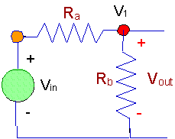
Use Formulas to Determine Current and Voltage Output
Voltage Output – V_{out} = V_{in} R_{b}/( R_{a} + R_{b})
R_{a} = 1000 W
R_{b} = 500 W
V_{in} = 15 v
Current Output – I_{series} = V_{in} /( R_{a} + R_{b} )
Current Output – Iparallel = Vin / (1/Ra + Rb)

Slide 17
Use Formulas to Determine Peak to Peak and RMS Voltage
There are two values of voltage with which we must be familiar. The first is "peak-to-peak" voltage. This is the voltage measured between the maximum Positive and Negative Amplitudes on the sine wave. (It is twice the Amplitude.) This value is the maximum voltage available, but it is not all useable in practical applications.
Vpp = Vp1 – Vp2
Vpp = (RMS x 1.414) x 2
The second value of voltage is the actual useful voltage that is available and is called RMS. This stands for "Root Mean Square," and it is the standard way of measuring and reporting effective Alternating Current and voltage. It is not the "peak"; it is the "average".
Multiply the Peak Amplitude by the Square Root of 2 (approximately 0.707)

Slide 18
Interpret and Convert Meter Readings
Kilo – 1000 Units
Centi – .01 Units
Milli – .001 Units
Mega – 1,000,000
Giga – 1,000,000,000
Example – 1.21 Giga watts =
1,210,000,000 watts

Slide 19
Tools, Materials, and Components
Identify and correctly use hand tools
Select proper conductor cable size and type
Identify types and characteristics of conduit
Cut, ream, deburr, and bend conduit
Identify boxes and fittings
Identify the function and purpose of various specialty devices

Slide 20
Identify and Correctly Use Hand Tools
Fish Tape – Pulls wire
Conduit Reamer – Deburrs conduit
Conduit Bender Head – Special markings to make various bends
Wire Strippers – Strip, cut, crimp insulation

Slide 21
Select Proper Conductor Cable Size and Type
Nonmetallic sheathed cable (Romex)
Metallic sheathed cable (BX/MC)
Both have various types depending on temperature rating and use.
Wire Gauge (AWG) | Circuit Ampere Rating (Amps)
14 | 15
12 | 20
10 | 30
8 | 40
6 | 55

Slide 22
Identify Types and Characteristics of Conduit
If the conductors have to be de-rated a larger size conduit maybe required
De-rating will occur if the ambient temperature is high, or if exposed to increased temperature
Maximum # of conductors in conduit is located in Ch. 9 and Annex C of the NEC

Slide 23
Cut, Ream, Deburr, and Bend Conduit
Cutting conduit leaves burrs which must be removed
Reaming sometimes leaves sharp edges and burrs
Files or other tools such as pliers can be used to de-burr or dull the edges of the conduit
6” “take up” on 90* rigid bends
5” “take up” on 90* thin wall bends

Slide 24
Identify the Function and Purpose of Various Specialty Devices
Ground Fault Circuit Interrupter (GFCI) – is a device that opens a circuit if a current-to-ground (exceeding .006 A) is detected
Arc-Fault – is a device that opens a circuit if a arc fault is detected
Transient Voltage Surge Suppressor (TVSS) – or surge protection device (SPD), are used to describe electrical devices typically installed in power distribution panels, process control systems, communications systems, and other heavy-duty industrial systems, for the purpose of protecting against electrical surges and spikes, including those caused by lightning.

Slide 25
National Electric Code (NEC)
Explain and apply Article 90 (Introduction) of the NEC
Identify and explain NEC general application
Explain procedures involved in NEC wiring and protection regulations
Cite NEC regulations relating to wiring methods and materials
Identify and select equipment for general use according to NEC regulations
Properly apply NEC tables and charts

Slide 26
Explain and Apply Article 90 (Introduction) of the NEC
Purpose – the practical safeguarding of persons and property from hazards arising from the use of electricity
Article 90 – states the purpose, outlines the NEC, explains mandatory and permissive rules, and deals with enforcement (AHJ)

Slide 27
Identify and Explain NEC General Application
Article 80 – moved to annex H, is administration and enforcement
Article 100 – definitions
NEC – Chapter layout
    Ch. 1-4 – apply generally
    Ch. 5-7 – modifies Ch. 1-4
    Ch. 8 – Ch. 1-7 does not apply
    Ch. 9 – (tables) applicable as referenced
    Annex A-I – informational only (not mandatory)

Slide 28
Explain Procedures Involved in NEC Wiring and Protection Regulations
Cable systems and accessories should be installed in positions that prevent them from being subject to mechanical damage, corrosion, chemical attack, heat and other detrimental environmental conditions.
Selection of the wiring system and cable type must consider these influences and where exposure to such conditions are avoidable, protective measures such as minimizing the risk of mechanical damage by the use of appropriate armored cable types should be considered.
The connection of cables and conduits to the electrical apparatus must be in accordance with the requirements of the relevant type of protection and installation rules.

Slide 29
Cite NEC Regulations Relating to Wiring Methods and Materials
NM cable – secured 8” within a box, 4’6” between supports
AC – secured 12” within a box, 4’6” between supports
EMT – secured 3’ within a box, 10’ between supports
6” of free conductor in each box
5” “take up” on 90* bend thin wall conduit
6” “take up” on 90* bend for rigid conduit

Slide 30
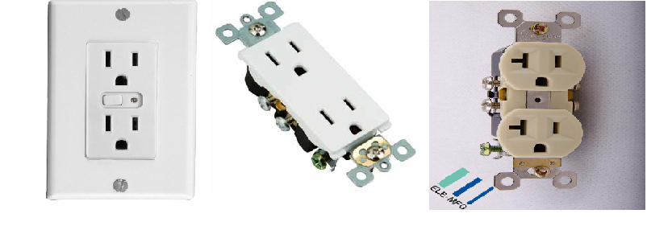
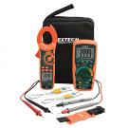
Identify and Select Equipment for General Use According to NEC Regulations

Slide 31
Properly Apply NEC Tables and Charts
Ch. 9 of the NEC contains tables to calculate fill percentage
Annex C charts number of conductors allowed in various conduit sizes
Article 314. 16 A lists maximum number of conductors allowed in various metal boxes

Slide 32
Blueprints, Specifications, and Estimations
Identify and interpret electrical symbols
Identify and interpret wiring and schematic
diagrams
Interpret and use specifications, print and job
site drawings
Perform basic math calculations and conversions
Demonstrate planning and layout of a circuit

Slide 33
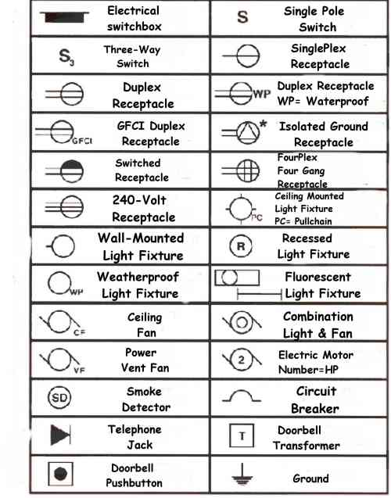
Identify and Interpret Electrical Symbols

Slide 34
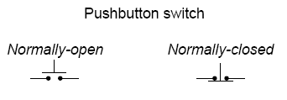
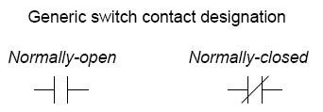
Identify and Interpret Wiring and Schematic Diagrams

Slide 35
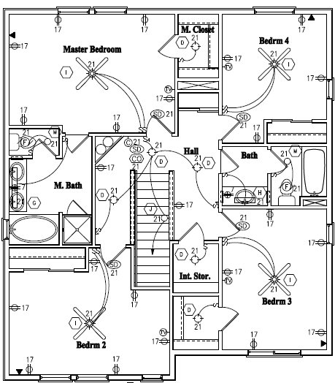
Interpret and Use Specifications, Print and Job Site Drawings

Slide 36
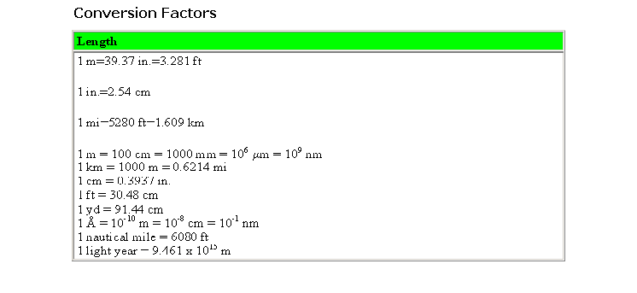
Perform Basic Math Calculations and Conversions

Slide 37
Demonstrate Planning and Layout of a Circuit
80% of OCPD can be used per circuit
    15 amp breaker, 12 amps allowed
    20 amp breaker, 16 amps allowed
    Duplex receptacle = 1.5 amps
    Lighting fixture = 1.5 amps per bulb
No space along the wall more than 6’ from a receptacle
    12’ max between receptacles
    Any wall space 2’ or more requires a receptacle
No space along a countertop more than 24’ from a receptacle
    48’ max between receptacle above countertop
    Any countertop space 12” or more requires a receptacle
Most rooms require a wall switched light

Slide 38
AC Theory and Magnetic Theory
Identify characteristics of AC circuits
Explain capacitance, impedance, current, voltage,
and resistance
Explain the function and characteristics of
rectifiers, inverters, and filters
Calculate power consumption, dissipation, and loss
Determine principles of magnetic theory

Slide 39
Identify characteristics of AC circuits
Series – a circuit having only one path for the current to flow
    Resistance (R) = the sum of all resistances
    Rt = (R1 + R2 + R3)
    Current (I) = the same throughout the circuit
    It = (I1 = 12 = I3)
    Voltage (V) = the sum of all voltages
    Vt = (V1 + V2 + V3)
Parallel – a circuit with multiple paths for the current to flow
    Resistance (R) = the reciprocal sum of all reciprocal resistances
    1/Rt = (1/R1 + 1/R2 + 1/R3)
    Current (I) = the sum of all currents
    It = (I1 + 12 + I3)
    Voltage (V) = the same throughout the circuit
    Vt = (V1 = V2 = V3)

Slide 40
Explain Capacitance, Impedance, Current, Voltage, and Resistance
Capacitance (C)– is the ability of a body to hold an electrical charge
Impedance (Z)– Impedance is the total opposition to current flow
Current (I) – is a flow of electric charge through a medium
Voltage (V) – the pressure (electrical potential) that moves electrons through a conductor
Resistance (R) – the opposition to the flow of electrons

Slide 41
Explain the Function and Characteristics of Rectifiers, Inverters, and Filters
Rectifiers – is an electrical device that converts alternating current (AC), which periodically reverses direction, to direct current (DC), which is in only one direction, a process known as rectification
Inverters – is an electrical device that converts direct current (DC) to alternating current (AC); the converted AC can be at any required voltage and frequency with the use of appropriate transformers, switching, and control circuits
Filters – are electronic circuits which perform signal processing functions, specifically to remove unwanted frequency components from the signal

Slide 42
Calculate Power Consumption, Dissipation, and Loss
Power consumption –
    First, divide watts by 1000 to get kilowatts:
    watts / 1000 = kW
    Then multiply kilowatts by the hours of usage to get kilowatt-hours:
    kW * hours = kWh
    Finally, multiply kilowatt-hours by the cost per:
kWh * (cost per kWh) = cost to operate
Power Dissipation – The power P dissipated by a resistor will leave the resistor in the form of thermal energy (heat). It will get hot due to the fact that the material it is made of opposes current flow
    The power in watts dissipated by a resistor with the value R will be the square of the current through it times its resistance. P=I²R
    The power in watts dissipated by a resistor with the value R will be the square of the voltage drop across it divided by its resistance. P=V²/R
Power Loss (Voltage drop) – Vd = (2 * L * R * I) / 1000
    R value comes from table 8 in ch. 9 NEC

Slide 43
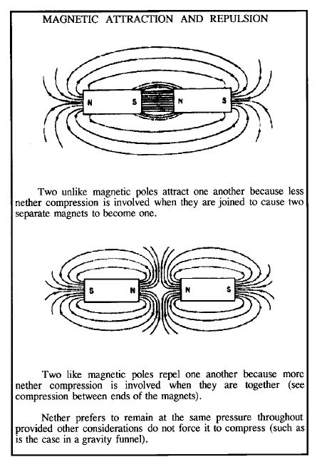
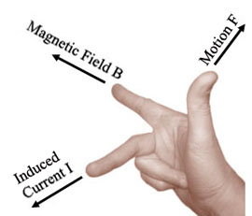
Determine Principles of Magnetic Theory

Slide 44
Motor Control Circuits, Logic Circuits, and Programmable Logic Controllers (PLCs)
Identify characteristics of various types of starters
Identify and interpret terms, abbreviations, acronyms, and symbols
Apply knowledge of signal and control systems
Install, test, and troubleshoot logic circuits
Understand programmable logic circuits (PLCs)
Create a motor control circuit diagram
Develop a logic control circuit

Slide 45
Identify Characteristics of Various Types of Starters
Direct On Line (DOL) – starter immediately connects the motor terminals directly to the power supply.
Motor Soft Starter – connects the motor to the power supply through a voltage reduction device and increases the applied voltage gradually or in steps
Adjustable-Speed Drive (ASD) or Variable-Speed Drive (VSD) – is an interconnected combination of equipment that provides a means of driving and adjusting the operating speed of a mechanical load
Intelligent Motor Controls (IMC) – uses a microprocessor to control power electronic devices used for motor control. IMCs monitor the load on a motor and accordingly match motor torque to motor load

Slide 46
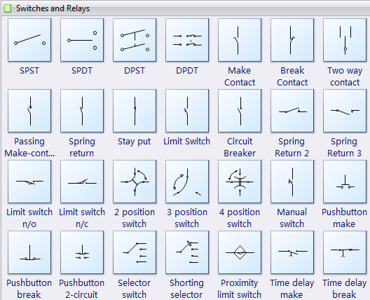
Identify and Interpret Terms, Abbreviations, Acronyms, and Symbols

Slide 47
Apply Knowledge of Signal and Control Systems
Breakover Voltage – minimum voltage required to cause a diac to break down and conduct
Diac – is a diode that conducts current only after its breakover voltage has been reached momentarily
Triac – is a trade name for an electronic component which can conduct current in either direction when it is triggered (turned on), and is formally called a bidirectional triode thyristor or bilateral triode thyristor
Sealing Contacts – auxiliary contacts found between terminals 2 and 3 on a motor starter are used to seal in the start push button in a three-wire control circuit.

Slide 48
Install, Test, and Troubleshoot Logic Circuits
Determine the condition of the relay coil and its contacts with an ohmmeter when the relay is out of the circuit or if it does not have voltage applied
Since the relay coil is made from a long piece of wire, the ohmmeter should indicate that the coil has some amount of resistance.
You need to verify that the coil does not have a short circuit or an open circuit. If the coil is shorted, its continuity (resistance) test will indicate 0 ohms or near zero resistance, and if it has an open circuit, its continuity test will indicate an infinite reading (infinity ohms).
If the coil shows any amount of resistance other than infinite and zero, you can move to the second part of the troubleshooting test and apply power to the coil.
When the proper amount of voltage is applied to the coil, the contacts should move. If you find that the coil is open when you perform the continuity test, or if it won't pull in the contacts when power is applied, you must replace the coil.

Slide 49
Understand Programmable Logic Circuits (PLCs)
Programmable logic controller (PLC) or programmable controller – is a digital computer used for automation of electromechanical processes, such as control of machinery on factory assembly lines, amusement rides, or lighting fixtures.
Unlike general-purpose computers, the PLC is designed for multiple inputs and output arrangements, extended temperature ranges, immunity to electrical noise, and resistance to vibration and impact.
Programs to control machine operation are typically stored in battery-backed or non-volatile memory.

Slide 50
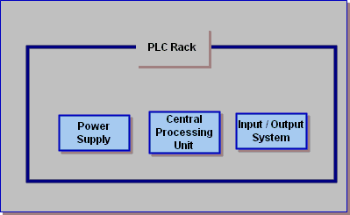
Understand Programmable Logic Circuits (PLCs)
PLCs span a wide range of sizes, but all contain six basic components:
Basic PLC Components
processor or central processing unit (CPU);
rack or mounting;
input assembly;
output assembly;
power supply;
programming unit, device, or PC/software

Slide 51
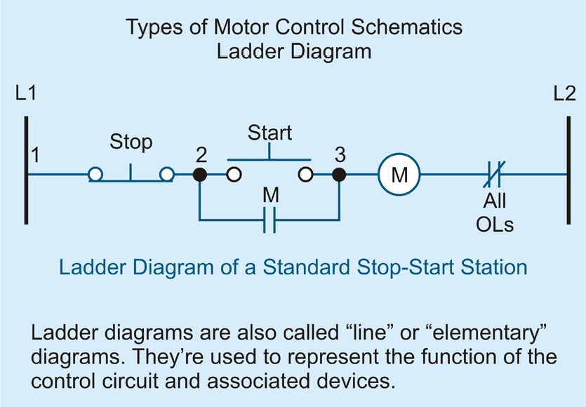
Create a Motor Control Circuit Diagram

Slide 52
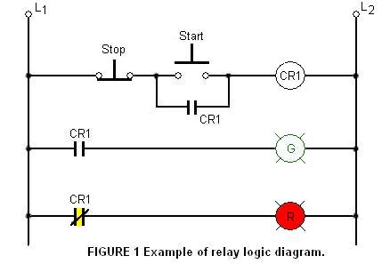
Develop a Logic Control Circuit

Slide 53
DC: Basic Electric and Electron Theories
Identify characteristics and components of DC circuits
Design a basic DC circuit
Explain the relationship of electricity, electrons, and atoms

Slide 54
Identify Characteristics and Components of DC Circuits
Four major components of a circuit:
    Source – battery, thermocouples, solar cells
    Load – light , motor, or anything drawing the power
    Conductor – path the current is going to travel along (copper wire)
    Control – giving the ability to turn on (close) and off (open) a circuit

Slide 55
Design a Basic DC Circuit
The source of electricity must have two terminals: a positive terminal and a negative terminal.
The source of electricity (whether it is a generator, battery or something else) will want to push electrons out of its negative terminal at a certain voltage. For example, one AA battery typically wants to push electrons out at 1.5 volts.
The electrons will need to flow from the negative terminal to the positive terminal through a copper wire or some other conductor. When there is a path that goes from the negative to the positive terminal, you have a circuit, and electrons can flow through the wire.
You can attach any type of load, such as a light bulb or motor, in the middle of the circuit. The source of electricity will power the load, and the load will perform whatever task it's designed to carry out, from spinning a shaft to generating light.

Slide 56
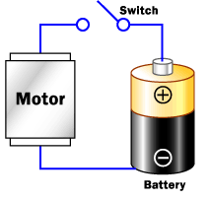
Design a Basic DC Circuit

Slide 57
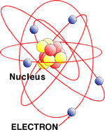
Explain the Relationship of Electricity, Electrons, and Atoms
Atom Structure
Electrons spin around the center, or nucleus, of atoms
The three main particles making up an atom are the proton, the neutron and the electron
Electrons can be made to move from one atom to another. When those electrons move between the atoms, a current of electricity is created

Slide 58
Circuit Theorems and Conversions
Identify and apply various circuit theorems
    Ohms’ Law
    Kirchoff’s Law
    Watt’s Law
Identify and apply various mathematical conversions
    scientific notations
    engineering notations

Slide 59
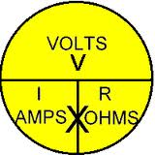
Identify and Apply Various Circuit Theorems: Ohm’s Law
Ohm's law states
Ohm’s Law Formula
States that the current through a conductor between two points is directly proportional to the potential difference across the two points, and inversely proportional to the resistance between them

Slide 60
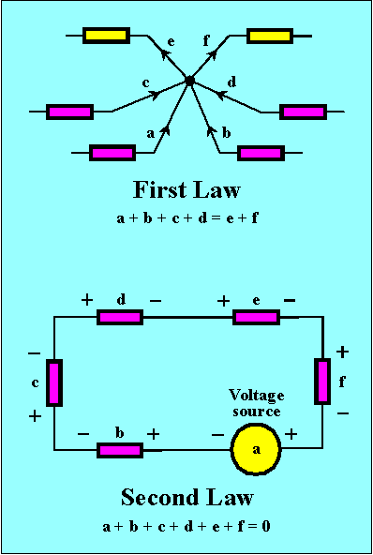
Identify and Apply Various Circuit Theorems: Kirchoff’s Law
The principle of conservation of electric charge implies that:
At any node (junction) in an electrical circuit, the sum of currents flowing into that node is equal to the sum of currents flowing out of that node.
The principle of conservation
of energy implies that:
The directed sum of the electrical potential differences (voltage) around any closed circuit is zero. or more simply, the sum of the emfs in any closed loop is equivalent to the sum of the potential drops in that loop.

Slide 61
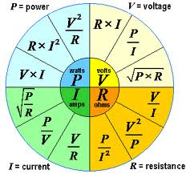
Identify and Apply Various Circuit Theorems: Watt’s Law
Watt's law defined
Watt's law Formulas
is the amount of power consumed by a device which, when supplied with 1 volt of difference across its terminals will use 1 amp of current

Slide 62
Identify and Apply Various Mathematical Conversions
Scientific notations
Engineering notations
Standard form or as exponential notation, is a way of writing numbers that accommodates values too large or small to be conveniently written in standard decimal notation
Examples:
  1000 = 1 x 10³
  482 = 4.82 x 10²
  1/100 = 0.01 = 1 x 10⁻²
  0.0078 = 7.8 x 10⁻³
is a version of scientific notation in which the powers of ten must be multiples of three
Examples:
  10⁶ instead of 1,000²
  Express 0.0000638 in engineering notation
    63.8 × 10^{–6}

Slide 63
Wiring, Circuits, and Installation
Select wiring appropriate for specific installations
Explain the correct applications of switched circuits
Install proper boxes, devices, and trim
Install rough-in wiring
Perform finish work
Wire switched outlets
Pull, splice, terminate, and connect wire
Test and troubleshoot completed installation
Identify basic service entrance requirements
Install fittings, connectors, and components

Slide 64
Select Wiring Appropriate for Specific Installations
Be able to use the proper tables listed in the NEC
Calculate the load for a given circuit or appliance
Determine outside factors such as temperature or exposure
Type of construction
Building code requirements and or preference

Slide 65
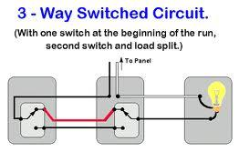
Explain the Correct Applications of Switched Circuits

Slide 66
Install Proper Boxes, Devices, and Trim
Receptacles – standard height 12” to the bottom or hammer height
Switches – 48” to the center of the box
Lighting fixtures – center of the room, or 72” if a wall sconce
NM boxes – indicate the maximum # of conductors allowed on the inside of the box
Metallic boxes use NEC table 314.16(A)
  total grounds count as 1
  total clamps count as 1
  Mounting strap or yoke count as 2

Slide 67
Install Rough-in Wiring
Install all boxes, flush to the wall, recommended heights:
  receptacles 12” to the bottom
  switches 48” to the center
  light fixtures in the center of the room or 72” to the center if wall sconces
Run all branch, feeder, and service conductors (wires)
  in each box connect all the ground wires
  in each box connect all the neutral wires
  mark the point wire (common screw wire)
  secure all wires deep into the box
Install service panel

Slide 68
Perform Finish Work
Connect all switches, receptacles and lighting fixtures
Install all cover plates, make sure device and plate are level, and screws are aligned
Connect any hard wired appliances
Tie in (hook up) service panel
Install all light bulbs
Test all devices and appliances for proper functionality

Slide 69
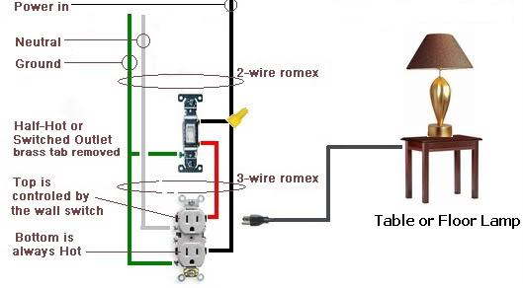
Wire Switched Outlets

Slide 70
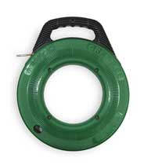
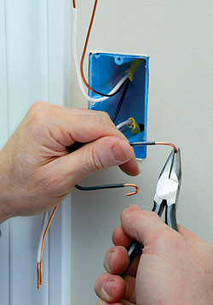
Pull, Splice, Terminate, and Connect Wire
Fish Tape: to pull wire
¾” stripped insulation, counterclockwise loop, and wire nuts to splice wires

Slide 71
Test and Troubleshoot Completed Installation
Determine the problem first:
  is it a short
  is it working but not properly
  is it not working at all
In case of a short test for continuity
If not working or not working properly test for voltage starting at the first position
Test the individual devices

Slide 72
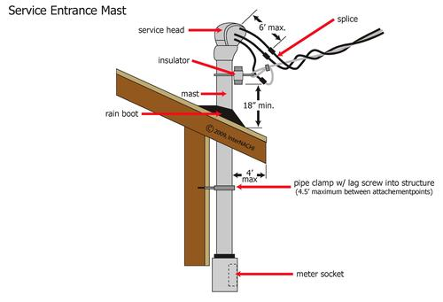
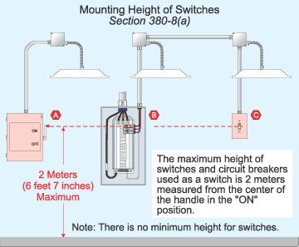
Identify Basic Service Entrance Requirements

Slide 73
Install Fittings, Connectors, and Components
General: Install electrical boxes and fittings where indicated, complying with manufacturer's written instructions, applicable requirements of NEC and NECA's "Standard of Installation", and in compliance with recognized industry practices to ensure that products fulfill requirements
Coordinate installation of electrical boxes and fittings with wire/cable and raceway installation work
Provide knockout closures to cap unused knockout holes where blanks have been removed
Install boxes and conduit bodies in those locations to ensure ready accessibility of electrical wiring

Slide 74
Install Fittings, Connectors, and Components (continued)
Avoid using round boxes where conduit must enter box through side of box, which would result in difficult and insecure connections when fastened with locknut
Fasten boxes rigidly to substrates or structural surfaces to which attached, or solidly embedded electrical boxes in concrete or masonry
Use cast metal outlets and device boxes for all exposed work outside
Ground all metallic junction boxes by bonding to the system raceway grounding conductor.
Ground the yoke or frame of all box-mounted devices

Slide 75
Transformers
Identify primary and secondary windings
Calculate voltage and current for
primary/secondary windings
Explain and calculate transformer efficiency
Determine KVA capacity and load

Slide 76
Identify Primary and Secondary Windings
Transformer – does not generate electrical power, it transfers electrical power. A transformer is a voltage changer
Most transformers are designed to either step voltage up or to step it down, although some are used only to isolate one voltage from another
Primary Winding – receives the energy and is called the input
Secondary Winding is discharges the energy and is called the output

Slide 77
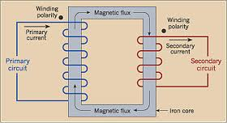
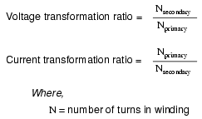
Calculate Voltage and Current for
Primary/Secondary Windings
Secondary voltage = Primary voltage (secondary turns / primary turns)
Secondary current = Primary current (primary turns / secondary turns)

Slide 78
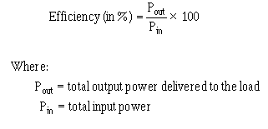
Explain and Calculate Transformer Efficiency
Explanation of Transformer Efficiency
Transformer Efficiency Formula
An ideal transformer would have no energy losses, and would be 100% efficient
In practical transformers energy is dissipated in the windings, core, and surrounding structures
Larger transformers are generally more efficient, and those rated for electricity distribution usually perform better than 98%

Slide 79
Determine KVA Capacity and Load
Single Phase
Three Phase
Formulas may be used to determine proper KVA size for the required transformer
To determine KVA when volts and amperes are known:
KVA = (Volts x Amps)/1000
To determine Amperes when KVA and volts are known:
Amps = (KVA x 1000)/Volts
Formulas may be used to determine proper KVA size for the required transformer
To determine three phase KVA when volts and amperes are known:
Three Phase KVA =(Volts x Amps x 1.73) / 1000
To determine Amperes when KVA and volts are known:
Amps =(3 Phase KVA x 1000) / (Volts x 1.73)

Slide 80
Motors
Describe characteristics of various types of motors
Distinguish between capacitor run and capacitor start
Wire a three-phase motor
Identify and connect motor connections
Install, test, and troubleshoot motors
Reverse motor rotation properly
Calculate motor efficiency
Select short-circuit and overload protection for specific purposes
Identify and interpret motor nameplate information

Slide 81
Describe Characteristics of Various Types of Motors
Armature – generally refers to one of the two principal electrical components of an electromechanical machine, generally in a motor or generator
Solenoid – refers to a long, thin loop of wire, often wrapped around a metallic core, which produces a magnetic field when an electric current is passed through it
Commutator – is a rotary electrical switch that periodically reverses the current direction between the rotor and the external circuit
Series wound motor – is referred to as a universal motor when it has been designed to operate on either AC or DC power

Slide 82
Distinguish Between Capacitor Run and Capacitor Start
Run capacitors – are designed for continuous duty, and they are energized the entire time the motor is running
Start capacitors – briefly increase motor starting torque and allow a motor to be cycled on and off rapidly
Dual run capacitor – supports 2 electric motors, such as in large air conditioner or heat pump units, with both a fan motor and a compressor motor

Slide 83
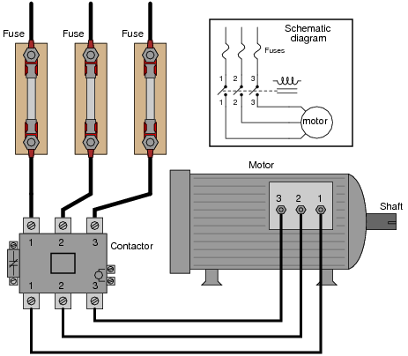
Wire a Three-Phase Motor

Slide 84
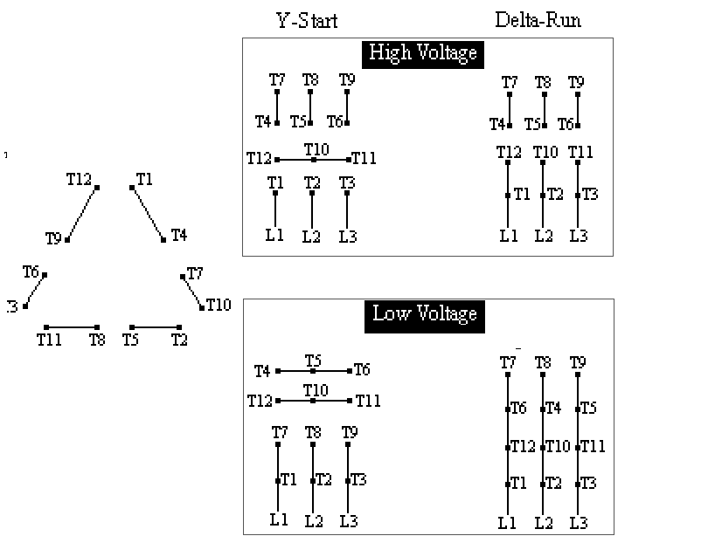
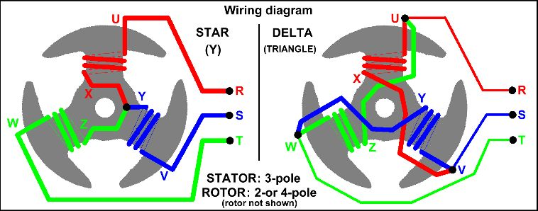
Identify and Connect Motor Connections

Slide 85
Install, Test, and Troubleshoot Motors
Shut off all electric power to the motor, whether by turning off a circuit breaker or removing fuses from the disconnect
Remove the wiring cover on the electric motor. Read the motor's nameplate data to confirm whether it's a low-voltage 115-volt motor, a 230-volt motor or a three-phase 230-volt or high-voltage 480-volt motor. This will determine the number of power leads the motor has. All single-phase 115-volt and 230-volt motors have two wire leads that connect to the power supply. All three-phase 230-volt and 480-volt motors have three wire leads that connect to the three-phase power
You may have to identify the power leads to the wires on the electric motor if it is a three-phase motor. This will ensure the rotation will be correct when you re-terminate the motor. Turn your ohm meter to the ohm setting. The meter should read OL (open lead) or zero ohms.

Slide 86
Install, Test, and Troubleshoot Motors
Touch one lead to the case of the motor, and test each motor lead. The ohm meter should read OL, or zero ohms. If a reading of any ohms is observed, you may have a direct short in the motor windings; the motor may be bad. Some electric motors, especially the three-phase type, may have a large resistance reading--in the 20 megaohms range or larger. This may be fine, or this may be a sign that the bearings are going bad.
Remove the capacitor from its housing if you are testing a single-phase motor that has a capacitor. The capacitor is like a battery and stores a high-voltage charge. Turn your ohm meter to volts and carefully touch to the bare leads of the capacitor. If voltage is read, the capacitor still contains a charge. Holding the leads of the meter to the capacitor should show it discharging. Continue until zero voltage is observed on the meter. Most modern volt ohm meters have a capacitor-testing switch, making it easy to determine the status of the capacitor. In most cases, the capacitor only needs to be replaced on these types of single-phase electric motors.

Slide 87
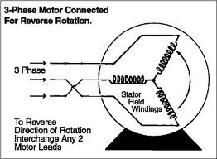
Reverse Motor Rotation Properly

Slide 88
Calculate Motor Efficiency
To calculate a motor's efficiency, the mechanical output power is divided by the electrical input power:
    N = P_{e} / P_{m}
Where η is energy conversion efficiency, P_{e} is electrical input power, and P_{m} is mechanical output power.

Slide 89
Select Short-Circuit and Overload Protection for Specific Purposes
One of the most important parameters is a consideration of the short circuit protection as well as the overload protection. Too many times the protective device, whether it be a fuse or a circuit breaker, has just been selected on the ampacity of the circuit to be protected. That is, if you pick a wire capable of withstanding 100 amps, you pick a 100 amp fuse or circuit breaker. This may not be sufficient, since only one requirement is covered and there are several other important requirements that need to be considered.
You must also select a protective device so it will have the proper interrupting rating. That is, it must be able to open safely for any value of short circuit current that could occur in that particular part of the system. This is a completely different rating than the normal running ampere rating of the protective device. It is the maximum current that would flow if there were a bolted short in the circuit.
The other area, which is greatly ignored, and must be considered here, concerns protecting components: such as, switchgear, bus duct, motor control centers, motor starter (including their contacts and overload heaters), motors, wire, transformers and circuit breakers.

Slide 90
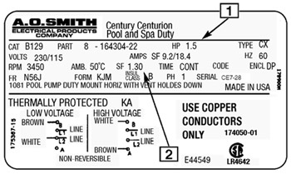
Identify and Interpret Motor Nameplate Information

Slide 91
NOCTI
Good Luck!!!

