Slide 1
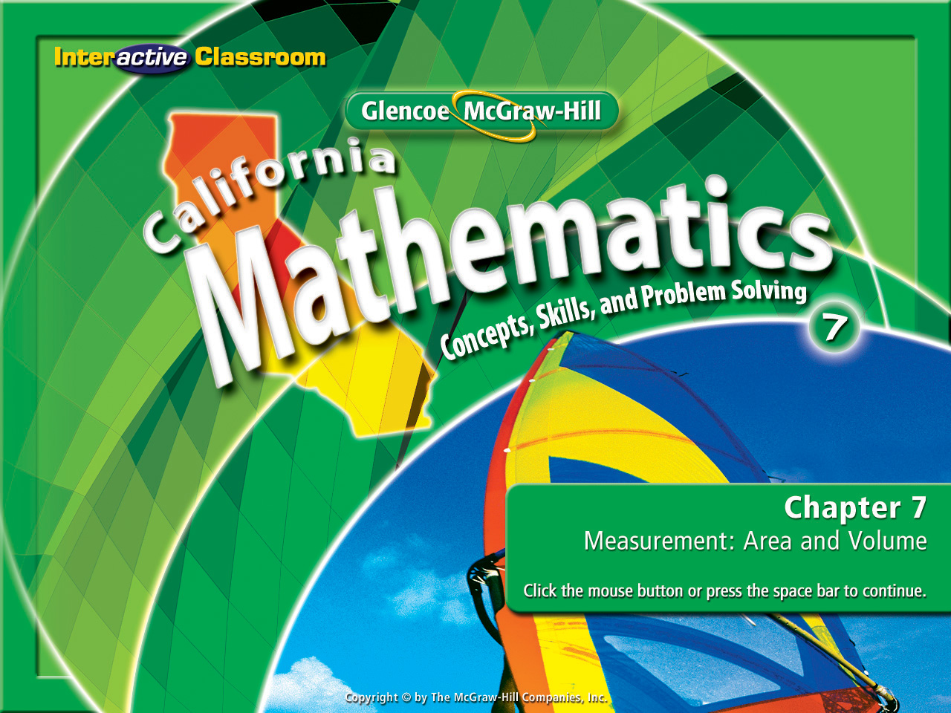
Splash Screen
Chapter 10
Lesson 10-1

Slide 2




(over Chapter 9)
Find f(3) if f(x) = 4x – 10.
A. 22
B. 2
C. –2
D. –22
A
B
C
D

Slide 3

(over Chapter 9)
Find the slope of the line that passes through the points (5, 2) and (1, –2).
A. –7
B. –1
C. 1
D. 7
A
B
C
D

Slide 4

(over Chapter 9)
Find the slope and y-intercept of y = 3x – 2.
A. –3; 2
B. –2; 3
C. 2; 3
D. 3; –2
A
B
C
D

Slide 5


Determine whether a function is linear or nonlinear.
nonlinear function

Slide 6

Preparation for AF1.5 Represent quantitative relationships graphically and interpret the meaning of a specific part of a graph in the situation represented by the graph.

Slide 7
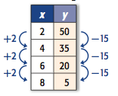
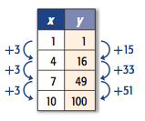
Look Closely and It Will Be Obvious
This is a “Linear Function”
This is a “Non-Linear” Function

Slide 8

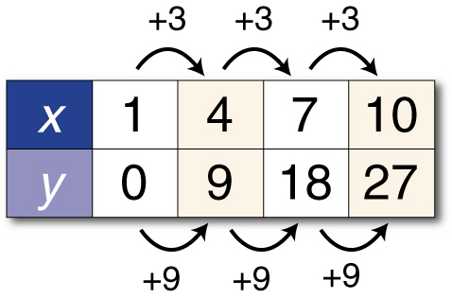
Identify Functions Using Tables
Determine whether the table represents a linear or nonlinear function. Explain.
As x increases by 3, y increases by 9 each time.
Answer: The rate of change is constant, so this function is linear.

Slide 9
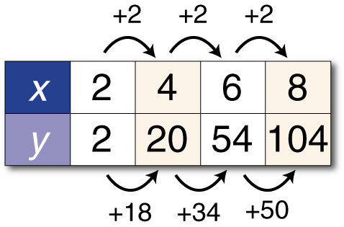
Identify Functions Using Tables
Determine whether the table represents a linear or nonlinear function. Explain.
As x increases by 2, y increases by a greater amount each time.
Answer: The rate of change is not constant, so this function is nonlinear.

Slide 10
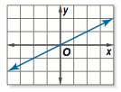
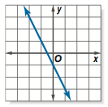
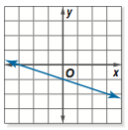
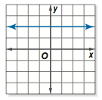
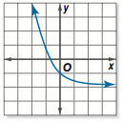
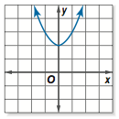
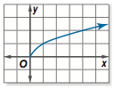
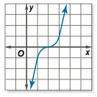
Look Closely and It Will Be Obvious
These are “Linear Functions”
These are “Non-Linear” Functions

Slide 11
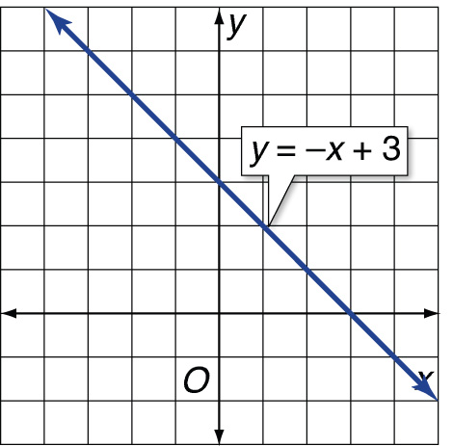
Identify Functions Using Graphs
Determine whether the graph represents a linear or nonlinear function. Explain.
Answer: The graph is a straight line, so the rate of change is constant. The graph represents a linear function.

Slide 12

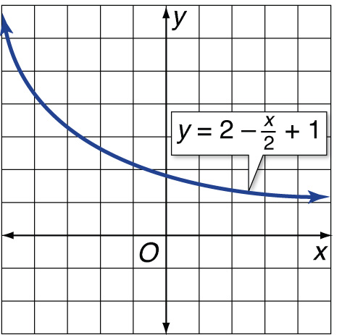
Identify Functions Using Graphs
Determine whether the graph represents a linear or nonlinear function. Explain.
Answer: The graph is a curve, not a straight line. So it represents a nonlinear function.

Slide 13




Look Closely and It Will Be Obvious
These are “Linear Functions”
These are “Non-Linear” Functions

Slide 14

Determine whether y = 5x² + 3 represents a linear or nonlinear function. Explain.
Since the power (exponent) of x is greater than 1 (it’s to the power of 2), this function is nonlinear.
Answer: Nonlinear; x is raised to the second power.

Slide 15

Identify Functions Using Equations
Determine whether y – 4 = 5x represents a linear or nonlinear function. Explain.
Rewrite the equation as y = 5x + 4.
Answer: Since x does not have a power larger than 1, this function is linear.

Slide 16


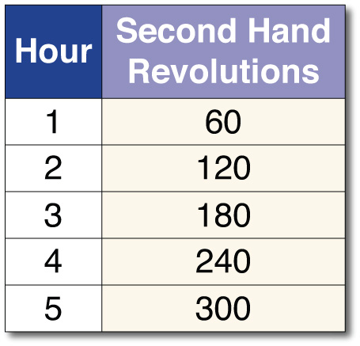
CLOCKS Use the table below to determine whether or not the number of revolutions per hour that the second hand on a clock makes is a linear function of the number of hours that pass.
Examine the difference between the second hand revolutions for each hour.
120 – 60 = 60 & 2 – 1 = 1
180 – 120 = 60 & 3 – 2 = 1
240 – 180 = 60 & 4 – 2 = 1
300 – 240 = 60 & 5 – 4 = 1
Answer: The differences are the same, so the function is linear.

Slide 17

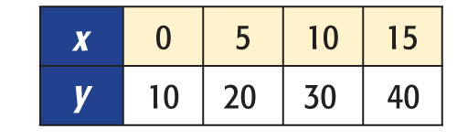
Determine whether the table represents a linear or nonlinear function. Explain.
A. Linear; rate of change is not constant.
B. Linear; rate of change is constant.
C. Nonlinear; rate of change is not constant.
D. Nonlinear; rate of change is constant.
A
B
C
D

Slide 18
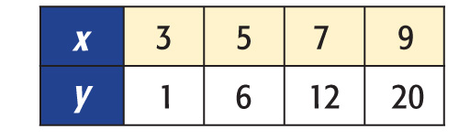
Determine whether the table represents a linear or nonlinear function. Explain.
A. Linear; rate of change is not constant.
B. Linear; rate of change is constant.
C. Nonlinear; rate of change is not constant.
D. Nonlinear; rate of change is constant.
A
B
C
D

Slide 19
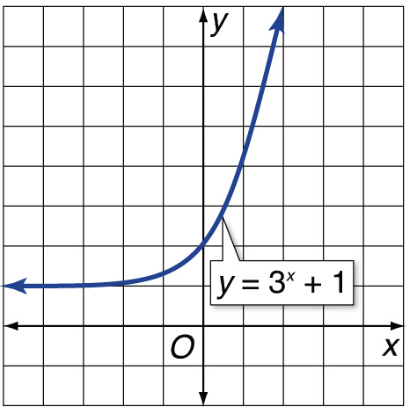
Determine whether the table represents a linear or nonlinear function. Explain.
A. Nonlinear; graph is a straight line.
B. Nonlinear; graph is a curve.
C. Linear; graph is a straight line.
D. Linear; graph is a curve.
A
B
C
D

Slide 20
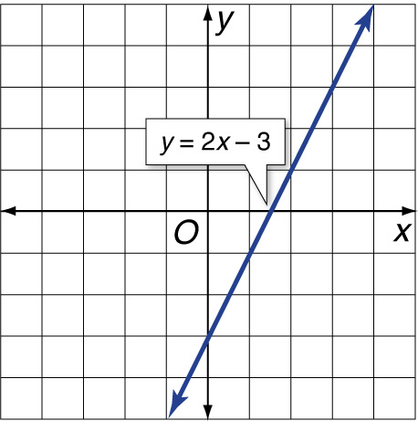
Determine whether the table represents a linear or nonlinear function. Explain.
A. Nonlinear; graph is a straight line.
B. Nonlinear; graph is a curve.
C. Linear; graph is a straight line.
D. Linear; graph is a curve.
A
B
C
D

Slide 21
Determine whether y = x² – 1 represents a linear or nonlinear function. Explain.
A. linear; is written in the form y = 2x³ – 1
B. Linear; power of x is greater than 1.
C. nonlinear; is written in the form y = 2x³ – 1
D. Nonlinear; power of x is greater than 1.
A
B
C
D

Slide 22
Determine whether –3x = y + 6 represents a linear or nonlinear function.
A. linear; can be written in the form y = 3x + 6
B. linear; can be written in the form y = –3x – 6
C. nonlinear; can be written in the form y = 3x + 6
D. nonlinear; can be written in the form y = –3x – 6
A
B
C
D

Slide 23
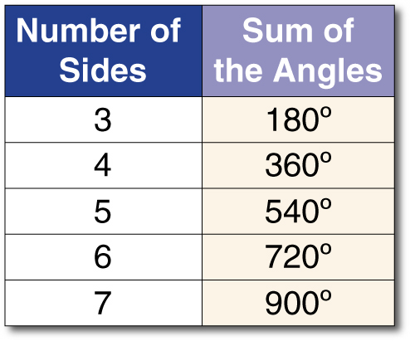
GEOMETRY Use the table below to determine whether or not the sum of the measures of the angles in a polygon is a linear function of the number of sides.
A. linear, the rate of change is constant
B. nonlinear, the rate of change is not constant
A
B

Slide 24





