Slide 1
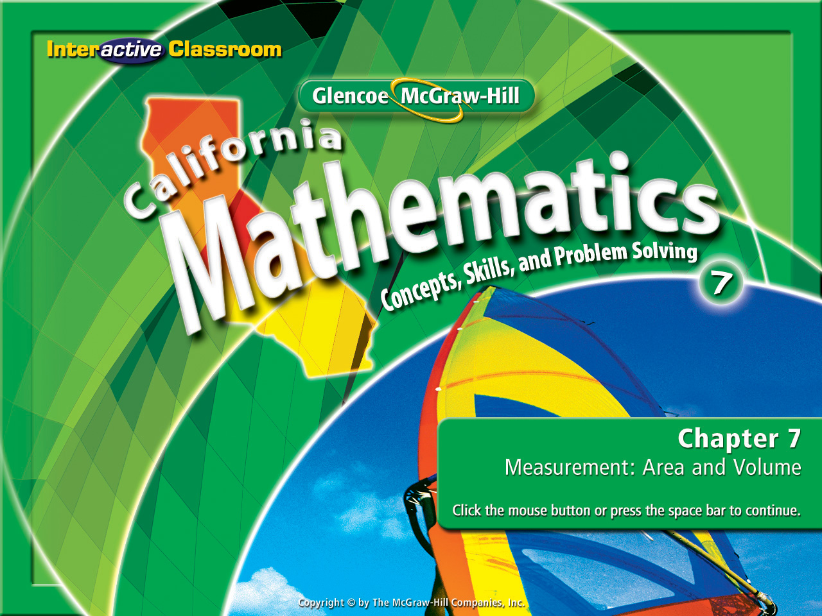
Splash Screen
Chapter 10
Lesson 10-2

Slide 2




(over Chapter 9)
James has 38 stamps in his stamp collection. He collects about 6 stamps a month. How many stamps will James have in 7 months?
A. 80
B. 51
C. 42
D. 13
A
B
C
D

Slide 3


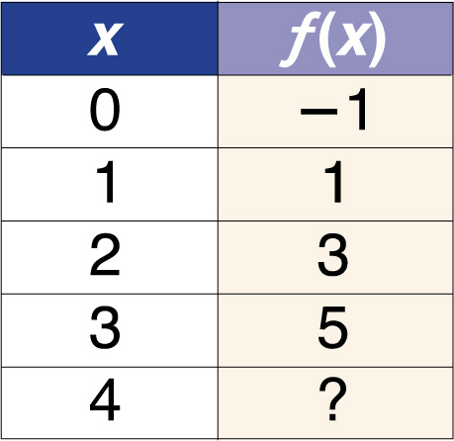
(over Chapter 9)
Refer to the table. What is the value of f(x) when x = 4?
A. –6
B. –5
C. 6
D. 7
A
B
C
D

Slide 4
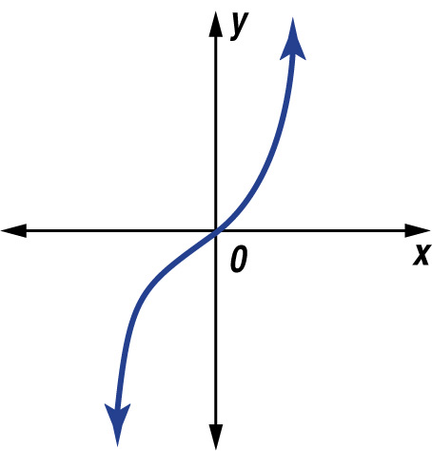

(over Lesson 10-1)
Determine whether the graph in the figure represents a linear or nonlinear function.
A. Linear; the graph is a straight line.
B. Linear; the graph is a curve.
C. Nonlinear; the graph is not a straight line.
D. Nonlinear; the graph is not a curve.
A
B
C
D

Slide 5
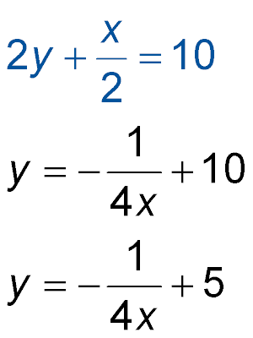
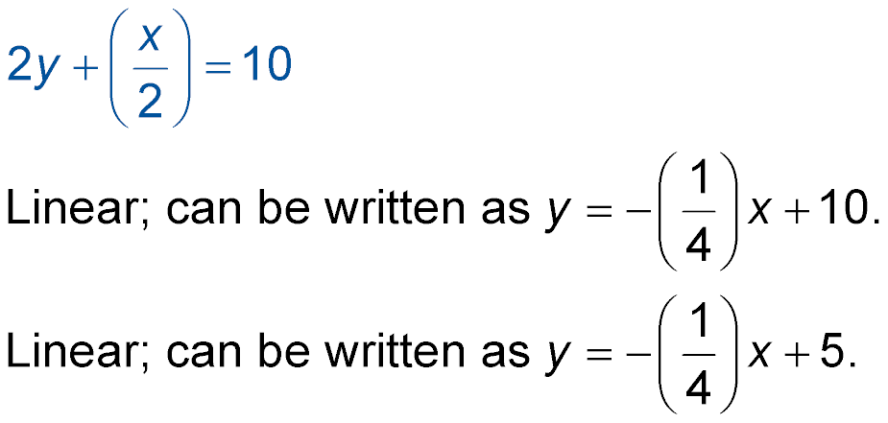
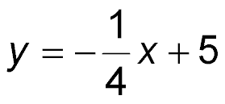
(over Lesson 10-1)
Determine whether the equation represents a linear or nonlinear function. Explain.
A.
B.
C. Nonlinear; the slope is negative.
D. Nonlinear; the power of x is not greater than 1.
A
B
C
D

Slide 6


Graph quadratic functions.
quadratic function

Slide 7

Standard 7AF1.5 Represent quantitative relationships graphically and interpret the meaning of a specific part of a graph in the situation represented by the graph.
Standard 7AF3.1 Graph functions of the form y = nx² and y = nx³ and use in solving problems.

Slide 8
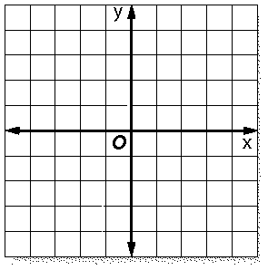
Remember these:
y = 2x + 2
y = ⅓x - 4
y = -3x + 4
These are classified as linear functions because they create a straight line.

Slide 9
y = 2x²
y = 3x²
See if you can unlock
the secret
of these functions.
y = 5x²
y = 7x²

Slide 10
What do we see?
y = 2x²
y = 3x²
y = 5x²
y = 7x²
1) There is no constant so the y-intercept is at the point of origin or 0 for each one.
2) All the lines are non-linear or curved.
3) Any x² results in a curved line pointed up.
4) The larger the slope (coefficient) the wider the curve is.

Slide 11
y = -2x²
y = -3x²
See if you can unlock
the secret
of these functions.
y = -5x²
y = -7x²

Slide 12
What do we see?
y = -2x²
y = -3x²
y = -5x²
y = -7x²
1) There is no constant so the y-intercept is at the point of origin or 0 for each one.
2) All the lines are non-linear or curved.
3) Any -x² results in a curved line pointed down.
4) The larger the slope (coefficient) the wider the curve is.

Slide 13

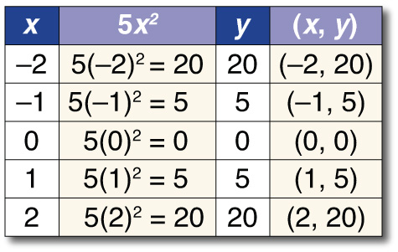
Graph Quadratic Functions
Graph y = 5x².
To graph a quadratic function, make a table of values, plot the ordered pairs, and connect the points with a smooth curve.

Slide 14
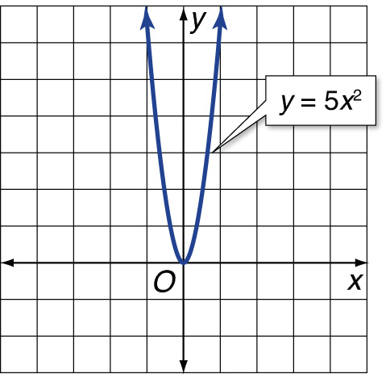
Graph Quadratic Functions
Answer:

Slide 15
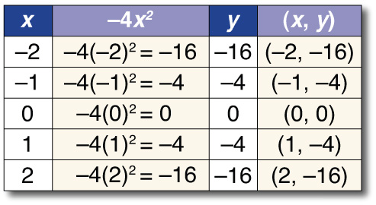
Graph Quadratic Functions
Graph y = –4x².

Slide 16
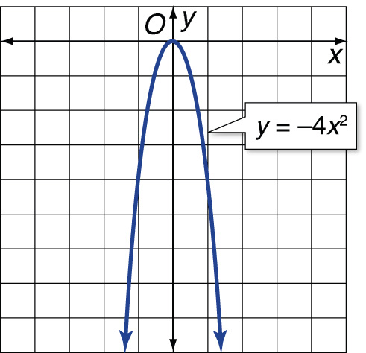
Graph Quadratic Functions
Answer:

Slide 17
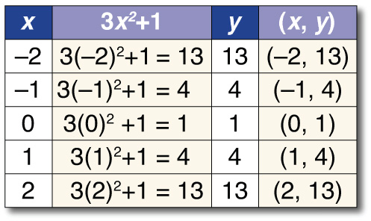
Graph Quadratic Functions
Graph y = 3x² + 1.

Slide 18
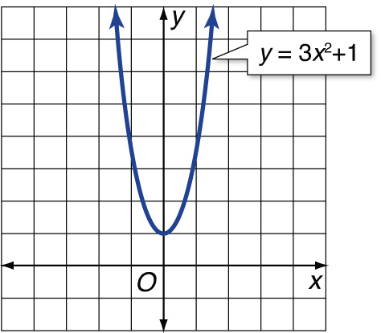
Graph Quadratic Functions
Answer:

Slide 19

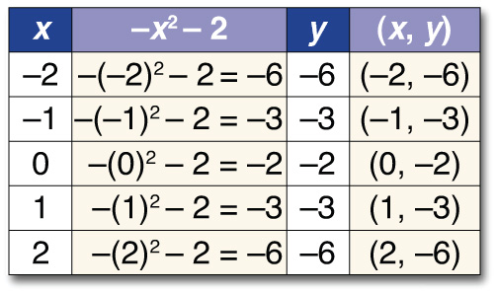
Graph Quadratic Functions
Graph y = –x² – 2.

Slide 20
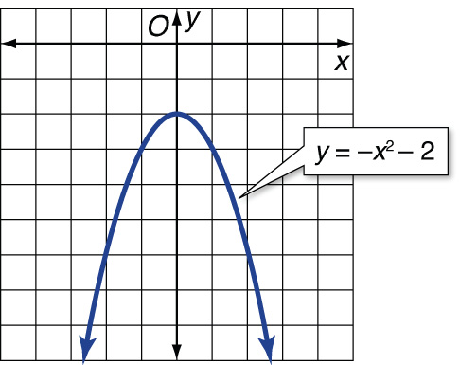
Graph Quadratic Functions
Answer:

Slide 21

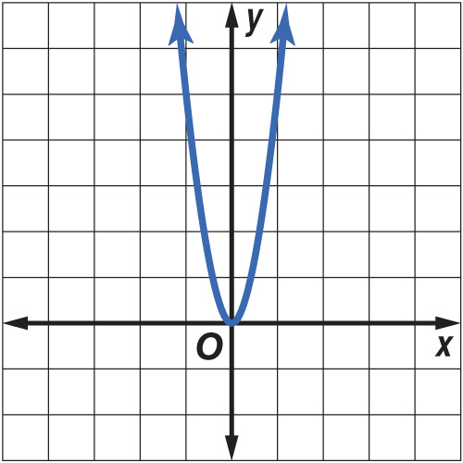
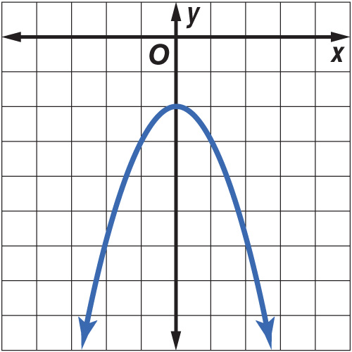
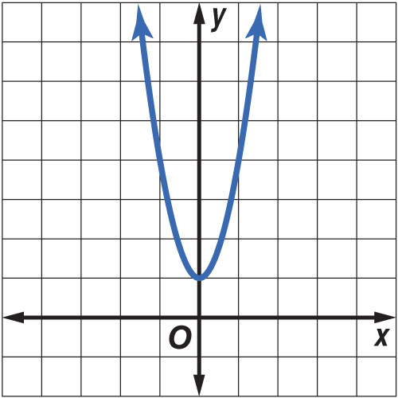
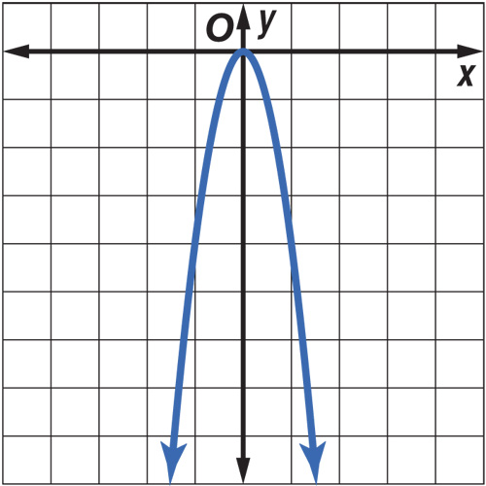
Graph y = 2x².
A. B.
C. D.
A
B
C
D

Slide 22
Graph y = –3x².
A. B.
C. D.
A
B
C
D

Slide 23
Graph y = 2x² + 2.
A. B.
C. D.
A
B
C
D

Slide 24
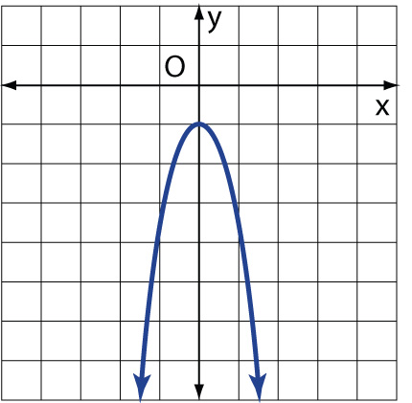
Graph y = –2x² – 1.
A. B.
C. D.
A
B
C
D

Slide 25
