Slide 1
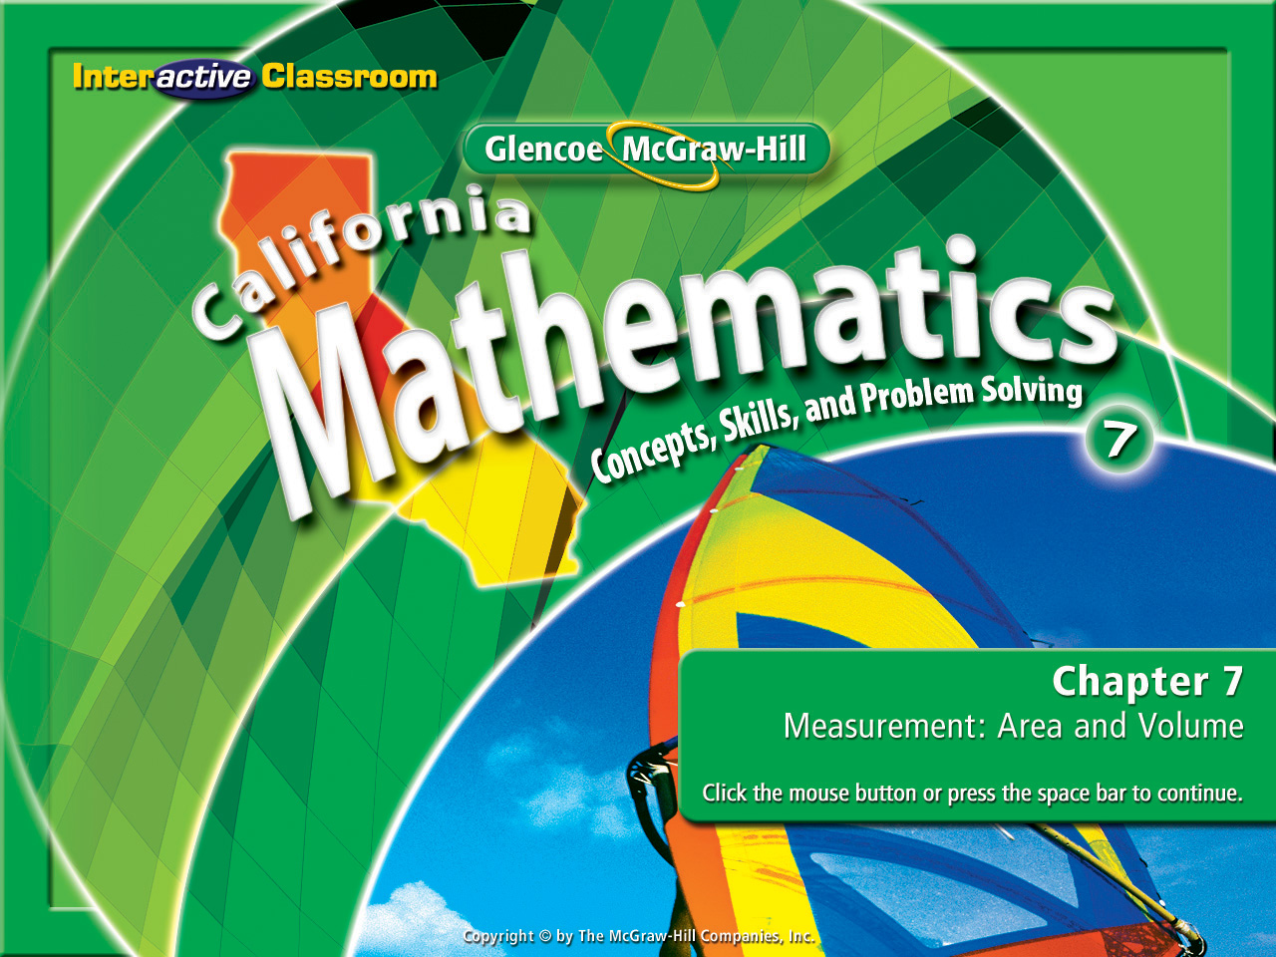
Splash Screen
Chapter 10
Lesson 10-8

Slide 2

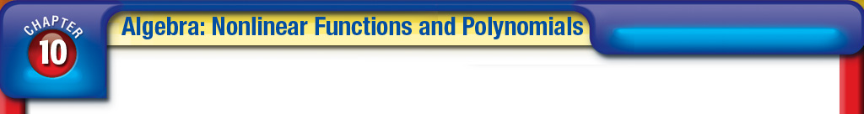







5Min 7-3
(over Lesson 10-6)
A. 6x¹⁵
B. 6x¹⁰
C. 6x⁷
D. 6x³
A
B
C
D

Slide 3


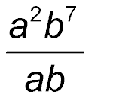
5Min 7-4
(over Lesson 10-6)
A.
B. a⁸b¹³
C. a¹⁵b³⁰
D. a²b⁷
A
B
C
D

Slide 4



5Min 7-5
(over Lesson 10-6)
The area of a rectangle is 3⁸ square inches. If the width is 3⁵ inches, find the length of the rectangle.
A. 3 inches
B. 9 inches
C. 27 inches
D. 81 inches
A
B
C
D

Slide 5


5Min 8-1
(over Lesson 10-7)
Simplify (5²)³.
A. 75
B. 1,000
C. 15,625
D. 3,125
A
B
C
D

Slide 6

5Min 8-2
(over Lesson 10-7)
Simplify (n⁵)⁸.
A. n¹³
B. n⁴⁰
C. n³
D. n^{–3}
A
B
C
D

Slide 7
5Min 8-3
(over Lesson 10-7)
Simplify (5k ⁵)³.
A. 5k ⁸
B. 5k ¹⁵
C. 125k ⁸
D. 125k ¹⁵
A
B
C
D

Slide 8


Lesson 8 MI/Vocab
Find roots of monomials.
cube root

Slide 9

Lesson 8 CA
Standard 7AF2.2 Multiply and divide monomials; extend the process of taking powers and extracting roots to monomials when the latter results in a monomial with an integer exponent.

Slide 10
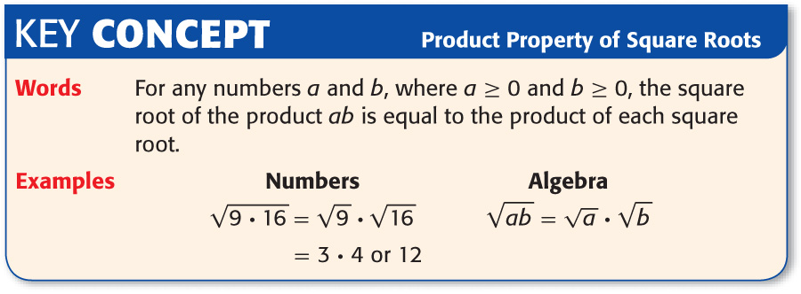
Lesson 8 KC1

Slide 11

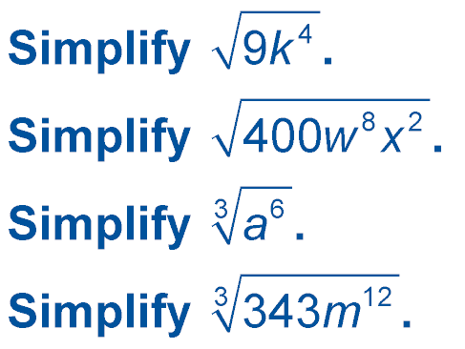
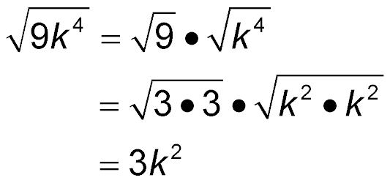
Lesson 8 Ex1
Simplify Square Roots
Product Property of Square Roots
Simplify.
Answer: 3k²

Slide 12
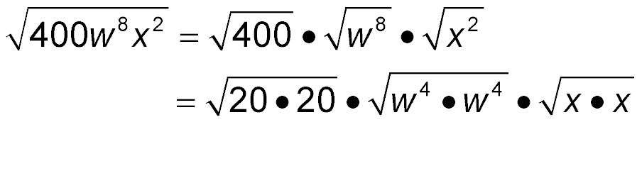
Lesson 8 Ex2
Simplify Square Roots
= 20w⁴|x|
Answer: 20w⁴|x|

Slide 13
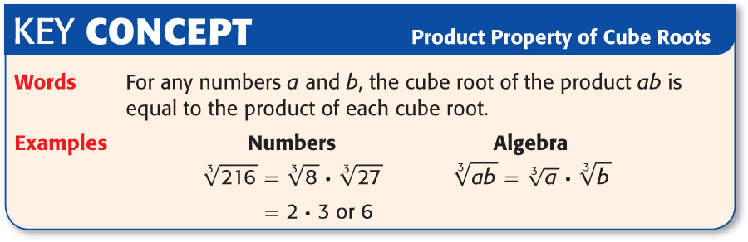
Lesson 8 KC2

Slide 14
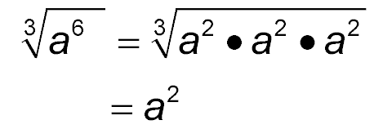
Lesson 8 Ex3
Simplify Cube Roots
Answer: a²

Slide 15
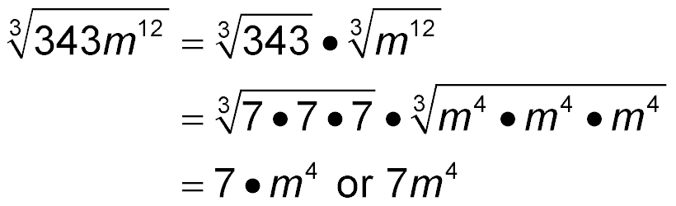
Lesson 8 Ex4
Simplify Cube Roots
Product Property of Cube Roots
Simplify.
Answer: 7m⁴

Slide 16

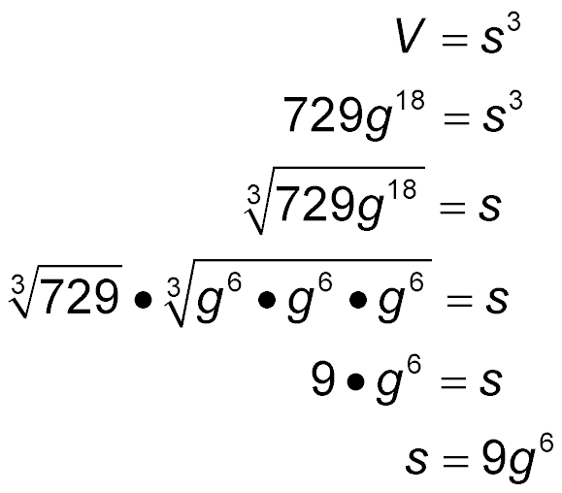
Lesson 8 Ex5
GEOMETRY Find the length of one side of a cube whose volume is 729g¹⁸ cubic units.
V = s³ Volume of a cube
729g¹⁸ = s³ Replace V with 729g¹⁸.
Definition of cube root
Product Property of Cube Roots
Simplify.
Answer: 9g⁶

Slide 17


Lesson 8 CYP1
A. 4|e|
B. 4e²
C. 8|e|
D. 8e²
A
B
C
D

Slide 18
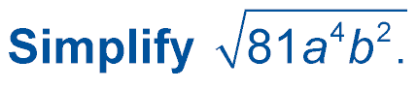
Lesson 8 CYP2
A. 9a²b
B. 9a²|b|
C. |9a²b|
D. 9|a²b|
A
B
C
D

Slide 19

Lesson 8 CYP3
A. y²
B. y⁴
C. y⁶
D. y⁹
A
B
C
D

Slide 20

Lesson 8 CYP4
Simplify .
A. 8h
B. 8h³
C. 8h⁶
D. 8h⁹
A
B
C
D

Slide 21
Lesson 8 CYP5
GEOMETRY Express the length of one side of the square whose area is 49m⁴n² square units as a monomial.
A. 7m²n units
B. 7m²|n| units
C. 7|m⁴n²| units
D. 7|m²n| units
A
B
C
D

Slide 22
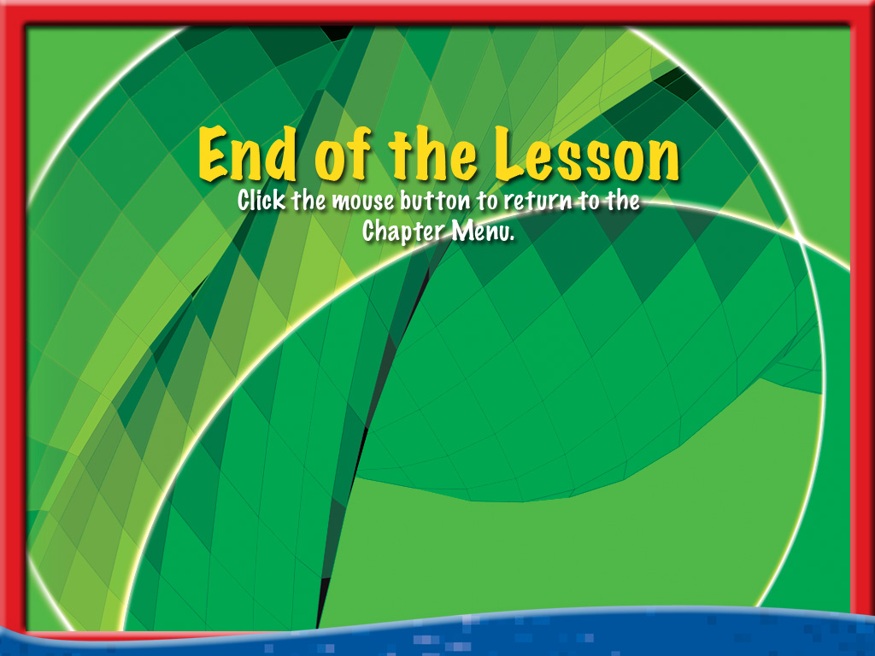



End of Lesson 8

