Slide 1

Splash Screen
Chapter 11
Lesson 11-3

Slide 2





(over Chapter 10)
Simplify . Express using positive exponents.
A. 1¹¹
B. 6¹¹
C. 6⁵
D. 12⁵
A
B
C
D

Slide 3

(over Chapter 10)
Simplify (x³)⁶. Express using positive exponents.
A. x⁹
B. 6x³
C. x¹⁸
D. 3x⁶
A
B
C
D

Slide 4
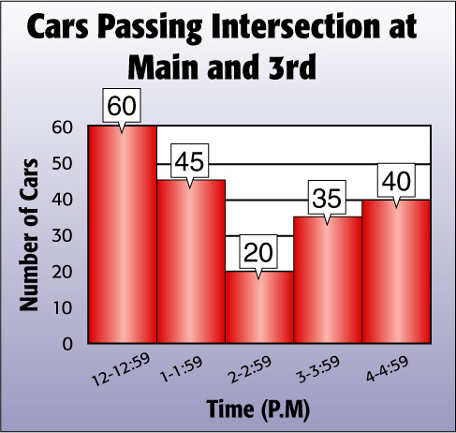

(over Lesson 11-2)
This histogram shows the number of cars passing the intersection at Main and 3rd. What interval represents the greatest number of cars?
A. 12:00 P.M. – 12:59 P.M.
B. 1:00 P.M. – 1:59 P.M.
C. 3:00 P.M. – 3:59 P.M.
D. 4:00 P.M. – 4:59 P.M.
A
B
C
D

Slide 5

(over Lesson 11-2)
This histogram shows the number of cars passing the intersection at Main and 3rd. How many cars passed the intersection more than once?
A. 60 cars
B. 40 cars
C. 45 cars
D. cannot be determined
A
B
C
D

Slide 6


Construct and interpret circle graphs.
circle graph

Slide 7

Standard 7SDAP1.1 Know various forms of display for data sets, including stem-and-leaf plot or box-and-whisker plot; use the forms to display a single set of data or to compare two sets of data.

Slide 8

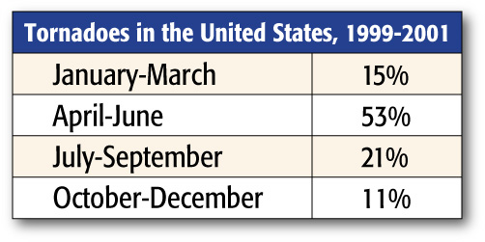
Construct a Circle Graph from Percents
TORNADOES The table shows when tornadoes occurred in the United States from 1999 to 2001. Make a circle graph using this information.
Source: spc.noaa.gov

Slide 9
Construct a Circle Graph from Percents
Source: spc.noaa.gov
Step 1 There are 360° in a circle. So, multiply each percent by 360 to find the number of degrees for each section of the graph.
Jan.–March: 15% of 360 = 0.15 • 360 or 54⁰
Apr.–June: 53% of 360 = 0.53 • 360 or about 191⁰
Jul.–September: 21% of 360 = 0.21 • 360 or about 76⁰
October–December: 11% of 360 = 0.11 • 360 or about 40⁰

Slide 10
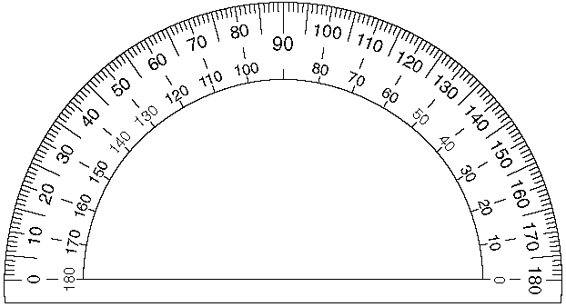
Construct a Circle Graph from Percents
Source: spc.noaa.gov
Step 2 - Use a compass to draw a circle and a radius.
- Then use a protractor to draw a 54° angle. This section represents
January – March. Label the section.
- From the new radius, draw the next angle. Label the section.
- Repeat for each of the remaining angles. Label each section. Then give the graph a title.
Oct- Dec
Jan - Mar
Jan-March 54⁰
Apr-June 191⁰
Jul-Sept 76⁰
Oct-Dec 40⁰

Slide 11
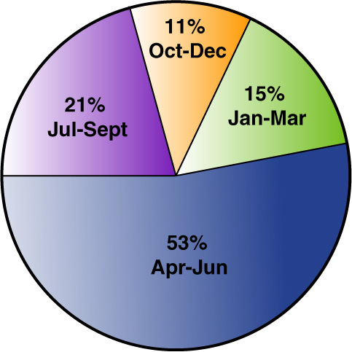
Construct a Circle Graph from Percents
Answer: Tornadoes in the United States 1999-2001
Source: spc.noaa.gov

Slide 12
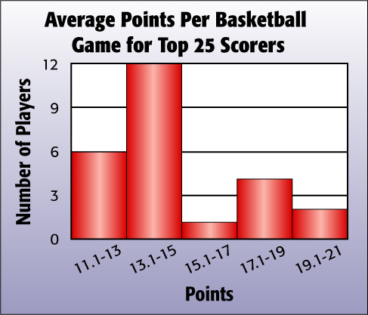
Construct a Circle Graph from Data
BASKETBALL Construct a circle graph using the information in the histogram.

Slide 13
Construct a Circle Graph from Data
Step 1 Find the total number of players.
6 + 12 + 1 + 4 + 2 = 25
Step 2 Find the ratio that compares the number in each point range to the total number of players. Round to the nearest hundredth.
11.1 to 13: 6 ÷ 25 = 0.24
13.1 to 15: 12 ÷ 25 = 0.48
15.1 to 17: 1 ÷ 25 = 0.04
17.1 to 19: 4 ÷ 25 = 0.16
19.1 to 21: 2 ÷ 25 = 0.08

Slide 14
Construct a Circle Graph from Data
Step 3 Use these ratios to find the number of degrees of each section. Round to the nearest degree if necessary.
11.1 to 13: 6 ÷ 25 = 0.24 • 360 = 86.4 or about 86°
13.1 to 15: 12 ÷ 25 = 0.48 • 360 = 172.8 or about 173°
15.1 to 17: 1 ÷ 25 = 0.04 • 360 = 14.4 or about 14°
17.1 to 19: 4 ÷ 25 = 0.16 • 360 = 57.6 or about 58°
19.1 to 21: 2 ÷ 25 = 0.08 • 360 = 28.8 or about 29°

Slide 16
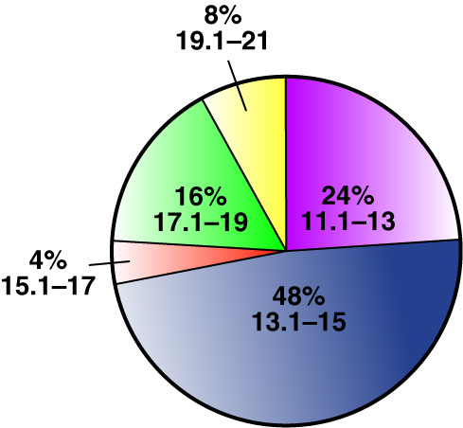
Construct a Circle Graph from Data
Step 4 Use a compass and protractor to draw a circle and the appropriate sections. Label each section and give the graph a title. Write the ratios as percents.
Average Points Per Basketball Game for Top 25 Scorers
173°
86°
58°
14°
29°

Slide 17
Analyze and Interpret Data
Use the circle graph to describe the makeup of the average game scores of the 25 top-scoring basketball players.
Average Points Per Basketball Game for
Top 25 Scorers

Slide 18
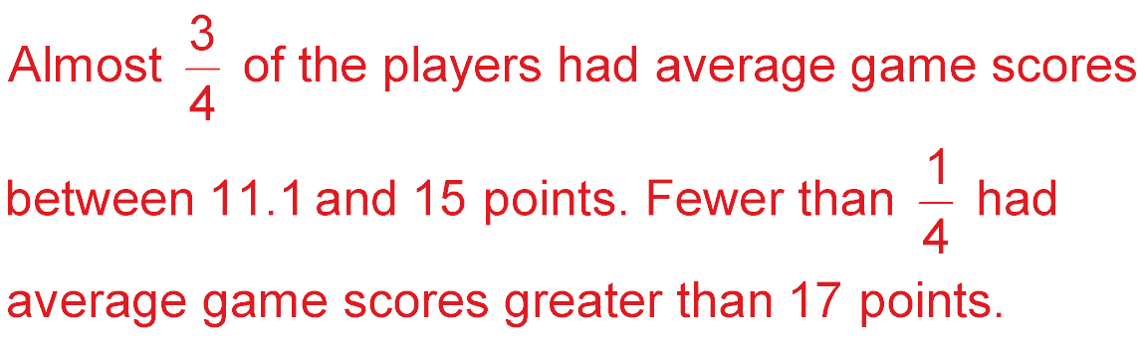
Analyze and Interpret Data
Sample answer:

Slide 19

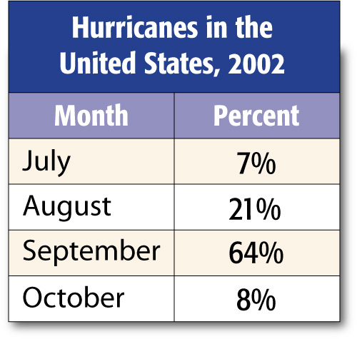
HURRICANES The table shows when hurricanes or tropical storms occurred in the Atlantic Ocean during the hurricane season of 2002. Make a circle graph using this information.

Slide 20
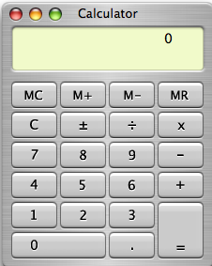
July:
25.2 or 25°
August:
75.6 or 76°
September:
230.4 or 230°
October:
28.8 or 29°

Slide 21
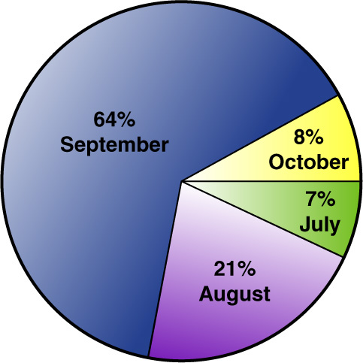
Answer: Hurricanes in the United States, 2002

Slide 22
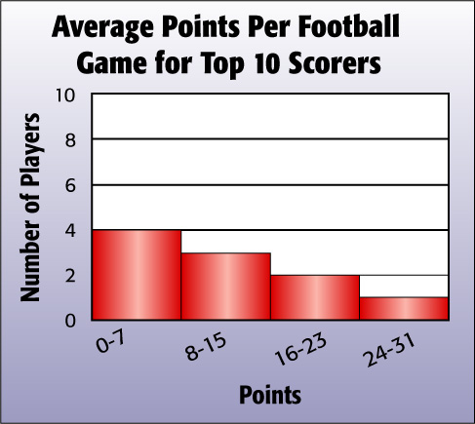
FOOTBALL Make a circle graph using the information in the histogram below.

Slide 23
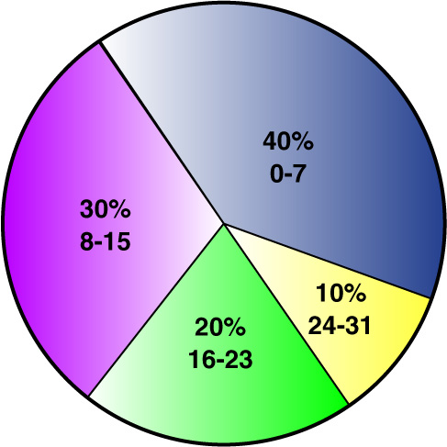
Answer: Average Points Per Football Game for Top 10 Scorers

Slide 24
Use the circle graph to describe the makeup of the average game scores of the 10 top-scoring football players.
Average Points Per Football Game for
Top 10 Scorers

Slide 25
Average Points Per Football Game for
Top 10 Scorers
Sample answer:
More than one half of the players had game scores between 0 and 15. Ten percent had scores greater than 23.

Slide 26





