Slide 1
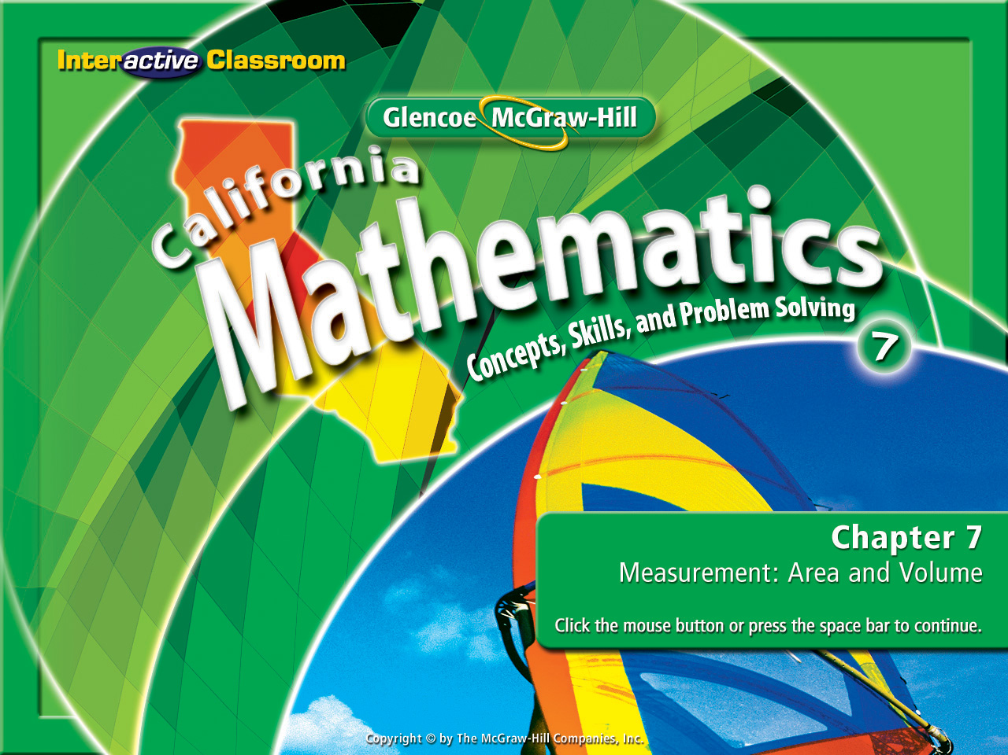
Splash Screen
Chapter 11
Lesson 11-4

Slide 2

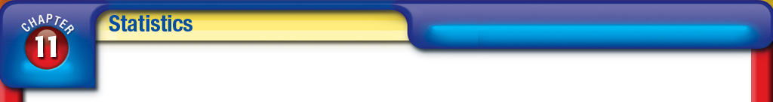


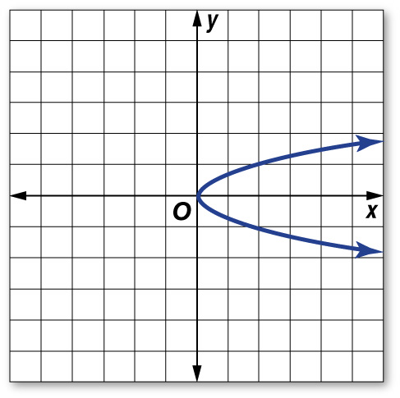
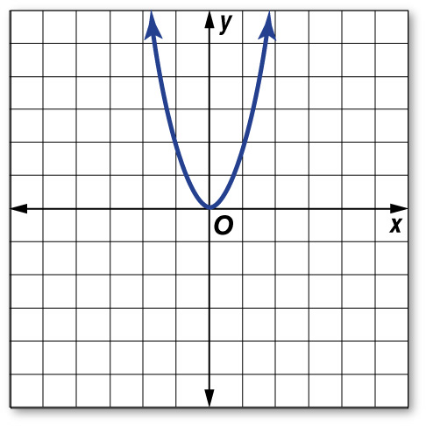
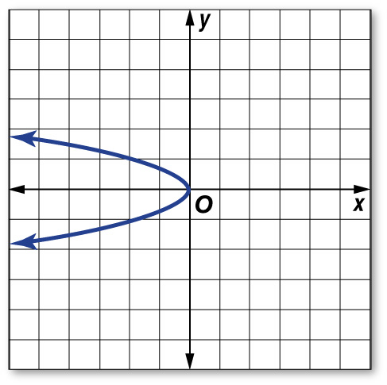
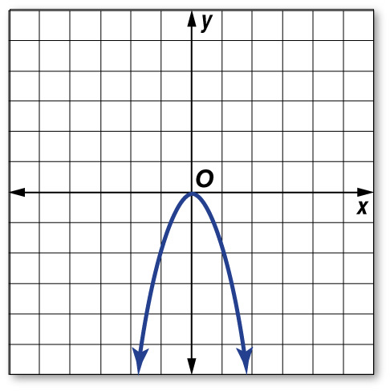
(over Chapter 10)
Graph y = 2x².
A. B.
C. D.
A
B
C
D

Slide 3
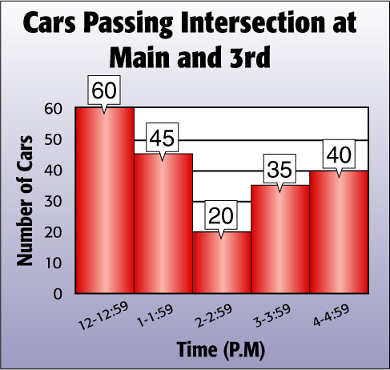

(over Lesson 11-2)
The histogram shows the number of cars passing the intersection at Main and 3rd. How many cars passed through between 2:00 P.M. and 4:59 P.M.?
A. 40 cars
B. 75 cars
C. 95 cars
D. 135 cars
A
B
C
D

Slide 4

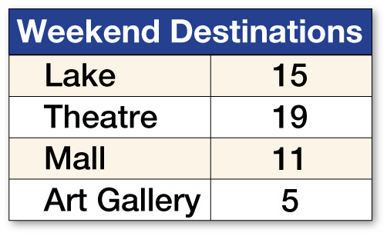
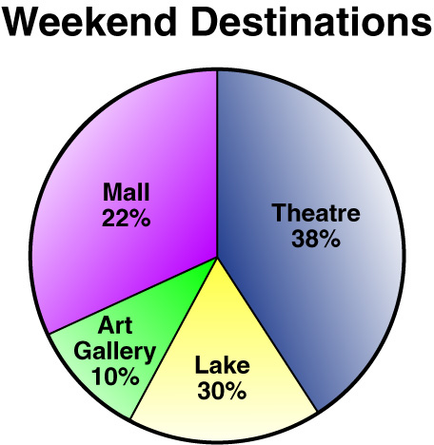
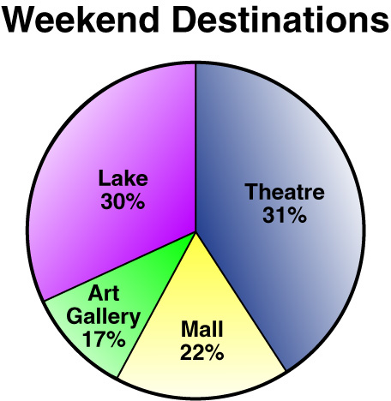


(over Lesson 11-3)
Which choice shows a circle graph for the set of data about weekend destinations given in the table?
A. B.
C . D.
A
B
C
D

Slide 5

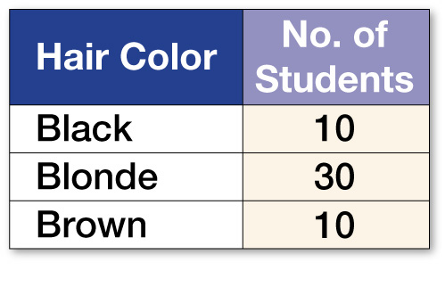
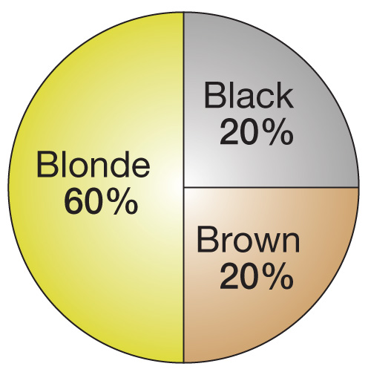
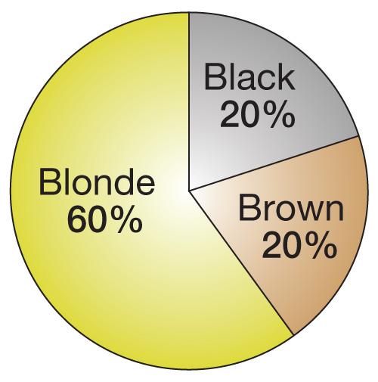
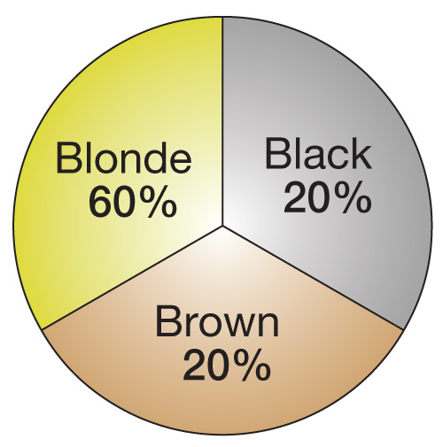
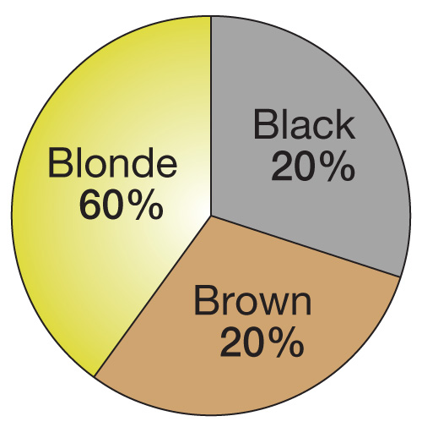
(over Lesson 11-3)
The table shows the different hair colors of the students in a class. Identify the circle graph for the data.
A. B.
C. D.
A
B
C
D

Slide 6


Find the mean, median, mode, and range of a set of data.
measures of central tendency
mean
median
mode
range

Slide 7

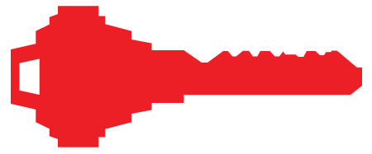
Standard 7SDAP1.3 Understand the meaning of, and be able to compute, the minimum, the lower quartile, the median, the upper quartile, and the maximum of a data set.

Slide 8
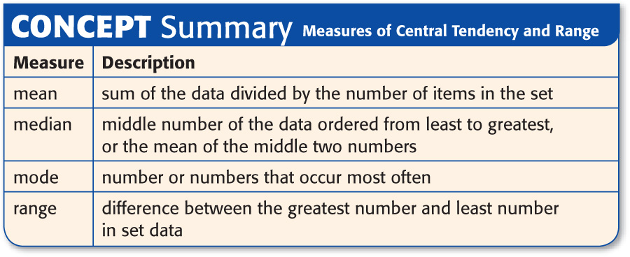

Slide 9

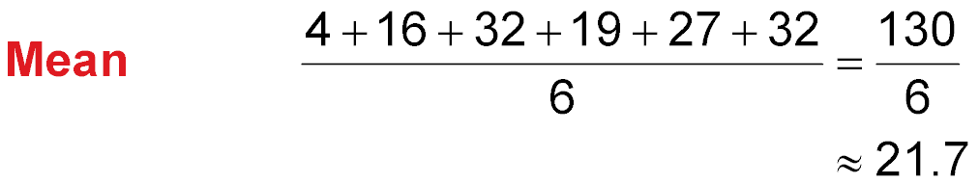
Find Measures of Central Tendency and Range
The ages in years, of the actors in a play are 4, 16, 32, 19, 27, and 32. Find the mean, median, mode, and range of the data.

Slide 10
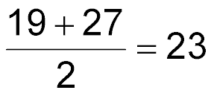
The ages in years, of the actors in a play are 4, 16, 32, 19, 27, and 32.
Find Measures of Central Tendency and Range
Median Arrange the numbers in order from least to greatest. The median is the average of the middle two numbers
4 16 19 27 32 32
Mode The data has a mode of 32.
Range 32 – 4 or 28 years
Answer: mean: 21.7; median: 23; mode: 32; range: 28

Slide 11

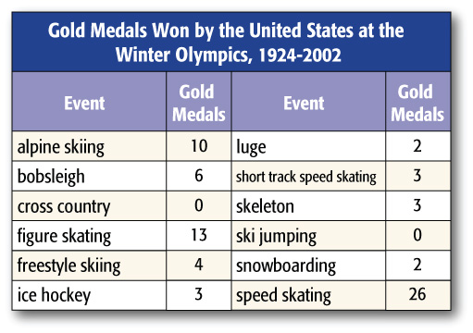
OLYMPICS Select the appropriate measure of central tendency or range to describe the data in the table. Justify your reasoning.

Slide 12
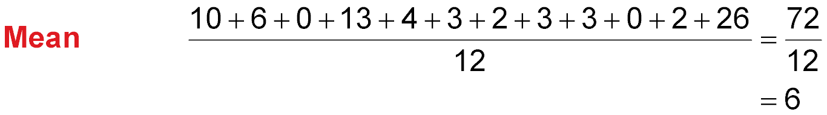
Find the mean, median, mode, and range of the data.
72 ÷ 12 = 6 The mean is 6 medals.
Median Arrange the numbers from least to greatest.
0, 0, 2, 2, 3, 3, 3, 4, 6, 10, 13, 26
The median is the average of the middle two numbers or 3 medals.
Mode There is one mode, 3.
Range 26 – 0 or 26 medals

Slide 13
OLYMPICS Select the appropriate measure of central tendency or range to describe the data in the table. Justify your reasoning.
Answer: The median (3) or the mode (3) is appropriate. The mean (6) is affected by the extreme value 26. The range of the data is 26.

Slide 14
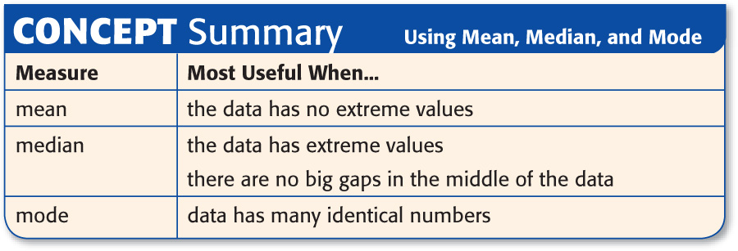
Write this one down & keep it in a safe place!!

Slide 15

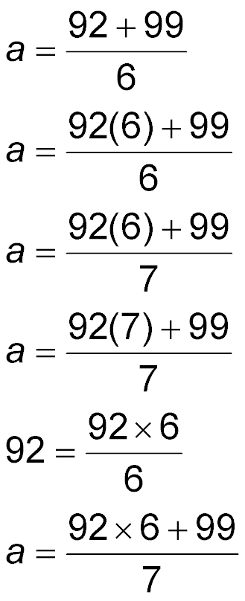
Using Appropriate Measures
Beatrice has an average of 92 on 6 quizzes. If she gets a 99 on the next quiz, which equation can be used to find a, her new average quiz score?
A. B.
C. D.
Read the Item You need to find the average quiz score after one grade is added.

Slide 16
Using Appropriate Measures
Solve the Item Beatrice’s average before adding new score:
sum of 6 quiz scores number of quizzes
average score
Beatrice’s average after adding new score:
new average score
sum of 6 quiz scores plus 99 number of quizzes plus 1
Answer: The correct answer choice is C because the sum of the scores is 99 more and there is one more score.

Slide 17

The ages, in years, of the children at a day care center are 3, 5, 3, 7, 6, and 4. Find the mean, median, mode, and range of the data.
A. mean: 4.7; median: 4.5; mode: 3; range: 4
B. mean: 4.7; median: 5; mode: 2; range: 28
C. mean: 28; median: 5.4; mode: 3; range: 6
D. mean: 4.6; median: 4.5; mode: 2; range: 5
A
B
C
D

Slide 18
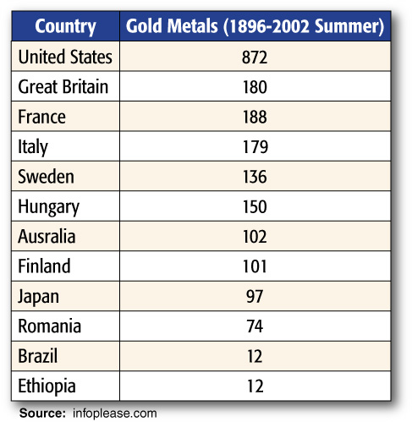
OLYMPICS Select the appropriate measure of central tendency or range to describe the data in the table. Justify your reasoning.
Answer: The median; the mean is affected by the extreme value of 872 and the mode is much lower than the rest of the data. The range or spread of the data is 860.

Slide 19
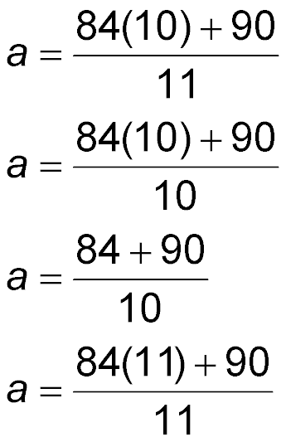
Alberto has an average of 84 on 10 quizzes. If he gets a 90 on the next quiz, which equation can be used to find a, his new average quiz score?
A.
B.
C.
D.
A
B
C
D

Slide 20
