Slide 1
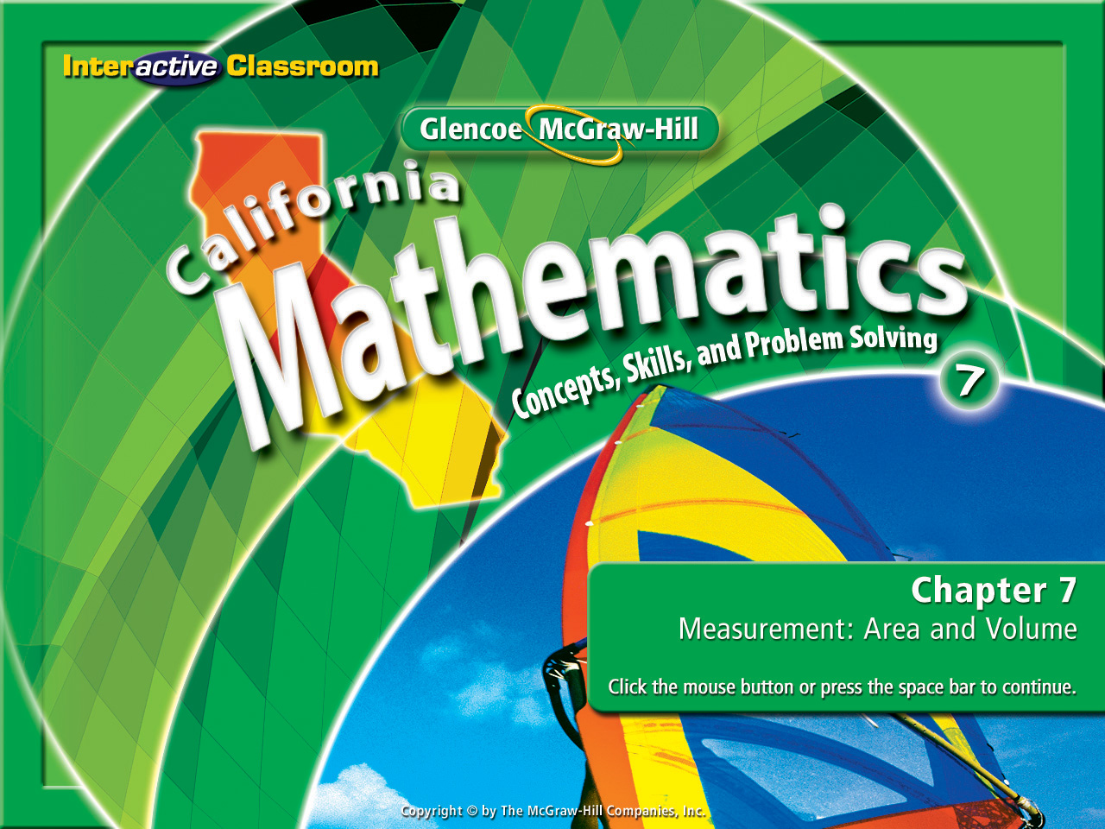
Splash Screen
Chapter 11
Lesson 11-5

Slide 2



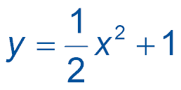
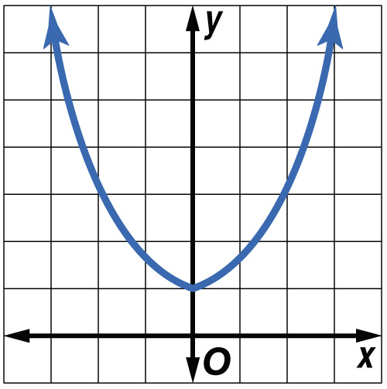
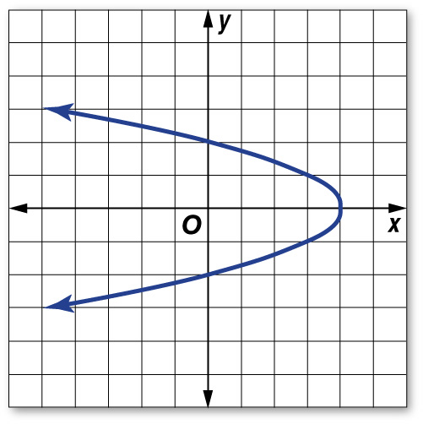
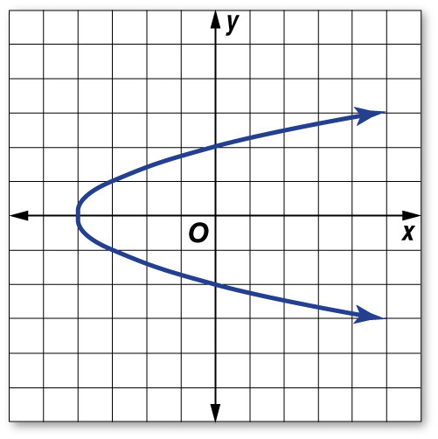
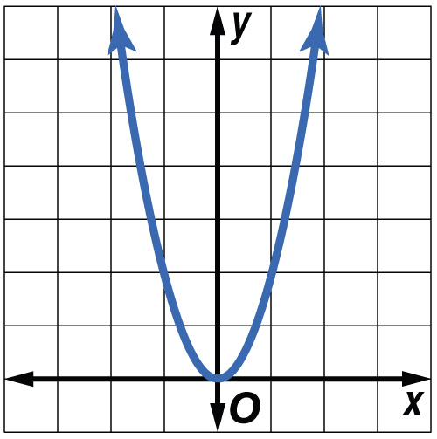
(over Chapter 10)
Graph .
A. B.
C. D.
A
B
C
D

Slide 3

(over Lesson 11-2)
A histogram is the best way to display which of the following?
A. numerical data organized into equal intervals
B. change over a period of time
C. a comparison of data to a the whole
D. none of the above
A
B
C
D

Slide 4
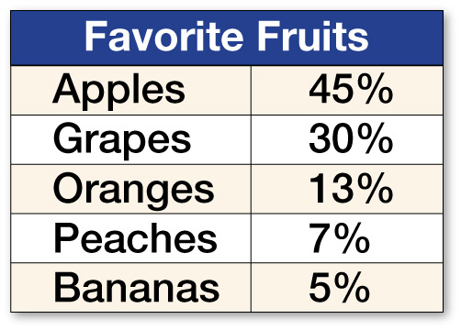
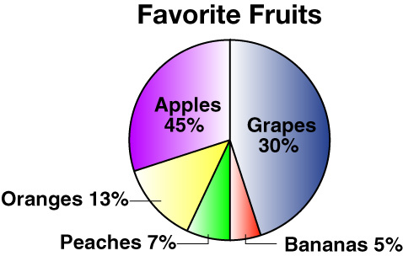
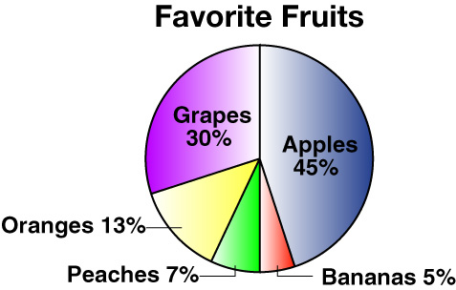
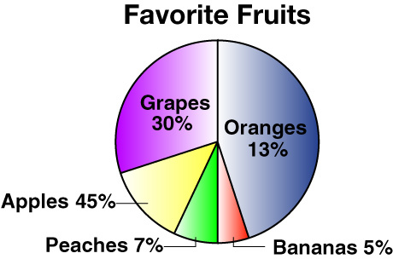
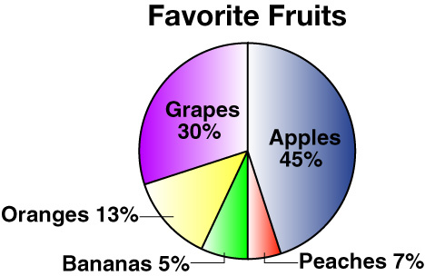
(over Lesson 11-3)
Which choice shows a circle graph for the set of data about favorite fruits given in the table?
B.
A. B.
C. D.
A
B
C
D

Slide 5
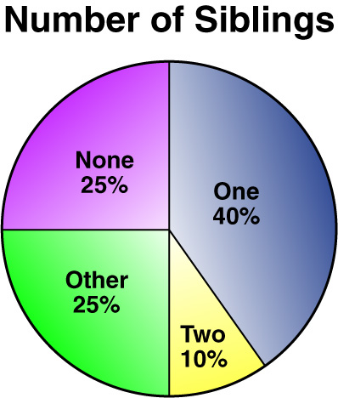
(over Lesson 11-3)
Using the circle graph in the figure, find the degree measure of the section that represents having 1 sibling.
A. 36º
B. 90º
C. 126º
D. 144º
A
B
C
D

Slide 6
(over Lesson 11-4)
Find the mean, median, and mode of the following set of data. Round to the nearest tenth if necessary. 4, 2, 5, 4, 7, 4, 1, 5
A. 4; 4; 4
B. 4; 4; 7
C. 4; 5; 4
D. 4; 8; 4
A
B
C
D

Slide 7
(over Lesson 11-4)
Find the mean, median, and mode of the following set of data. Round to the nearest tenth if necessary. 17, 21, 15, 18, 21, 18, 23
A. 19; 18; 18
B. 19; 18; 21
C. 19; 18; 15 and 17
D. 19; 18; 18 and 21
A
B
C
D

Slide 8


Find the measures of variation of a set of data.
measures of variation
quartiles
lower quartile
upper quartile
interquartile range
outlier

Slide 9


Standard 7SDAP1.3 Understand the meaning of, and be able to compute, the minimum, the lower quartile, the median, the upper quartile, and the maximum of a data set.

Slide 10
Think about the following:
Everything you will see will be an example of the following:
range, median, lower quartile, upper quartile
15.8
14.9
14.9
14.4
14.2
13.4
13.3
13.1
12.9
12.9
13.8
13.1
14.9
12.9 12.9 13.1 13.3 13.4 14.2 14.4 14.9 14.9 15.8
2.9

Slide 11

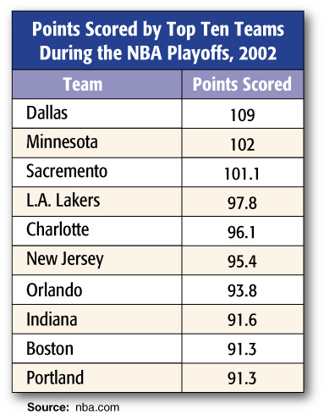

Find Measures of Variation
BASKETBALL Find the measures of variation for the data in the table.
The range is 109 – 91.3 or 17.7 points. Now determine the:
Median, Upper Quartile, & Lower Quartile
Begin by arranging the data in order from least to greatest.

Slide 12
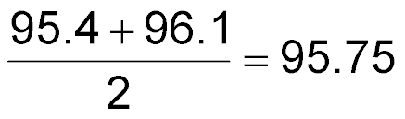
Find Measures of Variation
lower quartile median upper quartile
91.3 91.3 91.6 93.8 95.4 96.1 97.8 101.1 102 109
91.6
101.1
Answer:
- The median is 95.75
- The lower quartile is 91.6
- The upper quartile is 101.1
- The Interquartile Range is calculated as follows:
upper quartile – lower quartile
101.1 – 91.6 or 9.5

Slide 13

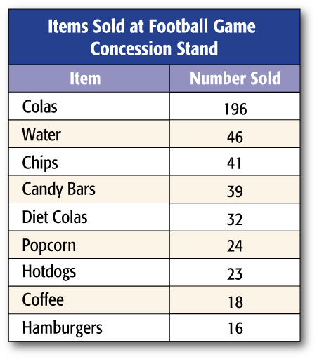
Find Outliers
CONCESSION SALES Find the measures of variation for the data found in the table below. Use these measures to find any outliers.

Slide 14
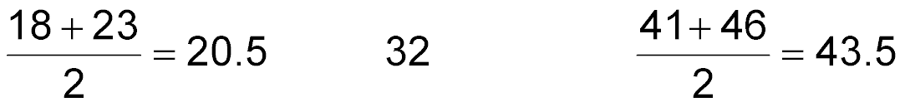
Find Outliers
First arrange the numbers in order form least to greatest.
16 18 23 24 32 39 41 46 196
32
- The median is 32
- The lower quartile is 20.5
- The upper quartile is 43.5
- To find the Interquartile Range, find the difference between the lower quartile and the upper quartile (43.5 – 20.5 = 23).

Slide 15
- The median is 32
Find Outliers
- The lower quartile is 20.5
- The upper quartile is 43.5
Use the measures of variation to find any outliers.
- The Interquartile Range is 23
- The lower quartile is 20.5, the upper quartile is 43.5. The interquartile range is 23.
- Data more than 1.5 times greater than the interquartile range beyond the lower quartile or the upper quartile is called an outlier.
- We take the interquartile range of 23 and multiply it by 1.5. This gives us an interquartile factor of 34.5

Slide 16
- The median is 32
- The lower quartile is 20.5
- The upper quartile is 43.5
Find Outliers
- The Interquartile Range is 23
-The interquartile factor is 34.5
Use the measures of variation to find any outliers.
- We find the difference between the lower quartile and the interquartile factor (20.5 – 34.5 = -14). Therefore any piece of data less than -14 would be considered an outlier. There is no data less than -14.
- We combine the interquartile factor and the upper quartile. That is 78. Therefore any piece of data more than 78 would be considered an outlier. There were 196 colas sold. Therefore, 196 would be considered an outlier.

Slide 17

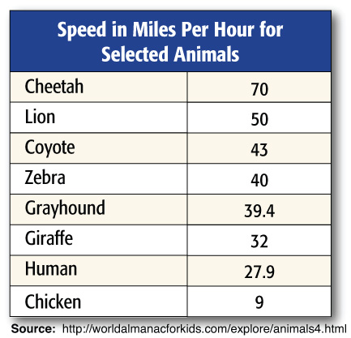
Find the measures of variation.
- The median is _______
- The lower quartile is _______
- The upper quartile is _______
- The interquartile range is ______
- The interquartile factor is ______

Slide 18
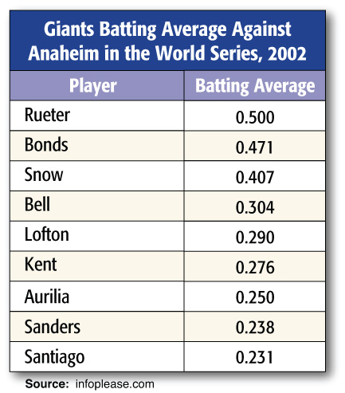
BASEBALLFind the measures of variation for the data in the table.
Answer:
range: 0.269
median: 0.290
upper quartile: 0.439
lower quartile: 0.244
interquartile range: 0.195

Slide 19
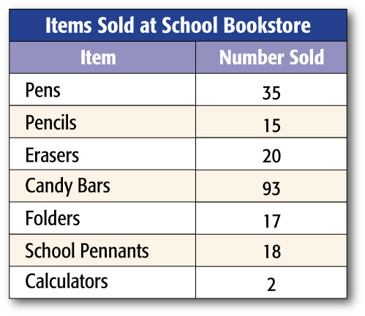

BOOKSTORE SALES Find any outliers for the data in the table.
A. 2, 93
B. 2
C. 35
D. 93
A
B
C
D

Slide 20
