Slide 1

Splash Screen
Chapter 11
Lesson 11-6

Slide 2





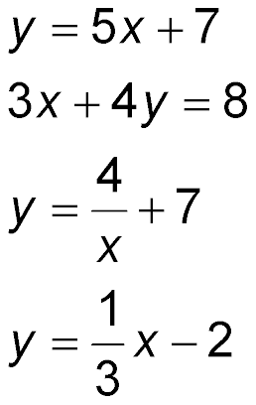
(over Chapter 10)
Which equation represents a nonlinear function?
A.
B
C.
D.
A
B
C
D

Slide 3

(over Lesson 11-4)
Find the mean, median, and mode of the following set of data. Round to the nearest tenth if necessary. 35, 34, 39, 33, 34
A. 35; 34; 33
B. 35; 34; 34
C. 35; 39; 33
D. 35; 39; 34
A
B
C
D

Slide 4

(over Lesson 11-4)
Find the mean, median, and mode of the following set of data. Round to the nearest tenth if necessary. 81, 72, 73, 72, 66, 81
A. 74.2; 72.5; 66
B. 74.2; 72; 81
C. 74.2; 72; 72 and 81
D. 74.2; 72.5; 72 and 81
A
B
C
D

Slide 5

(over Lesson 11-5)
Find the range, median, upper and lower quartiles, interquartile range, and any outliers for the following set of data. 1, 3, 4, 7, 8, 9, 11
A. 10; 7; 9; 3; 6; 1
B. 10; 7; 9; 3; 6; no outliers
C. 10; 7; 9; 3; 6; 11
D. 10; 7; 3; 9; 6; no outliers
A
B
C
D

Slide 6


Display and interpret data in a box-and-whisker plot.
box-and-whisker plot

Slide 7

Standard 7SDAP1.1 Know various forms of display for data sets, including stem-and-leaf plot or box-and-whisker plot; use the forms to display a single set of data or to compare two sets of data.

Slide 8

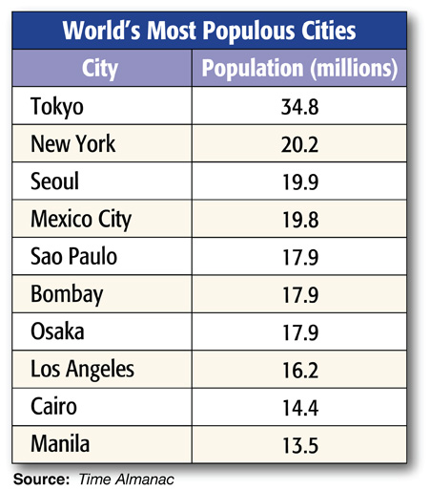
Construct a Box-and-Whisker Plot
POPULATION Use the data in the table at the right to construct a box-and-whisker plot.
Step 1 Determine the values for the measures of variation for the data.
Median:
17.9
Upper Quartile:
19.9
Lower Quartile:
16.2
Interquartile Range:
3.7
Interquartile Factor:
5.6
Outliers:
any data at or above 25.45 or below 10.65 (34.8)

Slide 9
Construct a Box-and-Whisker Plot
Step 2 Draw a number line that allows you to plot the least and greatest number in the data.
10
15
20
25
30
35
40
Step 3 Mark the extremes, the median, and the upper and lower quartile above the number line. Since the data have an outlier, mark the greatest value that is not an outlier.
Median:
17.9
Upper Quartile:
19.9
Lower Quartile:
16.2
Interquartile Range:
3.7
Interquartile Factor:
5.6
Outliers:
34.8

Slide 10
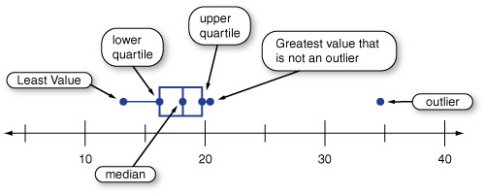
Construct a Box-and-Whisker Plot
Step 3 Draw the box and whiskers.
Answer:

Slide 11
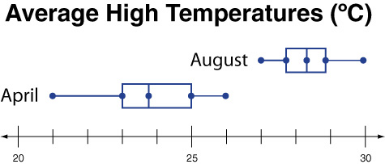
Compare Data
WEATHER Refer to the double box-and-whisker plot below. Which month had a greater range in high temperatures? Justify your reasoning.

Slide 12
Compare Data
Find the range in temperatures for August.
30 – 27 or 3°C
Find the range in temperatures for April.
26 – 21 or 5°C
Answer: April had a greater range in high temperatures. The difference between the upper and lower extremes for April was 5 degrees, and the difference between the upper and lower extremes for August was 3 degrees.

Slide 13

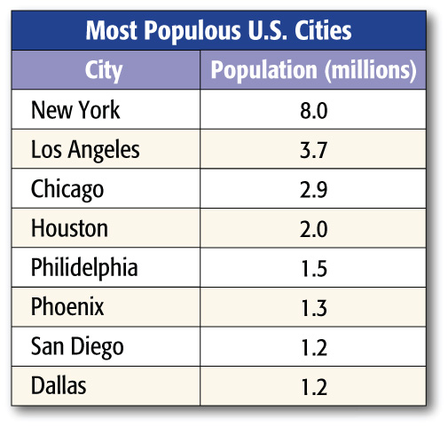

POPULATION Use the data in the table at the right to construct a box-and-whisker plot.
Answer:

Slide 14
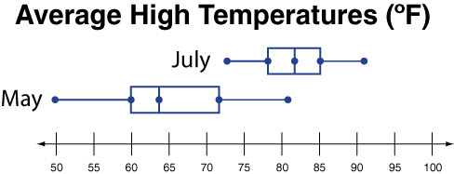
WEATHER Refer to the double box-and-whisker plot below. Which month had a greater range in high temperatures? Justify your reasoning.
A. July
B. May
A
B

Slide 15





