Slide 1

Splash Screen
Chapter 11
Lesson 11-7

Slide 2




(over Lesson 10-7)
Simplify (–2v³z ⁸)⁵.
A. –2v⁸z ¹³
B. –2v¹⁵z ⁴⁰
C. –32v⁸z ¹³
D. –32v¹⁵z ⁴⁰
A
B
C
D

Slide 3


(over Lesson 11-4)
Find the mean, median, and mode of the following set of data. Round to the nearest tenth if necessary. 35, 34, 39, 33, 34
A. 35; 34; 33
B. 35; 34; 34
C. 35; 39; 33
D. 35; 39; 34
A
B
C
D

Slide 4

(over Lesson 11-4)
Find the mean, median, and mode of the following set of data. Round to the nearest tenth if necessary. 81, 72, 73, 72, 66, 81
A. 74.2; 72.5; 66
B. 74.2; 72; 81
C. 74.2; 72; 72 and 81
D. 74.2; 72.5; 72 and 81
A
B
C
D

Slide 5

(over Lesson 11-5)
Find the range, median, upper and lower quartiles, interquartile range, and any outliers for the following set of data. 26, 23, 29, 44, 24, 31, 27
A. 21; 27; 24; 31; 7; 44
B. 21; 27; 24; 31; 7; no outliers
C. 21; 27; 31; 24; 7; 44
D. 21; 44; 31; 24; 7; 44
A
B
C
D

Slide 6





(over Lesson 11-6)
Which choice shows a box-and-whisker plot for the following set of data? 27, 17, 32, 46, 30, 24, 38, 23, 45, 43, 31
A.
B.
C.
D.
A
B
C
D

Slide 7


Display data in stem-and-leaf plots.
Interpret data in stem-and-leaf plots.
stem-and-leaf plots
stems
leaves
back-to-back stem-and-leaf plot

Slide 8

Standard 7SDAP1.1 Know various forms of display for data sets, including stem-and-leaf plot or box-and-whisker plot; use the forms to display a single set of data or to compare two sets of data.

Slide 9

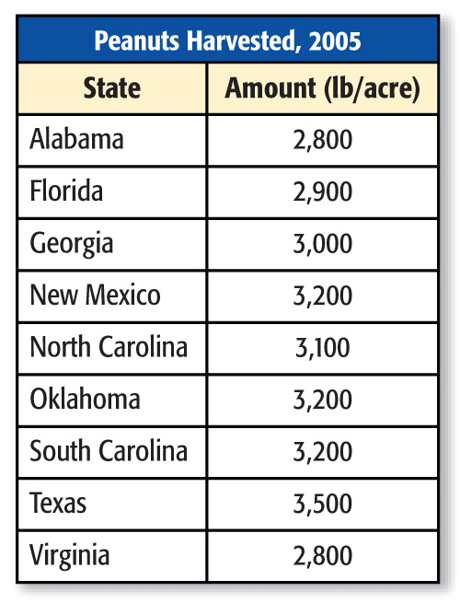
Draw a Stem-and-Leaf Plot
FOOD Display the data in a stem-and-leaf plot with or without the use of technology.
Step 1 Find the least and the greatest number. Then identify the greatest place value digit in each number.
The least number, 2,800, has 2 in the thousands place.
The greatest number, 3,500, has 3 in the thousands place.

Slide 10
Draw a Stem-and-Leaf Plot
Step 2 Draw an offset “T” chart. Label the left side “Stem” & the right side “Leaf”. Below the stem write the numbers 2 & 3
Step 3 Write the leaves to the right of the corresponding stem on the other side of the line. For example, for 2,800, write 8 to the right of 2.
Stem
Leaf
2
8
8
9
3
0
1
2
2
2
5
Step 4 Make sure the leaves are ordered from least to greatest. Repeat a leaf as often as it occurs (mode). Include a key to explain how to interpret the data.
2|8 = 2,800 lb

Slide 11
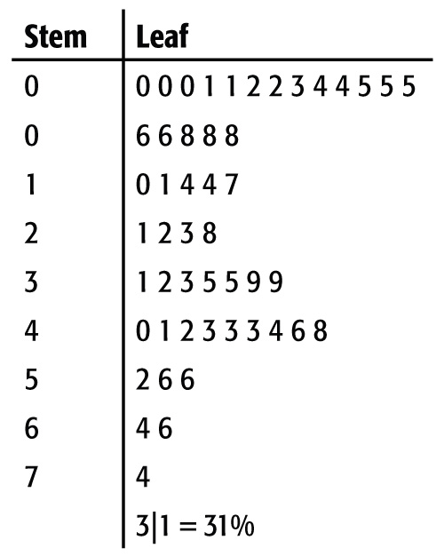
Interpret Data
MEXICO The stem-and-leaf plot lists the percent of people in each state in 2004 that were born in Mexico, rounded to the nearest whole number.

Slide 12
Interpret Data
A. Which interval contains the most percentages?
Answer: The 0 stem has the most leaves, so the 0-9% interval contains the most percentages.

Slide 13
Interpret Data
B. What is the greatest percent of people living in one U.S. state that were born in Mexico?
Answer: The highest stem is 7, and the highest leaf for that stem is 4. Therefore, 74% is the greatest percent of people living in one U.S. state that were born in Mexico.

Slide 14
Interpret Data
C. What is the median percent of people living in one U.S. state that were born in Mexico?
Answer: There are 49 percentages, so the 25th percentage, from least to greatest, is the median percent. The median percent is 22%.

Slide 15
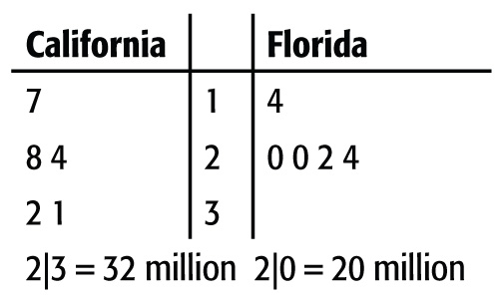
Compare Data
AGRICULTURE The yearly production of honey in California and Florida is shown for the years 2000 to 2004, in millions of pounds.

Slide 16
Compare Data
A. What state produces the most honey?
Add the number of pounds produced each year by each state.
California = 17 + 24 + 28 + 31 + 32 = 132 million pounds
Florida = 14 + 20 + 20 + 22 + 24 = 100 million pounds
Answer: So, California produced more honey than Florida.

Slide 17
Compare Data
B. Which state has the most varied production? Explain.
To determine how much the data vary, find the range for each state. To find the range, subtract the lowest value from the highest value for each state.
California: 32 – 17 = 15
Florida: 24 – 14 = 10
Answer: Since the range for California is higher, the data are more spread out. So, California has the most varied production.

Slide 18

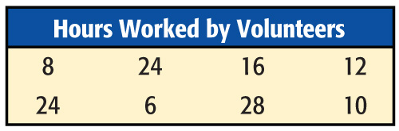
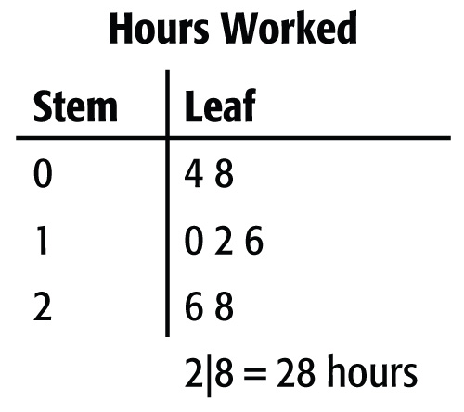
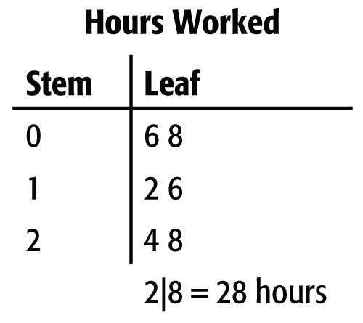
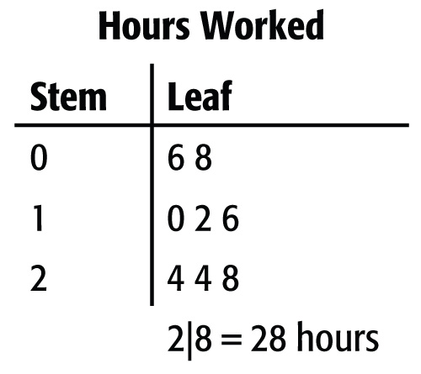
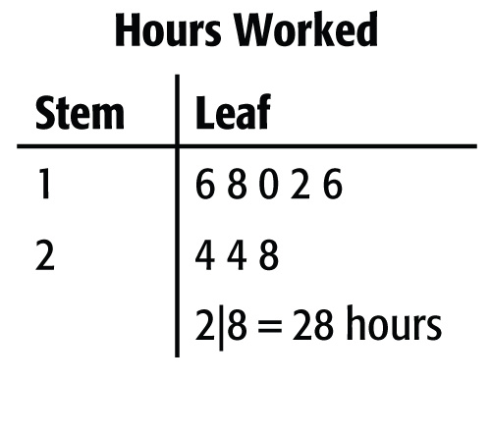
Which stem-and-leaf plot correctly displays the data?
A. B.
C. D.
A
B
C
D

Slide 19
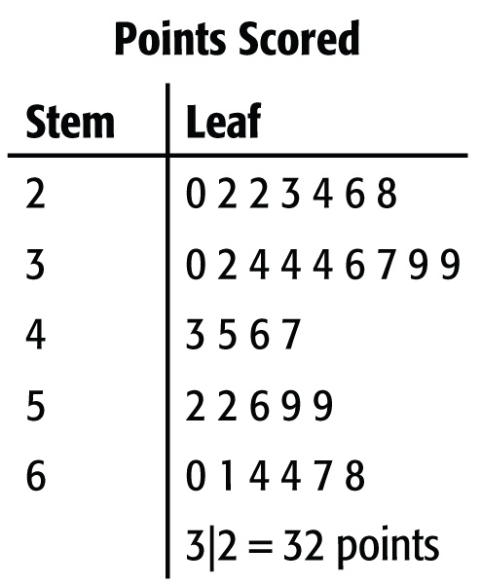
The stem-and-leaf plot shows the number of points scored by Janelle’s basketball team over the past two seasons. Which inference is true based on the data shown in the stem-and-leaf plot?
A. The range of the number of points scored is 40.
B. The greatest number of points the team has scored is 60.
C. The team has most often scored between 30 and 39 points.
D. The median number of points scored is 47.
A
B
C
D

Slide 20
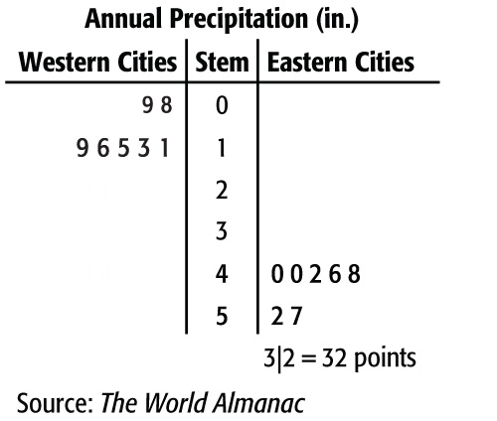
PRECIPITATION The total annual precipitation for a recent year is shown for various cities in the Eastern and Western United States. Which statement accurately compares the data?
A. The western cities received more precipitation per year than the eastern cities.
B. The data for the western cities are more spread out than the data for the eastern cities.
C. The median amount of precipitation is the same for the western and eastern cities.
D. The eastern cities received more precipitation per year than the western cities.
1|3 = 13” 4|6 = 46”
A
B
C
D

Slide 21





