Slide 1

Splash Screen
Chapter 11
Lesson 11-8

Slide 2





(over Lesson 11-4)
What is the median of the following set of data?
40, 50, 52, 33, 34, 37, 37, 43, 47
A. 37
B. 40
C. 40.5
D. 43
A
B
C
D

Slide 3

(over Lesson 11-5)
Find the range, median, upper and lower quartiles, interquartile range, and any outliers for the following set of data.
38, 31, 35, 17, 59, 32, 16, 41, 33, 39
A. 43; 34; 39; 31; 8; 16; 17; 59
B. 43; 35; 39; 31; 8; 16
C. 43; 35; 39; 31; 8; 59
D. 43; 34; 31; 39; 8; 16; 17; 59
A
B
C
D

Slide 4

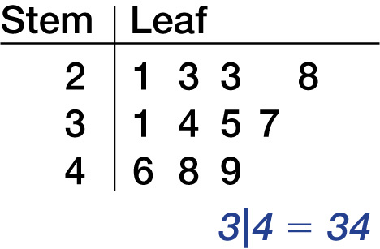
(over Lesson 11-5)
Find the interquartile range of the data shown in the stem-and-leaf plot.
A. 3
B. 6
C. 23
D. 25
A
B
C
D
3|4 = 34

Slide 5





(over Lesson 11-6)
Which choice shows a box-and-whisker plot for the following set of data? 51, 59, 67, 70, 76, 44, 52, 63, 69, 73, 99
A.
B.
C.
D.
A
B
C
D

Slide 6


(over Lesson 11-6)
Refer to the figure. Twenty-five percent of the data in the box-and-whisker plot is found between which two values?
A. 5 and 25
B. 20 and 35
C. 20 and 60
D. 35 and 60
A
B
C
D

Slide 7

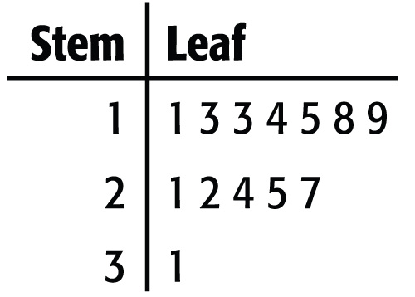
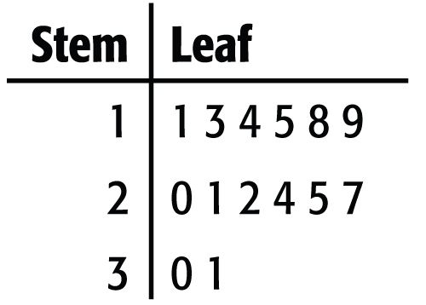
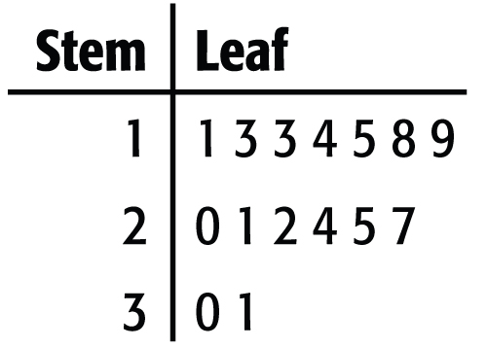
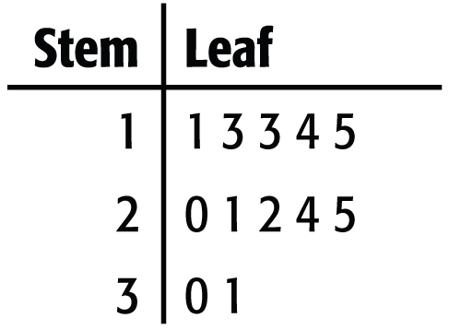
(over Lesson 11-7)
Make a stem-and-leaf plot of this list of hit totals for the girls’ softball team: 15, 18, 22, 11, 27, 24, 19, 13, 13, 21, 20, 31, 30, 25, 14
A. B.
C. D.
A
B
C
D

Slide 8

Select an appropriate display for a set of data.

Slide 9

Standard 7SDAP1.1 Know various forms of display for data sets, including stem-and-leaf plot or box-and-whisker plot; use the forms to display a single set of data or to compare two sets of data.

Slide 10

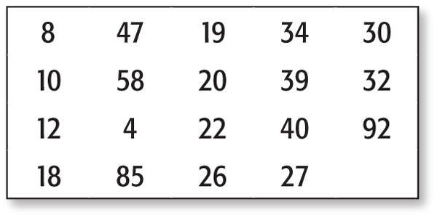

Select an Appropriate Display
So class, today I want you to use this data and display it into an appropriate graph.
Any questions?

Slide 11
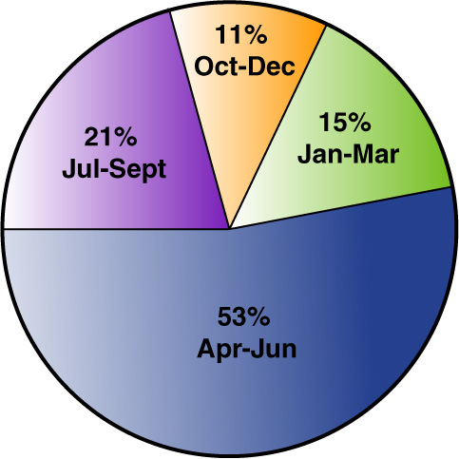
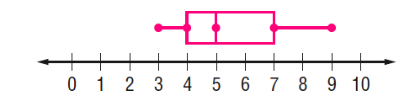
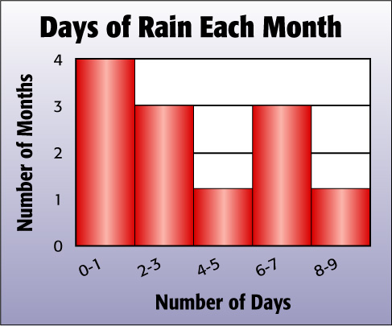

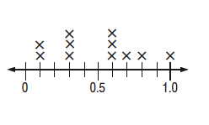
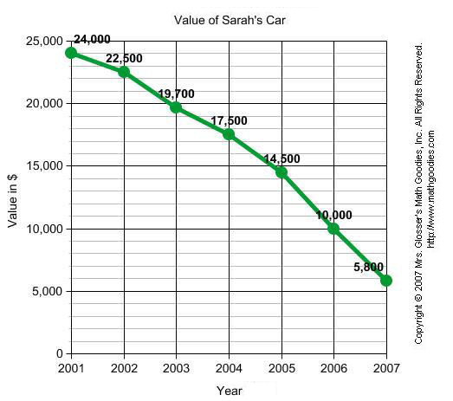
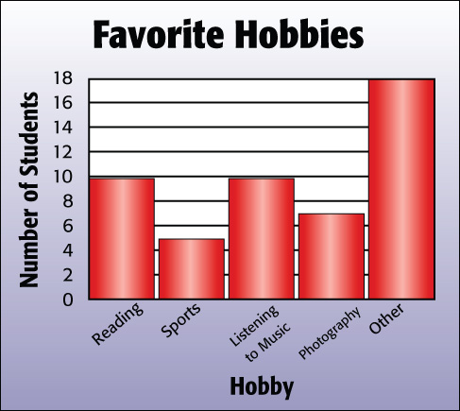
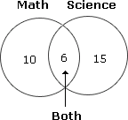
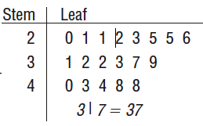
Yeah, I have a question. What’s the best graph to use?

Slide 12
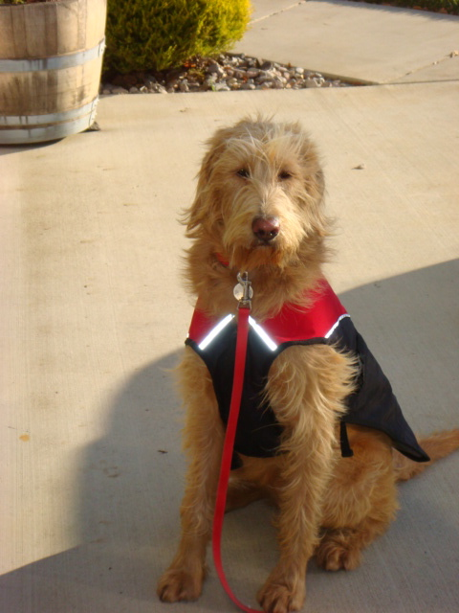
Select an Appropriate Display
Hey, I have an idea. I know someone that can help you out. Your teacher. Stay focused and they will show you the way!

Slide 13
Select an Appropriate Display
The local weather station reports that there were 4 months last year that recorded rain at least 1 day during the month, 3 months that had 2-3 days of rain, 1 month that had 4-5 days of rain, 3 months that had 6-7 days of rain, & 1 month that had 8-9 days of rain.
So which graph type is best for this data type?
Ok, write down your choice on your “Response Boards”.
- A Bar graph
- A Box-and-Whisker graph
- A Circle graph
That’s right, a Histogram because it shows frequency of data divided into equal intervals.
- A Histogram
- A Line graph
- A Line Plot
- A Stem-and-Leaf Plot
- A Venn Diagram

Slide 14
Select an Appropriate Display
The amount of money Mr. Mitchells’ NASA group class made collecting pennies was $20, $21, $21, $22, $23, $25, $25, $26, $31, $32, $32, $33, $37, $39, $40, $43, $44, $48, and $48.
So which graph type is best for this data type?
Ok, write down your choice on your “Response Boards”.
- A Bar graph
- A Box-and-Whisker graph
- A Circle graph
That’s right, a Stem-and-Leaf plot because it lists individual data in a condensed form.
- A Histogram
- A Line graph
- A Line Plot
- A Stem-and-Leaf Plot
- A Venn Diagram

Slide 15
Select an Appropriate Display
Last year at Evergreen Middle School, the cafeteria served the lunches to the following percentage of their students: 15% in Jan-Mar, 11% in Oct-Dec, 21% in Jul-Sept, and 53% in Apr-June.
So which graph type is best for this data type?
Ok, write down your choice on your “Response Boards”.
- A Bar graph
- A Box-and-Whisker graph
- A Circle graph
That’s right, a Circle Graph because it compares parts of the data to the whole (100%).
- A Histogram
- A Line graph
- A Line Plot
- A Stem-and-Leaf Plot
- A Venn Diagram

Slide 16
Select an Appropriate Display
In a recent poll, Evergreen Home School students reported that 10 spent free time reading, 5 spent their time playing sports, 10 spent most of their free time listening to music, 7 preferred photography, and 18 had a variety of interests.
So which graph type is best for this data type?
Ok, write down your choice on your “Response Boards”.
- A Bar graph
- A Box-and-Whisker graph
- A Circle graph
That’s right, a Bar Graph because it shows the number of items in specific categories.
- A Histogram
- A Line graph
- A Line Plot
- A Stem-and-Leaf Plot
- A Venn Diagram

Slide 17
Select an Appropriate Display
The growth pattern for an average 7th grader per month is .1”, .1”, .3”, .3”, .3”, .6”, .6”, .6”, .7”, .8”, .9”, and 1” per month.
So which graph type is best for this data type?
- A Bar graph
Ok, write down your choice on your “Response Boards”.
- A Box-and-Whisker graph
- A Circle graph
- A Histogram
That’s right, a Line Plot because it shows how many times each number occurs in the data.
- A Line graph
- A Line Plot
- A Stem-and-Leaf Plot
- A Venn Diagram

Slide 18
Select an Appropriate Display
Mr. Mitchell’s 7th grade students recent math/science scores are as follows: Math 10, Science 15, both Math and Science 6.
So which graph type is best for this data type?
Ok, write down your choice on your “Response Boards”.
- A Bar graph
- A Box-and-Whisker graph
That’s right, a Venn Diagram because it shows how elements among sets of data are related.
- A Circle graph
- A Histogram
- A Line graph
- A Line Plot
- A Stem-and-Leaf Plot
- A Venn Diagram

Slide 19
Select an Appropriate Display
A car depreciates (losses value) every year. Katey bought a car in 2001 for $24K. In 2002 it had depreciated to $22.5K, in 2003 to $19.7k, by 2004 to $17.5, by 2005 to $14.5K, by 2006K to $10K, and to 2007 by $5.8K.
So which graph type is best for this data type?
Ok, write down your choice on your “Response Boards”.
- A Bar graph
- A Box-and-Whisker graph
That’s right, a Line Graph because it shows change over a period of time.
- A Circle graph
- A Histogram
- A Line graph
- A Line Plot
- A Stem-and-Leaf Plot
- A Venn Diagram

Slide 20

Select an Appropriate Display
So which graph type is best for this data type?
Ok, write down your choice on your “Response Boards”.
- A Bar graph
- A Box-and-Whisker graph
- A Circle graph
- A Histogram
- A Line graph
- A Line Plot
- A Stem-and-Leaf Plot
- A Venn Diagram
That’s right, a Box-and-Whisker because it shows measures of variation for a data set.

Slide 21
So what’s the best one?

Slide 22
Select an Appropriate Display
You Be the Judge!
Bottom Line!

Slide 23
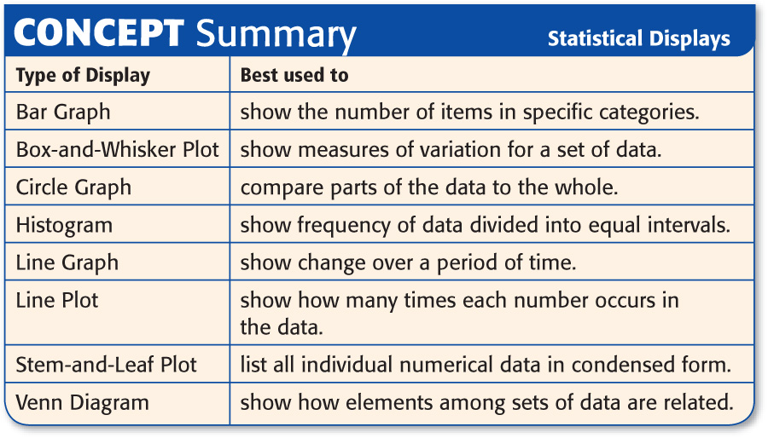

Slide 24
