Slide 1
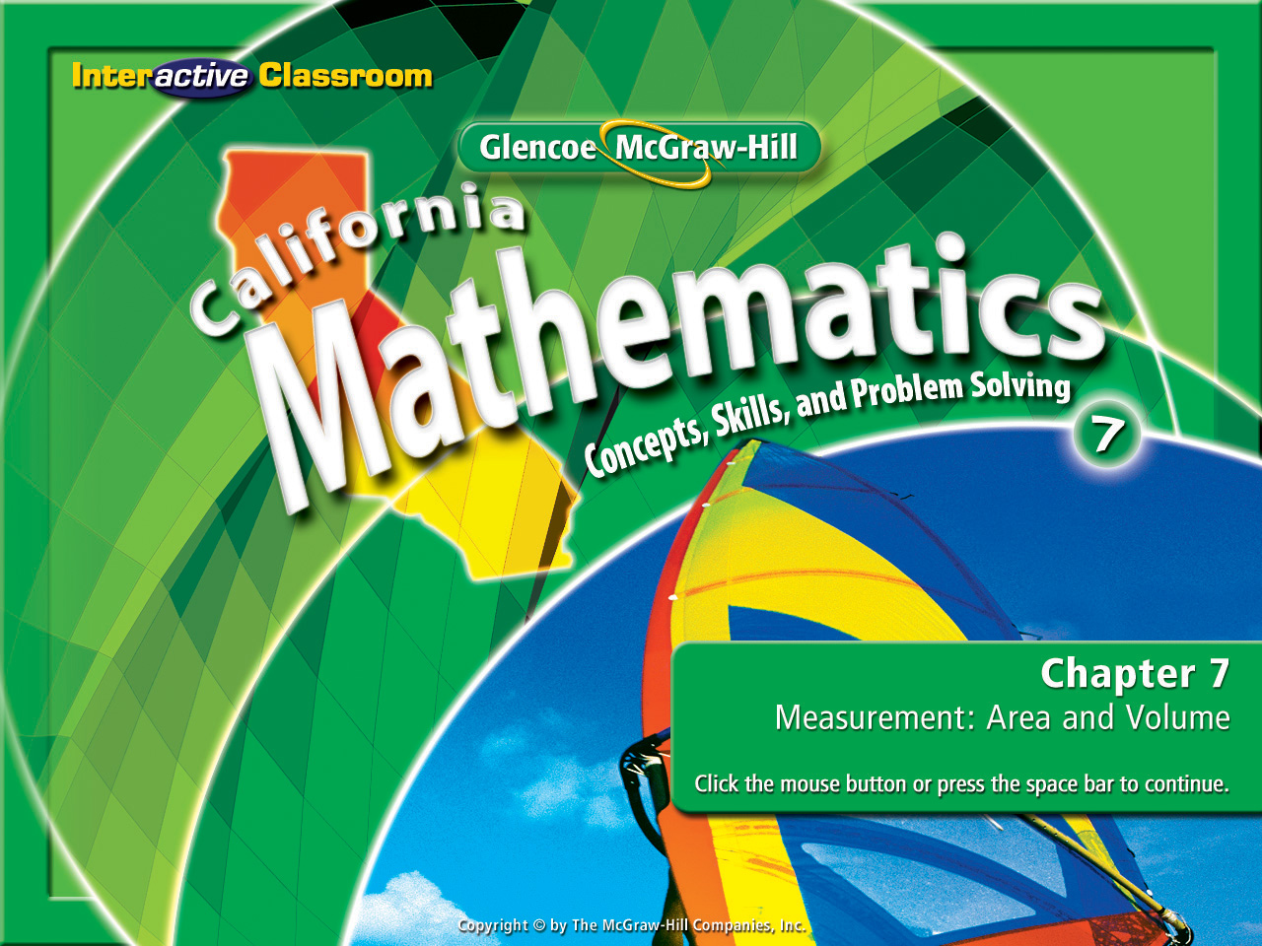
Splash Screen
Chapter 12
Lesson 12-1

Slide 2



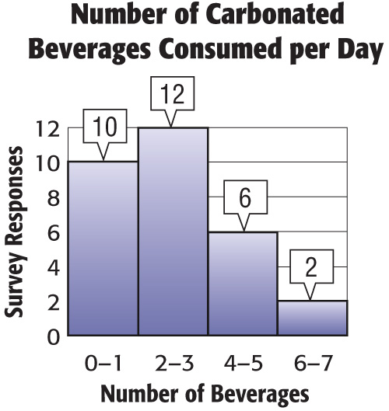




(over Chapter 11)
The histogram shows the number of carbonated beverages consumed per day. How many people were surveyed?
A. 22
B. 28
C. 30
D. 34
A
B
C
D

Slide 3


(over Chapter 11)
How many people drink more than 3 carbonated beverages per day?
A. 8
B. 6
C. 2
D. 12
A
B
C
D

Slide 4

(over Chapter 11)
What percentage of people drink 2–3 carbonated beverages per day?
A. 12%
B. 25%
C. 30%
D. 40%
A
B
C
D

Slide 5

(over Chapter 11)
Find the mean, median, and mode of the following set of data. 20, 27, 40, 17, 25, 33, 21
A. about 26.7; 25; none
B. about 26.7; 17; none
C. 30; 25; 25
D. 25; 17; none
A
B
C
D

Slide 6

(over Chapter 11)
Find the range of the following set of data. 20, 27, 40, 17, 25, 33, 21
A. 13
B. 23
C. 20
D. 16
A
B
C
D

Slide 7



(over Chapter 11)
Select an appropriate display for the number of people who prefer skiing to all of the winter sports.
A. histogram
B. box-and-whisker plot
C. circle graph
D. line graph
A
B
C
D

Slide 8


Count outcomes by using a tree diagram or the Fundamental Counting Principle.
outcome
event
sample space
tree diagram
Fundamental Counting Principle
probability
random

Slide 9


Reinforcement of Standard 6SDAP3.1 Represent all possible outcomes for compound events in an organized way (e.g., tables, grids, tree diagrams) and express the theoretical probability of each outcome. (CAHSEE)

Slide 10

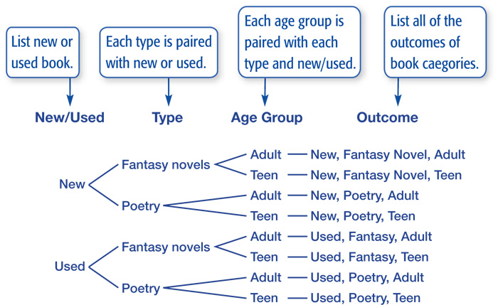
Use a Tree Diagram
A flea market vendor sells new and used books for adults and teens. Today she has fantasy novels and poetry collections to choose from. Draw a tree diagram to determine the number of categories of books.

Slide 11
Use a Tree Diagram
Answer: There are 8 different categories.

Slide 12
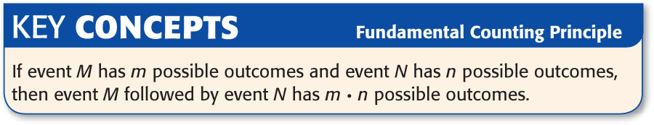
Multiplying possible outcomes is called the:
Fundamental Counting Principle

Slide 13

A manager assigns different codes to all the tables in a restaurant to make it easier for the wait staff to identify them. Each code consists of the vowel A, E, I, O, or U, followed by two digits from 0 through 9. How many codes could the manager assign using this method?
Find the number of possible outcomes. Use the Fundamental Counting Principle.
number of possible letters for the first place
number of possible digits for the second place
number of possible digits for the third place
number of possible codes
x
x
=
5
x
10
x
10
=
500
Answer: There are 500 possible codes.

Slide 14
Find Probability
What is the probability that Liana will guess her friend’s computer password on the first try if all she knows is that it consists of three letters?
Find the number of possible outcomes. Use the Fundamental Counting Principle.
choices for the first letter
choices for the second letter
choices for the third letter
total number of outcomes
x
x
=
26
x
26
x
26
=
17,576

Slide 15
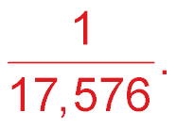
Find Probability
Answer: There are 17,576 possible outcomes. There is
1 correct password. So, the probability of
guessing on the first try is

Slide 16

A store has spring outfits on sale. You can choose either striped or solid pants. You can also choose green, pink, or orange shirts. Finally, you can choose either long-sleeved shirts or short-sleeved shirts. Draw a tree diagram to determine the number of possible outfits.

Slide 17
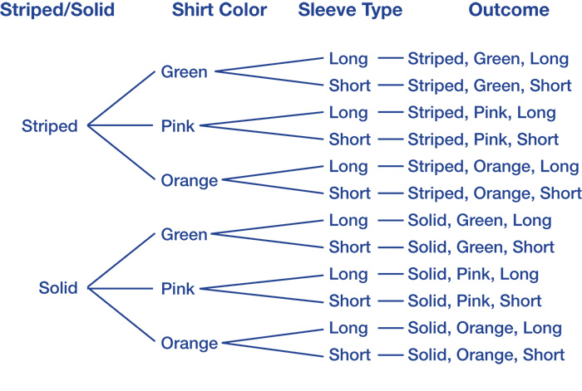
Answer: 12 different outfits.

Slide 18
A middle school assigns each student a code to use for scheduling. Each code consists of a letter, followed by two digits from 0 through 9. How many codes are possible? Use the Fundamental Counting Principle to solve this.
A. 2,600
B. 2,950
C. 3,400
D. 3,800
A
B
C
D

Slide 19
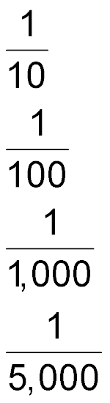
What is the probability that Shauna will guess her friend’s locker combination on the first try if all she knows is that it consists of three digits from 0 through 9? Use the Fundamental Counting Principle to solve this.
A.
B.
C.
D.
A
B
C
D

Slide 20
