Slide 1

Splash Screen
Chapter 12
Lesson 12-2

Slide 2




(over Lesson 12-1)
Determine the number of outcomes using a tree diagram. Two number cubes are rolled.
A. 12 outcomes
B. 24 outcomes
C. 36 outcomes
D. 72 outcomes
A
B
C
D

Slide 3

(over Lesson 12-1)
Determine the number of outcomes using a tree diagram. Four kinds of candy come in either red, blue, or yellow wrappers.
A. 7 outcomes
B. 12 outcomes
C. 16 outcomes
D. 24 outcomes
A
B
C
D

Slide 4

(over Lesson 12-1)
Use the Fundamental Counting Principle to find the number of possible outcomes. A month of the year is picked at random and a quarter is flipped.
A. 24 outcomes
B. 36 outcomes
C. 72 outcomes
D. 144 outcomes
A
B
C
D

Slide 5

(over Lesson 12-1)
Use the Fundamental Counting Principle to find the number of possible outcomes. A 4-digit code is created using the numbers 0–6.
A. 28 outcomes
B. 784 outcomes
C. 2,401 outcomes
D. 16,384 outcomes
A
B
C
D

Slide 6


Find the probability of independent and dependent events.
compound event
independent events
dependent events

Slide 7


Reinforcement of Standard 6SDAP3.1 Represent all possible outcomes for compound events in an organized way (e.g., tables, grids, tree diagrams) and express the theoretical probability of each outcome. (CAHSEE)

Slide 8
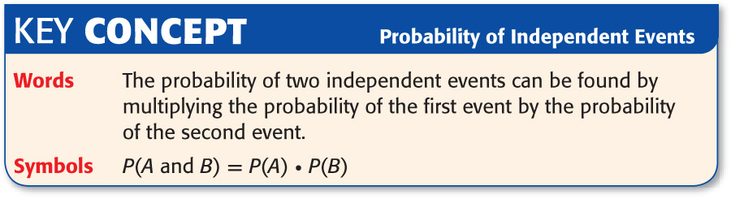
2
3
1
These are two independent events. The color that the spinner lands on does not depend on the number that is rolled.

Slide 9

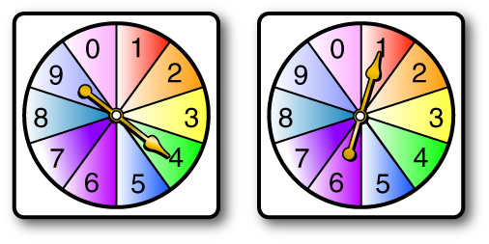
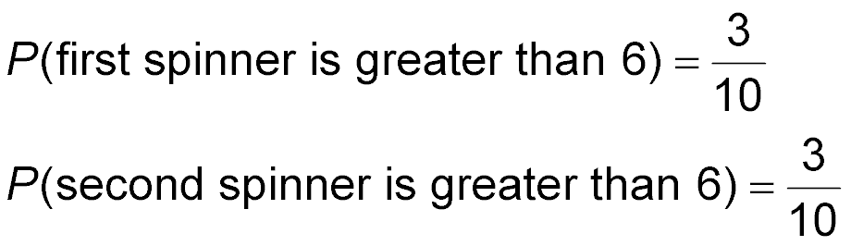
Probability of Independent Events
The two spinners below are spun. What is the probability that both spinners will show a number greater than 6?

Slide 10
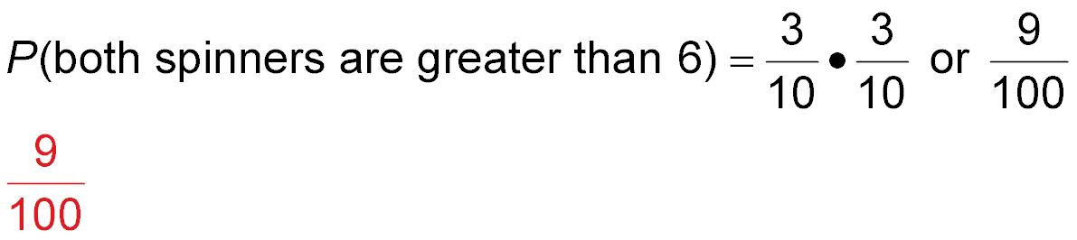
Probability of Independent Events
Answer:

Slide 11

Use Probability to Solve a Problem
A red number cube and a white number cube are rolled. The faces of both cubes are numbered from 1 to 6. What is the probability of rolling a 3 on the red number cube and rolling the number 3 or less on the white number cube?
2
2
3
1
3
1
Read the Item
You are asked to find the probability of rolling a 3 on the red number cube and rolling a number 3 or less on the white number cube. The events are independent because rolling one number cube does not affect rolling the other cube.

Slide 12
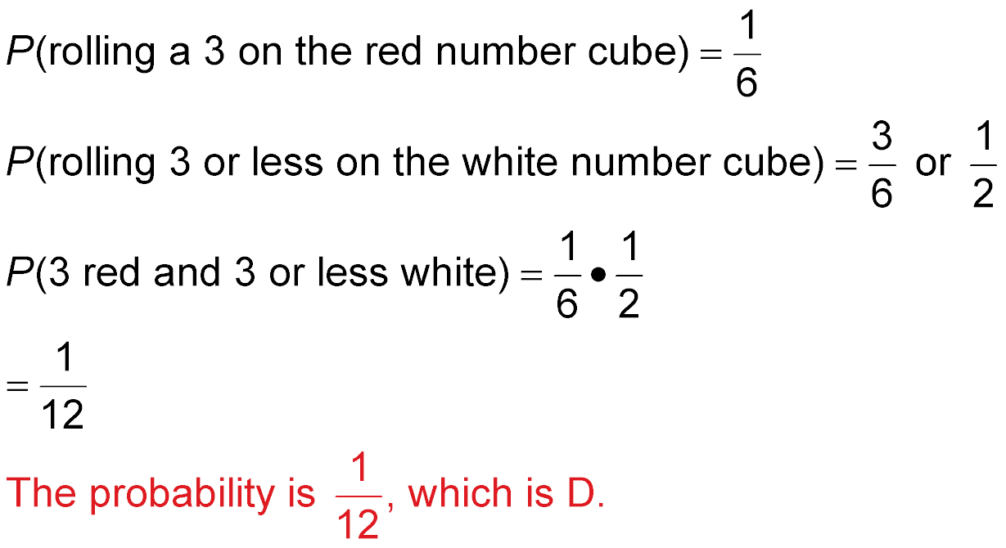
Use Probability to Solve a Problem
2
3
1
Solve the Item
First, find the probability of each event.
2
3
1
Then, find the probability of both events occurring.
P(A and B) = P(A) ● P(B)
Multiply.

Slide 13

Use Probability to Solve a Problem
2
2
3
1
3
1
A B C D
Answer:

Slide 14
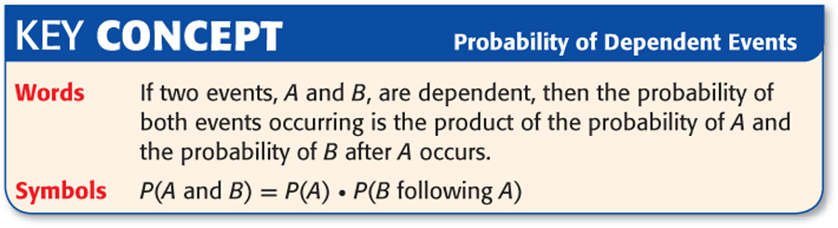
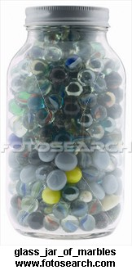
There are 50 marbles in the jar. If a marble is pulled out, the chances of pulling a gray one out is dependent upon what color of marble was pulled out the first time. Therefore, these are dependent events.

Slide 15



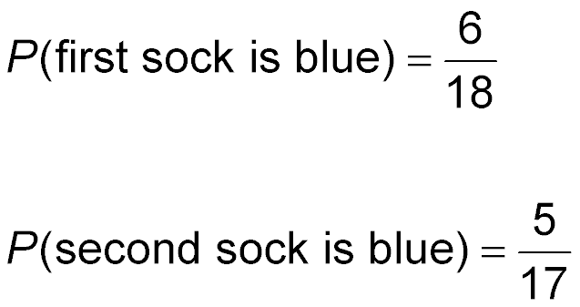
Probability of Dependent Events
There are 4 pink, 8 yellow, and 6 blue socks mixed up in a drawer. Once a sock is selected, it is not replaced. Find the probability of reaching into the drawer without looking and choosing 21 blue sock.
Since the first sock is not replaced, the first event affects the second event. These are dependent events.
number of blue socks
total number of socks

Slide 16
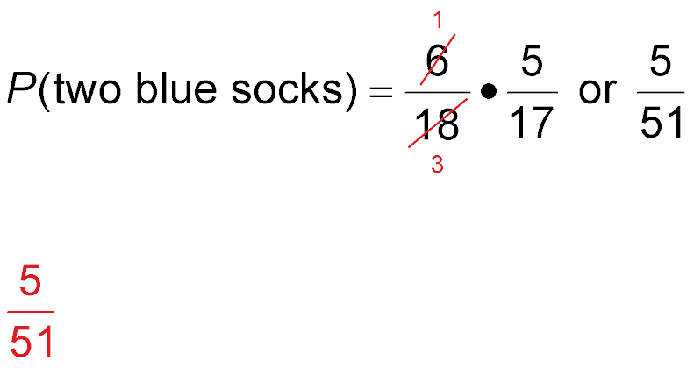
Probability of Dependent Events
number of blue socks after one blue sock is removed
total number of socks after one blue sock is removed
Answer:

Slide 17

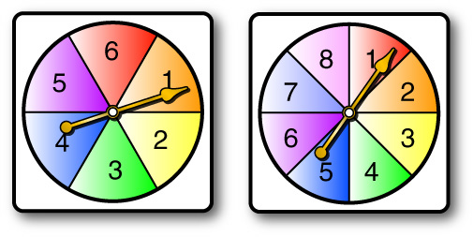

The two spinners below are spun. What is the probability that both spinners will show a number less than 4?
A. B.
C. D.
A
B
C
D

Slide 18

A white number cube and a green number cube are rolled. The faces of both cubes are numbered from 1 to 6. What is the probability of rolling an even number on the white number cube and rolling a 3 or a 5 on the green number cube?
A. B.
C. D.
A
B
C
D

Slide 19

There are 6 green, 9 purple, and 3 orange marbles in a bag. Once a marble is selected, it is not replaced. Find the probability that two purple marbles are chosen.
A.
B.
C.
D.
A
B
C
D

Slide 20
