Slide 1
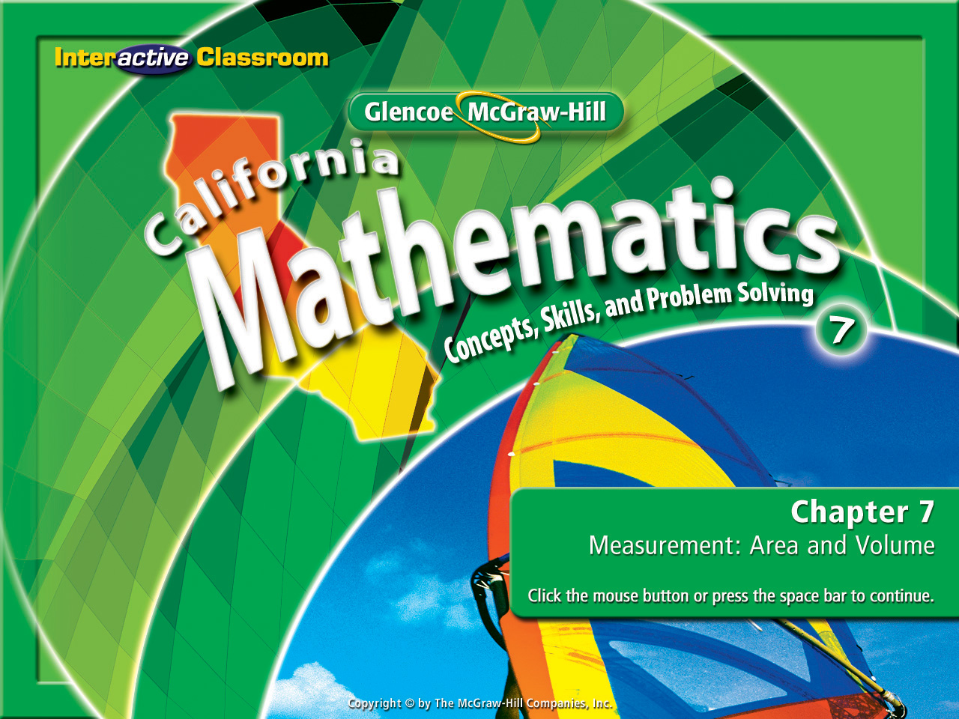
Splash Screen
Chapter 12
Lesson 12-3

Slide 2







(over Lesson 12-1)
A university gives each student an ID number with 2 letters (A–Z) followed by 3 digits (0–9). How many possible ID numbers are there?
A. 352 possible ID numbers
B. 1,676 possible ID numbers
C. 15,600 possible ID numbers
D. 676,000 possible ID numbers
A
B
C
D

Slide 3



(over Lesson 12-1)
Lindsey and Barbara are going to a pizza shop. They can order a pepperoni, sausage, Canadian bacon, or hamburger pizza. The pizzas can be made thin, regular, or thick crust. How many different pizzas can they order?
A. 3
B. 4
C. 12
D. 64
A
B
C
D

Slide 4



(over Lesson 12-2)
A day of the week is picked at random and a number cube is tossed. Find P(begins with S and 4).
A.
B.
C.
D.
A
B
C
D

Slide 5


(over Lesson 12-2)
A day of the week is picked at random and a number cube is tossed. Find P(Wednesday and 3).
A.
B.
C.
D.
A
B
C
D

Slide 6


(over Lesson 12-2)
A bag of pencils has 3 red, 5 blue, and 8 yellow pencils. Find P(red then blue) if each pencil selected is not returned to the bag.
A.
B.
C.
D.
A
B
C
D

Slide 7


Find experimental and theoretical probabilities and use them to make predictions.
experimental probability
theoretical probability

Slide 8


Reinforcement of Standard 6SDAP3.3 Represent probabilities as ratios, proportions, decimals between 0 and 1, and percentages between 0 and 100 and verify that the probabilities computed are reasonable; know that if P is the probability of an event, 1 – P is the probability of an event not occurring. (CAHSEE)

Slide 9

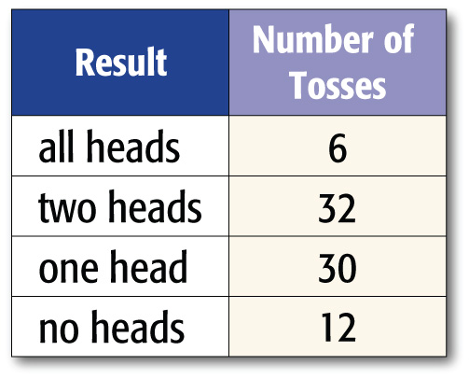
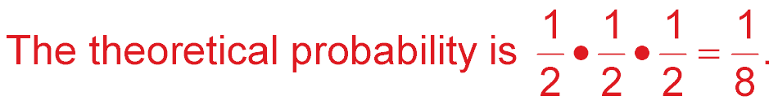
Theoretical and Experimental Probability
Nikki is conducting an experiment to find the probability of getting various results when three coins are tossed. The results of her experiment are given below. What is the theoretical probability of tossing all heads on the next turn?
Answer:

Slide 10
Theoretical and Experimental Probability
Nikki continues her experiment to find the probability of getting various results when three coins are tossed. The results of her experiment are given below. According to the experimental probability, is Nikki more likely to get all heads or no heads on her next toss?

Slide 11
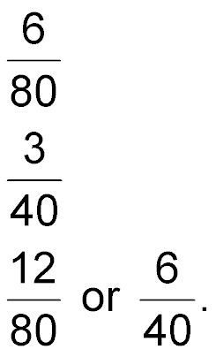
Is Nikki more likely to get all heads or no heads on her next toss?
Examine the table. Out of 80 trials, flipping all heads
occurred 6 times, and flipping no heads occurred 12
times. So, the experimental probability of flipping all
heads is or . And the experimental probability of
flipping no heads is
Answer: Nikki is more likely to get no heads on her next toss.

Slide 12

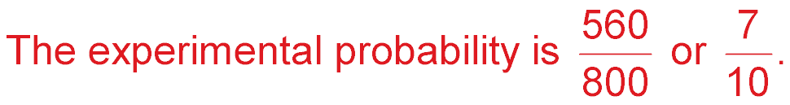
MARKETING Eight hundred adults were asked whether they were planning to stay home for winter vacation. Of those surveyed, 560 said that they were. What is the experimental probability that an adult planned to stay home for winter vacation?
There were 800 people surveyed and 560 said that they were staying home.
Answer:

Slide 13
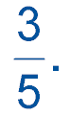
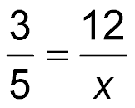
Use Probability to Predict
MATH TEAM Over the past three years, the probability
that the school math team would win a meet is
Is this probability experimental or theoretical? If
the team wants to win 12 more meets in the next 3
years, how many meets should the team enter?
This problem can be solved using a proportion.
3 out of 5 meets were wins
12 out of x meets should be wins.
Solve the proportion.

Slide 14
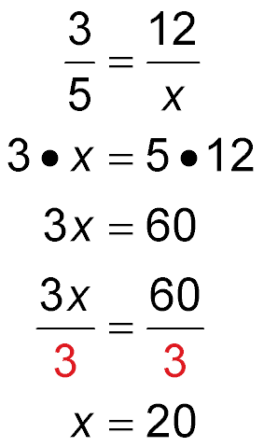
Use Probability to Predict
Write the proportion.
Find the cross products.
Multiply.
Divide each side by 3.
Answer: This is an experimental probability since it is based on actual results. They should enter 20 meets.

Slide 15

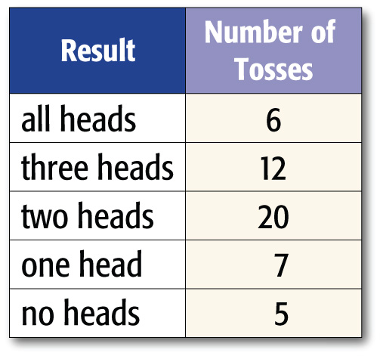

Marcus is conducting an experiment to find the probability of getting various results when four coins are tossed. The results of his experiment are given below. What is the theoretical probability of tossing all tails on the next turn?
A. B.
C. D.
A
B
C
D

Slide 16
Marcus is conducting an experiment to find the probability of getting various results when four coins are tossed. The results of his experiment are given below. According to the experimental probability, is Marcus more likely to get all heads or no heads on his next toss?
A. all heads
B. no heads
A
B

Slide 17
MARKETING Five hundred adults were asked whether they were planning to stay home for New Year’s Eve. Of those surveyed, 300 said that they were. What is the experimental probability that an adult planned to stay home for New Year’s Eve?
A.
B.
C.
D.
A
B
C
D

Slide 18
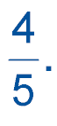
A. SPEECH AND DEBATE Over the past three years,
the probability that the school speech and debate
team would win a meet is Is this probability
experimental or theoretical?
A. experimental
B. theoretical
A
B

Slide 19
B. SPEECH AND DEBATE Over the past three years,
the probability that the school speech and debate
team would win a meet is If the team wants to win
20 more meets in the next 3 years, how many meets
should the team enter?
A
B
C
D
A. 16 meets B. 18 meets
C. 20 meets D. 25 meets

Slide 20
