Slide 1
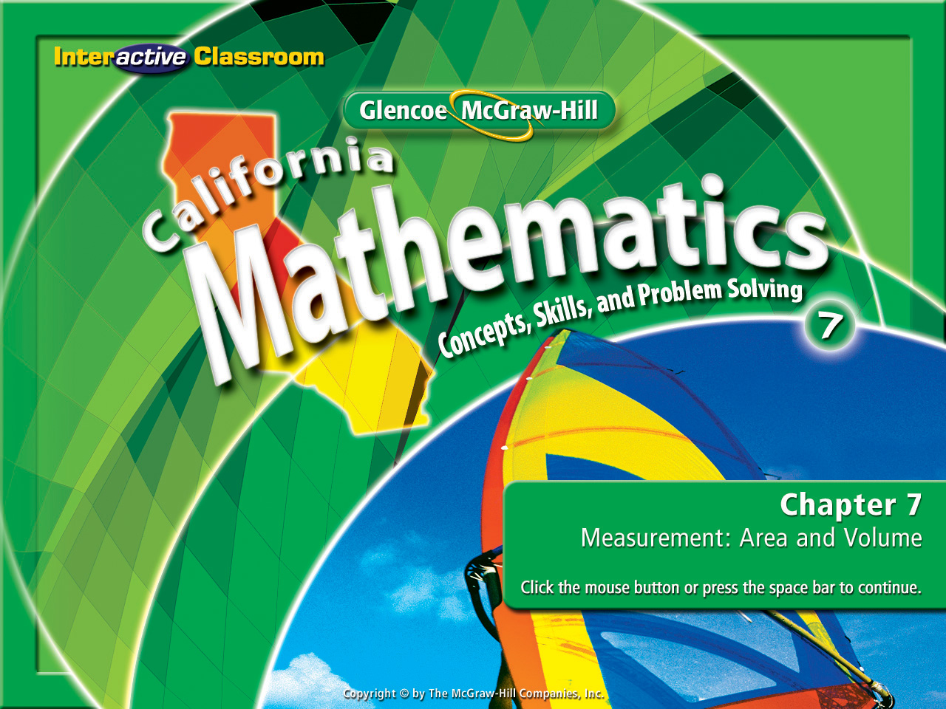
Splash Screen
Chapter 12
Lesson 12-5

Slide 2




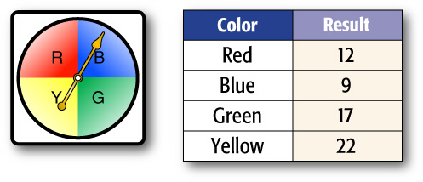



(over Lesson 12-3)
The figure shows a spinner and a table that displays the results of spinning the spinner. Based on the theoretical probability, how many times would you expect to spin yellow in 300 spins?
A. 60 times B. 75 times
C. 110 times D. 120 times
A
B
C
D

Slide 3


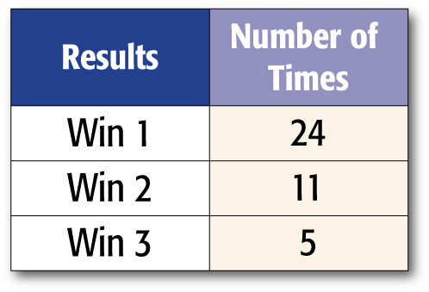

(over Lesson 12-3)
Roseanna recorded the results in the table shown using a spinner with 8 equal-sized sections. How many of the sections do you predict are labeled "Win 1?"
A. 1 B. 3
C. 5 D. 7
A
B
C
D

Slide 4


(over Lesson 12-4)
Roberto wants to buy a soda from the concession stand at a football game. The soda costs $0.50. If Roberto uses exact change, in how many different ways can he use nickels, dimes, and quarters? Solve using the act it out strategy.
A. 8 combinations
B. 10 combinations
C. 12 combinations
D. 14 combinations
A
B
C
D

Slide 5

(over Lesson 12-4)
Latasha has 5 different pictures that she wants to display on her bookshelf from left to right. She always wants to have the picture of her dog to be the first picture on the left. How many different ways can she arrange the pictures? Solve using the act it out strategy.
A. 90 combinations
B. 25 combinations
C. 20 combinations
D. 24 combinations
A
B
C
D

Slide 6

(over Lesson 12-4)
A coffee shop sells 4 different specialty coffees. If they sell their coffee in 3 different sizes, how many different cups of coffee can they sell? Solve using the act it out strategy.
A. 6 cups
B. 7 cups
C. 12 cups
D. 14 cups
A
B
C
D

Slide 7

(over Lesson 12-4)
The dimensions of a swimming pool are 50 m x 25 m. James decides to swim around the perimeter of the pool and then one lap lengthwise across the pool. If he continues this pattern, how far will he have swum after 12 rotations? Solve using the act it out strategy.
A
B
C
D
A. 1,200 m
B. 2,400 m
C. 3,000 m
D. 3,600 m

Slide 8


Predict the actions of a larger group by using a sample.
sample
systematic random sample
biased sample
convenience sample
voluntary response sample
population
unbiased sample
simple random sample
stratified random sample

Slide 9


Reinforcement of Standard 6SDAP2.5 Identify claims based on statistical data and, in simple cases, evaluate the validity of the claims. (CAHSEE)

Slide 10
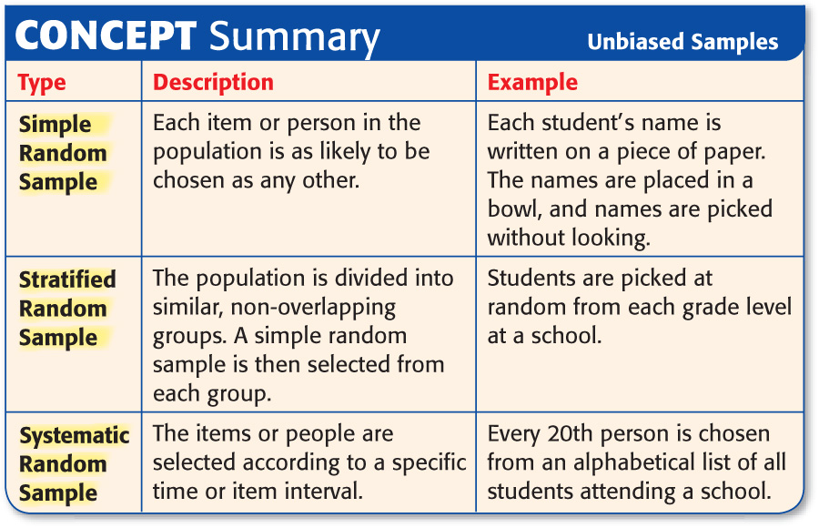

Slide 11
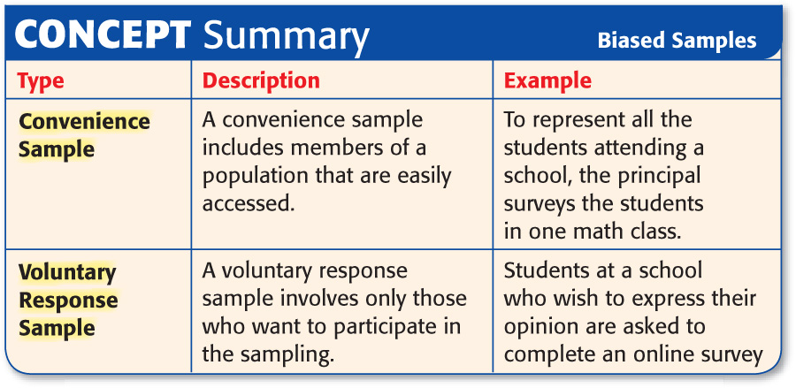

Slide 12

Determine Validity of Conclusions
Determine whether the conclusion is valid. Justify your answer. To determine which school lunches students like most, the cafeteria staff surveyed every tenth student who walked into the cafeteria. Out of 40 students surveyed, 19 students stated that they liked the burgers best. The cafeteria staff concluded that about 50% of the students like burgers best.
Answer: The conclusion is valid. Since the population is the students of the school, the sample is a systematic random sample. It is an unbiased sample.

Slide 13

Determine whether the conclusion is valid. Justify your answer. To determine what ride is most popular, every tenth person to walk through the gates of a theme park is surveyed. Out of 290 customers, 98 stated that they prefer The Zip. The park manager concludes that about a third of the park’s customers prefer The Zip.
Answer: The conclusion is valid. Since the population is the customers of the theme park, the sample is a systematic random sample. It is an unbiased sample.

Slide 14
Determine Validity of Conclusions
Determine whether the conclusion is valid. Justify your answer. To determine what sports teenagers like, Janet surveyed the student athletes on the girls’ field hockey team. Of these, 65% said that they like field hockey best. Janet concluded that over half of teenagers like field hockey best.
Answer: The conclusion is not valid. The students surveyed probably prefer field hockey. This is a biased sample. The sample is a convenience sample because the people are easily accessed.

Slide 15
Determine whether the conclusion is valid. Justify your answer. To determine whether people prefer dogs or cats, a researcher surveys 80 people at a dog park. Of those surveyed, 88% said that they prefer dogs, so the researcher concluded that most people prefer dogs.
Answer: The conclusion is not valid. People at a dog park probably prefer dogs. This is a biased sample. The sample is a convenience sample because the people are easily accessed.

Slide 16

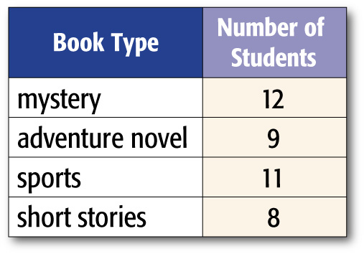
Using Sampling to Predict
BOOKS The student council is trying to decide what types of books to sell at its annual book fair to help raise money for the eighth grade trip. It surveyed 40 students at random. The books they prefer are in the table. If 220 books are to be sold at the book fair, how many should be mysteries?
First, determine whether the sample method is valid. The sample is a simple random sample since students were randomly selected. Thus, the sample is valid.
0.30 × 220 = 66
Answer: About 66 books should be mysteries.

Slide 17
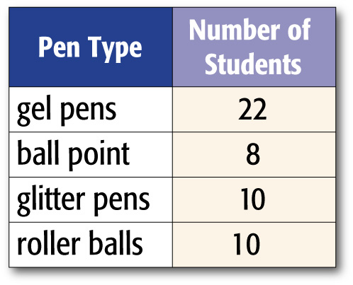
PENS The student shop sells pens. It surveys 50 students at random. The pens they prefer are in the table. If 300 pens are to be sold at the student shop, how many should be gel pens?
A. 96
B. 114
C. 125
D. 132
A
B
C
D

Slide 18
