Slide 1
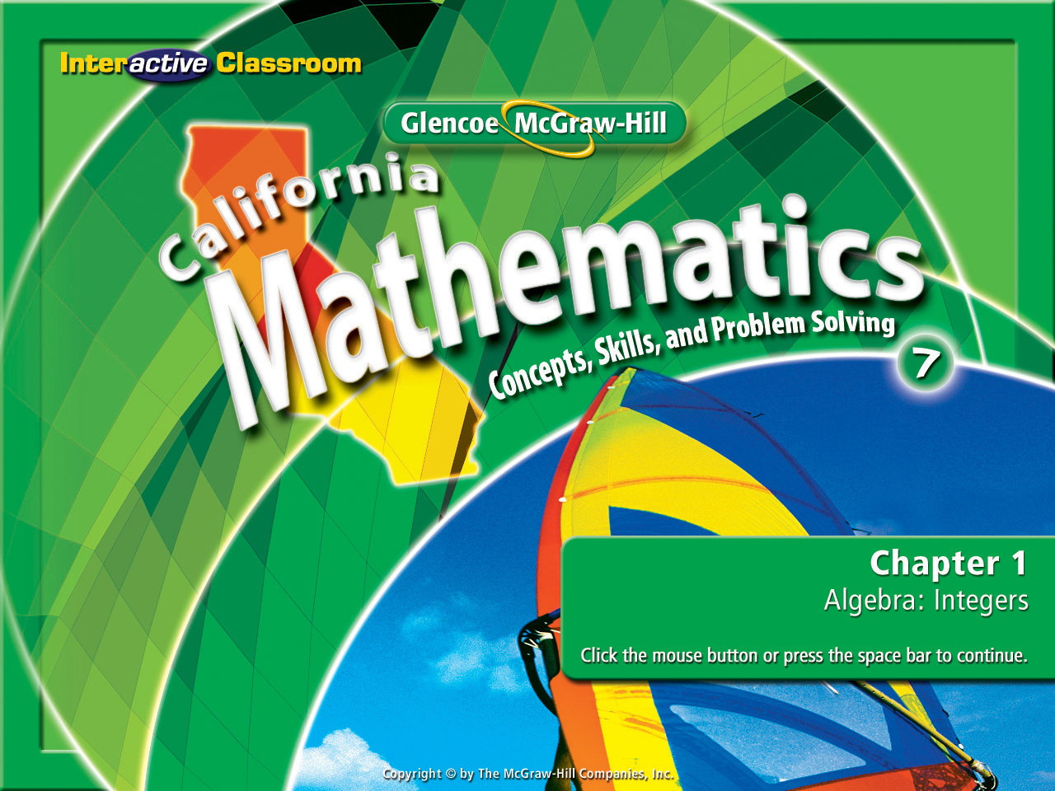
Splash Screen
Lesson 1-10
Solving Multiplication & Division Equations

Slide 2







(over Lesson 1-5)
Evaluate the expression –a – |b| – c if a = 3, b = -5, c = 8
A. 8
B. 16
C. –16
D. –8
A
B
C
D

Slide 3

(over Lesson 1-5)
Evaluate the expression a + c + b if a = –1, b = -6, and c = –2
A. -3
B. 9
C. 3
D. –9
A
B
C
D

Slide 4


(over Lesson 1-9)
A. 10
B. 4
C. –4
D. –10
A
B
C
D

Slide 5

(over Lesson 1-9)
A. 15
B. 11
C. –11
D. –15
A
B
C
D

Slide 6

(over Lesson 1-9)
A. 13
B. 5
C. –5
D. –13
A
B
C
D

Slide 7

(over Lesson 1-9)
A. –39
B. –17
C. 17
D. 39
A
B
C
D

Slide 8




(over Lesson 1-9)
7
If you increase a number by 9, the result is 26. Write and solve an equation to find the number.
A.
B.
C.
D.
A
B
C
D

Slide 9


(over Lesson 1-9)
Pam opened a checking account with $200. Then she wrote a check for $125. What is the current balance in Pam’s checking account?
8
A. –$33
B. $75
C. $83
D. $325
A
B
C
D

Slide 10


Solve equations by using inverse operations (division will cancel out multiplication and multiplication will cancel out division (÷).
solve
Finding the value of a variable to make the equation true.
solution
The value of a variable.
inverse operations
The opposite operation that will “undo” the other. Subtraction will “undo” addition & addition will “undo” subtraction.

Slide 11

Reinforcement of Standard 6AF1.1 Write and solve one-step linear equations in one variable.

Slide 12
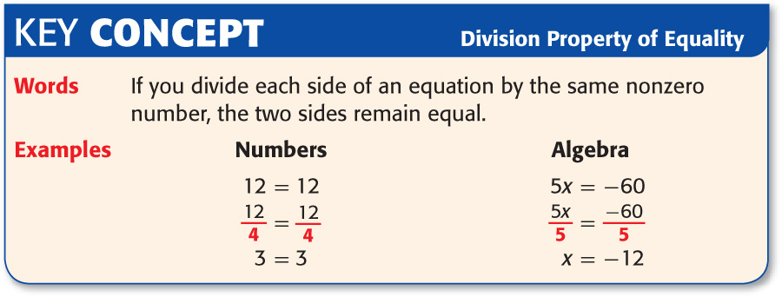

Slide 13
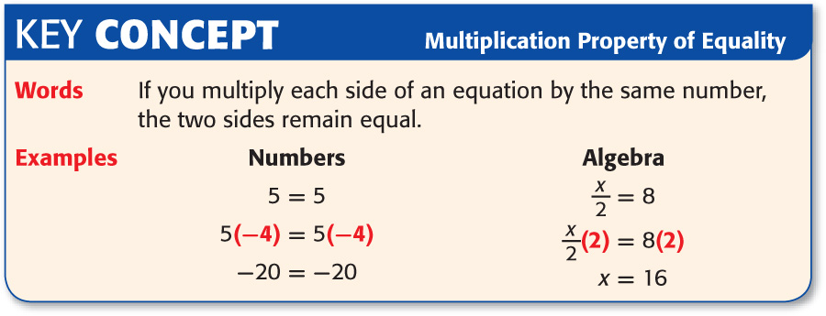

Slide 14

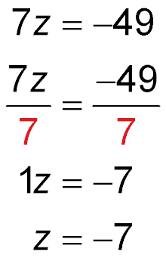
Solve a Multiplication Equation
Solve 7z = –49.
Write the equation.
Divide each side of the equation by 7.
Dividing 7 by 7, cancels out the 7 isolating the variable z by itself.
Dividing a -49 by 7 leaves a -7.
Answer: The solution to the variable z is –7.

Slide 15
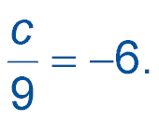
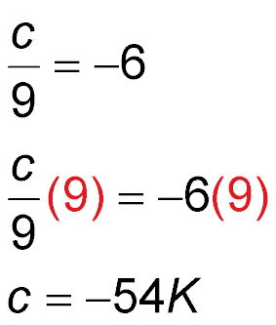
Solve a Division Equation
Solve
Write the equation
Multiply each side by 9.
Multiplying 9 times the divisor 9 cancels it out isolating the variable c by itself.
Multiplying 9 times the 6 gives you the solution for the variable c.
Answer: The solution is –54.

Slide 16

SURVEYING English mathematician Edmund Gunter lived around 1600. He invented the chain, which was used as a unit of measure for land and deeds. One chain equals 66 feet. If the south side of a property measures 330 feet, how many chains long is it?
Words One chain equals 66 feet.
Variable Let c = the number of chains in 330 feet.
Equation 330 = 66c

Slide 17
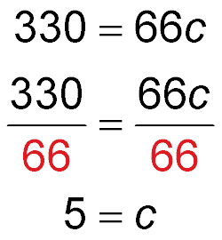
Write the equation.
Divide each side by 66 which will isolate the variable and find its’ solution.
Dividing 66 by 66, cancels out the 66 isolating the variable c by itself.
Dividing 330 by 66 leaves 5.
Answer: The number of chains in 330 feet is 5, the solution for c is 5.

Slide 18

Solve 8a = –64.
Think: “How can I cancel out the 8 in order to isolate the variable a by itself?”
A. –8
B. –6
C. 4
D. 8
A
B
C
D

Slide 19
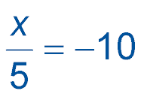
Solve .
Think: “How can I cancel out the divisor 5 and isolate the variable x by itself?”
A. 50
B. 2
C. –2
D. –50
A
B
C
D

Slide 20
HORSES Most horses are measured in hands. One hand equals 4 inches. If a horse measures 60 inches, how many hands is it?
A. 12 hands
B. 15 hands
C. 225 hands
D. 240 hands
4h = 60
A
B
C
D

Slide 21




