Slide 1
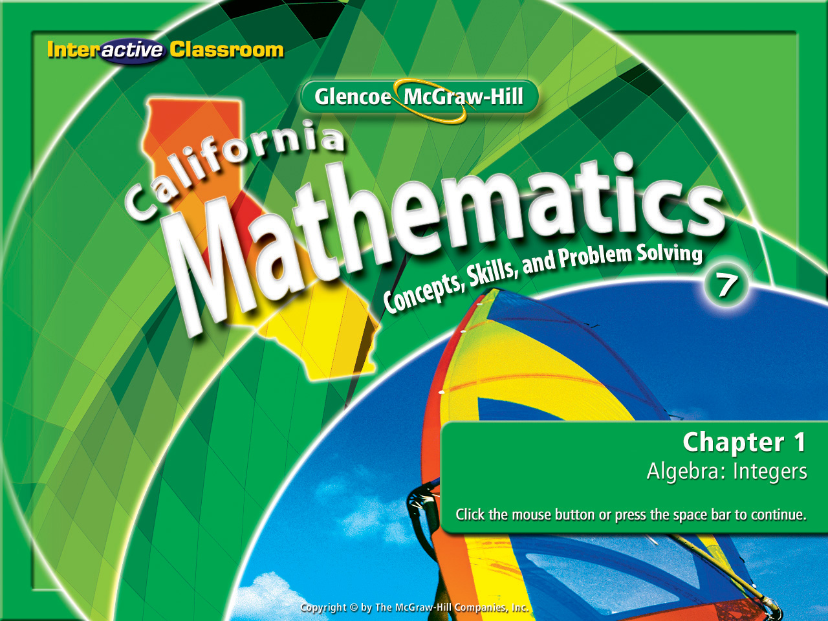
Splash Screen

Slide 2







Determine whether 29 is a prime or composite number.
A. composite
B. prime
A
B

Slide 3


Determine whether 36 is a prime or composite number.
A. composite
B. prime
A
B

Slide 4

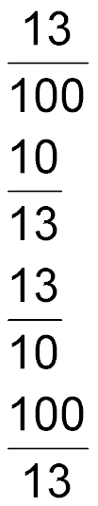
Write 13 percent as a fraction in simplest form.
A.
B.
C.
D.
A
B
C
D

Slide 5

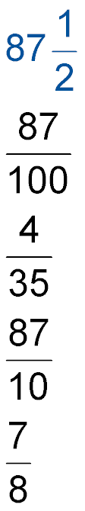
A company’s sales increase 87%. Write this percent as a fraction in simplest form.
A.
B.
C.
D.
A
B
C
D

Slide 6



The original price of a DVD was $30. The sale price is $24. What is the percent of decrease?
A. 10 percent
B. 15 percent
C. 20 percent
D. 25 percent
A
B
C
D

Slide 7


Evaluate expressions and identify properties.
variable
algebraic expression
numerical expression
order of operations
addition & multiplication properties

Slide 8


Standard 7AF1.2 Use the correct order of operations to evaluate algebraic expressions such as 3(2x + 5)².
Standard 7AF1.3 Simplify numerical expressions by applying properties of rational numbers (e.g. identity, distributive, associative, commutative) and justify the process used.
Standard 7AF1.4 Use algebraic terminology
(e.g. variable, equation, term, coefficient, inequality, expression, constant) correctly.

Slide 9
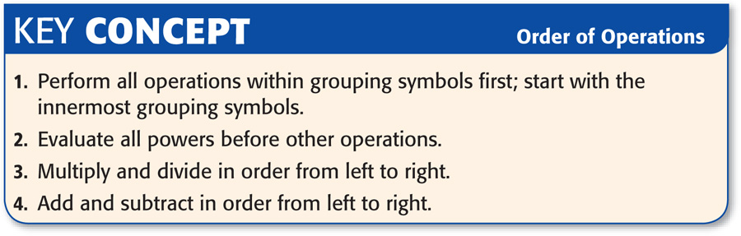
Remember:
Parenthesis,
Exponents,
Multiplication or Division,
Addition or Subtraction
P, E, M/D, A/S

Slide 10

Evaluate Algebraic Expressions
Evaluate 4(r – s)² if r = 6 and s = 3.
4(r – s)²
= 4(6 – 3)²
Replace r with 6 and s with 3.
= 4(3)²
Perform operations in the
parentheses first, (P, E, M/D, A/S).
= 4 ● 9
Evaluate the power. Then multiply.
Answer: 36

Slide 11
Evaluate Algebraic Expressions
Evaluate q² – 4r – 1 if q = 5 and r = 6.
q² + 4r – 1 = (5)² – 4(6) – 1
Replace q with 5 and r with 6.
= 25 – 4(6) – 1
Evaluate powers before other
operations. (P, E, M/D, A/S).
= 25 – 24 – 1
Multiply. P, E, M/D, A/S.
= 1 – 1
Add and subtract in order from left to
right. (P, E, M/D, A/S).
Answer: 0

Slide 12
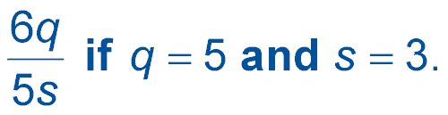
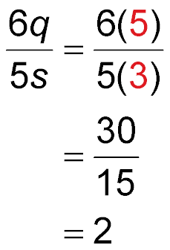
Evaluate Algebraic Fractions
Evaluate the expression
Replace q with 5 and s with 3.
Do all multiplication first. (P, E, M/D, A/S)
Do any division next. (P, E, M/D, A/S)
Answer: 2

Slide 13
Essential Properties
Write Each of These Down!!!!!
Addition & multiplication of numbers are ruled by specific “Properties”.
Addition
Multiplication
Identification Property
1 + 0 = 1
Identification Property
2 •1 = 2
Same number as you started with.
Same number as you started with.
Associative Property
1 +(2 + 3) = (1 + 2) + 3
Associative Property
1 • (2 • 3) = (1 • 2) • 3
Re-grouping with (parenthesis).
Re-grouping with (parenthesis).
Commutative Property
1 +(2 + 3) = 2 + (3 + 1)
Commutative Property
1 • (2 • 3) = 2 • (3 • 1)
Changing the order of the numbers.
Changing the order of the numbers.
Distributive Property
1 (2 + 3) = (2 + 3) 1
Distribute number outside to numbers inside.

Slide 14
Identify Properties
Name the property shown by 12 ● 1 = 12.
Multiplying any number by 1 gives you that number.
Answer: This is the Identity Property of Multiplication.

Slide 15
Identify Properties
Name the property shown by 12 (1 ● 5) = (12 ● 1) 5
The location of the grouping symbols (parenthesis), not the numbers, is changed.
Answer: This is the Associative Property of Multiplication.

Slide 16
Identify Properties
Name the property shown by (12 + 1) + 5 = 1 + (12 + 5)
The order of the numbers is changed and the parenthesis were changed. The focus with this property is the fact that the order of the numbers changed.
Answer: This is the Commutative Property of Addition.

Slide 17
Identify Properties
Name the property shown by 12 ( 1 + 5) = (12 ● 1 + 12 ● 5)
With this property, a factor outside grouping symbols (parenthesis) is multiplied by the numbers inside the parenthesis creating a new expression equal to the first expression.
Answer: This is the Distributive Property of Multiplication.

Slide 18

Use your notes for this section!!!!
A
B
C
D

Slide 19
Evaluate 2(a + b)² if a = 3 and b = 2.
A. 20
B. 50
C. 64
D. 100
A
B
C
D

Slide 20
Evaluate the expression b² + 3c – 5 if b = 4 and c = 2.
A. 9
B. 17
C. 20
D. 22
A
B
C
D

Slide 21
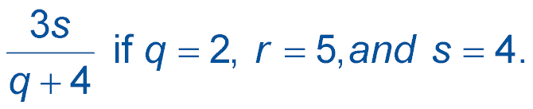
Evaluate the expression
A. 0
B. 1
C. 2
D. 4
A
B
C
D

Slide 22
Name the property shown by the statement 3 ● 2 = 2 ● 3.
A. Associative Property of Multiplication
B. Commutative Property of Addition
C. Commutative Property of Multiplication
D. Distributive Property
A
B
C
D

Slide 23
Name the property shown by the statement
(3 ● 2) 5 = 3 ( 2 ● 5).
A. Associative Property of Multiplication
B. Commutative Property of Addition
C. Commutative Property of Multiplication
D. Distributive Property
A
B
C
D

Slide 24

Name the property shown by the statement
3 (2 + 5) =( 3 ● 2 + 3 ● 5).
A. Associative Property of Multiplication
B. Commutative Property of Addition
C. Commutative Property of Multiplication
D. Distributive Property
A
B
C
D

Slide 25





