Slide 1
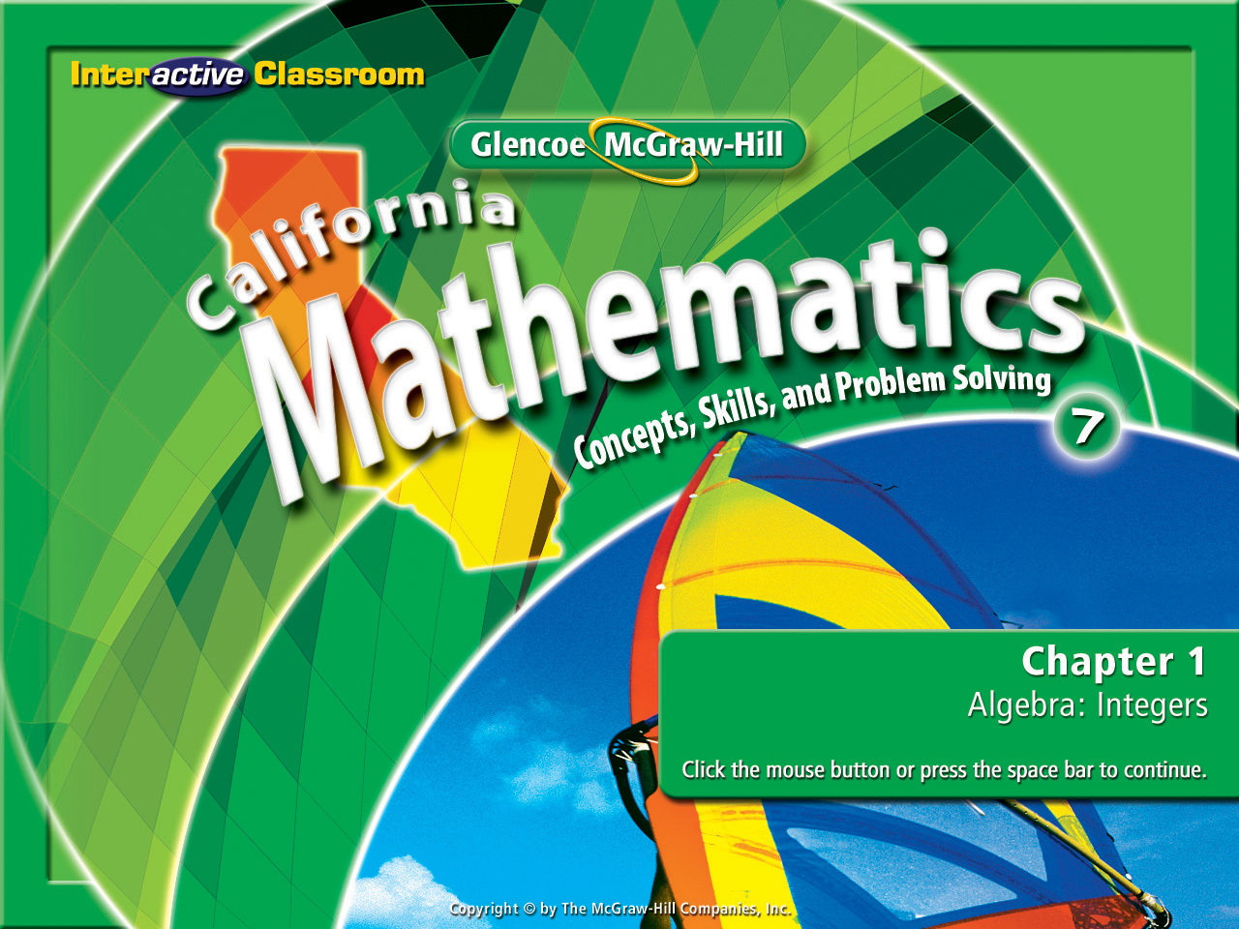
Splash Screen
Lesson 1-4
Adding Integers

Slide 2







(over Lesson 1-1)
A basketball player scored 27 points in the first game, 19 points in the second game, and 32 points in the third game. About how many more points did he score in the last two games than in the first game?
A. 20
B. 25
C. 30
D. 35
A
B
C
D

Slide 3

(over Lesson 1-2)
Evaluate z² + 4y – 10 if y = 8 and z = 5.
A. 20
B. 47
C. 57
D. 72
A
B
C
D

Slide 4


(over Lesson 1-3)
Write an integer for a gain of 5 pounds.
A. –5
B. –0.5
C. 0.5
D. 5
A
B
C
D

Slide 5

(over Lesson 1-3)
Write an integer for 5 degrees below zero.
A. –5
B. –0.5
C. 0.5
D. 5
A
B
C
D

Slide 6


Add integers.
opposites
additive inverse

Slide 7


Standard 7NS1.2 Add, subtract, multiply, and divide rational numbers (integers, fractions, and terminating decimals) and take positive rational numbers to whole-number powers.
Standard 7AF1.3 Simplify numerical expressions by applying properties of rational numbers (e.g. identity, inverse, distributive, associative, commutative) and justify the process used.

Slide 8
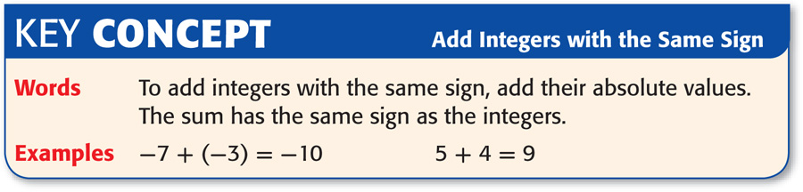

Slide 9

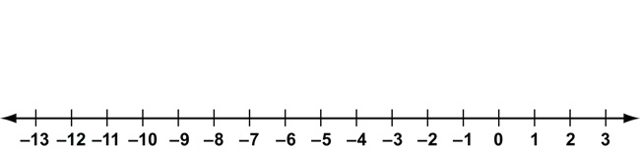
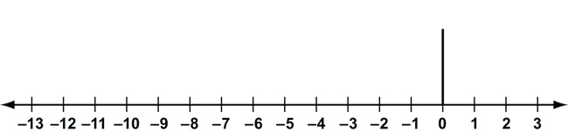
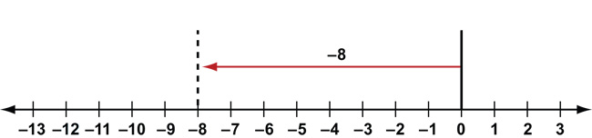
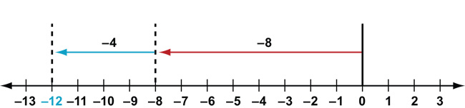
Add Integers with the Same Sign
New School Thinking
If two integers have the same sign,
simply add them together.
Find –8 + (–4).
Start at zero.
Move 8 units to the left.
From there, move 4 units left.
Answer: So, –8 + (–4) = –12.

Slide 10
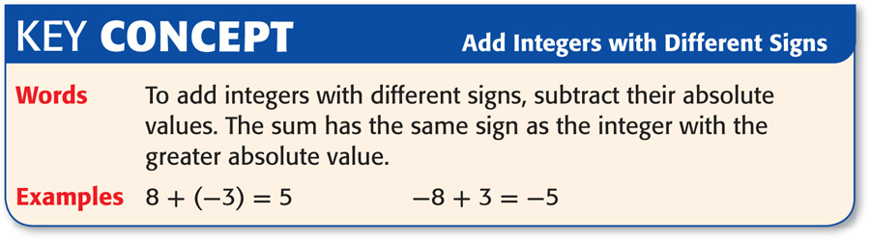

Slide 11
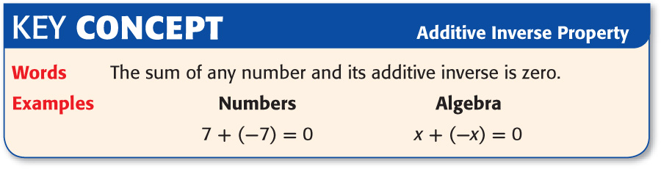

Slide 12
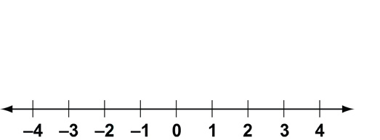
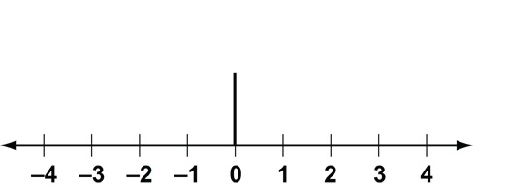
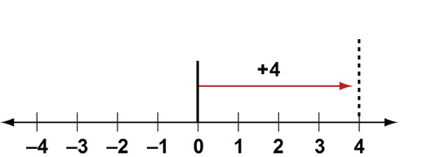
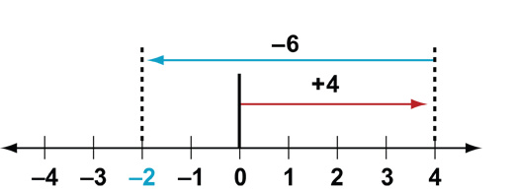
Add Integers with Different Signs
Find 4 + (–6).
Start at zero.
Move 4 units to
the right.
From there,
move 6 units left.
Answer: So, 4 + (–6) = –2.

Slide 13
Add Integers with Different Signs
Find 4 + (–6).
Find the difference between 4 & 6
(2)
Determine which integer has the highest absolute value
|-6|
Use the sign of the integer with the highest value in the final answer
(-)
Answer: So, 4 + (–6) = –2.

Slide 14
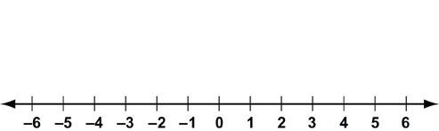
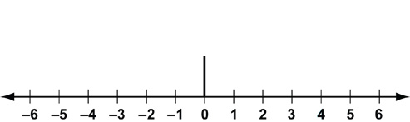
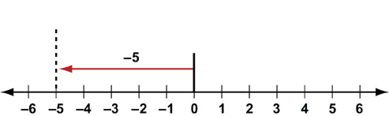
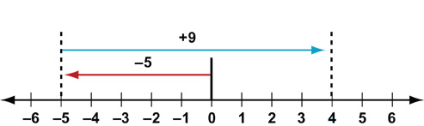
Add Integers with Different Signs
Find –5 + 9.
Start at zero.
Move 5 units to left.
From there, move 9 units right.
Answer: So, –5 + 9 = 4.

Slide 15
Add Integers with Different Signs
Find –5 + 9.
Find the difference between 5 & 9
(4)
Determine which integer has the highest absolute value
|9|
Use the sign of the integer with the highest value in the final answer
(+)
Answer: So, –5 + 9 = 4.

Slide 16
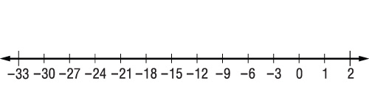
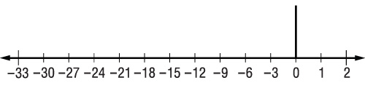
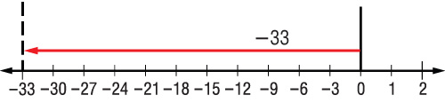
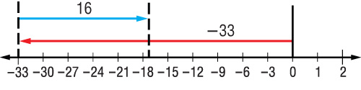
Add Integers with Different Signs
Find –33 + 16.
Start at zero.
Move 33 units to left.
From there, move 16 units right.
Answer: So, –33 + 16 = –17.

Slide 17
Add Integers with Different Signs
Find –33 + 16.
Find the difference between 33 & 16
(17)
Determine which integer has the highest absolute value
|-33|
Use the sign of the integer with the highest value in the final answer
(-)
Answer: So, –33 + 16 = –17.

Slide 18

Add Three or More Integers
Find 2 + (–5) + (–3).
= 2 + [ (–5) + (–3)]
Group using the Associative Property. -5 & -3 are both negative integers so group them together.
= 2 + (–8)
-5 & -3 combined give you -8.
= 2 + (–8)
The difference between 2 & 8 is 6. The|-8| is higher than the |2| therefore you will use the (-) sign in your final answer.
Answer: –6

Slide 19

Find –3 + (–6).
A. –9
B. –3
C. 3
D. 9
A
B
C
D

Slide 20
Find 3 + (–5).
A. –2
B. 2
C. 7
D. 8
A
B
C
D

Slide 21
Find –6 + 8.
A. –2
B. 0
C. 2
D. 4
A
B
C
D

Slide 22
Find –23 + 8.
A. –31
B. –15
C. 15
D. 31
A
B
C
D

Slide 23
Find 3 + (–6) + (–2).
A. –9
B. –5
C. –1
D. 4
A
B
C
D

Slide 24

MONEY Jaime gets an allowance of $5. She spends $2 on video games and $1 on lunch. Her best friend repays a $2 loan and she buys a $3 pair of socks. How much money does Jaime have left?
A. $1
B. $2
C. $3
D. $4
A
B
C
D

Slide 25




