Slide 1
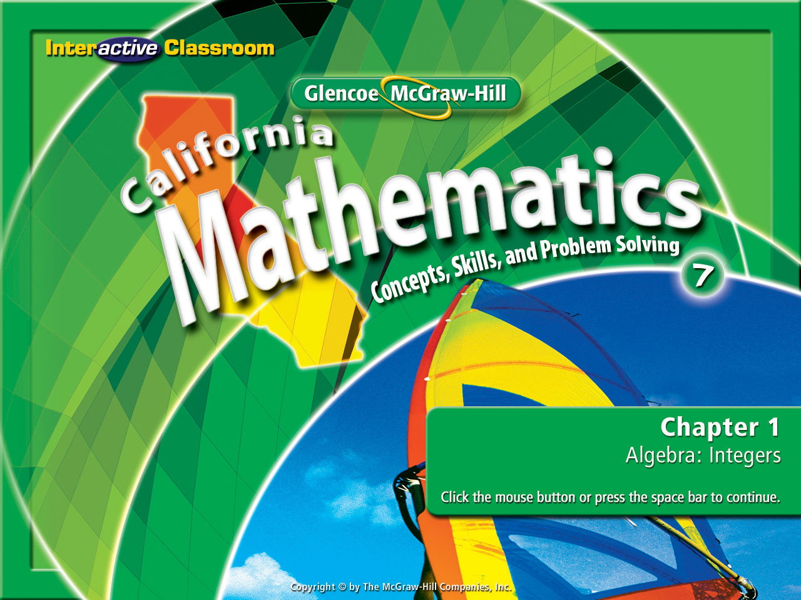
Splash Screen
Lesson 1-5
Subtracting Integers

Slide 2







Determine whether 97 is a prime or composite number.
A. composite
B. prime
A
B

Slide 3

(over Lesson 1-1)
A basketball player scored 27 points in the first game, 19 points in the second game, and 32 points in the third game. About how many more points did he score in the first two games than in the third game?
A. 15
B. 20
C. 30
D. 40
A
B
C
D

Slide 4


(over Lesson 1-2)
Evaluate if x = 3 and y = 8.
A. 48
B. 34
C. 16
D. 6
A
B
C
D

Slide 5

(over Lesson 1-3)
Use <, > or = to make -6 ____ –2 a true sentence.
A. <
B. >
C. =
A
B
C

Slide 6

Combining negative integers.

Slide 7


Standard 7NS1.2 Add, subtract, multiply, and divide rational numbers (integers, fractions, and terminating decimals) and take positive rational numbers to whole-number powers.

Slide 8
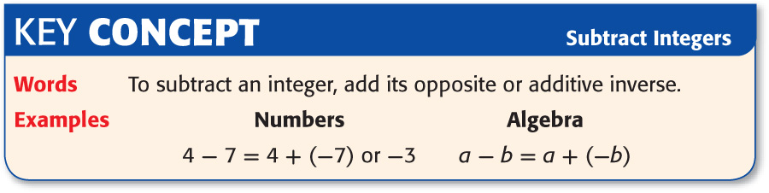
Here’s The Old School Thinking
Time To Change Your Way Of Thinking

Slide 9
New School Thinking
-5 – 6 =
When the 1st integer is negative & the 2nd integer is positive, treat them as though they are both negative. Think of the subtraction symbol as being a negative sign. Then combine them. Because they are both negatives, use the negative sign in the final answer.
-5 – 6 =
1st integer is negative, 2nd integer is positive, think of them as both being negative. Combine them.
-5 combined with -6 is -11
-5 – 6 = -11

Slide 10
New School Thinking
8 – (-12) =
When the 2nd integer is (-) you refer to it as a double negative. Change it to a (+). Then combine the integers like you would normally do in an addition of integers equation.
Think of the the 2nd integer as being a double negative (-), change it to a (+) then combine the two integers.
8 – (-12) =
an 8 combined to a 12 is 20
8 + 12 = 20

Slide 11

Subtract a Positive Integer
Find 2 – 6.
New School
In the problem 2 – 6, don’t look at it as a subtraction problem. Think of what a +2 combined with a -6 would be.
2 – 6 =
Answer: –4

Slide 12
Subtract a Positive Integer
Find -7 - 5
New School
In the problem -7 – 5, don’t look at it as a subtraction problem. Think of what a -7 combined with a -5 would be.
-7 –5 = -7 -5 =
Answer: –12

Slide 13
Subtract a Positive Integer
Find 11 – (– 8)
New School
11 –(-8) =
In the problem 11– (-8), don’t look at it as a subtraction problem. Think of it as a double negative – (-). Connect the two negatives to make a positive.
11 – ( - 8)
(
Answer: 19

Slide 14

Subtract a Negative Integer
WEATHER If the overnight temperature at a research station in Antarctica was –13° C, but the temperature rose to 2° C during the day, what was the difference between the temperatures?
New School
2 – (–13) =
We have a double negative, combine the negatives to make a positive 2 – (–13) = 2 + 13
Answer: The difference between the two temperatures is 15° C.

Slide 15

Evaluate Algebraic Expressions
Evaluate 12 – r if p = 6, q = –3, and r = –7.
New School
12 – r =
12 – (–7) = Replace r with –7.
The 2nd integer is a double negative (-),
change it to a (+).
Combine 12 and 7
Answer: 19

Slide 16

Evaluate Algebraic Expressions
Evaluate q – p² if p = 6, q = –3, and r = –7.
New School
q – p² =
3 – 6² = Replace q with –3 and p with 6.
–3 – 36 = Both integers are negative, combine them.
= -3 combined with -36.
Answer: –39

Slide 17

Find 3 – 7.
A. –6
B. –4
C. –1
D. 3
A
B
C
D

Slide 18
Find –6 – 2.
A. 4
B. 2
C. –4
D. –8
A
B
C
D

Slide 19
Find 15 – (– 3).
A. 9
B. 12
C. 18
D. 21
A
B
C
D

Slide 20
Find –7 – (–11).
A. –18
B. –4
C. 4
D. 18
A
B
C
D

Slide 21
Evaluate 10 – c if a = 3, b = –6, and c = –2.
A. 7
B. 12
C. 14
D. 16
A
B
C
D

Slide 22
Evaluate b – a if a = 3, b = –6, and c = –2.
A. –9
B. –7
C. –1
D. 3
A
B
C
D

Slide 23





