Slide 1

Splash Screen
Lesson 1-6
Multiplying & Dividing Integers

Slide 2








(over Lesson 1-2)
Which property is shown by the expression
(2 + 5) + 19 = 2 + (5 + 19)?
A. Identity
B. Distributive
C. Associative
D. Commutative
A
B
C
D

Slide 3

(over Lesson 1-3)
The following temperatures were recorded: 5 degrees above zero, 20 degrees below zero, 15 degrees below zero, and 10 degrees above zero. What would be the order of the temperatures from least to greatest?
A. {5, 10, –15, –20}
B. {–15, –20, 5, 10}
C. {–20, –15, 5, 10}
D. {–20, –15, 10, 5}
A
B
C
D

Slide 4


(over Lesson 1-4)
Combine –13 + 20.
A. –33
B. –7
C. 7
D. 33
A
B
C
D

Slide 5

(over Lesson 1-4)
Combine 17 + (–5).
A. 22
B. 12
C. –12
D. –22
A
B
C
D

Slide 6


(over Lesson 1-5)
Combine4 – 9.
A. 13
B. 5
C. –5
D. –13
A
B
C
D

Slide 7

(over Lesson 1-5)
Combine –2 – (–6).
A. 8
B. 4
C. –4
D. –8
A
B
C
D

Slide 8

Multiply and divide integers.

Slide 9


Standard 7NS1.2 Add, subtract, multiply, and divide rational numbers (integers, fractions, and terminating decimals) and take positive rational numbers to whole number powers.
Standard 7AF1.3 Simplify numerical expressions by applying properties of rational numbers (e.g. identity, inverse, distributive, associative, commutative) and justify the process used.

Slide 10
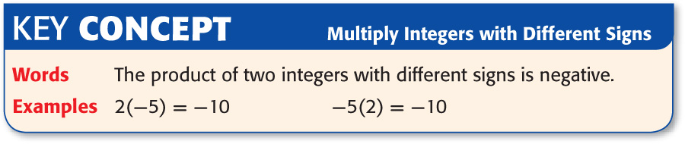

Slide 11
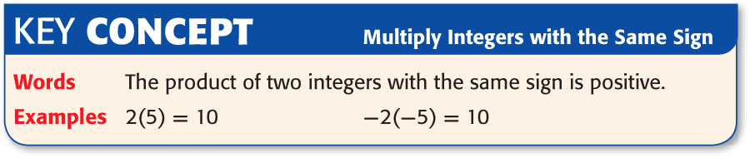

Slide 12
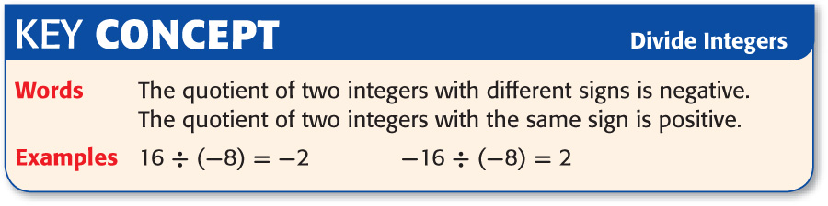

Slide 14

Multiply Integers with Different Signs
Find 8(–4).
8(–4) = (-?)
The factors have different signs. The
product is negative.
Answer: –32

Slide 15
Multiply Integers with Different Signs
Find –5(7).
–5(7) = (-?)
The factors have different signs. The product
is negative.
Answer: –35

Slide 16
Multiply Integers with the Same Signs
Find 5(7).
5(7) = (+?)
The factors have the same sign. The product
is positive.
Answer: 35

Slide 17
Multiply Integers with the Same Signs
Find -5(-7).
-5(-7) = (+?)
The factors have the same sign. The product
is positive.
Answer: 35

Slide 18
Divide Integers
Find 30 ÷ (–5).
30 ÷ –5 = (–?)
The dividend and the divisor have different signs. The quotient is negative.
Answer: –6

Slide 19
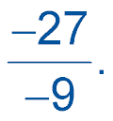
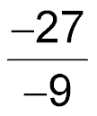
Divide Integers
Find
The dividend and the divisor have the same sign. The quotient is positive.
= (+?)
Answer: 3

Slide 20

Evaluate Algebraic Expressions
Evaluate 3x – (–4y) if x = –10 and y = –4.
3x – (–4y)
= 3(–10) – [–4(–4)]
Replace x with –10 and y with –4.
= –30 – 16
The product of 3 and –10 is negative,
and the product of –4 and –4 is positive.
Remember if both integers have the same
sign you combine. A (-) combined with a (-)
gives you a (-).
= –30 –16
Answer: –46

Slide 21


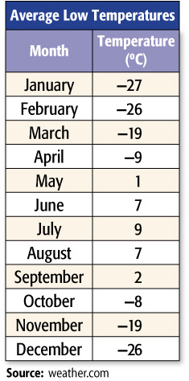
Find the Mean of a Set of Integers
WEATHER The table shows the low temperature for each month in McGrath, Alaska. Find the mean (average) of all 12 temperatures.

Slide 22

Find 6(–3).
A. –18
B. –9
C. 3
D. 6
A
B
C
D

Slide 23
Find –2(6).
A. 4
B. –2
C. –8
D. –12
A
B
C
D

Slide 24
Find –8(–8).
A. –16
B. 32
C. 64
D. 72
A
B
C
D

Slide 25
Find 5(–3)(–2).
A. 36
B. 30
C. –18
D. –28
A
B
C
D

Slide 26
36 ÷ (–6).
A. –6
B. –4
C. 6
D. 9
A
B
C
D

Slide 27
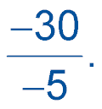
Find
A. –35
B. –25
C. 6
D. 7
A
B
C
D

Slide 28
Evaluate 2a – (–3b) if a = –6 and b = –4.
A. 12
B. 0
C. –12
D. –24
A
B
C
D

Slide 29
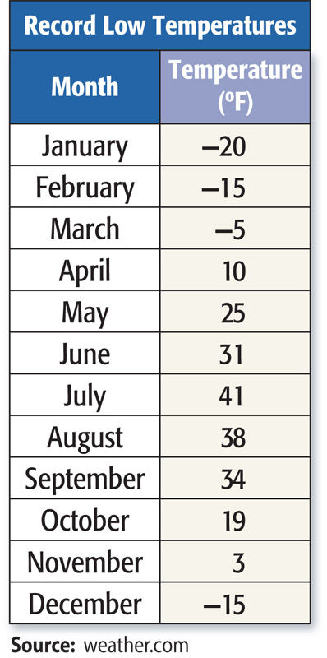
WEATHER The table shows the record low temperature for each month in Brook Park, Ohio. Find the mean (average) of all 12 temperatures.
A. about 11.6° F
B. about 12.2° F
C. about 12.9° F
D. about 13.5° F
A
B
C
D

Slide 30
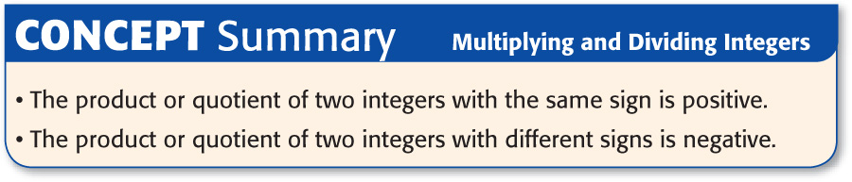

Slide 31




