Slide 1
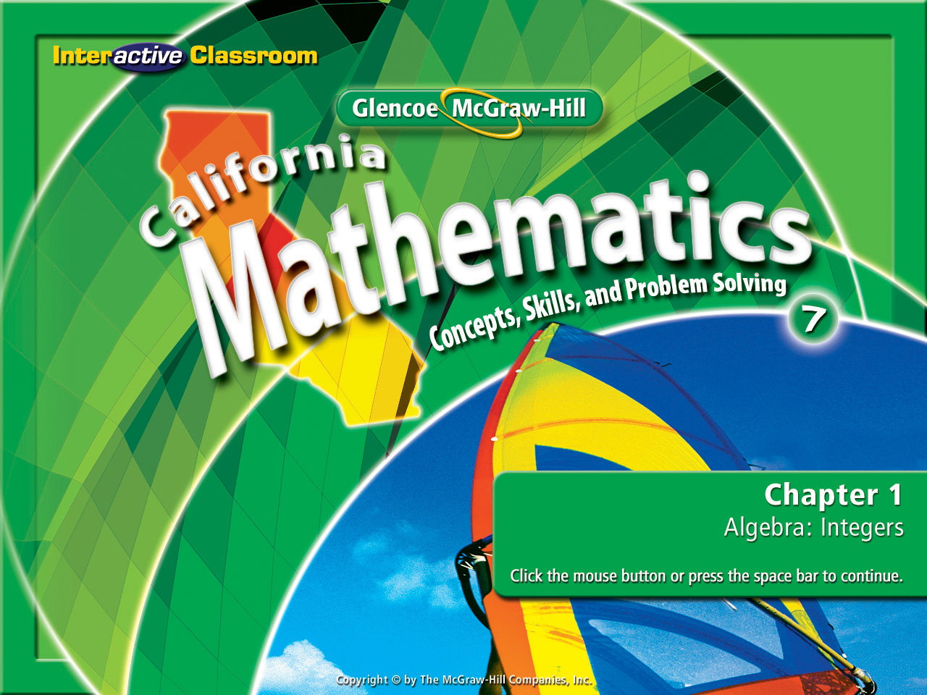
Splash Screen
Lesson 1-9
Solving Addition & Subtraction Equations

Slide 2







(over Lesson 1-5)
Subtract –21 – (–10).
A. –31
B. –11
C. 11
D. 31
A
B
C
D

Slide 3

(over Lesson 1-6)
Find the mean of the following set of integers. 3, –6,
–8, –10, –4
A. –25
B. –13
C. –5
D. –1
A
B
C
D

Slide 4



(over Lesson 1-7)
Write the verbal phrase half of Sylvia’s money as an algebraic expression.
A. 2 ● x
B.
D. x – 2
A
B
C
D

Slide 5

(over Lesson 1-5)
Evaluate the expression a + c + b if a = –3, b = –7, and c = –5.
A. -15
B. -9
C. 15
D. –8
A
B
C
D

Slide 6

(over Lesson 1-5)
Evaluate the expression | a | – c -|b| if a = -1, b = -8, and c = –2.
A. –5
B. 5
–1
D. 1
A
B
C
D

Slide 7

(over Lesson 1-5)
Evaluate – 4 –(-4) + (-4) - 4
A. 0
B. 8
C. -4
D. -8
A
B
C
D

Slide 8


Solve equations using the Subtraction and Addition Properties of Equality.
solve
Finding the value of a variable to make the equation true.
solution
The value of a variable.
inverse operations
The opposite operation that will “undo” the other. Subtraction will “undo” addition & addition will “undo” subtraction.

Slide 9

Reinforcement of Standard 6AF1.1 Write and solve one-step linear equations in one variable.

Slide 10
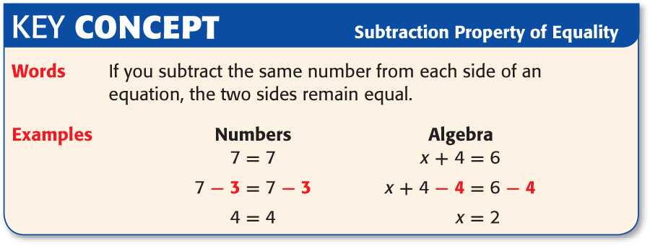

Slide 11

Solve an Addition Equation
Solve 7 = 15 + c.
Method 1 Vertical Method
7 = 15 + c
Write the equation.
Combine a -15 to each side to cancel out the 15, isolating the variable & finding its’ solution.
7 = 15 + c
–15 –15
–8 = c

Slide 12
Solve an Addition Equation
Method 2 Horizontal Method
7 = 15 + c
Write the equation.
Combine a -15 to each side to cancel out the 15, isolating the variable & finding its’ solution.
7 – 15 = 15 – 15 + c
–8 = c

Slide 13
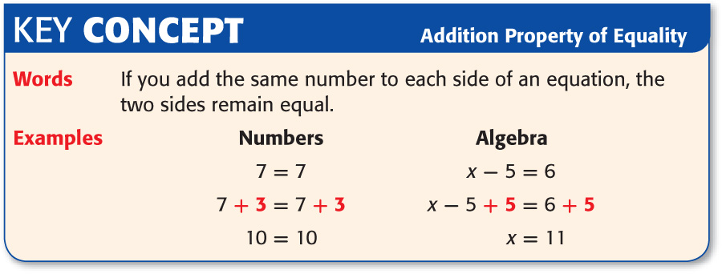

Slide 14
Solve an Addition Equation
OCEANOGRAPHY At high tide, the top of a coral formation is 2 feet above the surface of the water. This represents a change of –6 feet from the height of the coral at low tide. Write and solve an equation to determine h, the height of the coral at low tide.
Words The height of the coral at low tide plus (–6) feet is 2 feet.
Variable Let h represent the height of the coral at low tide.
Equation h + (–6) = 2

Slide 15
Solve an Addition Equation
Write the equation.
h + (–6) = 2
h + (–6) + 6 = 2 + 6
Combine a 6 to each side canceling out the -6, isolating the variable to find its’ solution.
h = 8
Answer: The height of the coral at low tide is 8 feet.

Slide 16
Solve a Subtraction Equation
Solve –5 = z – 16
Method 1 Vertical Method
–5 = z – 16
Write the equation.
–5 = z – 16
+16 +16
Combine a 16 to each side canceling out the -16, isolating the variable to find its’ solution.
11 = z

Slide 17
Solve a Subtraction Equation
Method 2 Horizontal Method
–5 = z – 16
Write the equation.
Combine a 16 to each side canceling out the -16, isolating the variable to find its’ solution.
–5 + 16 = z – 16 + 16
11 = z
Answer: The solution is 11.

Slide 18

Solve 6 = 11 + a
A. –5
B. –3
C. 13
D. 17
A
B
C
D

Slide 19
If Carlos makes a withdrawal of $15 from his savings account, the amount in the account will be $47. Write and solve an equation to find the balance of the account before the withdrawal.
A. $65
B. $45
C. $62
D. $32
x -15 = 47
A
B
C
D

Slide 20
Solve –6 = x –12
A. –6
B. –3
C. 6
D. 9
A
B
C
D

Slide 21




