Slide 1
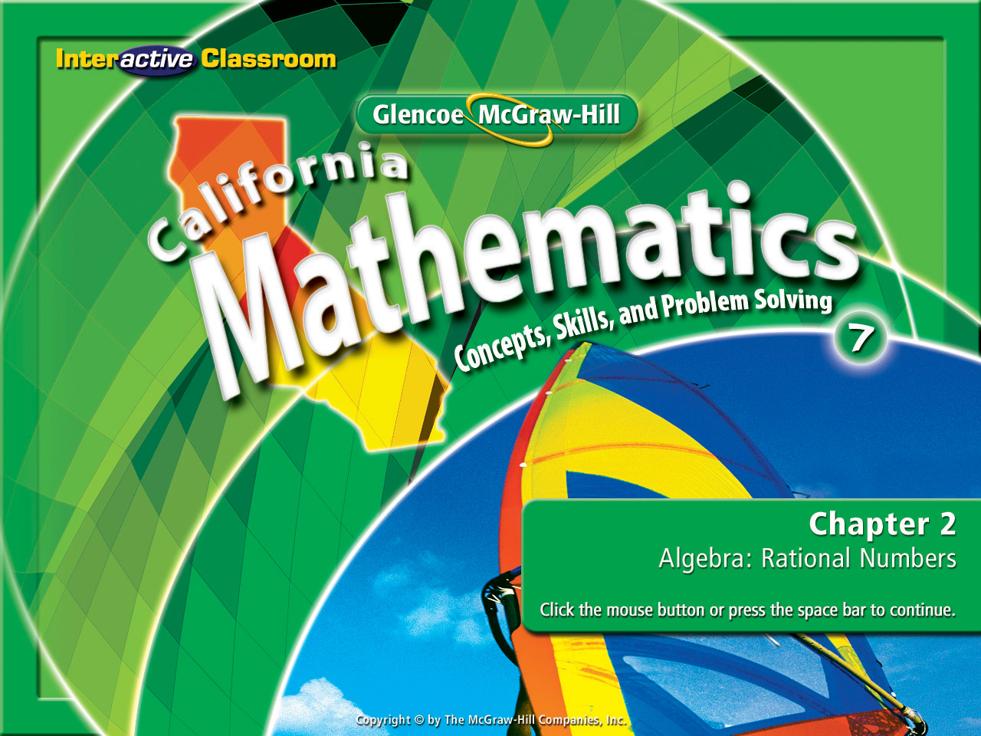
Splash Screen
Lesson 2-10
Scientific Notation

Slide 2



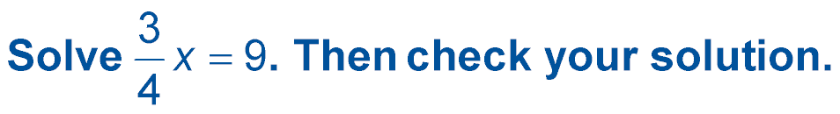

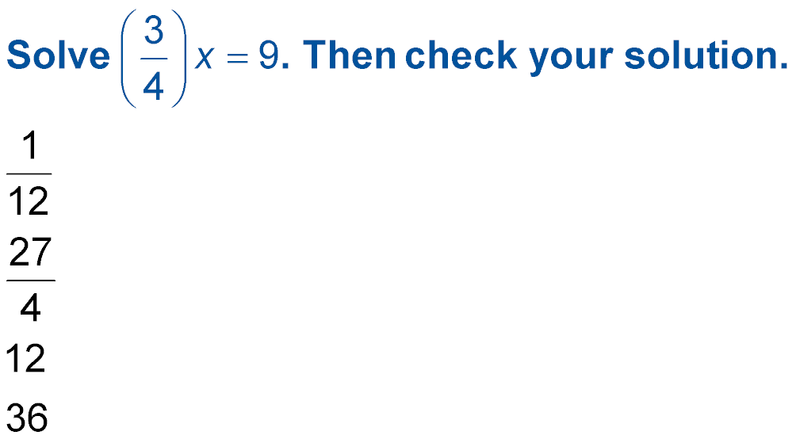



(over Lesson 2-7)
A.
B.
C. 12
D. 36
A
B
C
D

Slide 3

(over Lesson 2-7)
Solve –49 – d = –71. Then check your solution.
A. 120
B. 22
C. –22
D. –120
A
B
C
D

Slide 4

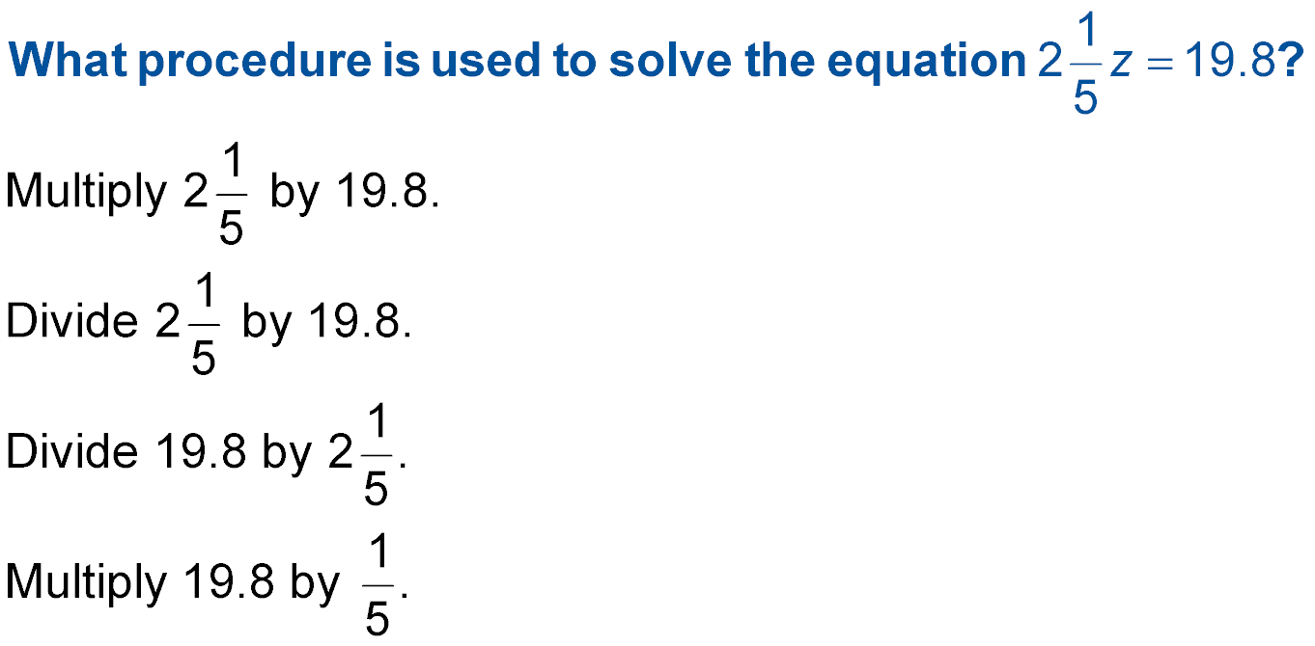


(over Lesson 2-7)
A.
B.
C.
D.
Multiply 11/5 by 19.8
A
B
C
D
Divide 11/5 by 19.8
Multiply 19.8 by 5/11
Divide 19.8 by 5/11

Slide 5


(over Lesson 2-9)
Write the expression c ● c ● c ● c ● c ● c ● c ● c ● c using exponents.
A. 9c
B. 9^{c}
C. c⁸
D. c⁹
A
B
C
D

Slide 6
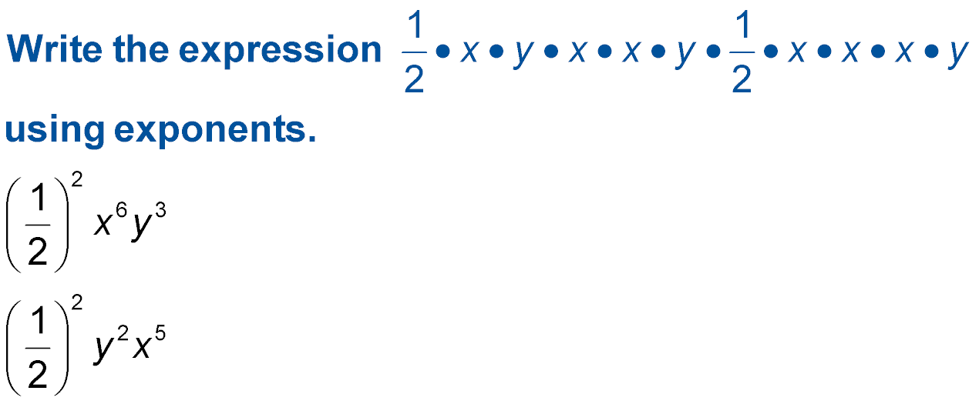

(over Lesson 2-9)
A. (y²)(x⁶)
B.
C.
D. (x⁷)(y²)
A
B
C
D

Slide 7

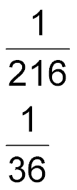
(over Lesson 2-9)
Evaluate 6^{(–3)}.
A.
B.
C. 36
D. 216
A
B
C
D

Slide 8


Express numbers in scientific notation.
scientific notation

Slide 9

Standard 7NS1.1 Read, write, and compare rational numbers in scientific notation (positive and negative powers of 10), compare rational numbers in general.

Slide 10


Slide 11
Presents

Slide 12
A Watch and
Discover!

Slide 13
Carefully evaluate what is happening here with the location of the decimal in each number.
1.2 x 10² = 120
Think: How far did the decimal move & in what direction?
5.34 x 10⁴ = 53,400
Think: How far did the decimal move & in what direction?
3.97 x 10⁶ = 3,970,000
Think: How far did the decimal move & in what direction?

Slide 14



So what’s the rule for this one?

Slide 15
Rule
5. 3 4 x 10⁴ = 5 3, 4 0 0.
This is a (+) exponent, therefore move the decimal point as many places to the right as the exponent tells you to.
Remember to add as many 0’s as needed to get the decimal to the right spot.

Slide 16
Carefully evaluate what is happening here with the location of the decimal in each number.
-3.27 x 10² = -327
Think: How far did the decimal move & in what direction?
-53.4 x 10⁴ = -534,000
Think: How far did the decimal move & in what direction?
-35.7 x 10⁶ = -35,700,000
Think: How far did the decimal move & in what direction?

Slide 17
So what’s the rule for this one?

Slide 18
Rule
-3 2. 7 x 10⁴ = -3 2 7, 0 0 0.
Though the integer is a (-), the exponent is a (+). Move the decimal point as many places to the right as the exponent tells you to.
Remember to add as many 0’s as needed to get the decimal to the correct spot.

Slide 19

Express Numbers in Standard Form
Write 9.62 × 10⁵ in standard form.
9.62 × 10⁵ =
The exponent is a (+5), the decimal point moves 5 places to the right.

Slide 20
Express Numbers in Standard Form
Write -5.123 × 10⁵ in standard form.
-5.123 × 10⁵ =
The exponent is a (+5), the decimal point moves 5 places to the right.

Slide 21
Write Numbers in Scientific Notation
Write –931,500,000 in scientific notation.
–931,500,000 =
The number in standard form is not a decimal. Therefore the exponent will be a positive one.

Slide 22
Carefully evaluate where the decimal is placed in each number and the power assigned to the base number 10.
372.5 x 10⁻³ = .3725
Think: How far did the decimal move & in what direction?
-523.9 x 10⁻⁴ = -.052390
Think: How far did the decimal move & in what direction?
534 x 10⁻⁵ = 0.00534
Think: How far did the decimal move & in what direction?

Slide 23
So what’s the rule for this one?

Slide 24
Rule
-53.4 x 10⁻⁵ = -0 .0 0 0 5 3.4
The exponent is a (-). Therefore the exponent moves left 5 places.
Remember moving a decimal to the left means the exponent is a (-).

Slide 25
Express Numbers in Standard Form
Write 2.85 × 10^{–6} in standard form.
2.85 × 10^{–6} =
The exponent is a negative, it will move to the left 6 places.

Slide 26
Write Numbers in Scientific Notation
Write 4.43 x 10⁻³ in standard form.
4.43 x 10⁻³
The number is a decimal. The exponent must be written as a (-).

Slide 27
Write Numbers in Scientific Notation
Write 0.0613 in scientific notation.
0.0613 =
The number is a decimal. The exponent must be written as a (-).

Slide 28

Write 5.32 × 10⁴ in standard form.
A. 532
B. 5,320
C. 53,200
D. 532,000
A
B
C
D

Slide 29
Write 3.81 × 10^{–4} in standard form.
A. 0.000381
B. 0.00381
C. 0.0381
D. 0.381
A
B
C
D

Slide 30
Write 35,600,000 in scientific notation.
A. 3.56 × 10⁴
B. 3.56 × 10⁵
C. 3.56 × 10⁶
D. 3.56 × 10⁷
A
B
C
D

Slide 31
Write 0.000653 in scientific notation.
A. 6.53 × 10^{–3}
B. 6.53 × 10^{–4}
C. 6.53 × 10^{–5}
D. 6.53 × 10^{–6}
A
B
C
D

Slide 32
Later Dudes!

Slide 33




