Slide 1

Splash Screen
Lesson 2-2
Comparing & Ordering Rational Numbers

Slide 2








(over Chapter 1)
A. 90
B. 19
C. –19
D. –90
A
B
C
D

Slide 3


(over Chapter 1)
Solve the equation.
A. 40
B. 10
C. –10
D. –40
A
B
C
D

Slide 4


(over Lesson 2-1)
Write the fraction as a decimal.
A. –2.4
B. –0.4166
C. 0.416
D. 2.4
¯
A
B
C
D

Slide 5


(over Lesson 2-1)
Write the
A. 2.15
B. 2.3
C. 0.3
D. 0.15
A
B
C
D

Slide 6

Think:
What is a rational number?
Compare and order rational numbers.

Slide 7

Standard 7NS1.1 Read, write, and compare rational numbers in scientific notation (positive and negative powers of 10), compare rational numbers in general.

Slide 8


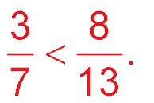
Compare Positive Rational Numbers Using Cross Multiplication.
Replace ■ with <, >, or = to make ■ a true sentence.
Cross multiply the dividends with the divisors & write their products:
39
56
Answer: Since 39 is < 56 then:

Slide 9
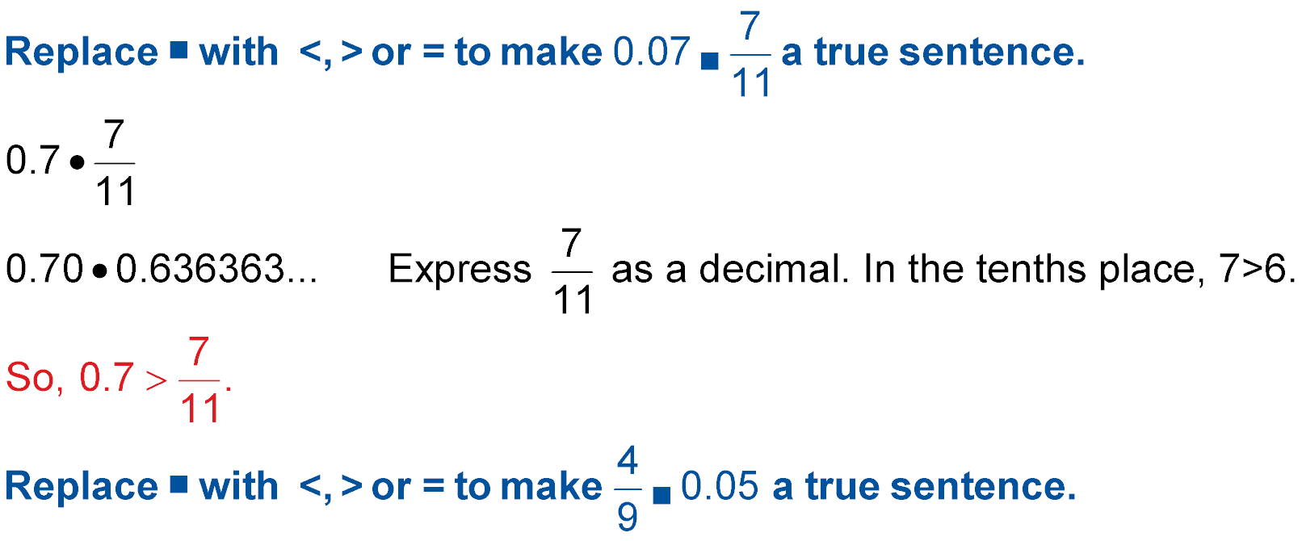
Another Look At Using Cross Multiplication
Replace ■ with <, >, or = to make: 0.7 ■ a true sentence.
7
10
Make 0.7 a fraction:
Compare the two fractions by cross multiplying the dividends and divisors :
77
7
10
7
11
70
77 Is greater than 70. Use the original numbers to state your final answer:
Answer:

Slide 10

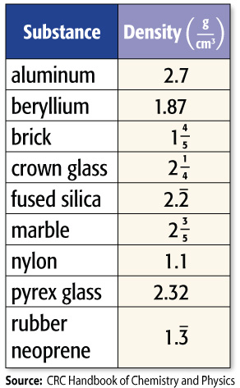
Order Rational Numbers
CHEMISTRY The values for the approximate densities of various substances are shown in the table. Order the densities highlighted from least to greatest.
Remember that you have to divide the dividend by the divisor.
Write each fraction as a decimal.
4
5
1
4
1
2
3
5
= 1.8
= 2.25
2
= 2.6
Line up the decimals and compare the values of each one:
1.8
2.25
Using their original form, the correct order from least to greatest is:
2.6
1
4
3
5
4
5
2
2
1

Slide 11

Compare Negative Rational Numbers
Replace ■ with <, >, or = to make –4.62 ■ –4.7 a true sentence.
–4.62 ■ –4.7
Graph the decimals on a number line.
Answer: Since –4.62 is to the right of –4.7, –4.62 > –4.7.

Slide 12
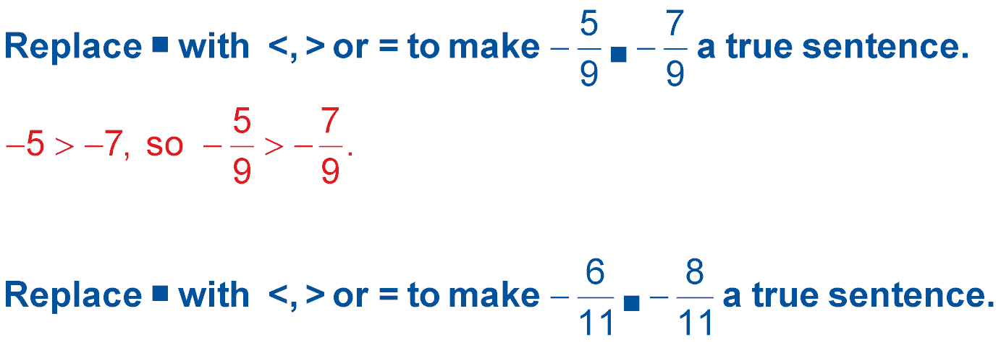

Compare Negative Rational Numbers
Replace ■ with <, >, or = to make a true sentence.
Since the divisors are the same, compare the dividends.
Answer:

Slide 13


Replace ■ with <, >, or = to make a true sentence.
A. >
B. <
C. =
D. none of the above
A
B
C
D

Slide 14
Replace ■ with <, >, or = to make 0.5 a true sentence.
■
A. >
B. <
C. =
D. none of the above
A
B
C
D

Slide 15
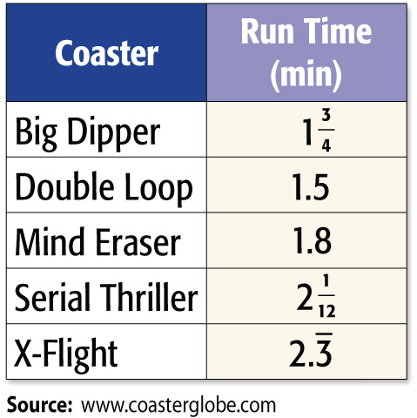
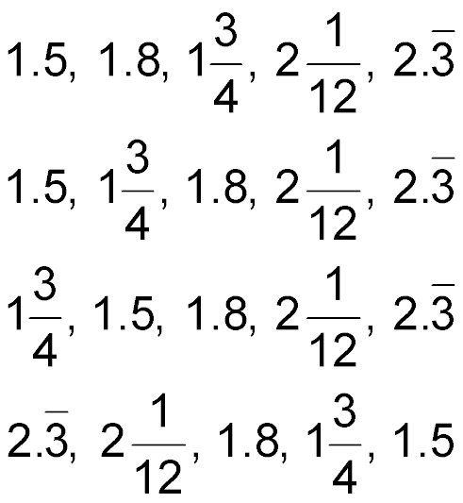
AMUSEMENT PARKS The ride times for five amusement park attractions are shown in the table. Order the lengths from least to greatest.
A.
B.
C.
D.
A
B
C
D

Slide 16
Replace ■ with <, >, or = to make –2.67 ■ –2.7 a true sentence.
A. <
B. >
C. =
D. none of the above
A
B
C
D

Slide 17
Replace ■ with <, >, or = to make a true sentence.
A. >
B. <
C. =
D. none of the above
A
B
C
D

Slide 18





