Slide 1
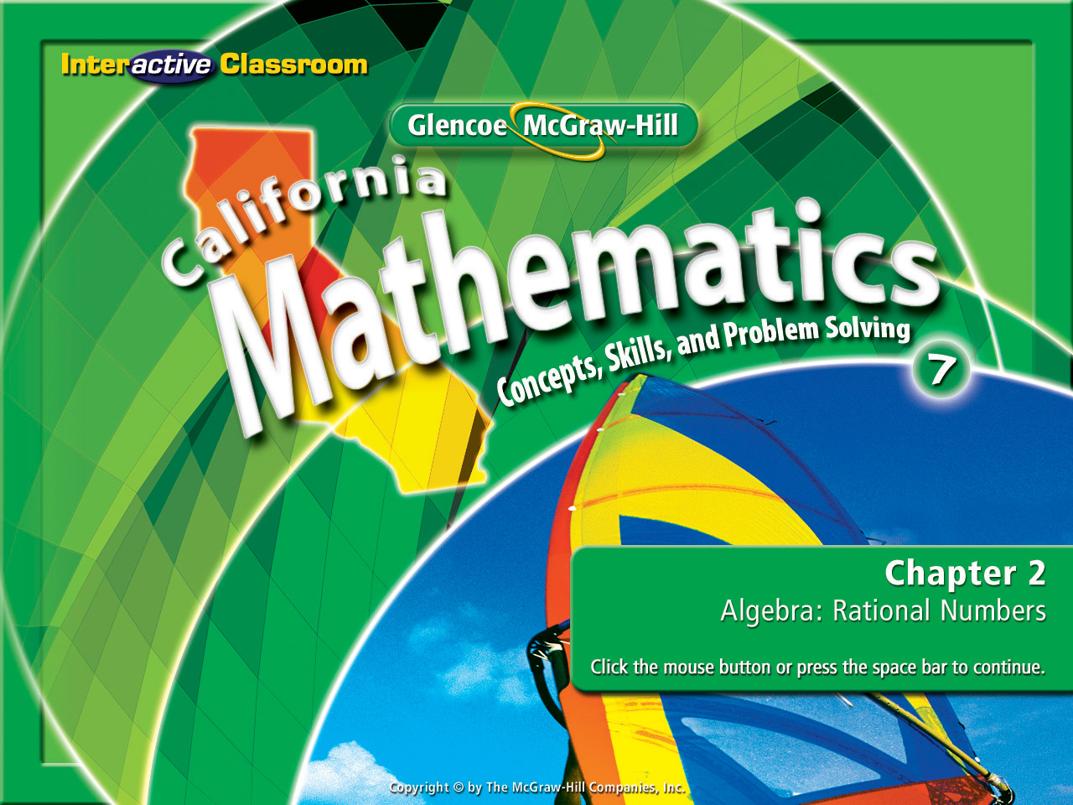
Splash Screen
Lesson 2-3
Multiplying Fractions

Slide 2








(over Chapter 1)
Yasmine earns $0.25 for each cup of lemonade she sells. She earned $86 last Thursday selling lemonade. How many cups of lemonade did she sell last Thursday?
A. 344
B. 2,150
C. 340
D. 443
A
B
C
D

Slide 3




(over Lesson 2-1)
Write the fraction as a decimal.
A. 1.143
B. 0.875
C. 0.78
D. 0.13
A
B
C
D

Slide 4

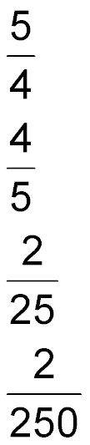
(over Lesson 2-1)
Write the decimal 0.08 as a fraction in simplest form.
A.
B.
C.
D.
A
B
C

Slide 5

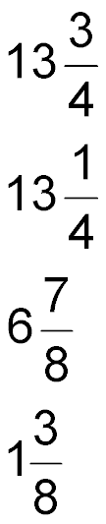
(over Lesson 2-1)
Write the decimal 1.375 as a mixed number in simplest form.
A.
B.
C.
D.
A
B
C
D

Slide 6


5Min 3-1
(over Lesson 2-2)
Use <, >, or = to make a true sentence.
A. <
B. >
C. =
A
B
C

Slide 7


5Min 3-3
(over Lesson 2-2)
Use <, >, or = to make a true sentence.
A. <
B. >
C. =
A
B
C

Slide 8


Multiply positive and negative fractions.
GCF
The greatest of the common factors of two or more numbers.

Slide 9


Standard 7NS1.2 Add, subtract, multiply, and divide rational numbers (integers, fractions, and terminating decimals) and take positive rational numbers to whole-number powers.
Standard 7MG1.3 Use measures expressed as rates (e.g. speed, density) and measures expressed as products (e.g. person-days) to solve problems; check the units of the solutions; and use dimensional analysis to check the reasonableness of the answer.

Slide 10
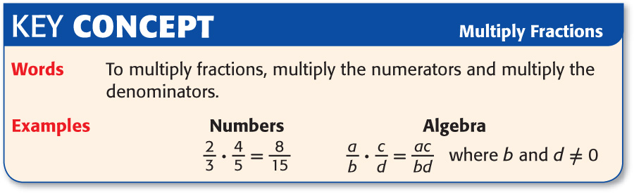

Slide 11


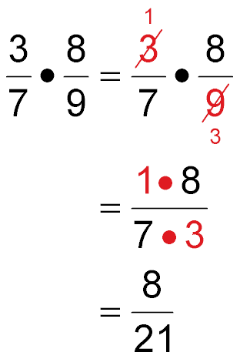

Multiply Positive Fractions
Begin by trying to cross cancel. In this problem you can divide 3 and 9 by their GCF, 3.
Multiply the dividends.
Multiply the divisors.
Now
Because you cross canceled in the first step there is no need to simplify the final answer.
Answer:

Slide 12

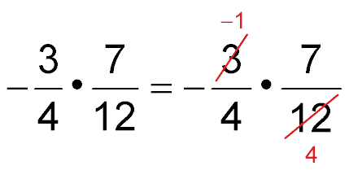
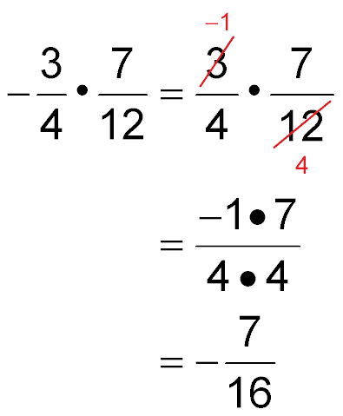
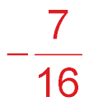
Multiply Negative Fractions
Begin by trying to cross cancel. In this problem you can divide -3 and 12 by their GCF, 3.
Multiply the dividends.
Multiply the divisors.
Now
The dividend and divisor have different signs, so the product is negative.
Answer:

Slide 13
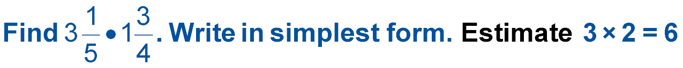
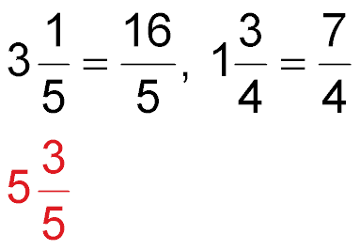
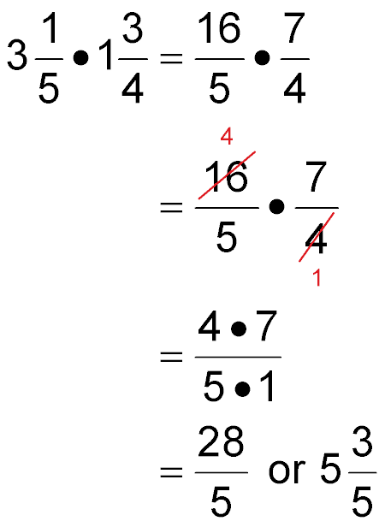
Multiply Mixed Numbers
Begin by changing each mixed number into an improper fraction.
Cross cancel if possible. Here you can divide 16 and 4 by their GCF, 4.
Multiply the dividends.
Multiply the divisors.
Now
Next slide please!

Slide 14
Multiply Mixed Numbers
Evaluate your result. Simplify by changing any improper fraction to a mixed number.
Remember, no need to reduce because you cross cancelled in the original equation!!!!!!
Answer:

Slide 15

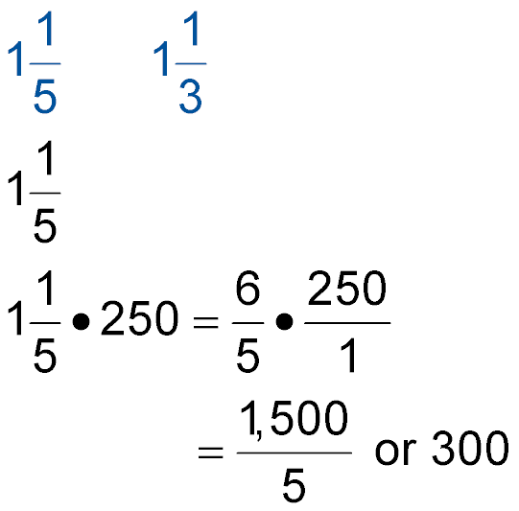
VOLUNTEER WORK Last summer, the 7th graders
performed a total of 250 hours of community service.
If the 8th graders spent this much time
volunteering, how many hours of community service
did the 8th graders perform?
Key Data: The 8th graders spent the amount of time as the
7th graders on community service.

Slide 16
11/5 of 250
Think:
1
1
5
6
5
250 = 250
1
Change 11/5 and 250 to mixed numbers.
=
50
6
5
250
1
•
Set up the equation. Look to cross cancel. In this problem 5 is the GCF of itself & 250.
1
6
1
50
1
Solve
300
•
=

Slide 17
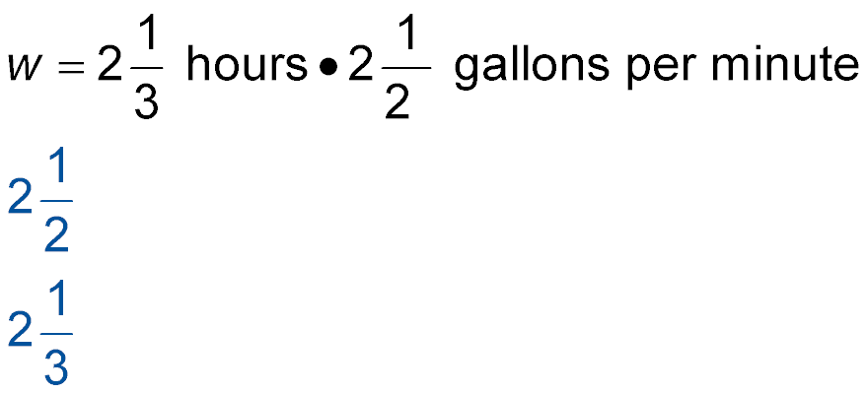
Use Dimensional Analysis
WATER USE Low–flow showerheads use gallons
of water per minute. If family members shower a total
of hours per week, how much water does the
family use for showers each week?
Words Water used equals the time multiplied by the water flow rate.
Variable Let w represent the gallons of water used.
Equation

Slide 18
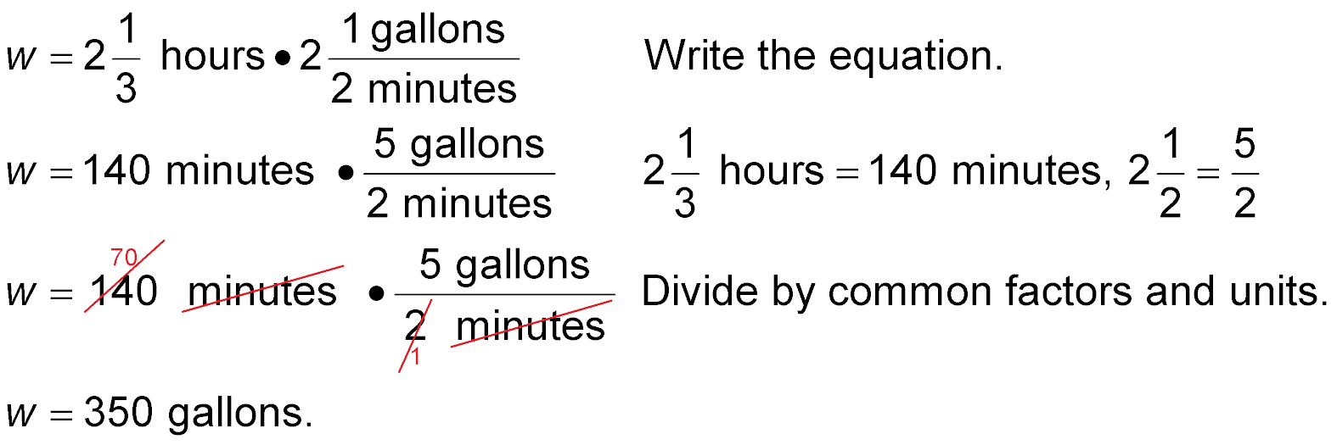
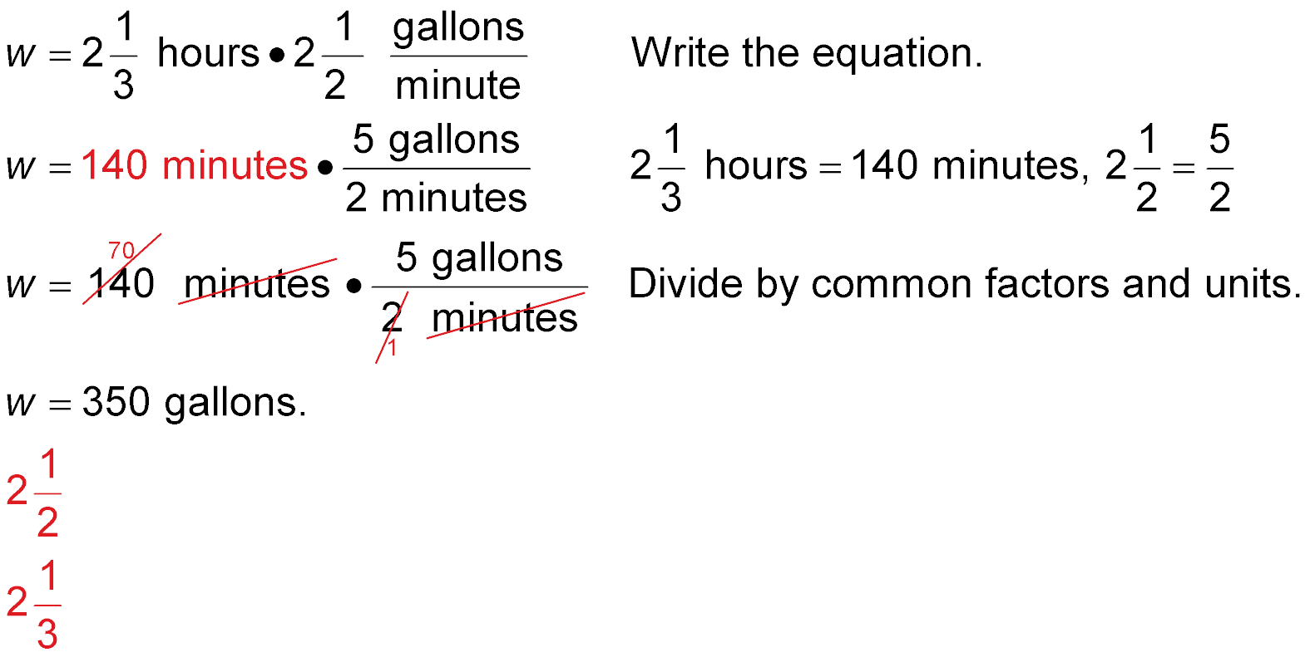
Change 21/3 hours to minutes.
Change 21/2 gallons per minute to gallons per minute.
Cross cancel by dividing by common factors and units.
Solve by multiplying straight across.

Slide 19




A.
B.
C.
D.
A
B
C
D

Slide 20

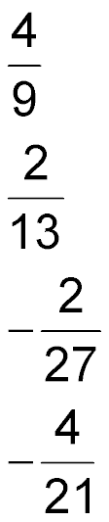
A.
B.
C.
D.
A
B
C
D

Slide 21


A.
B.
C.
D.
A
B
C
D

Slide 22
VOLUNTEER WORK Last summer, the 5th graders
performed a total of 150 hours of community service.
If the 6th graders spent this much time
volunteering, how many hours of community service
did the 6th graders perform?
A. 175 hours B. 190 hours
C. 200 hours D. 225 hours
A
B
C
D

Slide 23
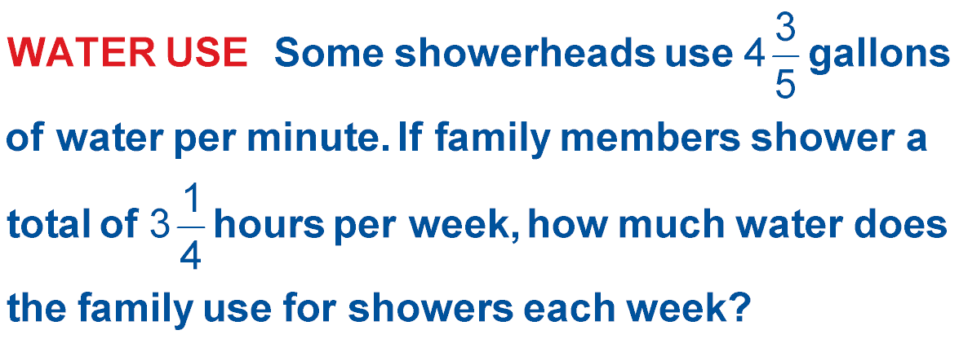
A. 15 gallons B. 38 gallons
C. 775 gallons D. 897 gallons
A
B
C
D

Slide 24




