Slide 1

Splash Screen
Lesson 2-4
Dividing Positive & Negative Fractions

Slide 2





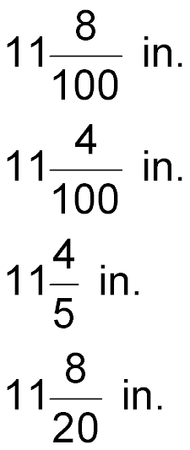



(over Lesson 2-1)
The largest moth is the Atlas moth. The Atlas moth is 11.8 inches long. Which of the following is the length of an Atlas moth written as a mixed number?
A.
B.
C.
D.
A
B
C
D

Slide 3

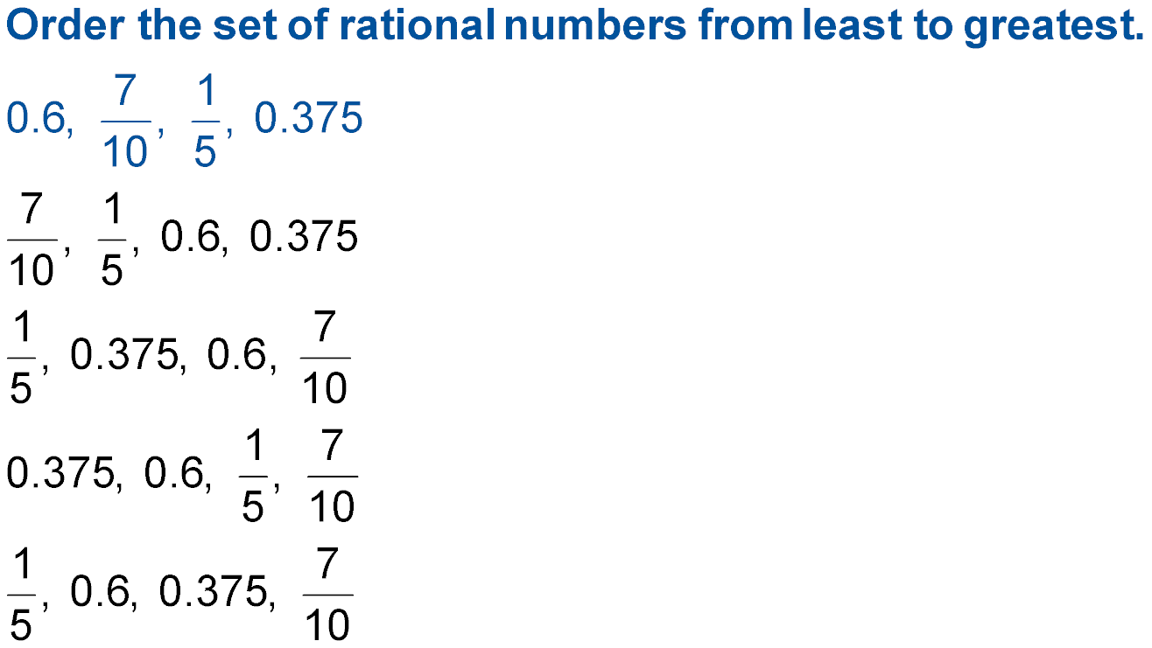

(over Lesson 2-2)
A.
B.
C.
D.
A
B
C
D

Slide 4
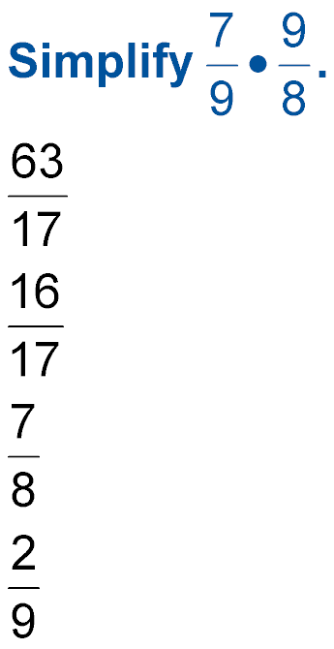


(over Lesson 2-3)
Multiply
A.
B.
C.
D.
A
B
C
D

Slide 5
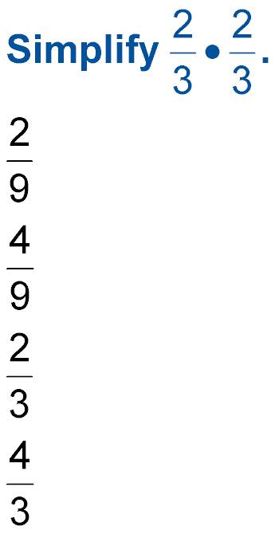

(over Lesson 2-3)
Multiply
A.
B.
C.
D.
A
B
C
D

Slide 6
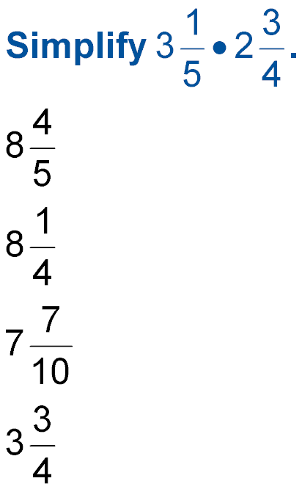

(over Lesson 2-3)
Multiply
A.
B.
C.
D.
A
B
C
D

Slide 7


Divide positive and negative fractions.
reciprocals
The opposite of a fraction or whole number.
4 and ¼ or 2/3 and 3/2 are reciprocals.
multiplicative inverse
The product of a fraction or whole number and its reciprocal equaling one.

Slide 8


Standard 7NS1.2 Add, subtract, multiply, and divide rational numbers (integers, fractions, and terminating decimals) and take positive rational numbers to whole-number powers.

Slide 9
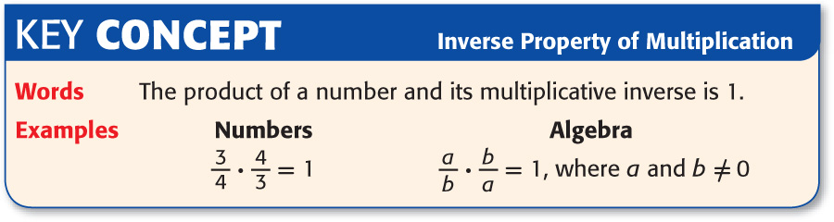

Slide 10

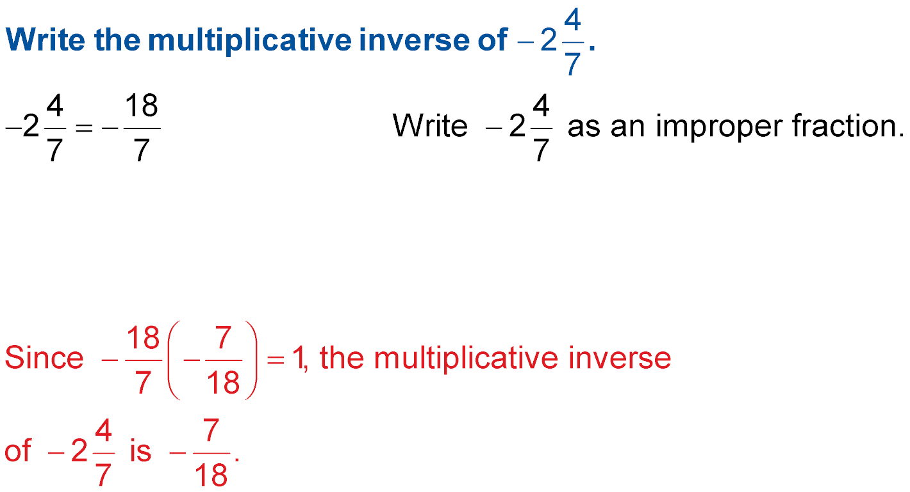
Find a Multiplicative Inverse
Answer:

Slide 11
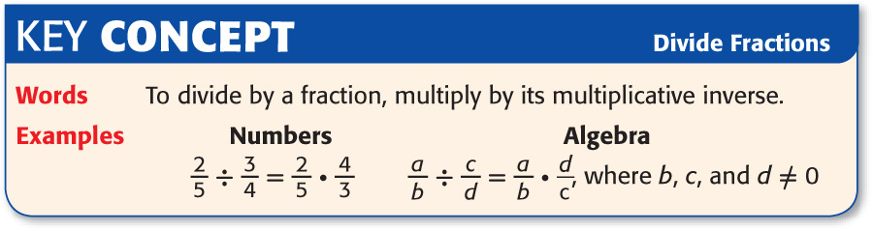

Slide 12
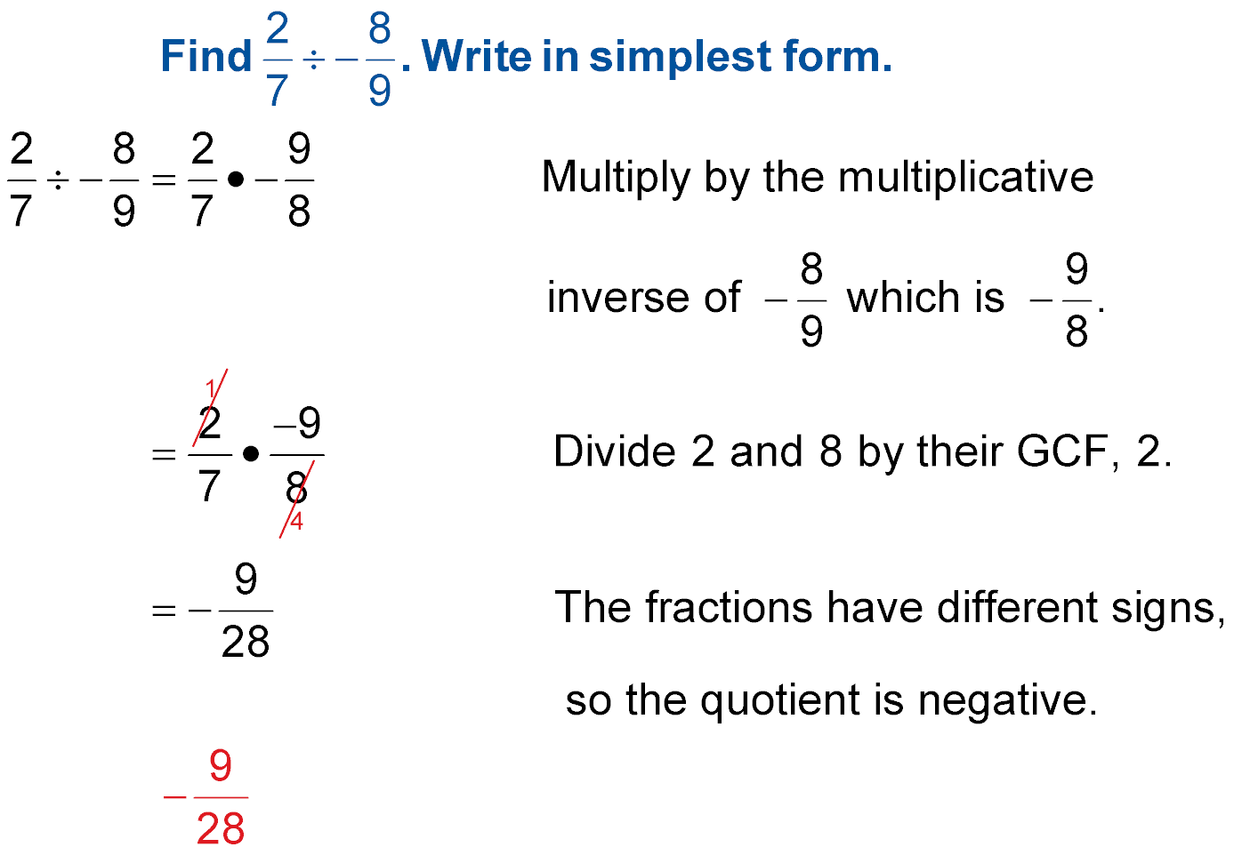
Divide Fractions and Mixed Numbers
Multiply by the multiplicative
The fractions have different signs, so the quotient is negative.
Answer:

Slide 13
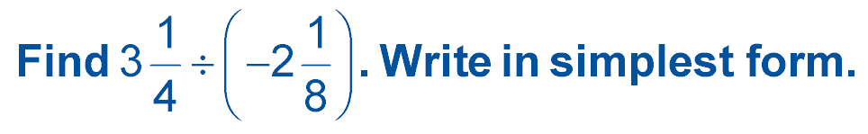
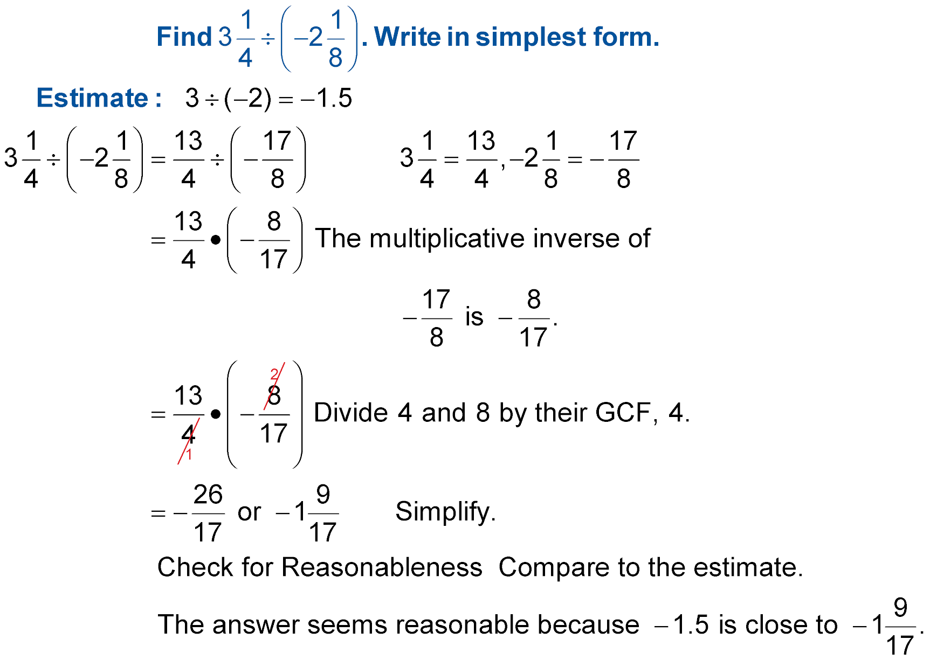
Divide Fractions and Mixed Numbers
The multiplicative
inverse of
You can cross cancel by dividing 4 and 8 by their GCF, 4.
Simplify.

Slide 14

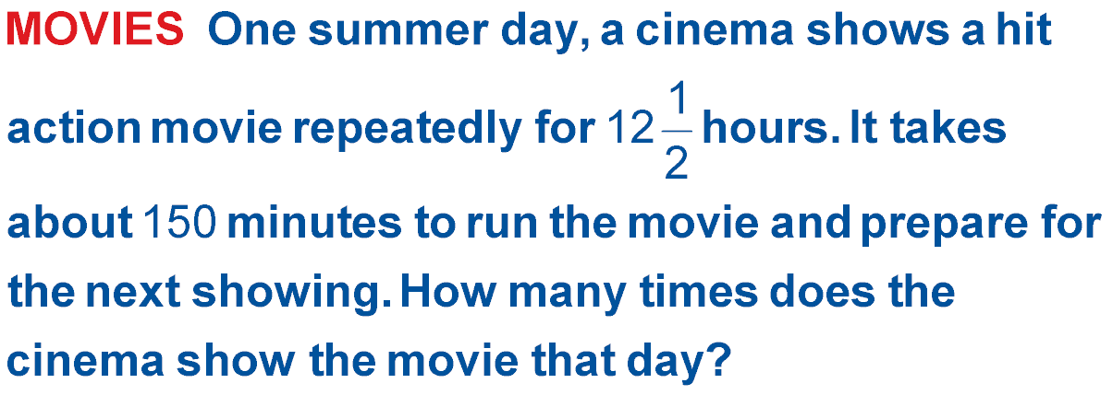
Think,
Since 150 minutes is equal to 21/2 hours, divide 121/2 by 21/2 to get your answer.

Slide 15
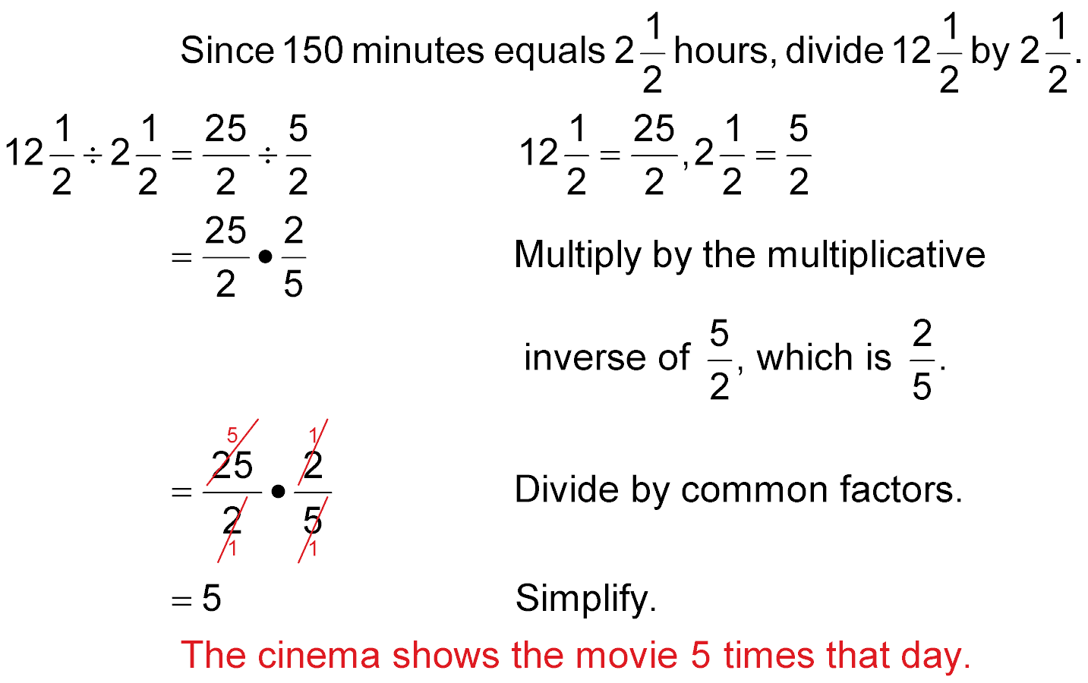
Cross cancel by dividing by the common factors.
= 5
Simplify 5/1.
Answer: The cinema shows the movie 5 times that day.

Slide 16
Think:
If 5 persons each worked 5 days, the project requires (5) 101/2 person-days of work. Divide this number by 4 persons to find the number of days it will take the Reyes family to complete their painting.
PAINTING It took the five members of the Johnson family 101/2 days to paint the seven rooms of their house. At this rate, how long will it take the four members of the Reyes family to complete a similar task in their house?

Slide 17
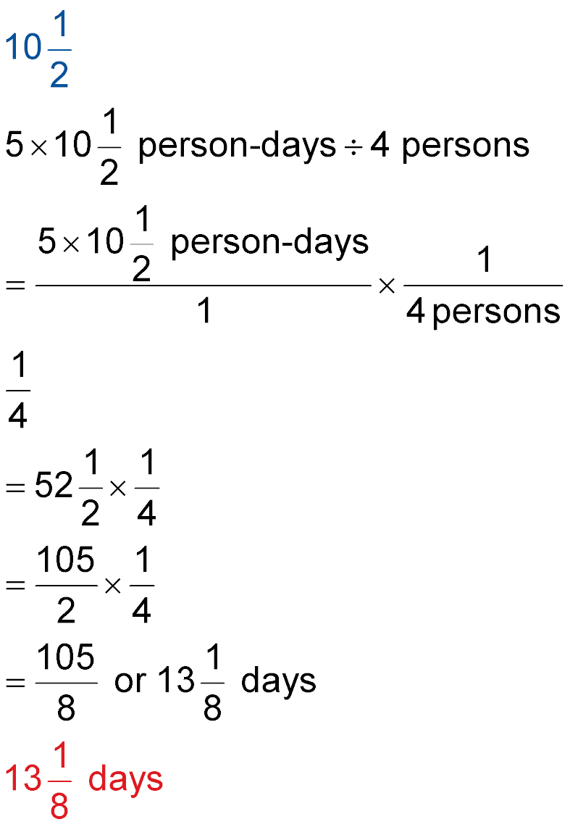
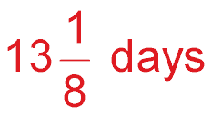
21
2
105
2
5 •
=
÷ 4
Follow P, E, M/D, A/S. Multiply 5 times 21/2 first which is 105/2.
There are no GCF’s to help cross cancel, so multiply 105/2 by the multiplicative inverse of 4, which is 1/4.
Simplify by converting the improper fraction to a mixed number.
Answer:

Slide 18

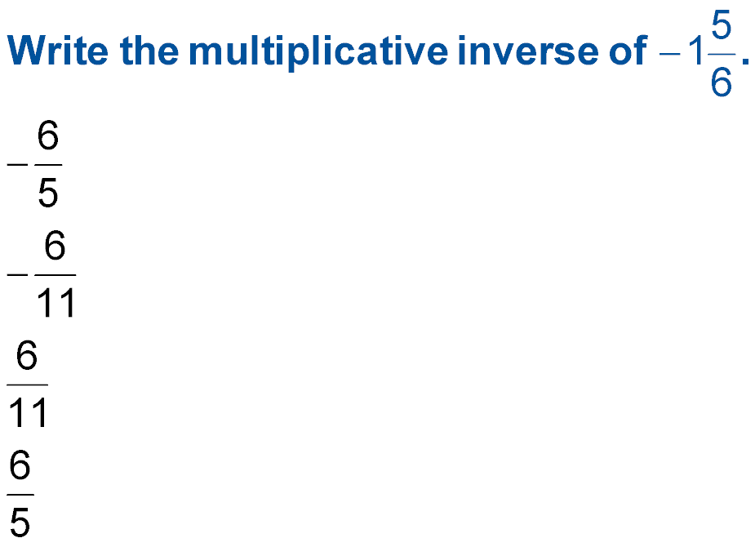
A.
B.
C.
D.
A
B
C
D

Slide 19
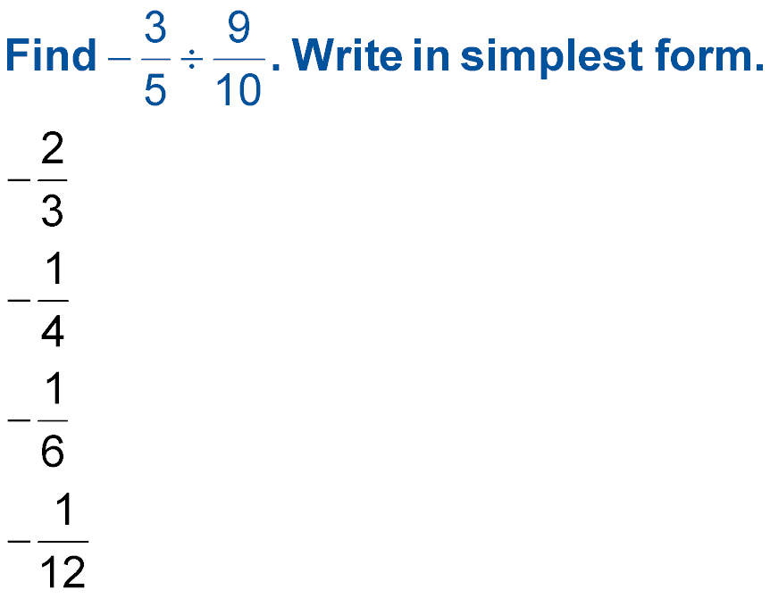
A.
B.
C.
D.
Think:
I must write the multiplicative inverse of the 2nd fraction
I multiply but can I cross cancel first?
A
B
C
D

Slide 20
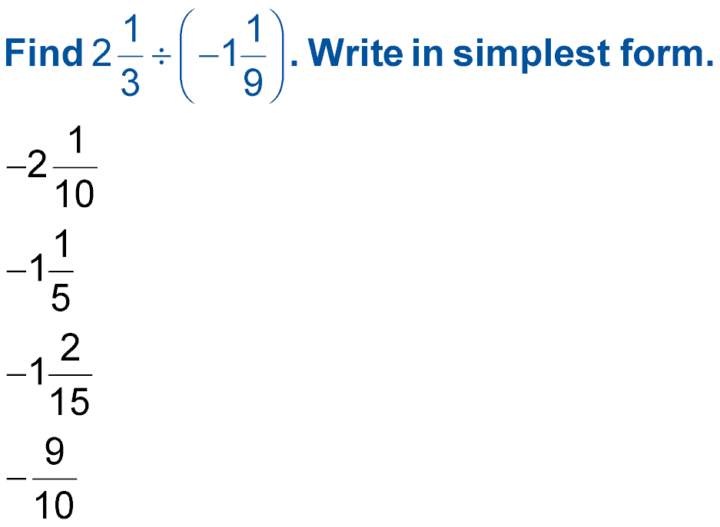
A.
B.
C.
D.
Think:
✔ I must change each mixed number to an improper fraction.
✔ I must write the multiplicative inverse of the 2nd fraction.
✔ I multiply. Can I cross cancel first?
A
B
C
D

Slide 21
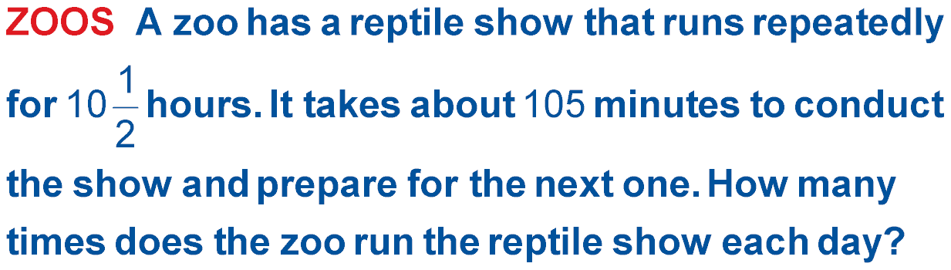
A. 4 times
B. 5 times
C. 6 times
D. 7 times
A
B
C
D

Slide 22
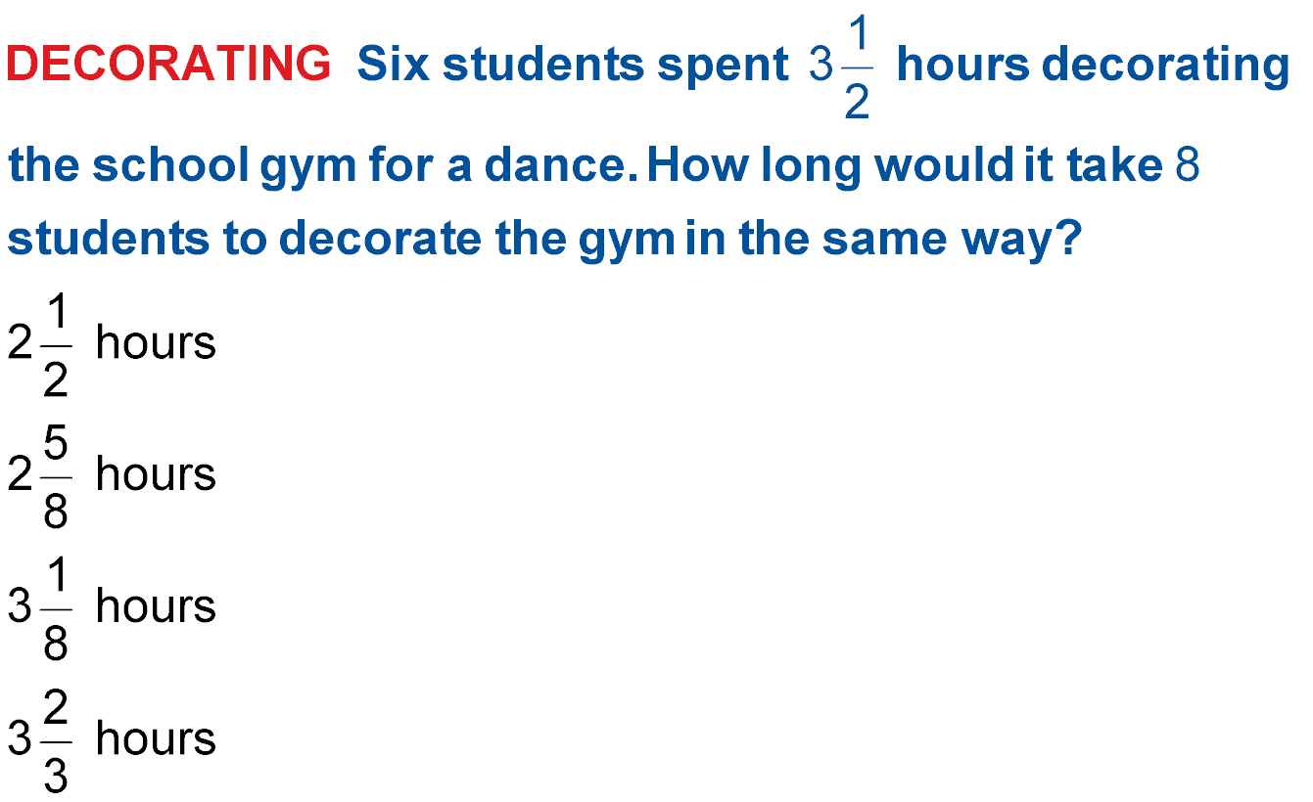
A.
B.
C.
D.
Think:
✔ I need to find out how long it will take six students.
✔ I then need to divide that by eight students.
A
B
C
D

Slide 23




