Slide 1

Splash Screen
Lesson 2-5
Combining Like Fractions

Slide 2




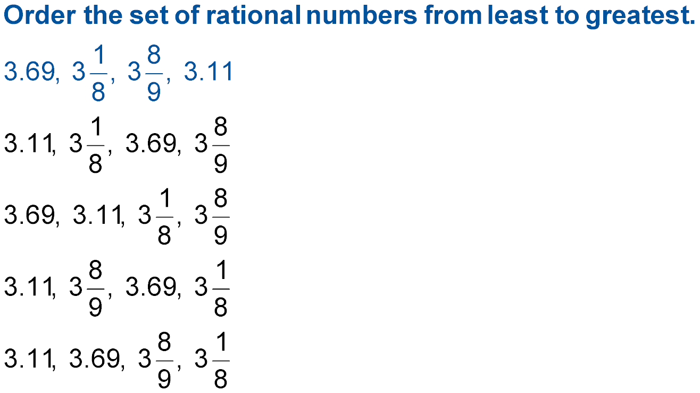



(over Lesson 2-2)
A.
B.
C.
D.
A
B
C
D

Slide 3
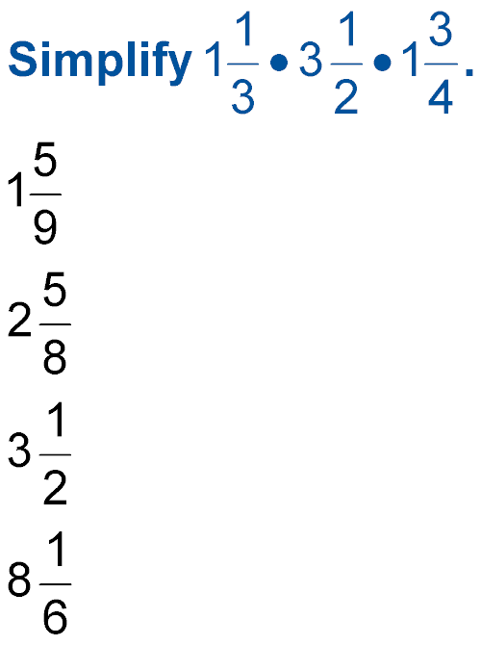

(over Lesson 2-3)
Multiply
A.
B.
C.
D.
A
B
C
D

Slide 4
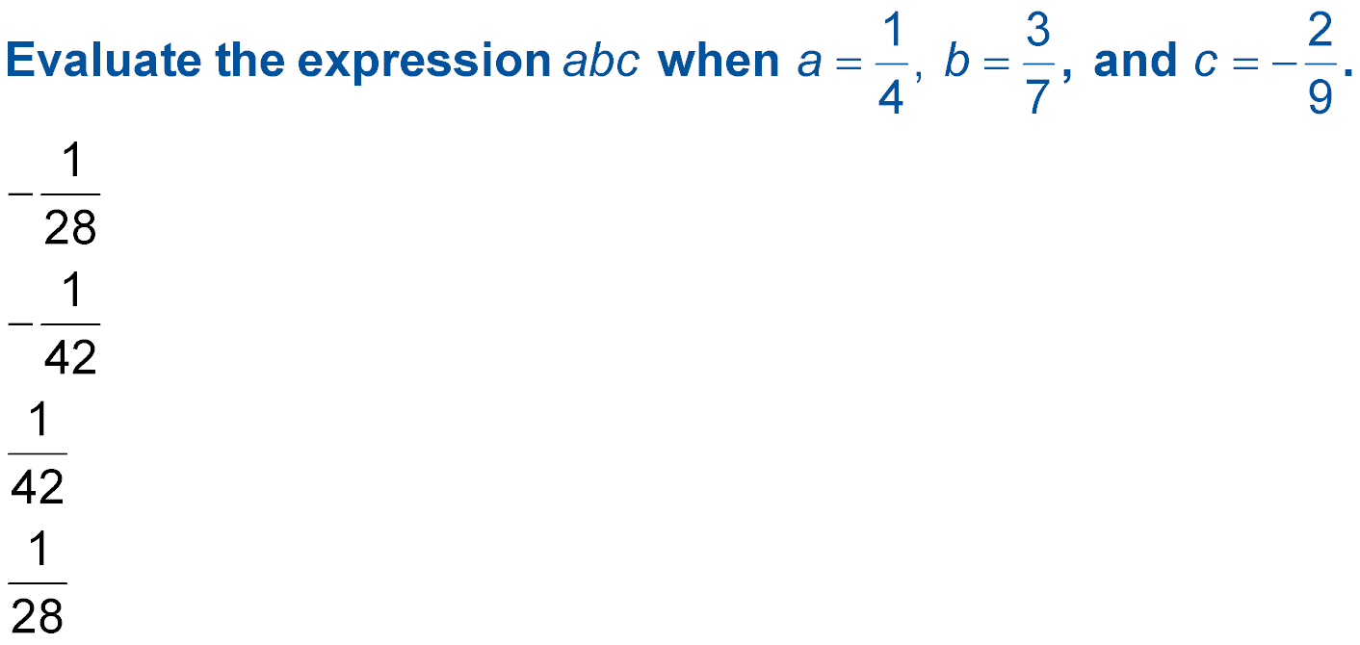

(over Lesson 2-3)
A.
B.
C.
D.
A
B
C
D

Slide 5



(over Lesson 2-4)
Write the multiplicative inverse of 9.
A.
B. 9
–9
D.
A
B
C
D

Slide 6
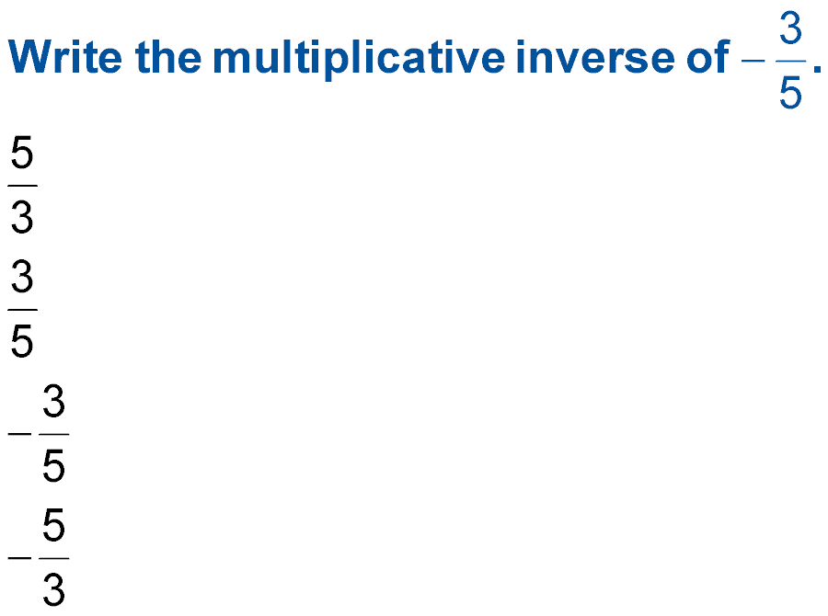

(over Lesson 2-4)
A.
B.
C.
D.
A
B
C
D

Slide 7

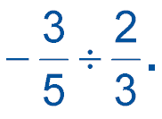
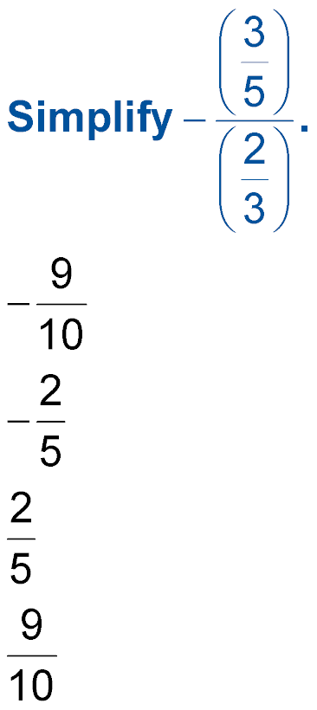
(over Lesson 2-4)
Divide
A.
B.
C.
D.
A
B
C
D

Slide 8


Combine Like Fractions
Combine fractions with like denominations.
like fractions
✓ Fractions that have the same divisors.

Slide 9


Combine Like Fractions
Standard 7NS1.2 Combine, multiply, and divide rational numbers (integers, fractions, and terminating decimals) and take positive rational numbers to whole-number powers.

Slide 10
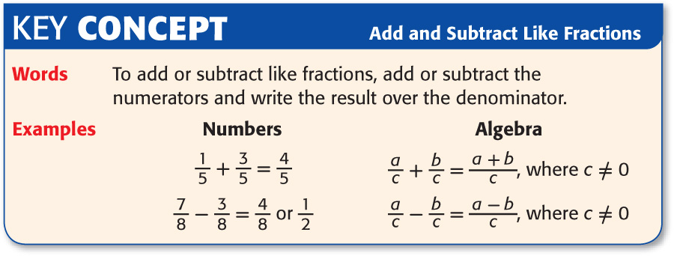
To combine like fractions, combine the dividends and
write the result over the divisor.

Slide 11

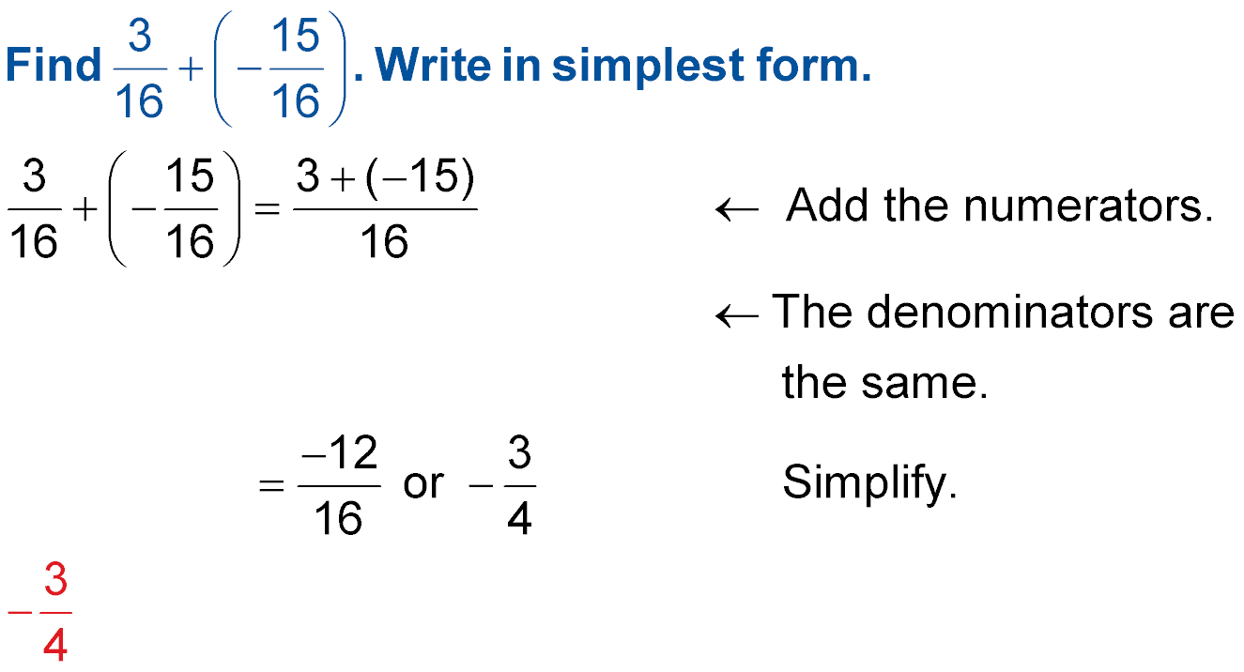
Combine Like Fractions
Combine Like Fractions
Combine the dividends.
The divisors are the same. Leave them as they are.
Simplify by finding the GCF of 12 & 16. Divide the GCF into both the dividend & divisor.
Answer:

Slide 12
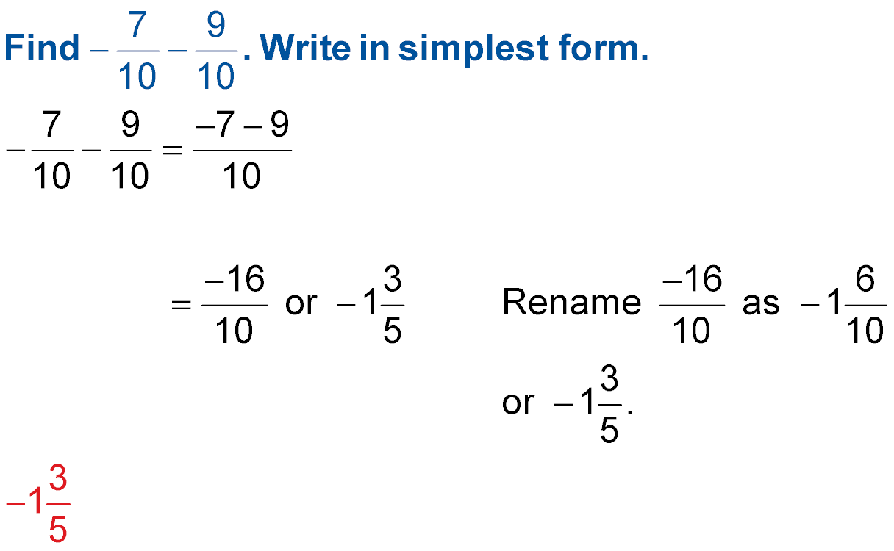
Combine Like Fractions
Combine Like Fractions
Combine the dividends.
The divisors are the same.
Answer:

Slide 13
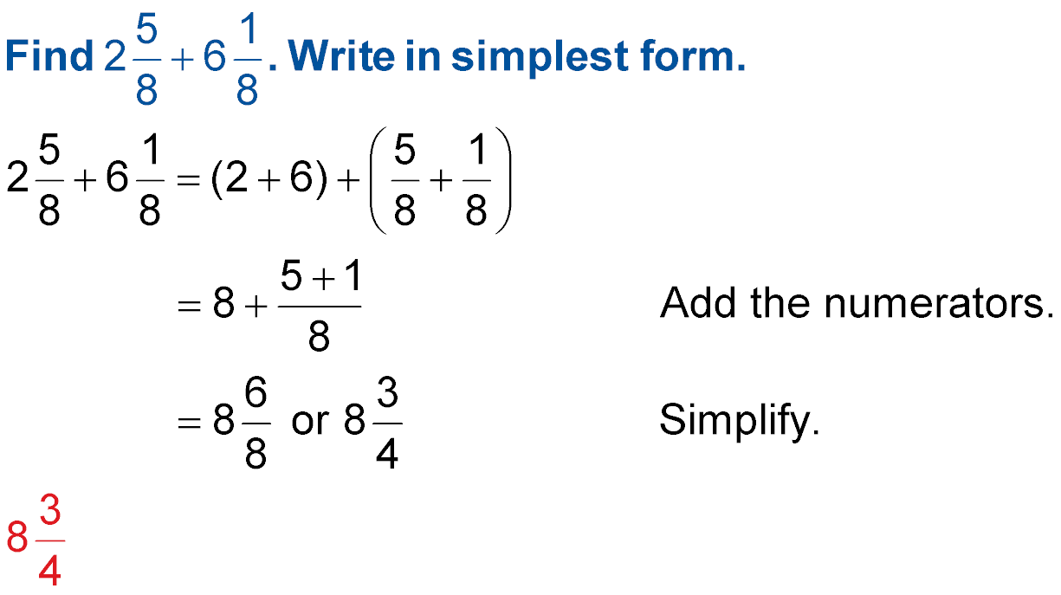
Combine Like Fractions
Combine Mixed Numbers
Combine the whole numbers and fractions separately.
Combine the dividends.
Answer:

Slide 14

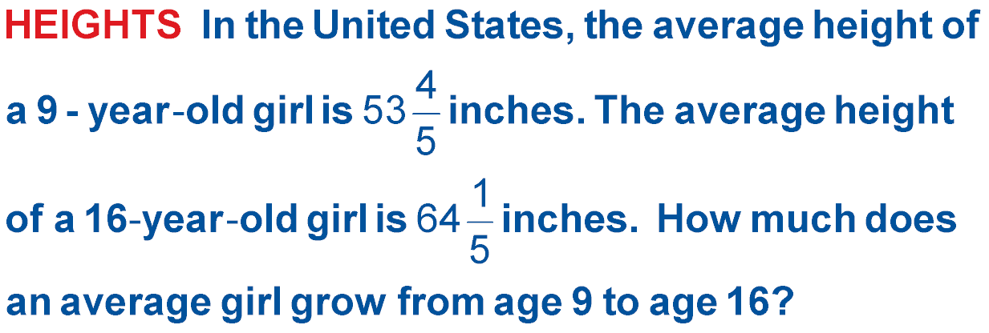
Combine Like Fractions
Combine Mixed Numbers

Slide 15
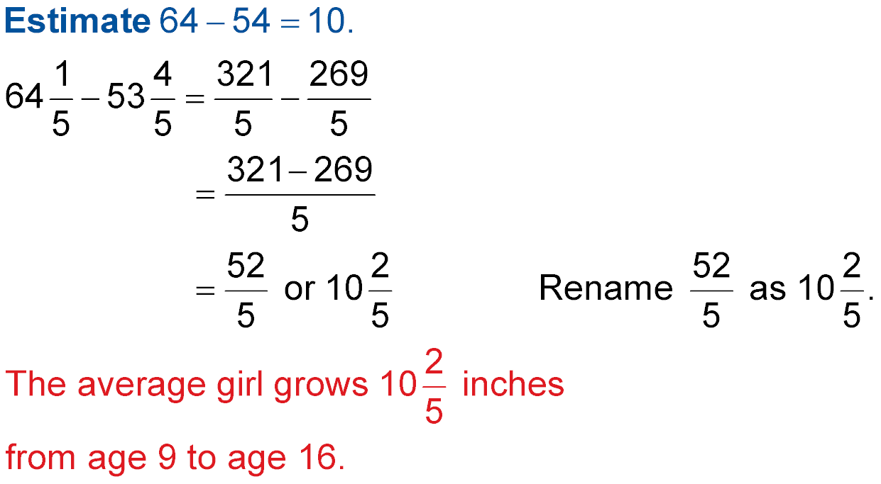
Combine Like Fractions
Combine Mixed Numbers
Write the mixed numbers as improper fractions.
Combine the dividends.
The divisors are the same.
Answer:

Slide 16
Combine Like Fractions
Combine Mixed Numbers with Borrowing
-
10
2
7
5
5
7
You should ALWAYS rewrite a horizontally written fraction problem vertically 1st!!!!!!
☹
Horizontal
☺
Vertical
10
2
7
Notice that the divisors are like. Great, but the top fraction has a smaller dividend than the one on the bottom fraction. OOPS!!!
-
5
5
7
Next Slide Please

Slide 17
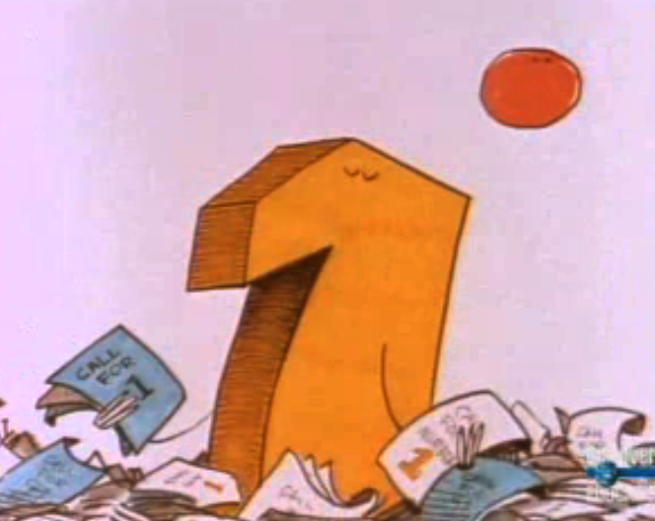
Once again it’s time for the adventures of the number 1.

Slide 18
Combine Like Fractions
Subtract Mixed Numbers with Borrowing
10
2
7
The dividend 2 needed to borrow some value. Otherwise, he would lose for he was less than 5. But, who does he borrow from?
-
5
5
7
I know.
Pick me!
Pick me!
Pick me!
Says 10!
10 - ? = What 2 needs.
So 2 borrows from 10. But how much does he borrow? Being economical, he only wants what he needs & can afford to pay back.
Next Slide Please

Slide 19
Combine Like Fractions
Combine Mixed Numbers with Borrowing
So 2/7 borrows 1 from 10. Ten now becomes nine. So what does 2/7 become? Hmmm, I wonder.
7
7
9
7
Because 2 borrowed 1 from a whole number, he actually borrowed 7/7 which is another name for 1. He added the 7/7 to his 2/7 and became 9/7. Now he was 9 9/7.
2
7
10 = 9 +
9
=
-
-
5
5
7
5
=
5
7
He was ready to take on 5 and
his enemy 5/7.
Next Slide Please

Slide 20
Combine Like Fractions
Combine Mixed Numbers with Borrowing
Finally 9/7 was on even ground with 5/7. The difference between nine sevenths and five sevenths is 4/7.
9
2
7
9
9
7
=
-
5
5
7
5
5
7
=
Therefore 4/7 is the fractional part left over. But what about the whole numbers?
4
7
4
The difference between a 9 and a 5 is ………….4!
Next Slide Please

Slide 21
Once again 1 proves
that it can do the job of any number.

Slide 22

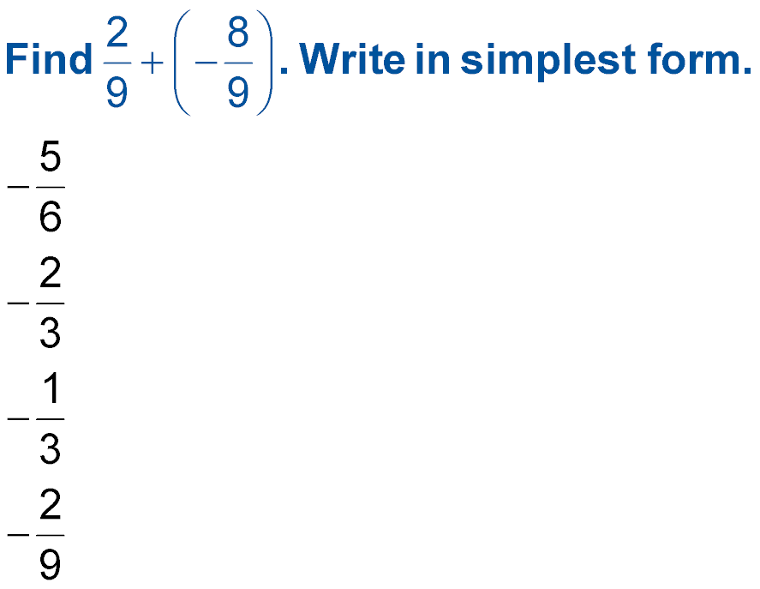
Combine Like Fractions
A.
B.
C.
D.
A
B
C
D

Slide 23
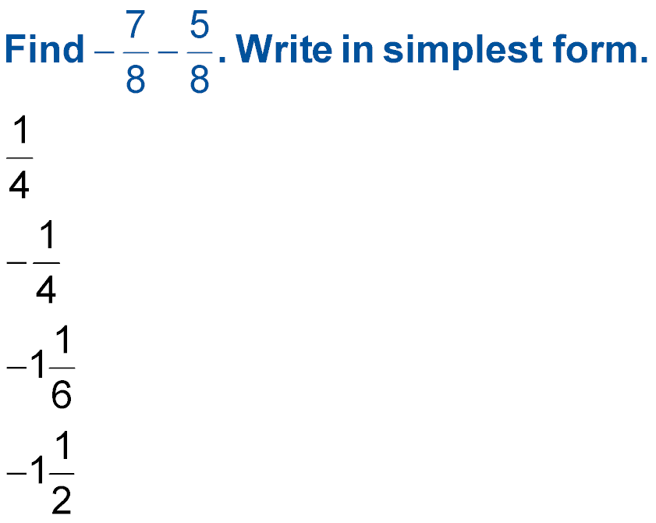
Combine Like Fractions
A.
B.
C.
D.
A
B
C
D

Slide 24
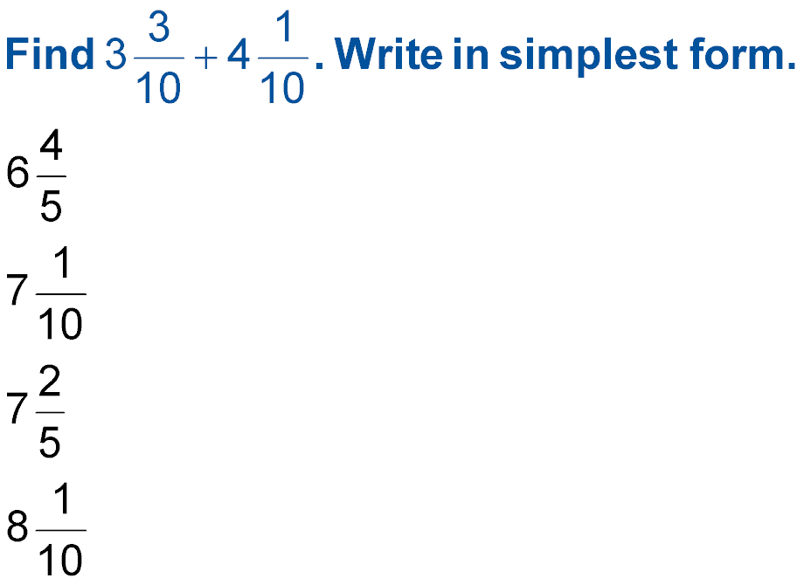
Combine Like Fractions
A.
B.
C.
D.
A
B
C
D

Slide 25
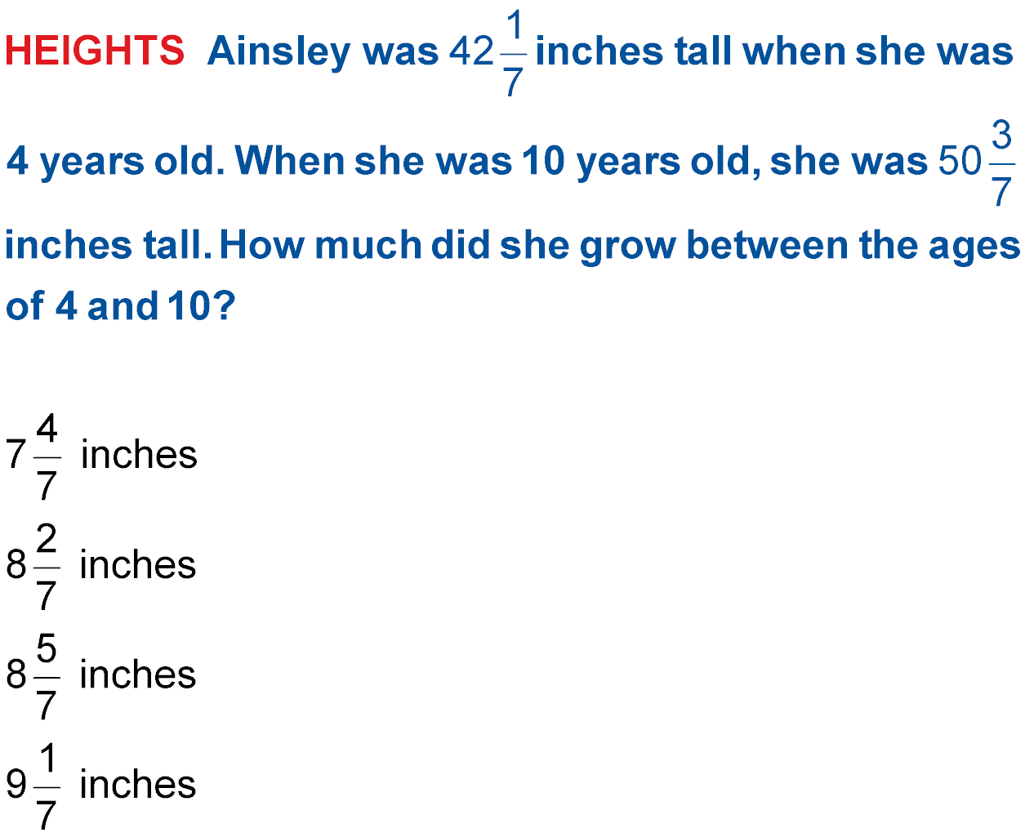
Combine Like Fractions
A.
B.
A
B
C
D
C.
D.

Slide 26
Combine Like Fractions
Find 32/9 – 15/9 =
A. 23/9
B. 12/9
C. 12/3
D. 16/9

Slide 27
Combine Like Fractions
Find 12/5 – 3/5 =
A. 21/5
B. -14/5
C. 4/5
D. 7/5

Slide 28




