Slide 1
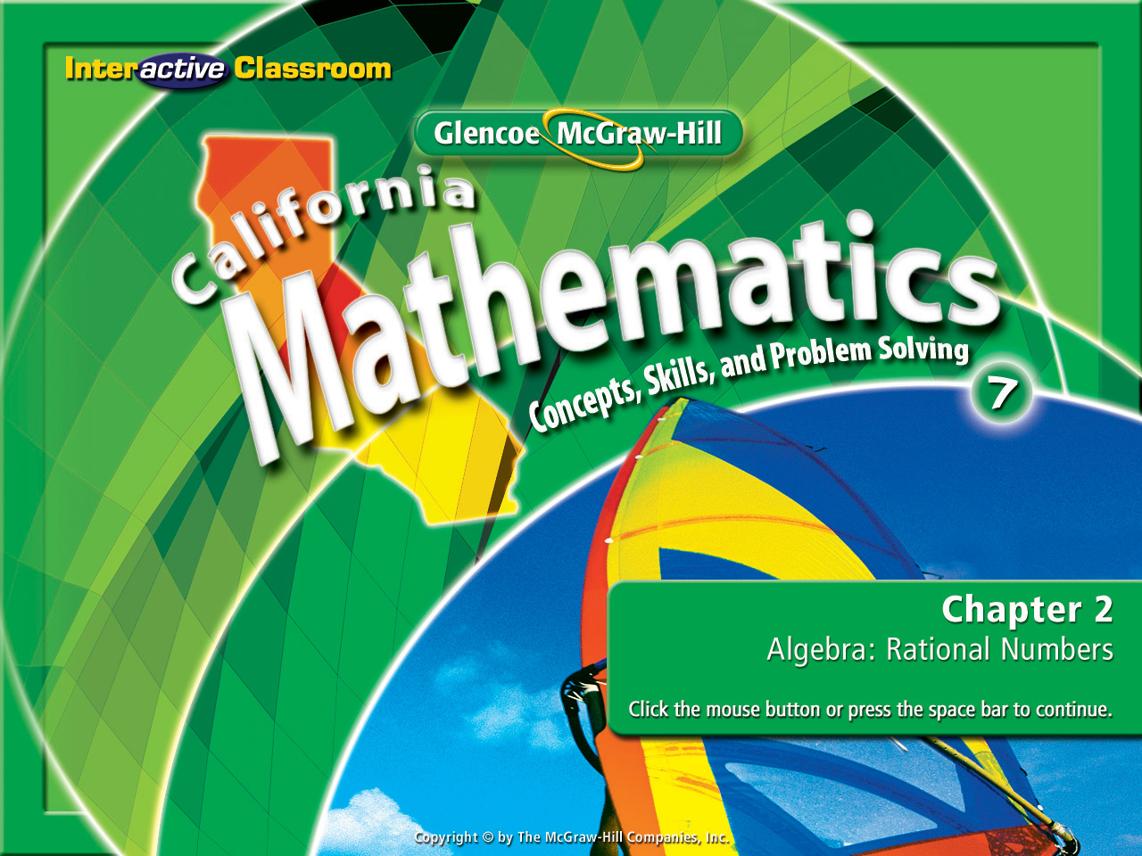
Splash Screen
Lesson 2-6
Combining Unlike Fractions

Slide 2




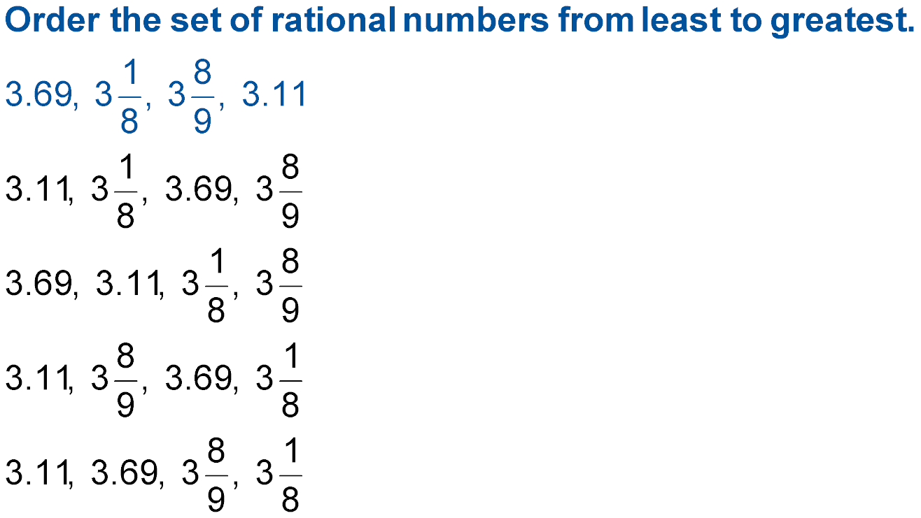



(over Lesson 2-2)
A.
B.
C.
D.
A
B
C
D

Slide 3


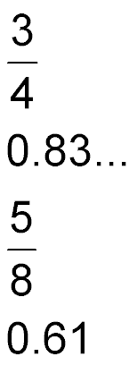

(over Lesson 2-2)
Which number is least?
A.
B. 0.83
C.
D. 0.61
A
B
C
D

Slide 4

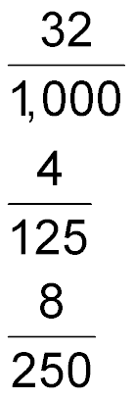
(over Lesson 2-3)
Which of the following is 0.032 written as a fraction in simplest form?
A. 3.2
B.
C.
D.
A
B
C
D

Slide 5
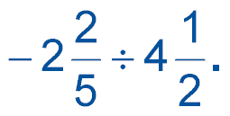

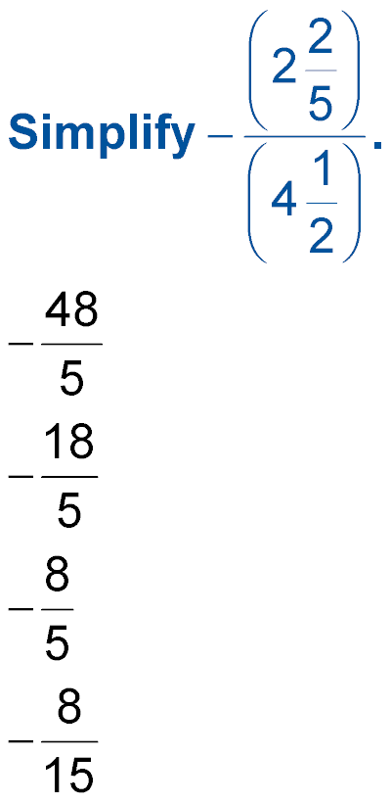
(over Lesson 2-4)
Divide
A.
B.
C.
D.
A
B
C
D

Slide 6


Combine UnLike Fractions
Combine fractions with unlike divisors.
unlike fractions
✓ Fractions that have the different divisors.

Slide 7


Combine UnLike Fractions
Standard 7NS1.2 Combine, multiply, and divide rational numbers (integers, fractions, and terminating decimals) and take positive rational numbers to whole-number powers.
Standard 7NS2.2 Combine fractions by using factoring to find common divisors.

Slide 8

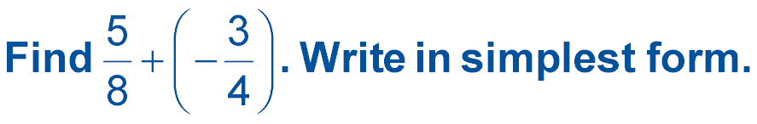
Combine UnLike Fractions
Combine Unlike Fractions
5
8
=
3
4
-
=

Slide 9
Combine UnLike Fractions
Finding The “Least Common Multiple”
- 4
5
8
8
12
=
+ 2
5
12
=

Slide 10
Combine UnLike Fractions
Finding The “Least Common Multiple”
- 3
5
6
6
15
=
- 5
4
15
=

Slide 11

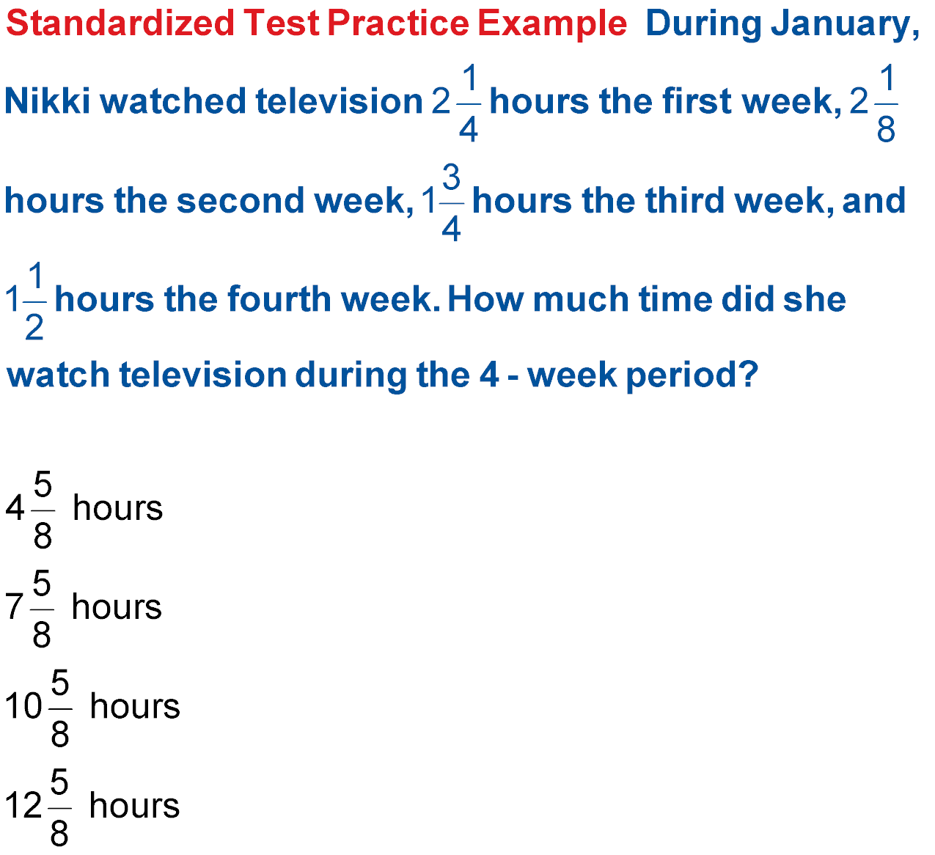
Combine UnLike Fractions
EXAMPLE During January, Nikki watched television hours the first week,
hours the second week, hours the third week, and hours the fourth
week. How much time did she watch television during the 4-week period?
Read the Item
You need to find the sum of four mixed numbers. First we need an LCD. What number could each denominator be made into?

Slide 12
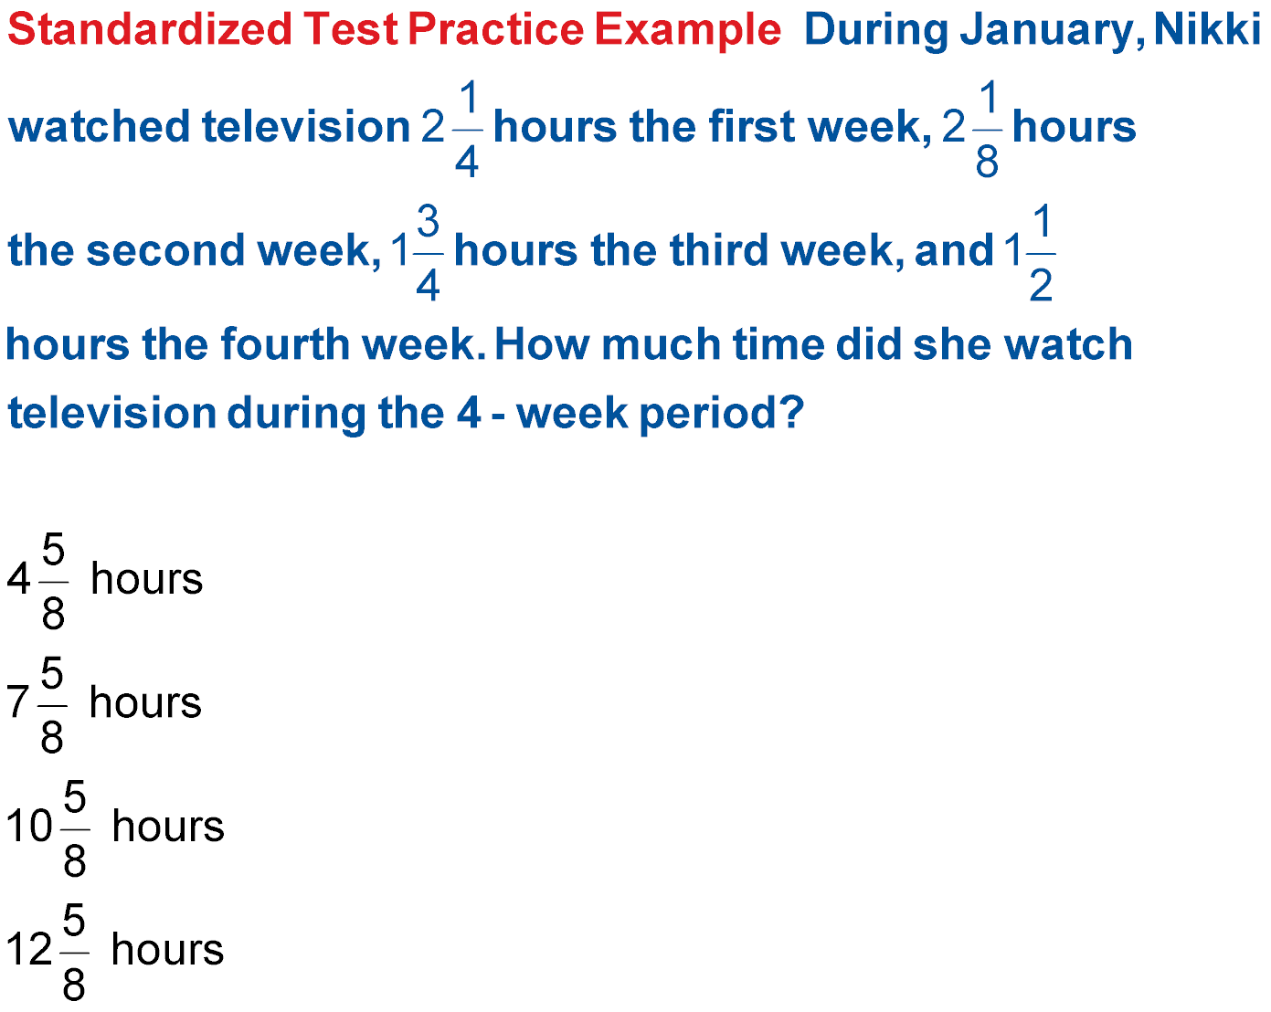
Combine UnLike Fractions
2
1
8
=
2
1
4
=
1
3
4
=
1
1
2
=
A B C D

Slide 13

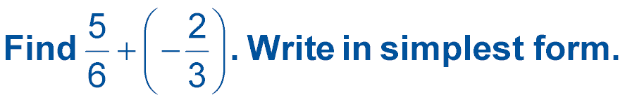

Combine UnLike Fractions
A.
B.
C.
D.
A
B
C
D

Slide 14
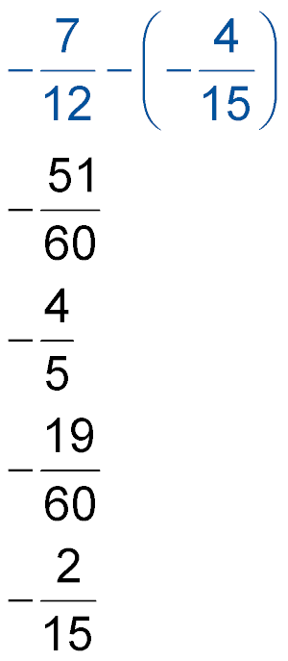
Combine UnLike Fractions
Combine. Write in simplest form.
A.
B.
C.
D.
A
B
C
D

Slide 15
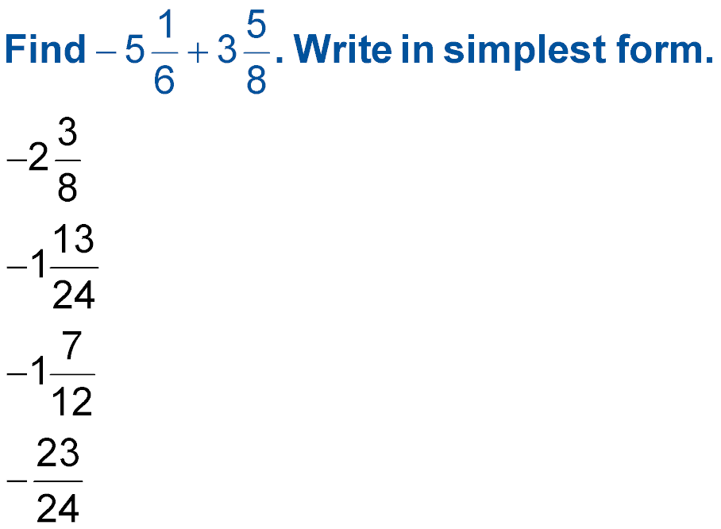
Combine UnLike Fractions
A.
B.
C.
D.
A
B
C
D

Slide 16
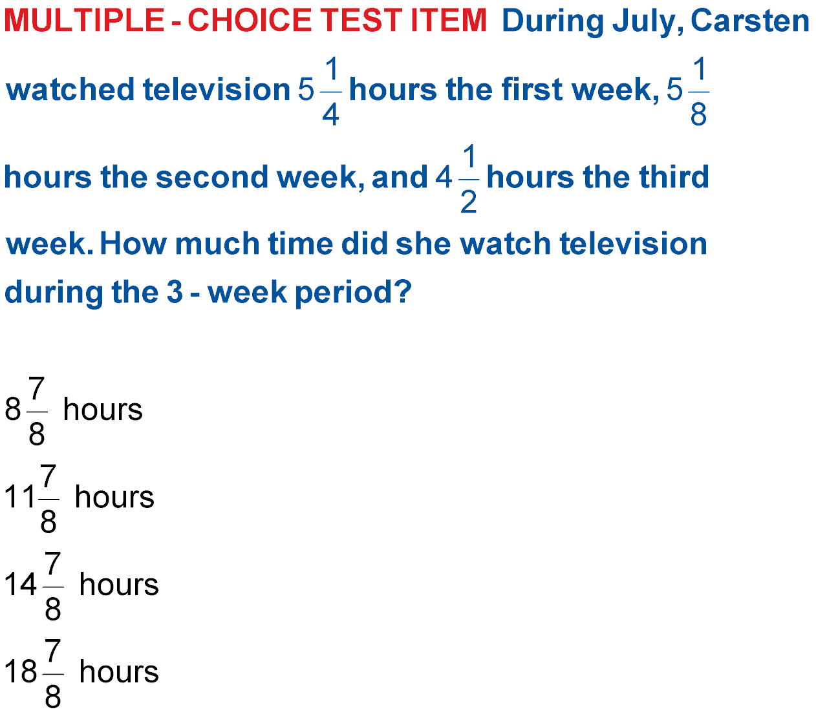
Combine UnLike Fractions
During July, Carsten watched television hours the first week,
hours the second week, and hours the third week. How much
time did she watch television during the 3-week period?
A. B.
C D.
A
B
C
D

Slide 17




