Slide 1
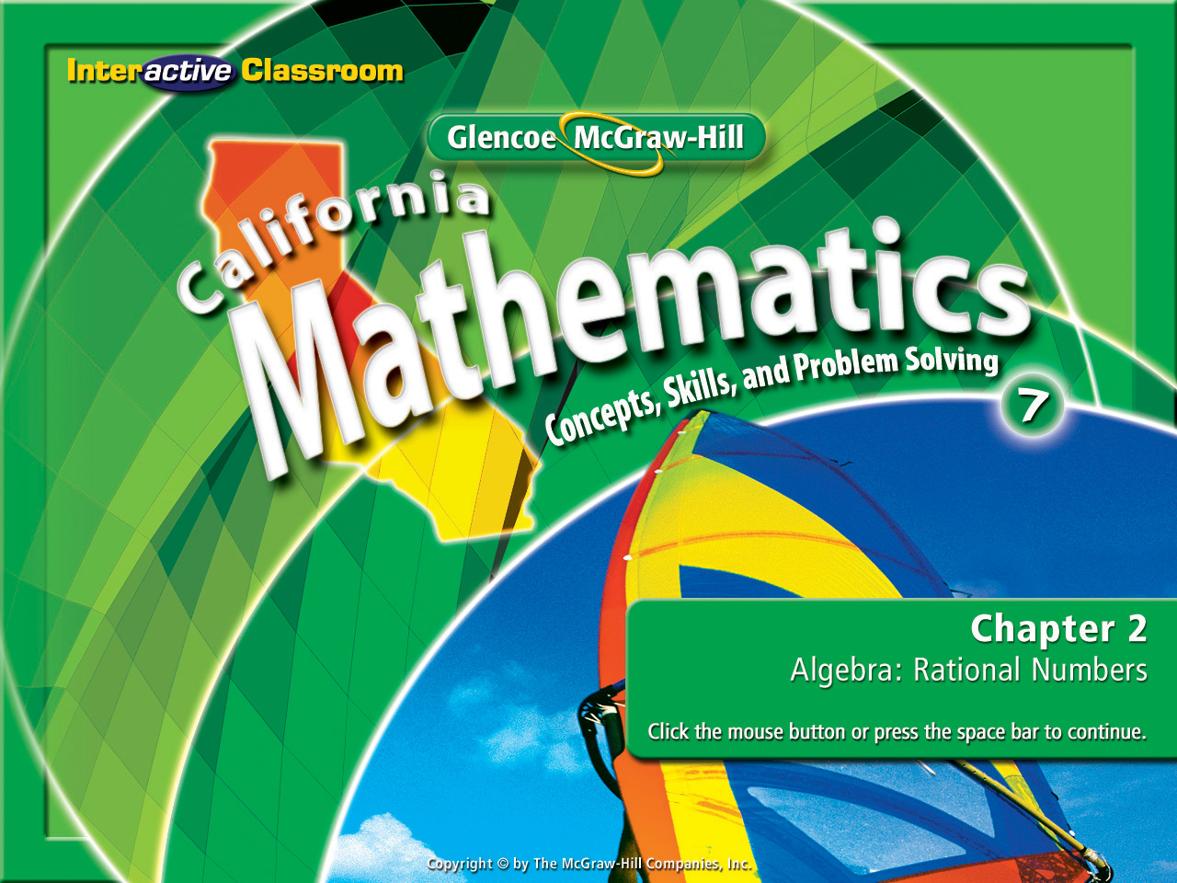
Splash Screen
Lesson 2-7
Solving Equations With Rational Numbers

Slide 2



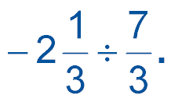

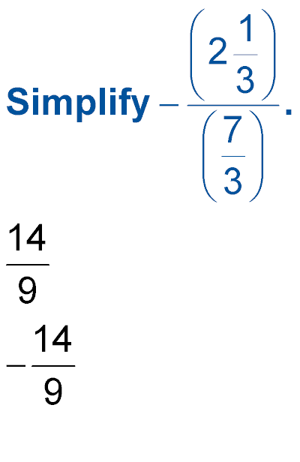



(over Lesson 2-4)
Divide
A.
B. 1
C. –1
D.
A
B
C
D

Slide 3
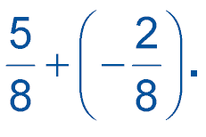

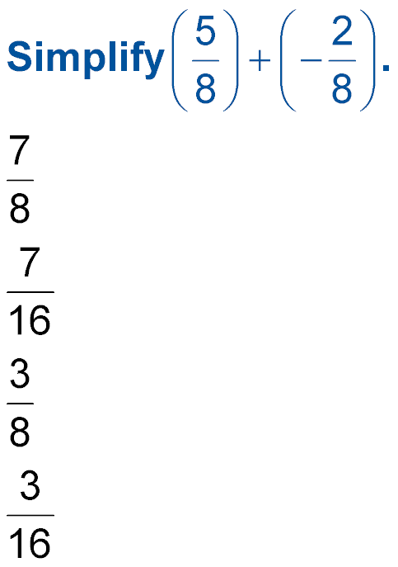
(over Lesson 2-5)
Find
A.
B.
C.
D.
A
B
C
D

Slide 4
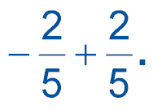

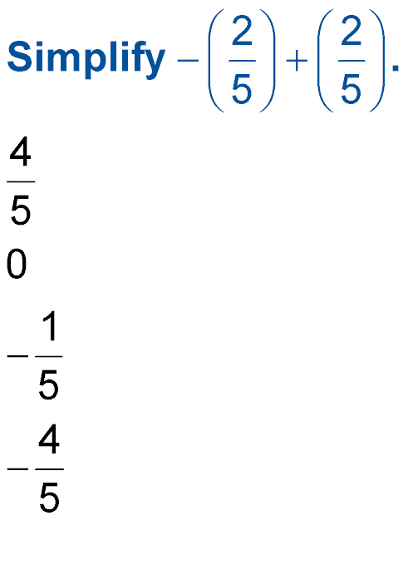
(over Lesson 2-5)
Find
A.
B. 0
C.
D.
A
B
C
D

Slide 5
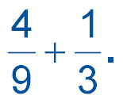

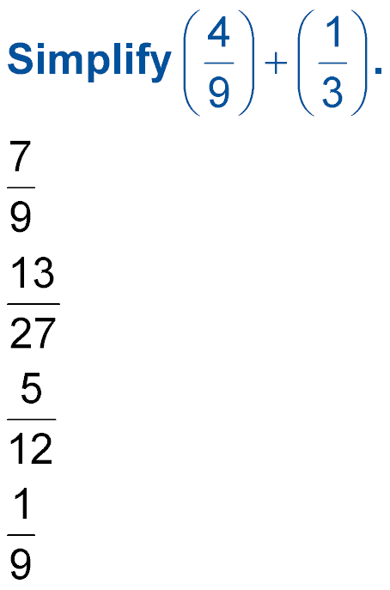

(over Lesson 2-6)
Find Write in simplest form.
A.
B.
C.
D.
A
B
C
D

Slide 6
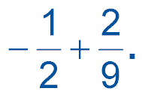

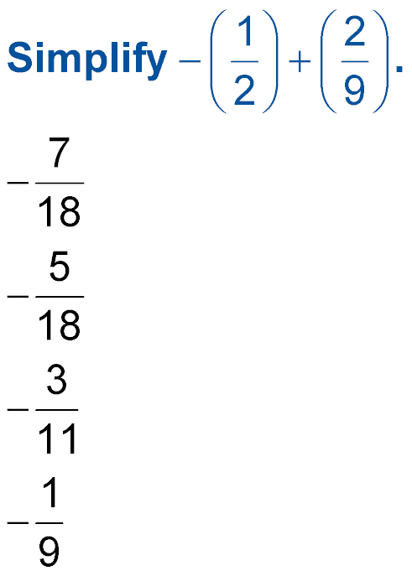
(over Lesson 2-6)
Find Write in simplest form.
A.
B.
C.
D.
A
B
C
D

Slide 7


Standard 7AF1.1 Use variables and appropriate operations to write an expression, an equation, an inequality, or a system of equations or inequalities that represents a verbal description (e.g. three less than a number, half as large as an area A).
Standard 7NS1.2 Combine, multiply, and divide rational numbers (integers, fractions, and terminating decimals) and take positive rational numbers to whole-number powers.

Slide 8

Solve by Using Addition or Subtraction
Solve g + 2.84 = 3.62.
g + 2.84 = 3.62
Write the equation.
Combine a -2.84 to each side.
Simplify. Find the solution
for g.

Slide 9
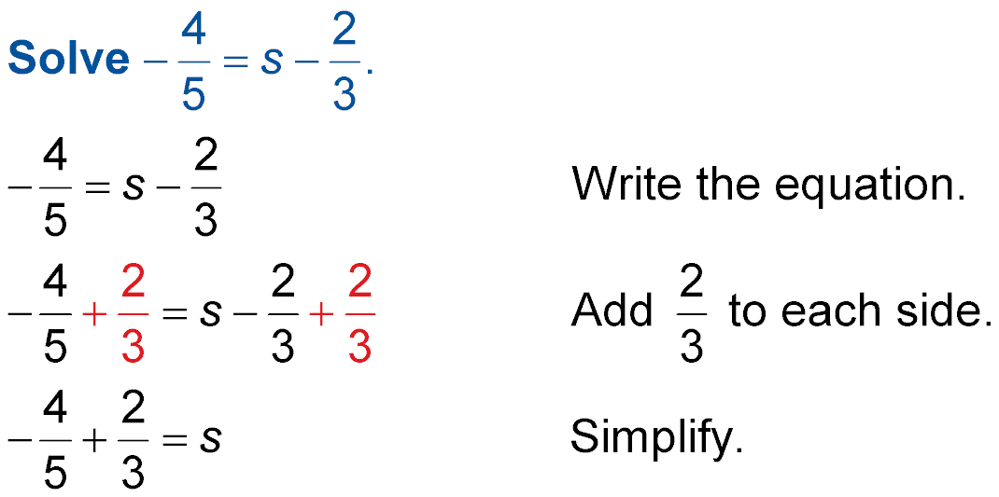
Solve by Using Addition or Subtraction
Combine

Slide 10
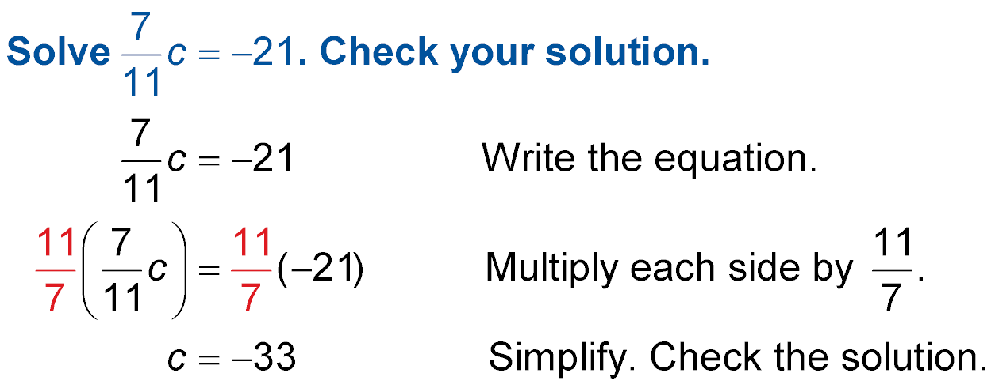
Solve by Using Multiplication or Division
Use the multiplicative inverse
on each side of the equation.

Slide 11
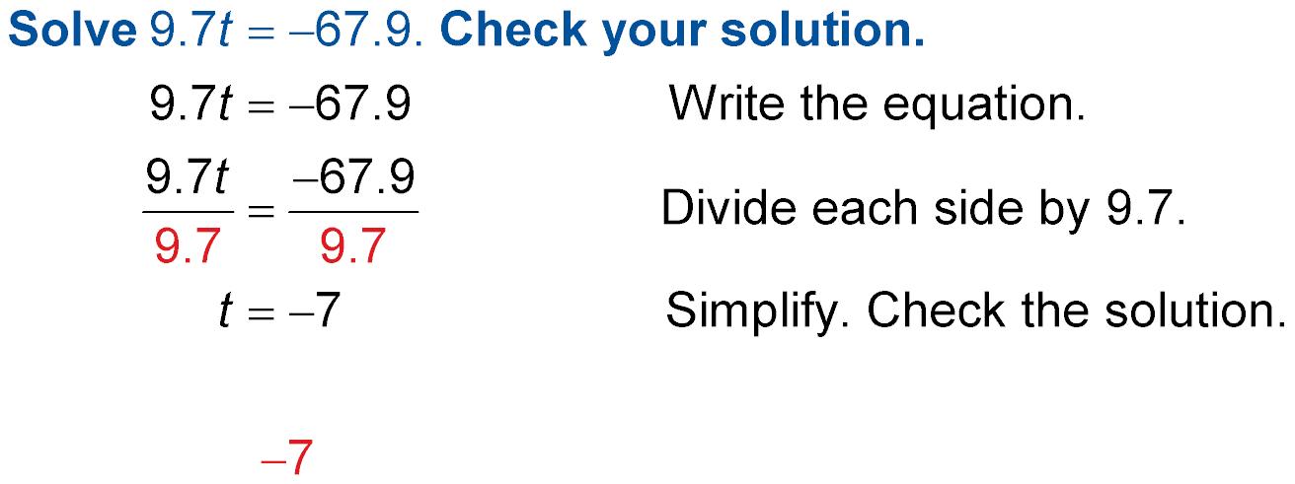
Solve by Using Multiplication or Division
Use the multiplicative inverse of 9.7
to divide each side of the equation.

Slide 12

Solve h + 2.65 = 5.73.
A. 3.08
B. 3.26
C. 7.92
D. 8.38
A
B
C
D

Slide 13
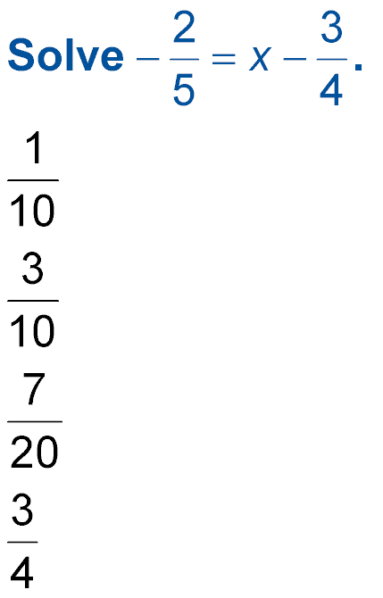
A.
B.
C.
D.
A
B
C
D

Slide 14

A. 22
B. 9
C. –12
D. –45
A
B
C
D

Slide 15
Solve 3.4t = –27.2.
A. –12
B. –8
C. –5
D. –2
A
B
C
D

Slide 16




