Slide 1
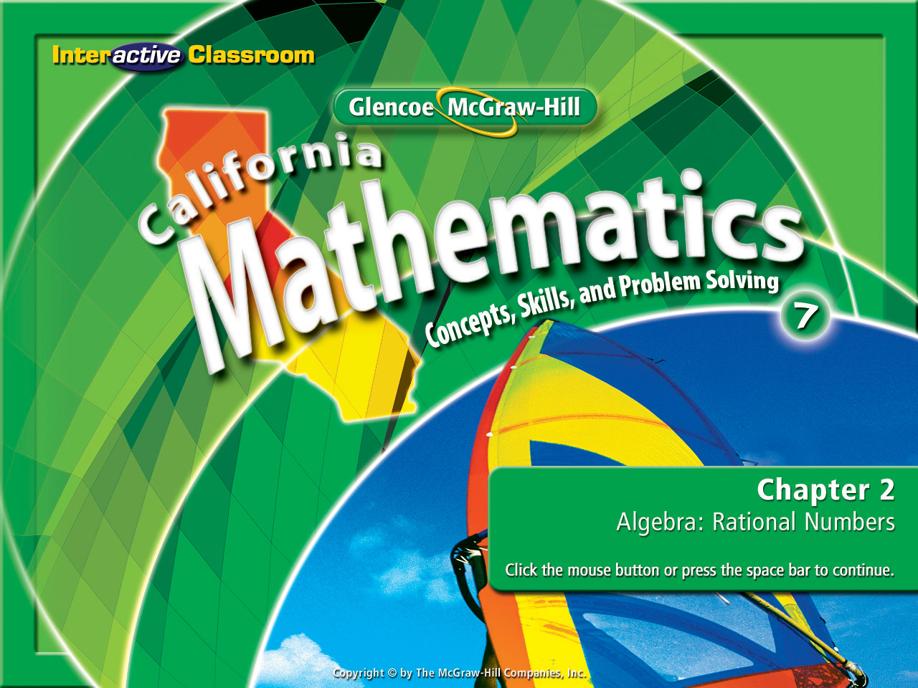
Splash Screen
Lesson 2-9
Powers & Exponent

Slide 2




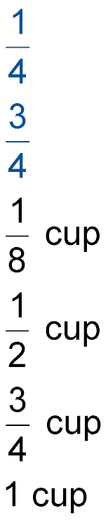




(over Lesson 2-4)
A traditional salad dressing requires cup of oil
and cup of vinegar per serving. How much oil
is in a half serving?
A. B.
C. D. 1 cup
A
B
C
D

Slide 3
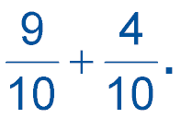

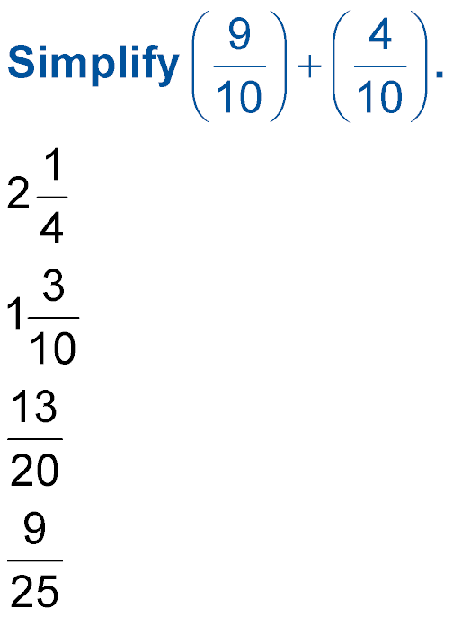

(over Lesson 2-5)
Find
A.
B.
C.
D.
A
B
C
D

Slide 4
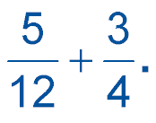

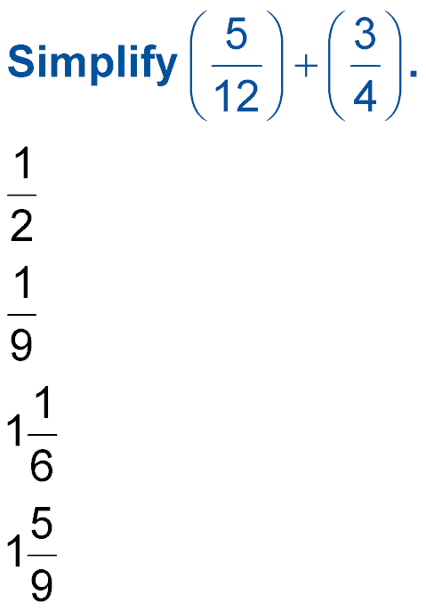
(over Lesson 2-6)
Find Write in simplest form.
A.
B.
C.
D.
A
B
C
D

Slide 5
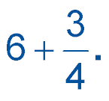

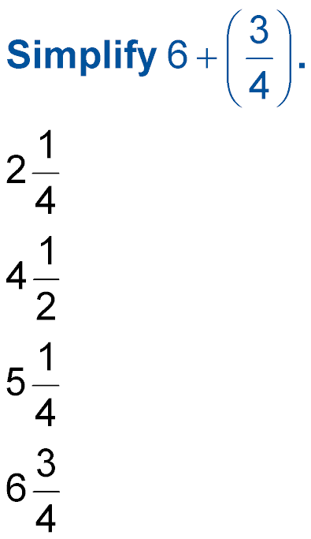
(over Lesson 2-6)
Find - Write in simplest form.
A.
B.
C.
D.
A
B
C
D

Slide 6
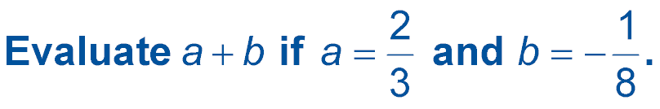

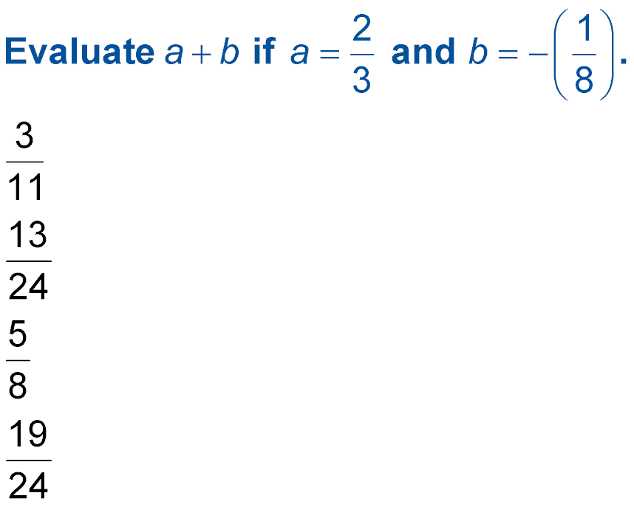
(over Lesson 2-6)
A.
B.
C.
D.
A
B
C
D

Slide 7


(over Lesson 2-7)
Solve c + 2.16 = 5. Then check your solution.
A. 7.10
B. 2.84
C. –2.84
D. –16.6
A
B
C
D

Slide 8


Use powers and exponents in expressions and evaluate.
power
The use of a base number and an exponent.
base
A factor being repeated.
exponent
The number of times a base is repeated.
2⁴

Slide 9


Standard 7NS1.2 Combine, multiply, and divide rational numbers (integers, fractions, and terminating decimals) and take positive rational numbers to whole-number powers.
Standard 7NS2.1 Understand negative whole-number exponents. Multiply and divide expressions involving exponents with a common base.
Standard 7AF2.1 Interpret positive whole-number powers as repeated multiplication and negative whole- number powers as repeated division or multiplication by the multiplicative inverse. Simplify and evaluate expressions that include exponents.

Slide 10


Slide 11
Presents

Slide 12
A Watch and
Discover!

Slide 13
One of the following correctly represents the fractions in exponent form:
3/4 • 3/4 • 3/4 • 3/4• 3/4
3⁵
4
5
3⁵
4⁵
3
4
3
4⁵

Slide 14
Here’s a new set of equations to ponder:
9
1
512
1
2
½ • ½ • ½ • ½ • ½ • ½ • ½ • ½ • ½
= equals =
= equals =
4
2
3
16
81
2/3 • 2/3 • 2/3 • 2/3
= equals =
= equals =
8
125
3
2
5
= equals =
2/5 • 2/5 • 2/5
= equals =
10
a
b
= equals =
a/b • a/b • a/b • a/b • a/b • a/b • a/b • a/b • a/b • a/b

Slide 15
Okay, which of the following correctly represents the fractions in exponent form?
3/4 • 3/4 • 3/4 • 3/4• 3/4
3⁵
4
5
3⁵
4⁵
3
4
3
4⁵

Slide 16


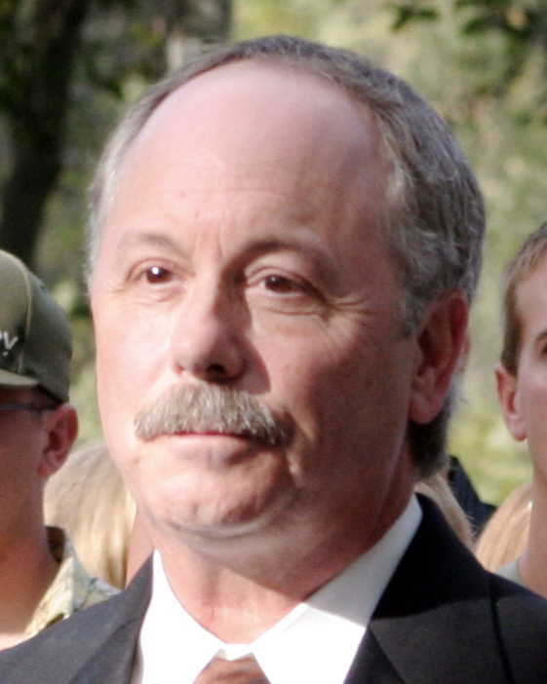
So what’s the rule for this one?

Slide 17
Rule
8
125
3
2
5
2/5 • 2/5 • 2/5
= equals =
= equals =

Slide 18
Look these over & decide what is happening:
2
3
2
3
2
3
2
3
2
3
4
4
4
•
•
•
•
•
•
•
2
3
2
3
2
3
2
3
2
3
(
)
(
)
•
•
•
•
•
4
4
4
•
•
2
3
5
(
)
4³
•

Slide 19
Does it matter if we use letters?
a • a • a • b • b • b • b = a • b • b • a • a • b • b
(a • a • a) • (b • b • b • b)
a³ • b⁴

Slide 20
Rule
2
3
2
3
2
3
2
3
2
3
(
)
(
)
•
•
•
•
•
4
4
4
•
•
2
3
5
(
)
4³
•

Slide 21
nothing
zilch
zero
nada
0
What if zero is used as an exponent?
0⁰ = 1
a⁰ = 1
2⁰ = 1
10⁰ = 1
bc⁰ = 1
3015⁰ = 1

Slide 22
So what’s the rule for this one?

Slide 23
Rule
0⁰ = 1
a⁰ = 1

Slide 24
What do you think about these?
bc¹ = bc
a¹ = a
2¹ = 2
136¹ = 136
25¹ = 25

Slide 25
So what’s the rule for this one?

Slide 26
Rule
136¹ = 136
bc¹ = bc

Slide 27
So here’s a really crazy one to think about:
1
2²
1
4
2⁻² =
=
1
3³
1
27
3⁻³ =
=
1
4⁴
1
256
4⁻⁴ =
=

Slide 28
So what’s the rule for this one?

Slide 29
Rule
25⁻¹ = 1/25
A⁻¹ = 1/A

Slide 30

Write 2 ● 2 ● 2 ● 2 ● 5 ● 5 ● 5 using exponents.
A. 2³ ● 5³
B. 2⁴ ● 5³
C. (2 ● 5)⁴
D. (2 ● 5)⁷
A
B
C
D

Slide 31
Write x ● y ● x ● x ● y ● y ● y using exponents.
A. x³ ● y⁴
B. x⁴ ● y³
C. x³ ● y⁷
D. (x ● y)⁷
A
B
C
D

Slide 32
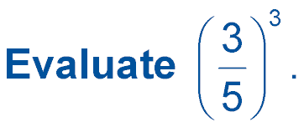
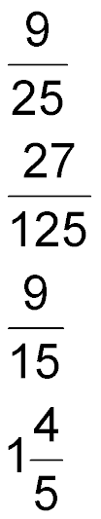
A.
B.
C.
D.
A
B
C
D

Slide 33
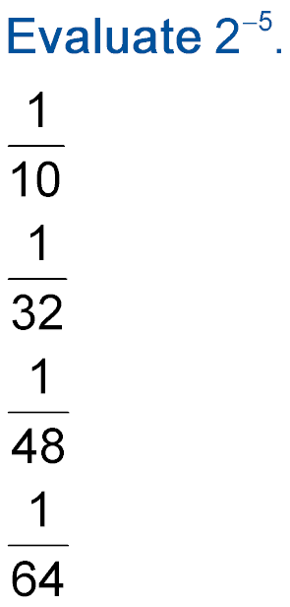
Evaluate 2^{–5}.
A.
B.
C.
D.
A
B
C
D

Slide 34
ALGEBRA Evaluate x² ● y⁴ if x = 3 and y = 4.
A. 576
B. 1,846
C. 2,304
D. 3,112
A
B
C
D

Slide 35
Later Dudes!

Slide 36




