Slide 1
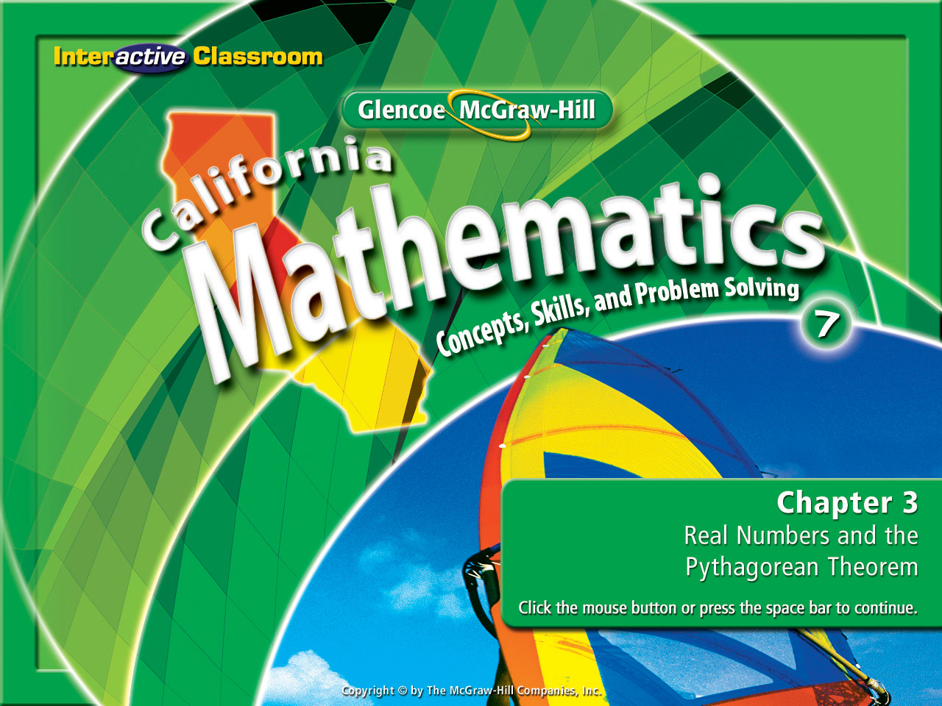
Chapter 3, Lesson 3-2
Estimating
Square Roots

Slide 2






(over Chapter 2)
Mercury is the closest planet to the Sun. Mercury is 3.6 × 10⁷ miles away from the Sun. Write the distance from Mercury to the Sun in standard form.
A
B
C
D
A. 360,000 miles
B. 3,600,000 miles
C. 36,000,000 miles
D. 360,000,000 miles

Slide 3

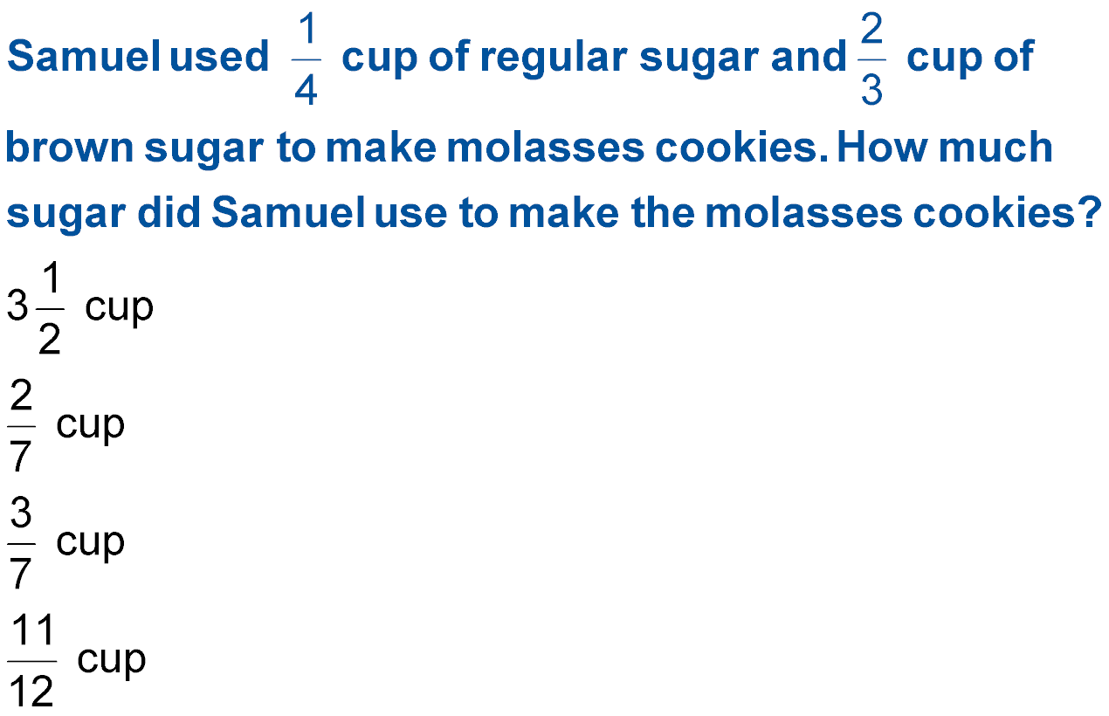


(over Chapter 2)
A
B
C
D
A.
B.
C.
D.

Slide 4


(over Lesson 3-1)
Find –
A. –14
B. –12
C. 12
D. 14
A
B
C
D

Slide 5

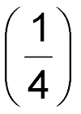
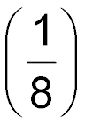
(over Lesson 3-1)
Solve the equation q² = 16.
A
B
C
D
±
B. ±
C. ± 4
D. ± 8

Slide 6
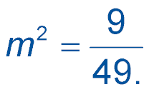

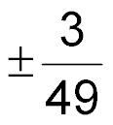



(over Lesson 3-1)
Solve the equation .
A
B
C
D
A.
B.
C.
D.

Slide 7

Estimate square roots.

Slide 8

Standard 7NS2.4 Use the inverse relationship between raising to a power and extracting the root of a perfect square; for an integer that is not square, determine without a calculator the two integers between which its square root lies and explain why.

Slide 9


Slide 10
Presents

Slide 11
A Watch and
Discover!

Slide 12
3² = 9
The
√
9 is 3
The exact whole number square root is 3.
4² = 16
5² = 25
Watch Carefully
The
√
is 4 < < 5
The closest whole number square root is 4.
6² = 36
7² = 49
The
√
39 is 6 < < 7
The closest whole number square root is 6.

Slide 13
2² = 4
3² = 9
The
√
5 is 2 < < 3
The closest whole number square root is 2.
7² = 49
8² = 64
Here’s Some More
The
√
60 is 7 < < 8
The closest whole number square root is 8.
9² = 81
10² = 100
The
√
92.4 is 9 < < 10
The closest whole number square root is 10.

Slide 14



So what is happening here?
How do we find the √ of numbers
that aren’t perfect squares?

Slide 15







Estimate Square Roots
Estimate to the nearest whole number.
The first perfect square less than 54 is 49.
The first perfect square greater than 54 is 64.
So you express the square root of 54 by writing it like this:
7 < < 8
However, the final answer is:
So , is between 7 and 8. Since 54 is closer to 49 than 64, the best whole number estimate for is 7.

Slide 16




Estimate Square Roots
Estimate to the nearest whole number.
The first perfect square less than 41.3 is 36.
The first perfect square greater than 41.3 is 49.
So you express the square root of 41.3by writing it like this:
However, the final answer is:
So, is between 6 and 7. Since 36 is closer to 41.3 than 49, the best whole number estimate for is 6.

Slide 17

Let’s Try Some From The Textbook:
Estimate to the nearest whole number:

Slide 18


Estimate to the nearest whole number.
A. 5
B. 6
C. 7
D. 8
A
B
C
D

Slide 19

Estimate to the nearest whole number.
A. 3
B. 4
C. 5
D. 6
A
B
C
D

Slide 20
