Slide 1
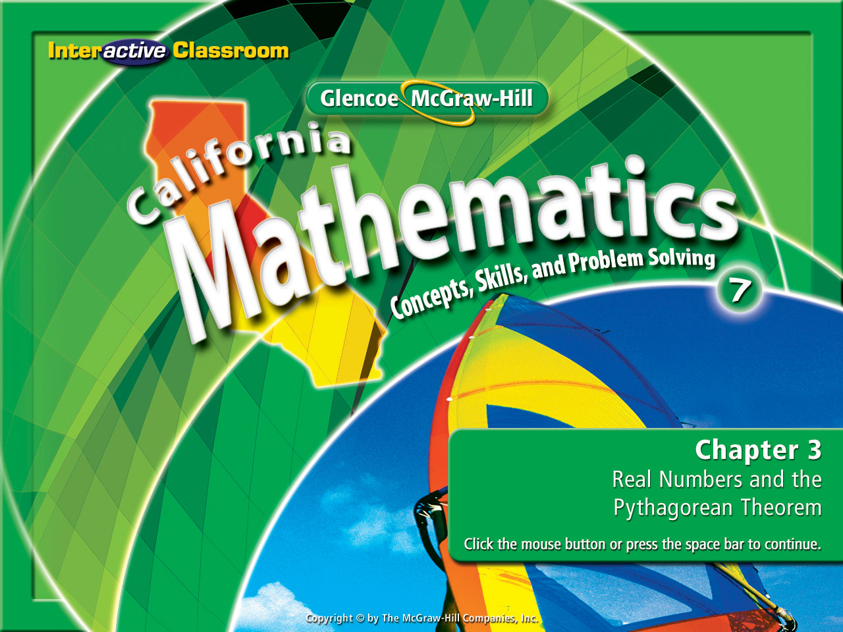

Chapter 3, Lesson 3-4
The Real
Number System

Slide 2








(over Lesson 3-1)
Find
A. 81
B. 18
C. 9
D. 3

Slide 3


(over Lesson 3-1)
Find the positive square root of 36.
A. 6
B. 9
C. 12
D. 18

Slide 4


(over Lesson 3-2)
Estimate to the nearest whole number.
A. 5
B. 6
C. 7
D. 8

Slide 5


(over Lesson 3-2)
Estimate to the nearest whole number.
A. 6
B. 7
C. 8
D. 9

Slide 6

(over Lesson 3-2)
Estimate the solution of x² = 102 to the nearest integer.
A. 9 ± 4
B. 10 ± 5
C. -9.5± 10
D. 10.5 ± 11

Slide 7

Please take a moment to
get a calculator for this lesson

Slide 8


IIdentify and classify numbers in the real number system.
Identify and classify numbers in the real number system.
• Rational number
irrational number
• Whole number
real number
• Integer
• Irrational number

Slide 9


7NS1.4 Differentiate between rational and irrational numbers.

Slide 10
Real Number | Whole Number | Integer | Rational | Irrational
✔
✔
✔
✔
✔
✔
4.83
✔
✔
12/4
✔
✔
✔

Slide 11

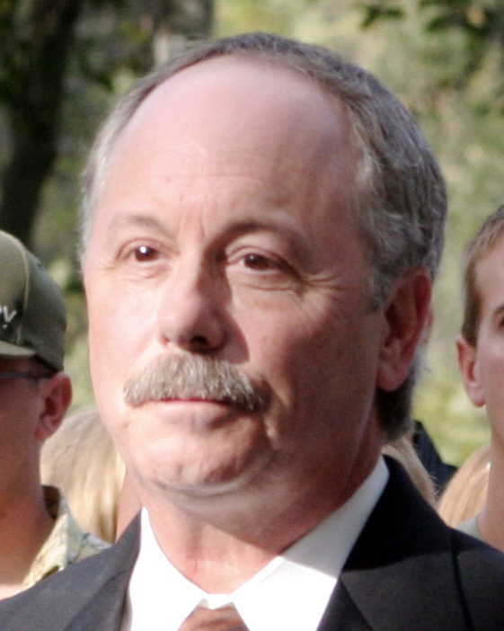
Here’s a Number
by Number Breakdown
4.83
The decimal portion of this number, .13131313 repeats, therefore it is a rational number.
The negative square root of 90 is -9.4868329…, a non-terminating decimal, therefore it is an irrational number.
The fraction simplifies to 3, therefore it is a whole number, an integer, and a rational number.
The decimal portion of this number terminates, therefore it is a rational number.
The square root of 67 is 8.1853527..., a non-terminating decimal, therefore it is an irrational number.
12/4
The decimal portion of this number is non-terminating. Therefore it is an irrational number.
The negative square root of 64 is -8 a whole number, and an integer, therefore it is a rational number.

Slide 12
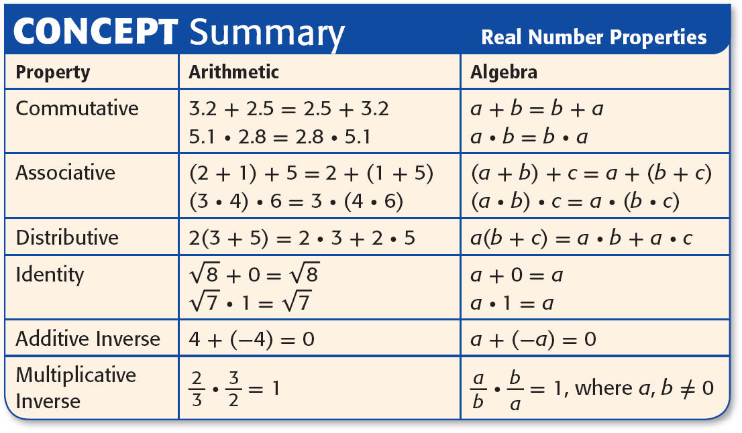
Real numbers follow the properties that are true for
whole numbers, integers, and rational numbers.

Slide 13
Take a moment to create this flow chart:

Slide 14
The Real Number System Chart
Real Numbers
Rational Numbers
Irrational Numbers
Integers
Fractions & Terminating & Repeating Decimals that are not Integers
Whole Numbers
Negative Integers

Slide 15
The Real Number System Chart Examples
Real Numbers
Rational Numbers
√10 = 3.1622776......
-12, 0, 6
2/3 = .666 = .6
4/5 = .8
2, 15, 186
-2, -15, -186

Slide 16

Classify Numbers
Name all sets of numbers to which 1/11 belongs. Use
your calculators to help you.
The fraction as a decimal ends in a repeating pattern.
Answer: It is a rational number because it is
equivalent to 0.090909…

Slide 17


Classify Numbers
Name all sets of numbers to which belongs.
Answer: Since , it is a whole number, an integer, and a rational number.

Slide 18


Classify Numbers
Name all sets of numbers to which belongs. Use
your calculators to help you.
Answer: Since the decimal does not repeat or terminate, it is an irrational number.

Slide 19






Graph Real Numbers
Estimate and to the nearest tenth. Then graph and on a number line. Use your calculators to help you.
or about 2.8
or about –1.4
Answer:

Slide 20
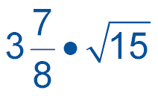
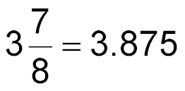

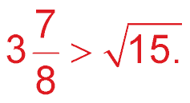
Compare Real Numbers
Replace • with <, >, or = to make
a true sentence.
Write each number as a decimal. Use your calculators to help you.
Answer: Since 3.875 is greater than 3.872983346…,

Slide 21




Compare Real Numbers
Replace • with <, >, or = to make
a true sentence.
Write as a decimal. Use your calculator to help you.
Answer: Since is less than 3.224903099…,

Slide 22

Name all sets of numbers to which 0.1010101010… belongs.
A. rational
B. irrational
C. whole, rational
D. integer, rational

Slide 23

Name all sets of numbers to which belongs.
A. integer
B. rational, integer
C. integer, whole
D. rational, integer, whole

Slide 24

Name all sets of numbers to which belongs.
A. rational
B. irrational
C. integer
D. integer, irrational

Slide 25




Estimate and to the nearest tenth. Then graph
and on a number line.
Answer:

Slide 26
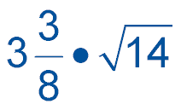
Replace • with <, >, or = to make
a true sentence.
A. <
B. >
C. =

Slide 27

Replace • with <, >, or = to make
a true sentence.
A. <
B. >
C. =

Slide 28
