Slide 1
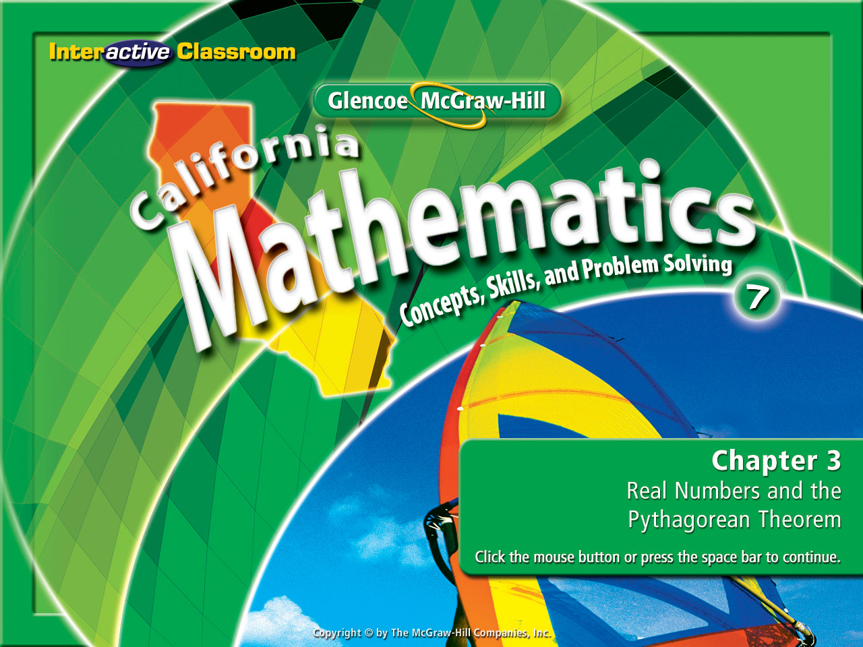
Chapter 3, Lesson 3-5
The
Pythagorean Theorem

Slide 2








(over Lesson 3-1)
The chairs in the multi-purpose room of a school need to be arranged in a square. If there are 225 chairs, how many should be in each row?
A
B
C
D
A. 13
B. 14
C. 15
D. 25

Slide 3


(over Lesson 3-2)
Estimate the solution of p² = 62 to the nearest integer.
A. ± 3
B. ± 4
C. ± 7
D. ± 8
A
B
C
D

Slide 4

(over Lesson 3-2)
Choose the two numbers that have square roots between 9 and 10.
A
B
C
D
A. 82, 87
B. 80, 87
C. 79, 101
D. 82, 101

Slide 5


(over Lesson 3-4)
Name all sets of numbers to which the real number 286 belongs.
A
B
C
D
A. rational, integer, whole number, real
B. integer, irrational, rational, real
C. integer, irrational, real
D. irrational, real

Slide 6


(over Lesson 3-4)
Name all sets of numbers to which the real number belongs.
A
B
C
D
A. rational, real
B. integer, real
C. whole number, real
D. irrational, real

Slide 7


Use the Pythagorean Theorem.
legs
hypotenuse
Pythagorean Theorem

Slide 8


Standard 7MG3.3 Know and understand the Pythagorean theorem and its converse and use it to find the length of the missing side of a right triangle and the lengths of other line segments and, in some situations, empirically verify the Pythagorean theorem by direct measurement.
Standard 7MR3.2 Note the method of deriving the solution and demonstrate a conceptual understanding of the derivation by solving similar problems.

Slide 9
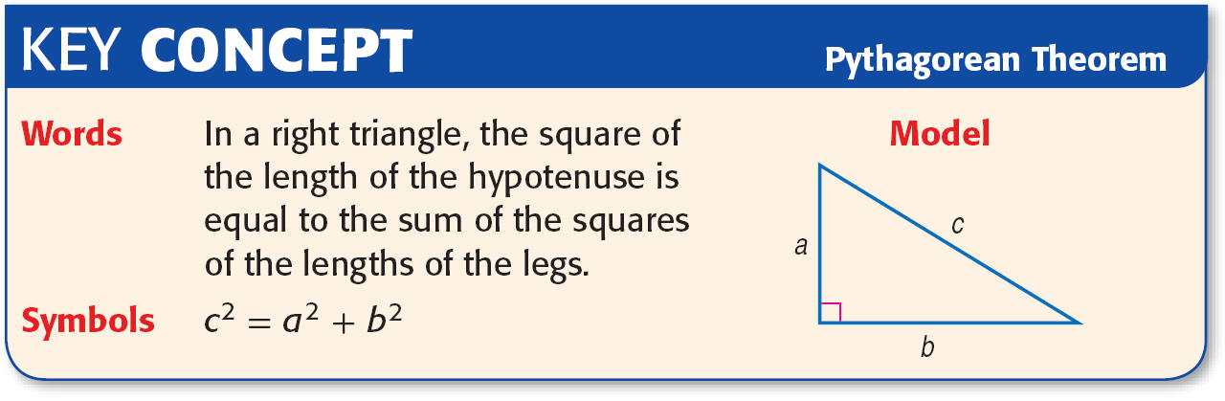

Slide 10
Triangles & The
Pythagorean Theorem
Hi! I’m 1 leg of a right triangle.
Hi! I’m the hypotenuse of a right triangle.
c²
a²
Hi! I’m another leg of a right triangle.
b²

Slide 11
a² + b² = c²
c²
c = 15
9² + 12² = c²
a = 9²
b = 12²
81+ 144 = c²
Watch as the
Pythagorean
Theorem is
demonstrated
for you.
225 = c²
=
²
15 = c

Slide 12
a² + b² = c²
c²
c = 13
a = 5²
5² + 12² = c²
b = 12²
25 + 144 = c²
Here’s another
example of the
Pythagorean
Theorem
in action.
169= c²
=
²
13 = c

Slide 13



So let’s talk this over.

Slide 14
Write these steps down.
c² = ?
a = 5²
b = 12²

Slide 15

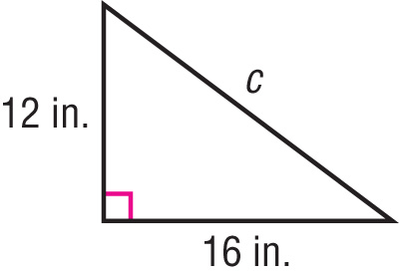
Find the Length of a Side
Write an equation to find the length of the missing side of the right triangle. Then find the missing length. Round to the nearest tenth, if necessary.

Slide 16
Find the Length of a Side
c² = a² + b²
Write the Pythagorean Theorem
c² = 12² + 16²
Replace a with 12 and b with 16.
c² = 144 + 256
Evaluate
c² = 400
Add 144 and 256.
2
Find the square root of c² & 400
=
The equation has two solutions, 20 and –20. However, the length of a side must be positive. So, the hypotenuse is 20 inches long.
Answer:

Slide 17

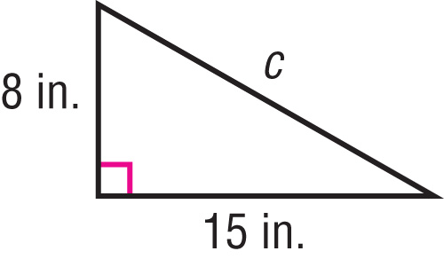
Write an equation to find the length of the missing side of the right triangle. Then find the missing length. Round to the nearest tenth, if necessary.
A
B
C
D
A. c² = 8² + 15²; 17 in.
B. c² = 15² – 8²; 19 in.
C. 15² = a² + 8²; 20 in.
D. 15² = c² – 8²; 21 in.

Slide 18
