Slide 1

Chapter 3, Lesson 3-6
Using the
Pythagorean Theorem

Slide 2








(over Lesson 3-4)
Estimate to the nearest tenth.
A. 6
B. 5.8
C. 5
D. 2.9
A
B
C
D

Slide 3


(over Lesson 3-4)
Estimate to the nearest tenth.
A. 16.6
B. 17
C. 17.9
D. 18
A
B
C
D

Slide 4

(over Lesson 3-4)
Are irrational numbers sometimes, always, or never rational numbers?
A. always
B. sometimes
C. never
A
B
C

Slide 5
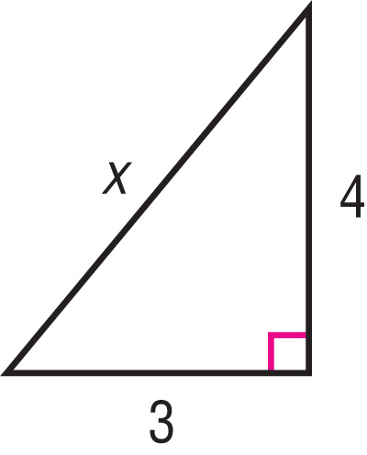


(over Lesson 3-5)
Write an equation you could use to find the length of the missing side of the right triangle. Then find the missing length. Round to the nearest tenth if necessary.
cm
A
B
C
D
cm
A. x² + 4² = 3²; 5 cm
B. x² + 3² = 4²; 3.6 cm
C. 3² + 4² = x²; 5 cm
D. 3² + 4² = x²; 25 cm

Slide 6

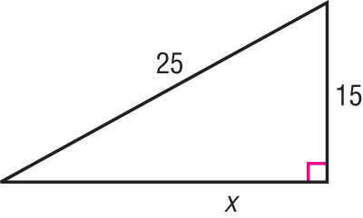
(over Lesson 3-5)
Write an equation you could use to find the length of the missing side of the right triangle. Then find the missing length. Round to the nearest tenth if necessary.
A
B
C
D
A. 15² + x² = 25²; 20
B. 25² + x² = 15²; 24.7
C. 15² + 25² = x²; 25.3
D. 15² + 25² = x²; 29.2

Slide 7

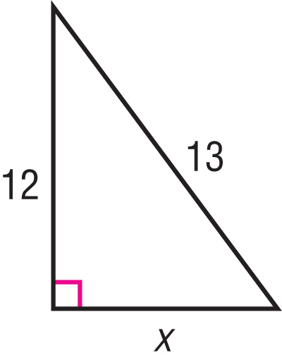

(over Lesson 3-5)
Write an equation you could use to find the length of the missing side of the right triangle. Then find the missing length. Round to the nearest tenth if necessary.
A
B
C
D
A. 12² + 13² = x²; 17.7
B. 12² + 13² = x²; 13.5
C. x² + 12² = 13²; 12.5
D. x² + 12² = 13²; 5

Slide 8

Solve problems using the Pythagorean Theorem.

Slide 9


Standard 7MG3.3 Know and understand the Pythagorean theorem and its converse and use it to find the length of the missing side of a right triangle and the lengths of other line segments and, in some situations, empirically verify the Pythagorean theorem by direct measurement.

Slide 10

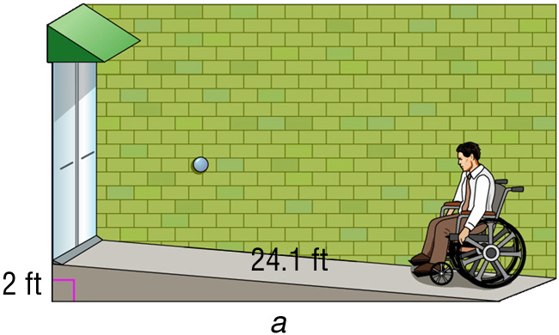
Use the Pythagorean Theorem
to Solve a Problem
RAMPS A ramp to a newly constructed building must be built according to the guidelines stated in the Americans with Disabilities Act. If the ramp is 24.1 feet long and the top of the ramp is 2 feet off the ground, how far is the bottom of the ramp from the base of the building?
Notice the problem involves a right triangle.
Use the Pythagorean Theorem.

Slide 11
Use the Pythagorean Theorem
to Solve a Problem
24.1² = a² + 2²
Replace c with 24.1 and b with 2.
580.81 = a² + 4
Evaluate 24.1² and 2².
580.81 – 4 = a² + 4 – 4
Isolate the variable by combining a -4 from each side.
576.81 = a²
Simplify by finding the square root of 576.81 and a².
24.0 ≈ a
Simplify.
Answer: The end of the ramp is about 24 feet from the base of the building.

Slide 12

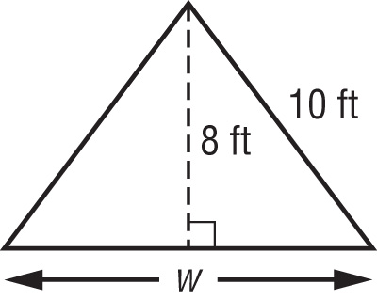
Use the Pythagorean Theorem
The cross-section of a camping tent is shown below. Find the width of the base of the tent.
A. 6 ft
B. 8 ft
C. 10 ft
D. 12 ft
Don’t solve yet, let’s explore this first.

Slide 13
Use the Pythagorean Theorem
Read the Item
From the diagram, you know that the tent forms two congruent right triangles. We can use the Pythagorean Theorem to help us find a. We know a represents half the base of the tent.

Slide 14
Use the Pythagorean Theorem
Solve the Item
Use the Pythagorean Theorem.
c² = a² + b²
Write the formula for the Pythagorean Theorem.
10² = a² + 8²
Replace the variables with the known values: c = 10 and b = 8
100 = a² + 64
Evaluate 10² and 8².
100 – 64 = a² + 64 – 64
Isolate the variable by combining a -64 from each side.
= a²
Simplify to find the value of the variable, a, by finding the square root of 36 and a².
6 = a
Simplify

Slide 15
Use the Pythagorean Theorem
The cross-section of a camping tent is shown below. Find the width of the base of the tent.
A. 6 ft
B. 8 ft
C. 10 ft
D. 12 ft
Answer: The width of the base of the tent is 2a or
(2)6 = 12 feet. Therefore, choice D is correct.

Slide 16

RAMPS If a truck ramp is 32 feet long and the top of the ramp is 10 feet off the ground, how far is the end of the ramp from the truck?
A
B
C
D
A. about 30.4 feet
B. about 31.5 feet
C. about 33.8 feet
D. about 35.1 feet

Slide 17
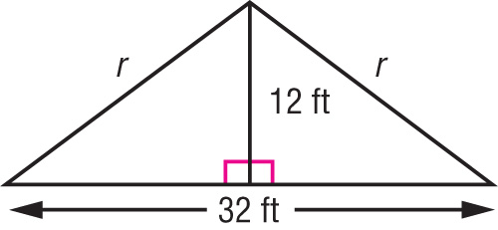
This picture shows the cross-section of a roof. How long is each rafter, r?
A
B
C
D
A. 15 ft
B. 18 ft
C. 20 ft
D. 22 ft

Slide 18
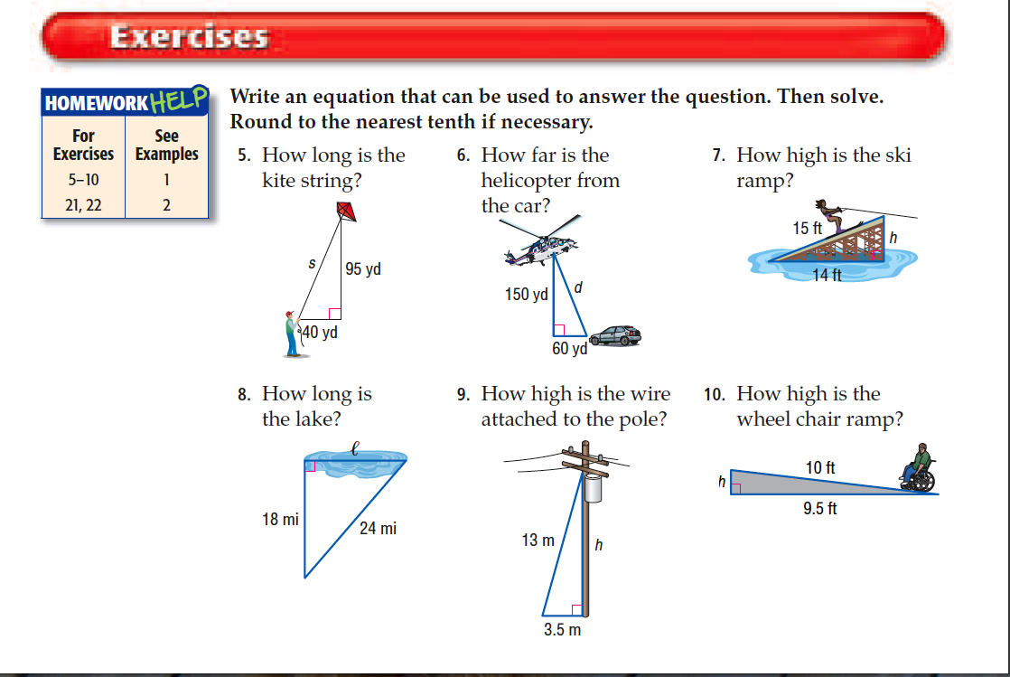
Let’s try some out of the textbook.

Slide 19




