Slide 1
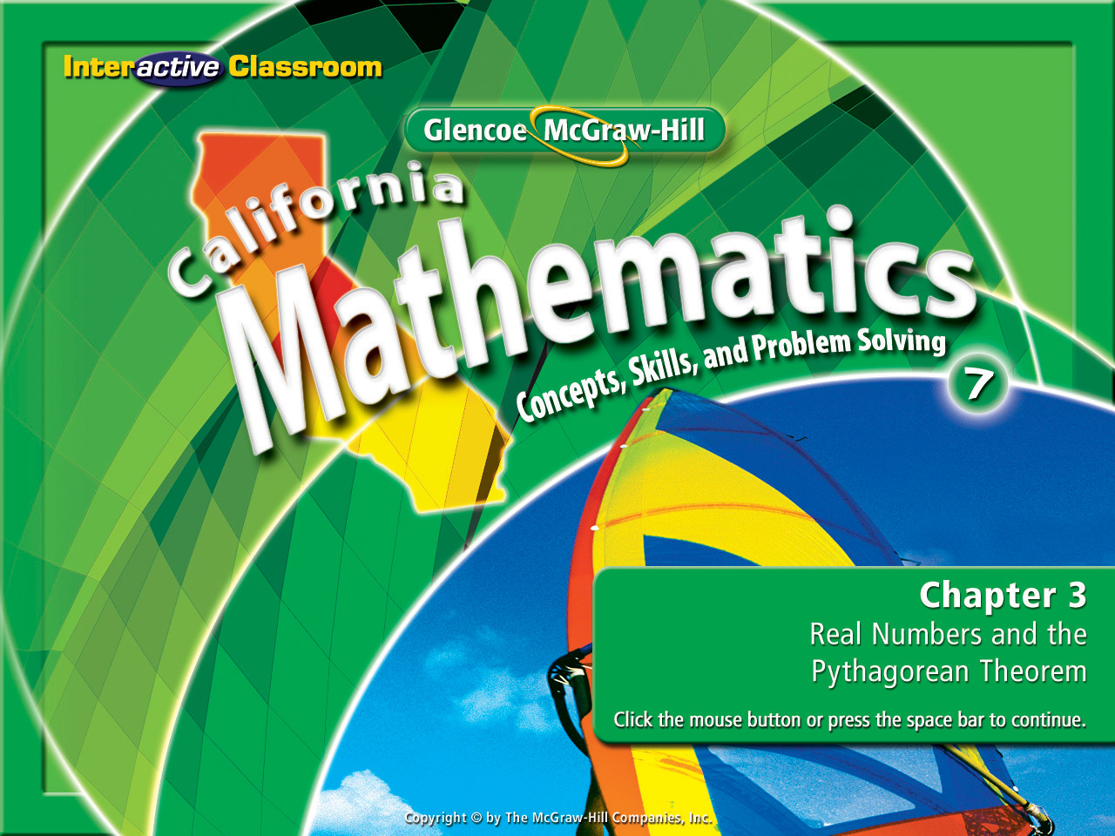
Chapter 3, Lesson 3-7
Distance on the
Coordinate Plane

Slide 2









(over Lesson 3-4)
To which set does not belong?
A
B
C
D
A. real
B. rational
C. fractions
D. negative integers

Slide 3


(over Lesson 3-5)
Is a triangle with side lengths of 18, 25, and 33 a right triangle?
A. yes
B. no
Use the three steps to success!
1) Write the formula.
2) Label the triangle a, b, & c.
3) Replace the variables with known data.
A
B

Slide 4

(over Lesson 3-5)
A man drives 33 miles east and 12 miles south. Approximately how many miles is the man from his starting point? Draw a triangle to model this.
A
B
C
D
A. 33
B. 50
C. 35
D. 12
Use the three steps to success!
1) Write the formula.
2) Label the triangle a, b, & c.
3) Replace the variables with known data.

Slide 5

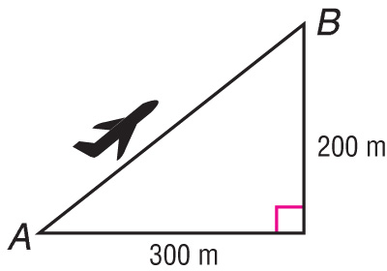

(over Lesson 3-6)
A plane is traveling from point A to point B. How far will the plane have flown when it reaches its destination? Write an equation that can be used to answer the question and solve. Round to the nearest tenth if necessary.
A
B
C
D
km
km
A. 300² – 200² = p²; 223.6 km
B. 300 – 200 = p; 100 km
C. 300 + 200 = p; 500 km
D. 300² + 200² = p²; 360.3 km
Use the three steps to success!
1) Write the formula.
2) Label the triangle a, b, & c.
3) Replace the variables with known data.

Slide 6

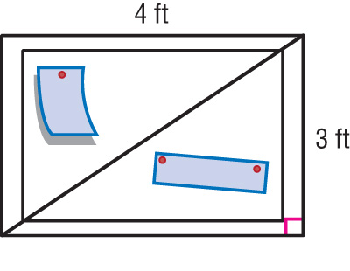
(over Lesson 3-6)
A girl is pinning ribbon to a 3 ft × 4 ft bulletin board. How long will the ribbon have to be to stretch from corner to corner diagonally? Write an equation that can be used to answer the question and solve. Round to the nearest tenth if necessary.
A
B
C
D
A. 4² + 3² = r²; 5 ft
B. 4 + 3 = r; 7 ft
C. 4² – 3² = r²; 3.6 ft
D. r² – 3² = 4²; 2.6 ft
Use the three steps to success!
1) Write the formula.
2) Label the triangle a, b, & c.
3) Replace the variables with known data.

Slide 7
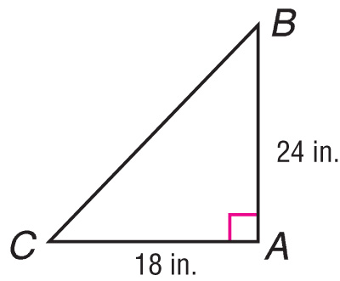

(over Lesson 3-6)
Triangle ABC is a right triangle. What is the perimeter of the triangle?
A
B
C
D
A. 30 in.
B. 58 in.
C. 72 in.
D. 15.8 in.
Use the three steps to success!
1) Write the formula.
2) Label the triangle a, b, & c.
3) Replace the variables with known data.

Slide 8


Graph rational numbers on the coordinate plane.
Find the distance between two points on the coordinate plane.
coordinate plane
ordered pair
origin
x-coordinate
y-axis
y-coordinate
x-axis
quadrants

Slide 9

Standard 7MG3.2 Understand and use coordinate graphs to plot simple figures, determine lengths and areas related to them, and determine their image under translations and reflections.

Slide 10

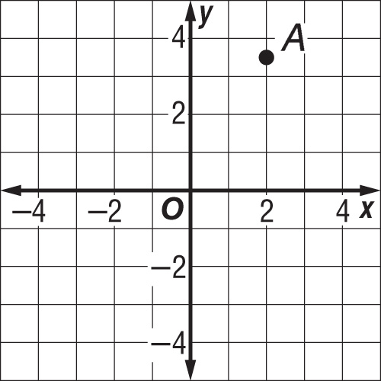

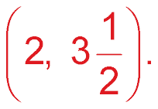
Name an Ordered Pair
Name the ordered pair for point A.
Start at the origin.
Move right to find the
x-coordinate of point A, which is 2.
Move up to find the
y-coordinate, which is
Answer: So, the ordered pair for point A is

Slide 11
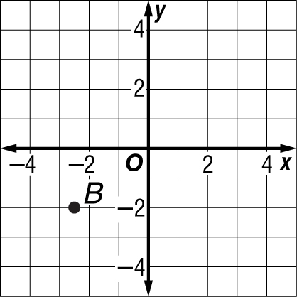
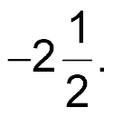
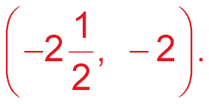
Name an Ordered Pair
Name the ordered pair for point B.
Start at the origin.
Move left to find the
x-coordinate of point B,
which is
Move down to find the
y-coordinate, which is –2.
Answer: So, the ordered pair for point B is

Slide 12
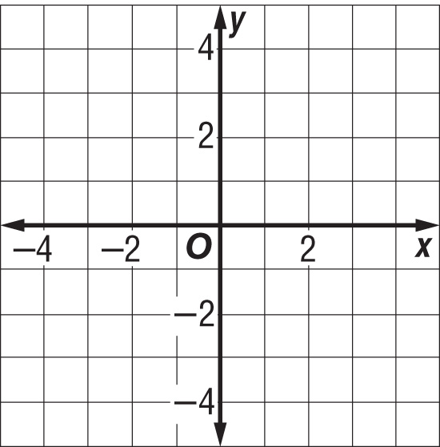
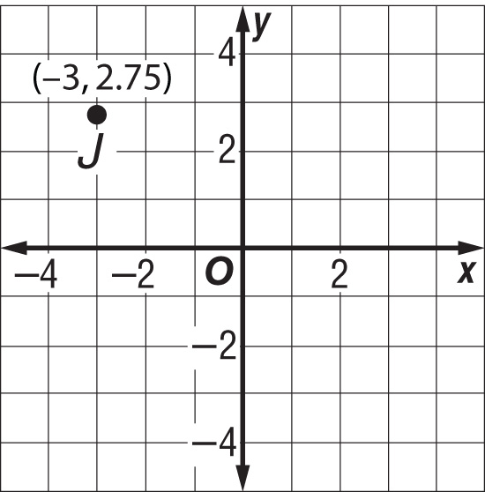
Graphing Ordered Pairs
Graph and label point J(–3, 2.75).
Start at the origin and move 3 units to the left. Then move up 2.75 units.
Answer:
Draw a dot and label it
J(–3, 2.75).

Slide 13
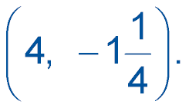

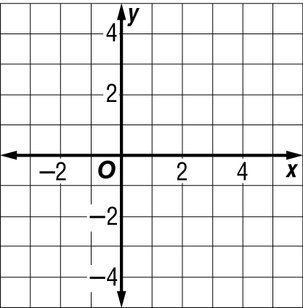
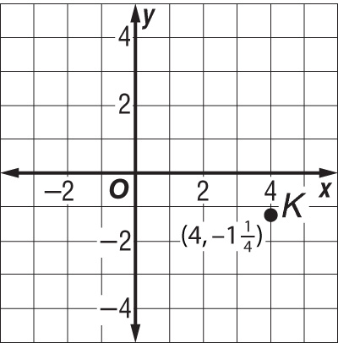
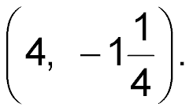
Graphing Ordered Pairs
Graph and label point K
Start at the origin and move 4 units to the right.
Then move down units.
Answer:
Draw a dot and label it
K

Slide 14
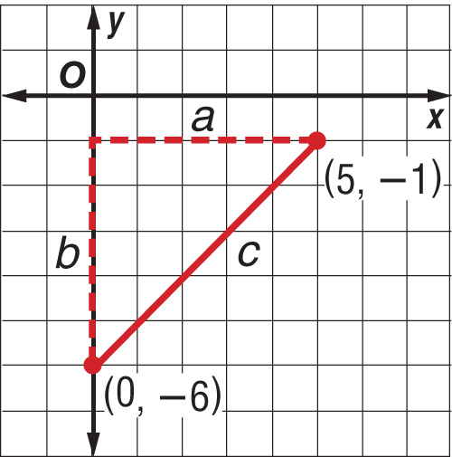
Find Distance in the Coordinate Plane
Graph the ordered pairs (0, –6) and (5, –1). Then find the distance between the points.
Let c = the distance between the
two points, a = 5, and b = 5.

Slide 15


Find Distance in the Coordinate Plane
c² = a² + b² Write the Pythagorean Theorem
c² = 5² + 5² Replace a with 5 and b with 5.
c² = 50 Evaluate the squares and combine values.
Definition of square root
=
c ≈ 7.1 Simplify.
Answer: The points are about 7.1 units apart.

Slide 16

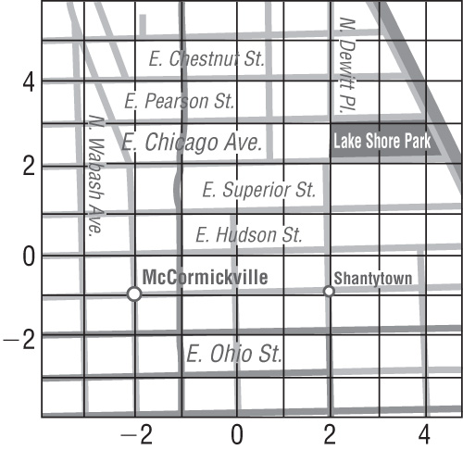
Use a Coordinate Plane to
Solve a Problem
TRAVEL Melissa lives in Chicago, Illinois. A unit on the grid of her map shown below is 0.08 mile.
Find the distance between McCormickville at (–2, –1) and Lake Shore Park at (2, 2).
Let c = the distance between McCormickville and Lake Shore Park. Then a = 3 and b = 4.

Slide 17

Use a Coordinate Plane to
Solve a Problem
c² = a² + b² Write the Pythagorean Theorem.
c² = 3² + 4² Replace the variable a with 3 and the variable b with 4.
c² = 9 + 16 Evaluate the squares.
=
Isolate the variable by determining the square root for c and 25.
c = 5 Simplify.
(5) (0.08) Multiply 5 by the scale factor 0.08 to obtain the actual mileage distance.
Answer: The actual distance between McCormickville and Lake Shore
Park is 0.4 miles.

Slide 18

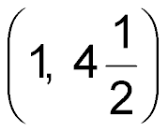
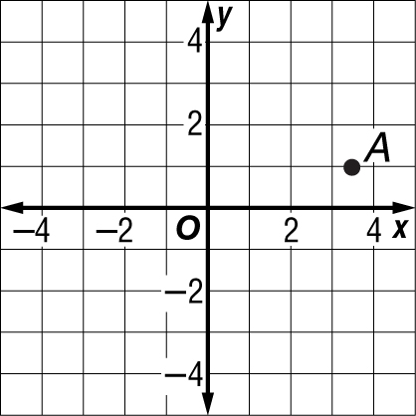
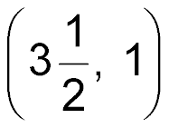
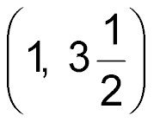
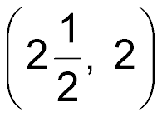
Name the ordered pair for point A.
A.
B.
C.
D.
A
B
C
D

Slide 19
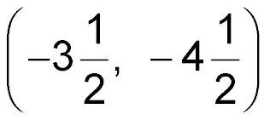
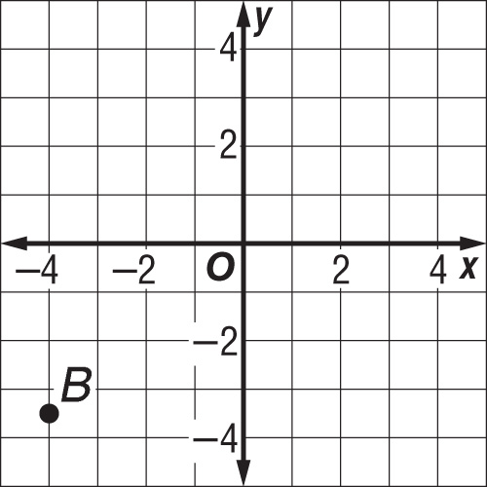
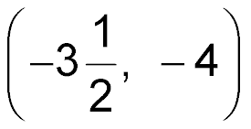
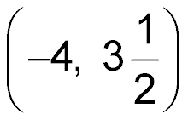
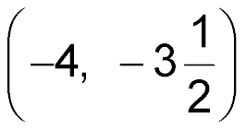
Name the ordered pair for point B.
A.
B.
C.
D.
A
B
C
D

Slide 20
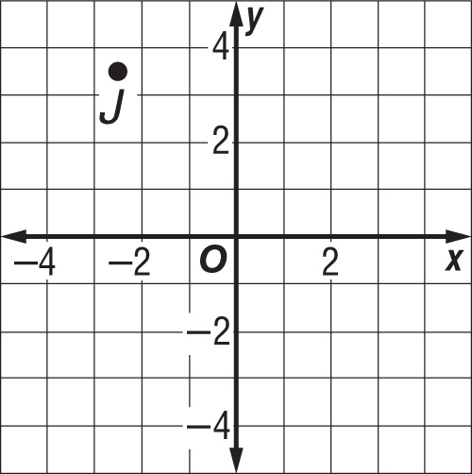
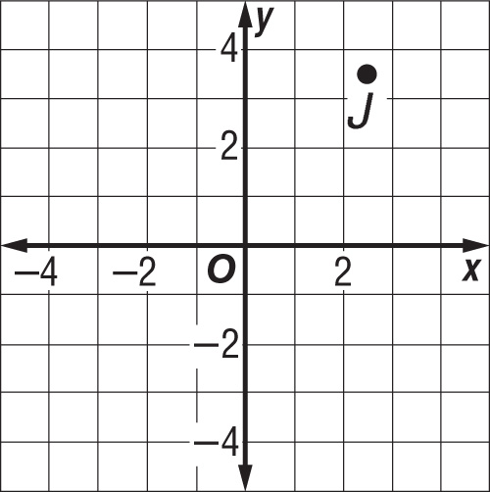
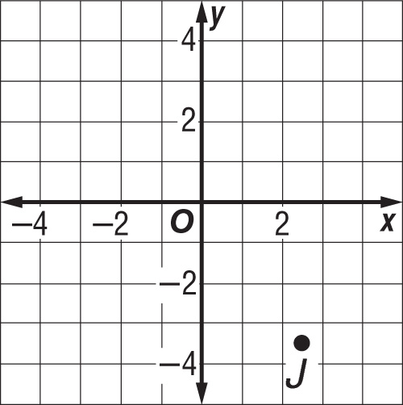
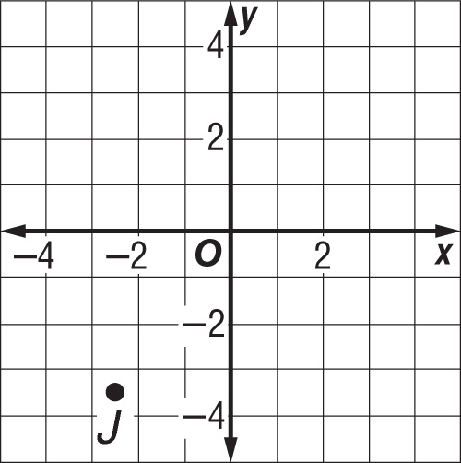
Graph and label point J(–2.5, 3.5).
A.
B.
C.
D.
A
B
C
D

Slide 21
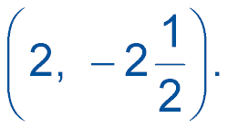
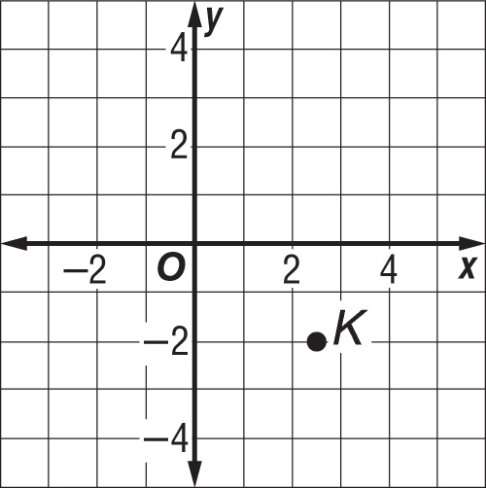
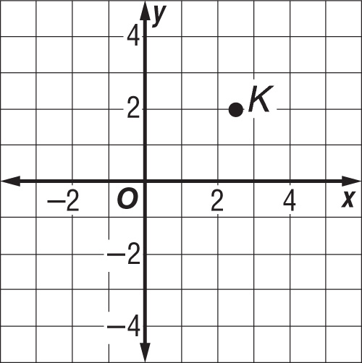
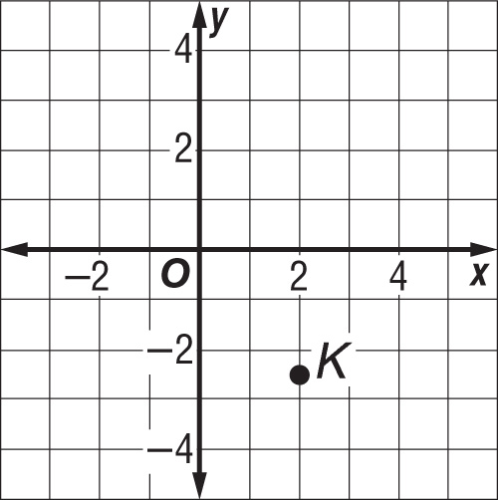
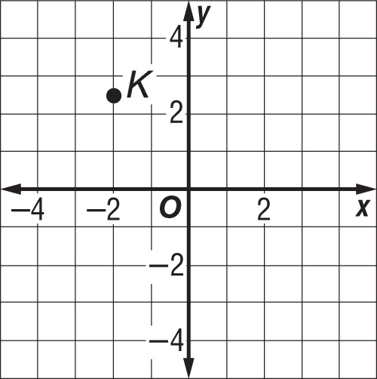
Graph and label point K
A
B
C
D
A.
B.
C.
D.

Slide 22
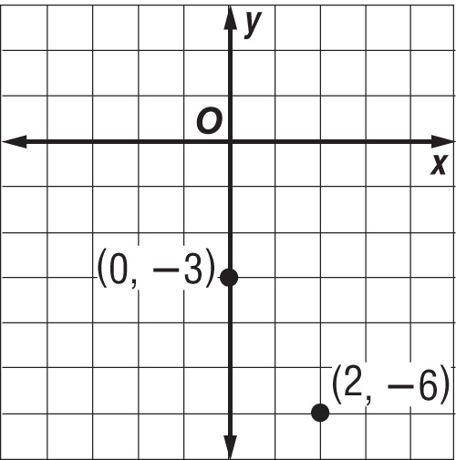
Graph the ordered pairs (0, –3) and (2, –6). Then find the distance between the points.
A
B
C
D
A. about 3.1 units
B. about 3.6 units
C. about 3.9 units
D. about 4.2 units

Slide 23
TRAVEL Sato lives in Chicago. A unit on the grid of his map shown below is 0.08 mile. Find the distance between Shantytown at (2, –1) and the intersection of N. Wabash Ave. and E. Superior St. at (–3, 1).
A
B
C
D
A. about 0.1 mile
B. about 0.2 mile
C. about 0.3 mile
D. about 0.4 mile

Slide 24
