Slide 1
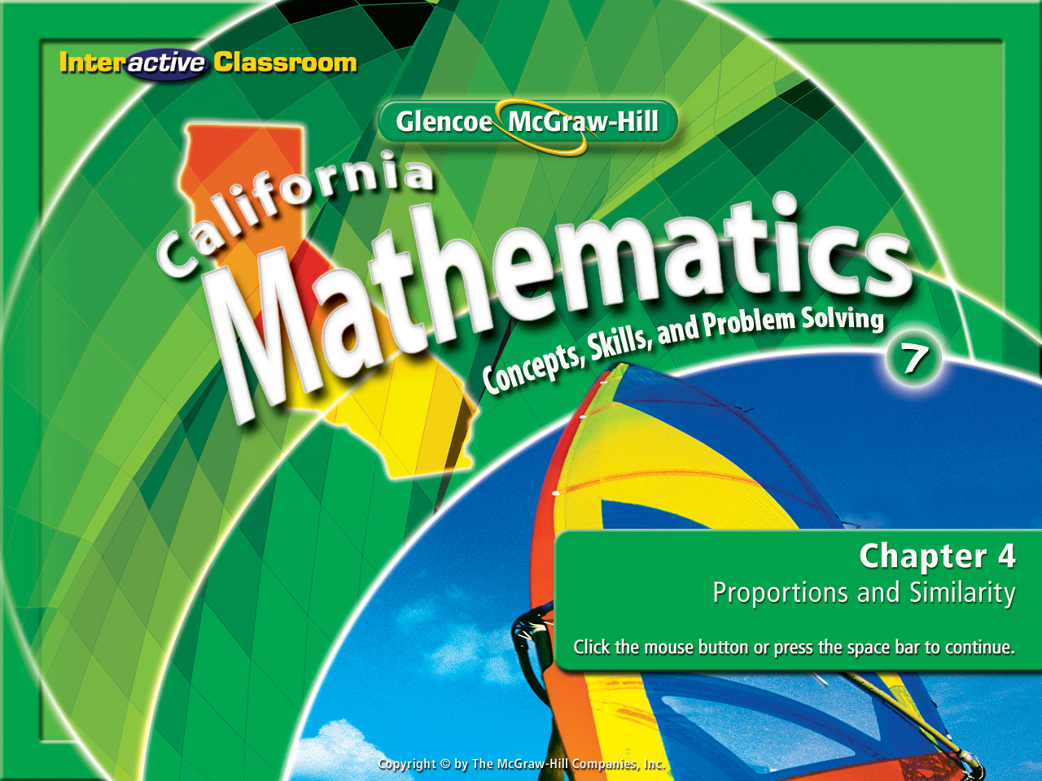
Splash Screen
Chapter 4
Lesson 4-1

Slide 2


Express ratios as fractions in simplest form and determine unit rates.
ratio
rate
unit rate

Slide 3


Standard 7AF4.2 Solve multi-step problems involving rate, average speed, distance, and time or a direct variation.
Standard 7MG1.3 Use measures expressed as rates (e.g. speed, density) and measures expressed as products (e.g. person-days) to solve problems; check the units of the solutions; and use dimensional analysis to check the reasonableness of the answer.

Slide 4
12 missed days out of 180 days
12
180
or
12 out of 180
12 wins to 18 losses
12
18
or
12 : 18
These are called ratios:
6 inches of water to 7 feet of snow
6in
7ft
6in
84in
1in
14in
or
or
1 : 14
3 quarts of soda : 1 gallon of juice
3qt
1gal
3qt
4qt
or
or
3 : 4

Slide 5
8
28
2
7
8 Siamese cats out of 28 cats
=
or
2 out of 7
W a t c h a n d O b s e r v e
16
24
2
3
16 pepperoni pizzas out of 24 pizzas
=
or
2 out of 3

Slide 6
Each ratio is being stated in simplest form.
8 Siamese cats out of 28 cats was written as a ratio, reduced, then re-written in ratio form as 2 out of 7.
8
28
2
7
=
Here’s What’s Happening
16 pepperoni pizzas out of 24 pizzas was written as a ratio, simplified, then rewritten in ratio form as 2 out of 3.
16
24
2
3
=

Slide 7
A ratio is a comparison of two numbers or quantities by division. That is why they are mostly written as a fraction in the fraction’s simplest form.
So what is a
ratio ?

Slide 8
$50 for 4 days of work
$50
4days
$12.50
1day
or
3 pounds of dog food in 5 days
3lb
5days
.60lb
1day
or
These are called unit rates:
153 points in 18 games
153pts
18games
8.5pts
1game
or
315 miles on 15 gallons of gas
315mi
15gal
21mi
1gal
or

Slide 9
186mi
3hrs
62mi
1hr
=
186 miles in 3 hours
or
62 miles per hour
W a t c h a n d O b s e r v e
24tickets
8rides
3tickets
1ride
=
24 tickets for 8 rides
or
3 tickets per ride

Slide 10
Each rate is being stated in simplest form.
186 miles in 3 hours was written as a ratio, simplified, then re-written in ratio form with 1 as the denominator.
186mi
3hr
62mi
1hr
=
Here’s What’s Happening
24 tickets for 8 rides was written as a ratio, simplified, then re-written in ratio form with 1 as the denominator.
24tickets
8rides
3tickets
1ride
=

Slide 11
A unit rate is a ratio that compares two quantities with different types of units dollars to pounds, hits to games, or miles to hours. In a unit rate the denominator is always simplified to 1.
So what is a
unit rate?

Slide 12


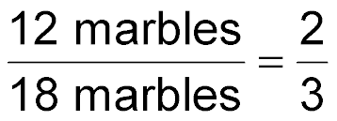
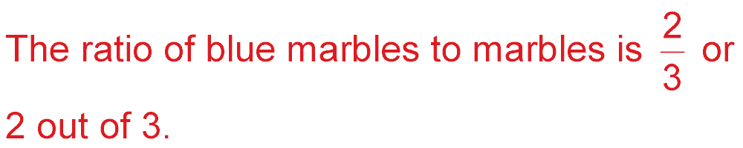
Write Ratios in Simplest Form
Express 12 blue marbles out of 18 marbles in simplest form.
Divide the numerator and denominator by the greatest common factor, 6. Divide out common units.
Answer:

Slide 13

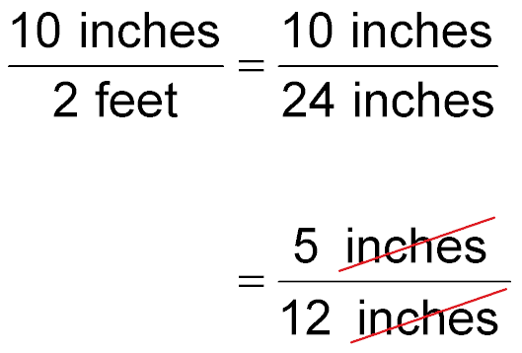
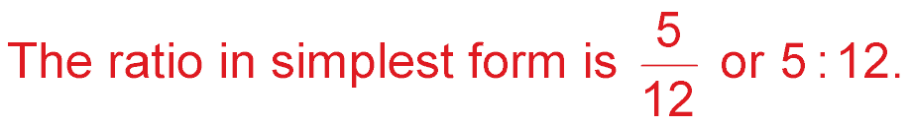
Write Ratios in Simplest Form
Express 10 inches to 2 feet in simplest form.
Convert 2 feet to 24 inches.
Divide the numerator and denominator by 2. Divide out common units.
Answer:

Slide 14

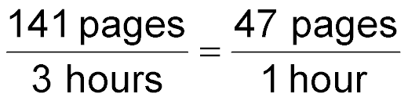
Find a Unit Rate
READING Yi-Mei reads 141 pages in 3 hours. How many pages does she read per hour?
Write the rate that expresses the comparison of pages to hours. Then find the unit rate.
Divide the numerator and denominator by 3 to get a denominator of 1.
Answer: Yi-Mei reads an average of 47 pages per hour.

Slide 15


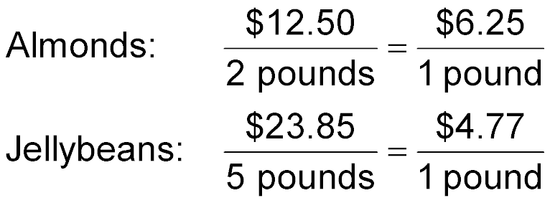
Compare Unit Rates
SHOPPING Alex spends $12.50 for 2 pounds of almonds and $23.85 for 5 pounds of jellybeans. Which item costs less per pound? By how much?
For each item, write a rate that compares the cost of the item to the number of pounds. Then find the unit rates.
Answer: The almonds cost $6.25 per pound, and the jellybeans cost $4.77 per pound. So, the jellybeans cost $6.25 – $4.77 or $1.48 per pound less than the almonds.

Slide 16


Express 5 blue marbles out of 20 marbles in simplest form.
A.
B.
C.
D.
A
B
C
D

Slide 17
Express 14 inches to 2 feet in simplest form.
A.
B.
C.
D.
A
B
C
D

Slide 18
TRAVEL On a trip from Columbus, Ohio, to Myrtle Beach, South Carolina, Lee drove 864 miles in 14 hours. What was Lee’s average speed in miles per hour?
A. about 57 mph
B. about 60 mph
C. about 62 mph
D. about 65 mph
A
B
C
D

Slide 19
SHOPPING Cameron spends $22.50 for 2 pounds of macadamia nuts and $31.05 for 3 pounds of cashews. Which item costs less per pound? By how much?
A. cashews by $0.90
B. cashews by $1.25
C. macadamia nuts by $0.90
D. macadamia nuts by $1.25
A
B
C
D

Slide 20
