Slide 1
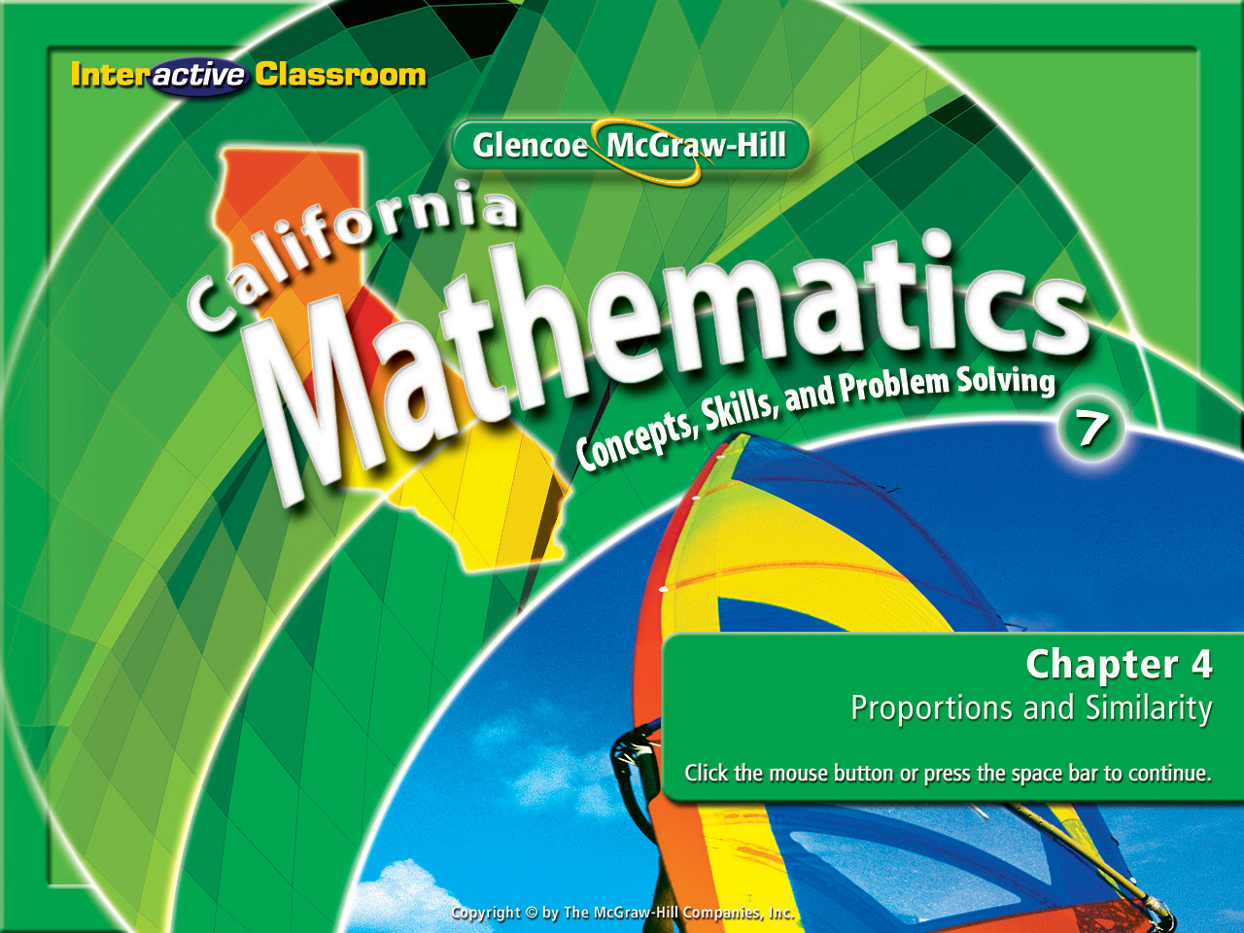
Chapter 4
Lesson 4-5

Slide 2







(over Lesson 4-1)
Express the rate as a unit rate. 198 miles in 3 hours
A. 201 mi/h
B. 195 mi/h
C. 66 mi/h
D. 33 mi/h
A
B
C
D

Slide 3

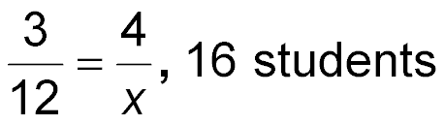
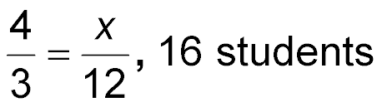
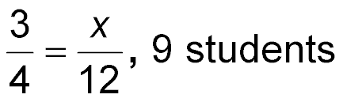
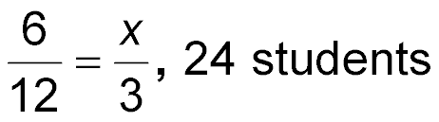

(over Lesson 4-3)
Write and solve the proportion. For every 4 students, 3 like peanut butter and jelly sandwiches. If there are 12 students, how many like peanut butter and jelly sandwiches?
A.
B.
C.
D.
A
B
C
D

Slide 4

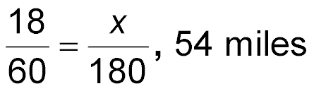
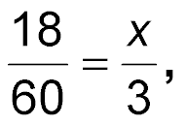
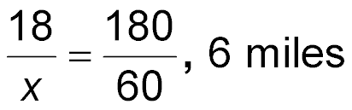
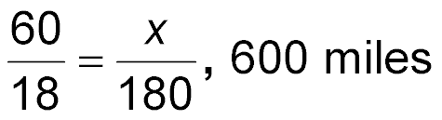
(over Lesson 4-3)
Write and solve the proportion. On the biking portion of a triathlon, an athlete biked 18 miles in 60 minutes. How many miles will the athlete have biked in 3 hours?
A.
B
C.
D.
0.9 mile
A
B
C
D

Slide 5

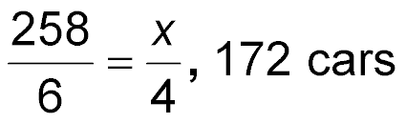
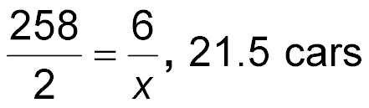
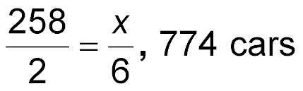
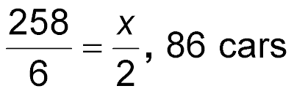
(over Lesson 4-3)
Write and solve the proportion. If 258 cars pass through an inter-
section in six hours, how many cars pass through the intersection every two hours?
A.
B.
C.
D.
A
B
C
D

Slide 6

(over Lesson 4-4)
Daniel wants to display three different pictures in a row on his bedroom wall. How many different ways can he arrange the three pictures? Use the draw a diagram strategy.
A. 3 ways
B. 12 ways
C. 6 ways
D. 9 ways
A
B
C
D

Slide 7

(over Lesson 4-4)
The music teacher is arranging students on risers for the spring concert. If she places 6 people in the first row and each additional row has 3 more students in it, how many students will be in the fifth row? Use the draw a diagram strategy.
A. 18 students
B. 36 students
C. 54 students
D. 60 students
A
B
C
D

Slide 8


Identify similar polygons and find missing measures of similar polygons.
polygon
similar
corresponding parts
congruent
scale factor

Slide 9

Reinforcement of Standard 6NS1.3 Use proportions to solve problems. Use cross multiplication as a method for solving such problems, understanding it as the multiplication of both sides of an equation by a multiplicative inverse.

Slide 10
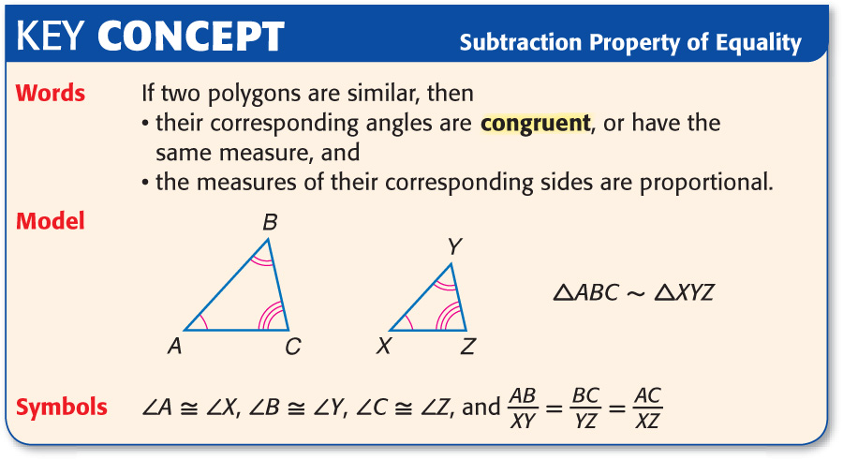

Slide 11
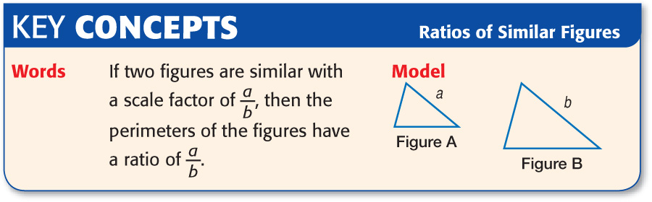

Slide 12

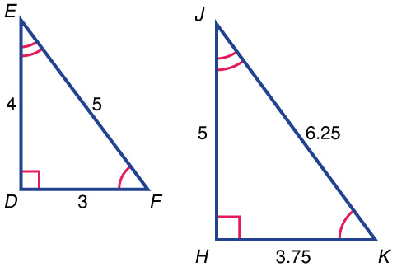
Identify Similar Polygons
Determine whether triangle DEF is similar to triangle HJK. Explain your reasoning.

Slide 13
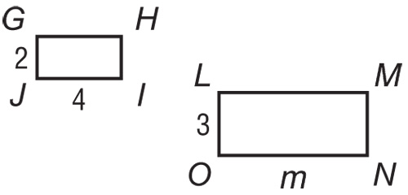
Finding Missing Measures
Given that rectangle LMNO ~ rectangle GHIJ, find m.

Slide 14

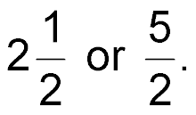
Scale Factor and Perimeter
A polygon has sides 2.5 times as long as a similar polygon. The smaller polygon has a perimeter of 42 inches. What is the perimeter of the larger polygon?
Read the Item Since each side of the larger polygon is 2.5 times as long as the corresponding sides of the smaller polygon, the scale factor from the smaller polygon to the larger
polygon is
1st create a proportion skeleton.

Slide 15
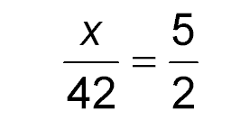
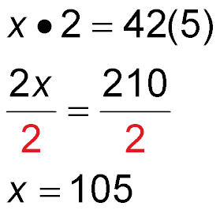
Scale Factor and Perimeter
Let x represent the perimeter of the larger polygon. The ratio of the
perimeters is equal to the ratio of the sides.
larger perimeter
Scale factor relating sides
smaller perimeter
Remember that the polygon has sides 2.5 times as long as a similar polygon. The smaller polygon has a perimeter of 42 inches.
Find the cross products.
Multiply. Then divide each side by 2.
Simplify.
Answer: 105 inches

Slide 16

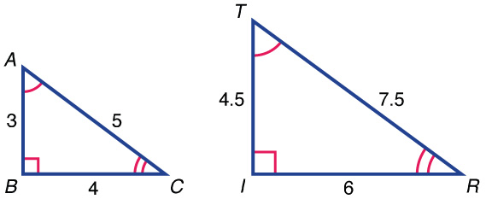
Determine whether triangle ABC is similar to triangle TRI.
A. yes
B. no
A
B
1st create a proportion skeleton.

Slide 17
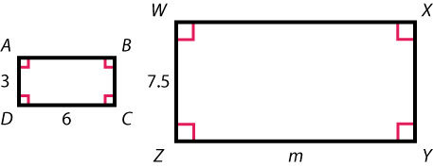
Given that rectangle ABCD ~ rectangle WXYZ, find m.
A. 12
B. 15
C. 16
D. 18
1st create a proportion skeleton.

Slide 18
A polygon has sides 3.5 times as long as a similar polygon. The larger polygon has a perimeter of 77 inches. What is the perimeter of the smaller polygon?
1st create a proportion skeleton.
A. 22 in.
B. 34 in.
C. 72 in.
D. 269.5 in.
A
B
C
D

Slide 19
