Slide 1
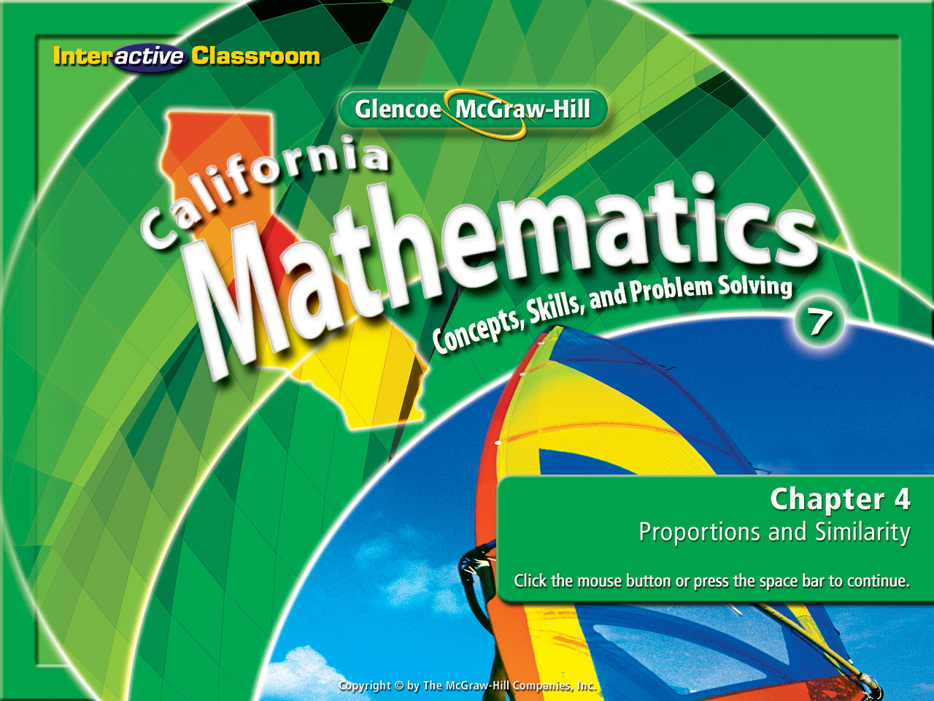
Chapter 4
Lesson 4-6

Slide 2








(over Lesson 4-1)
Which of the following options is the best buy for a bag of flour?
A. 1 pound at $0.79
B. 5 pounds at $1.70
C. 4 pounds at $1.40
D. 10 pounds at $3.60
A
B
C
D

Slide 3
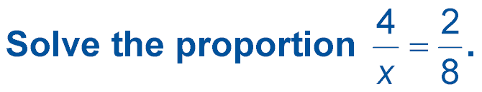


(over Lesson 4-3)
A. 1
B. 12
C. 16
D. 32
A
B
C
D

Slide 4


(over Lesson 4-4)
Jeanine is filling her wading pool with water. After
3 minutes and 15 seconds, the pool is only full.
If the pool can hold 350 gallons of water, how much
longer will it take to fill the pool?
A
B
C
D
A. 13 minutes
B. 9 minutes 45 seconds
C. 6 minutes 30 seconds
D. 3 minutes 15 seconds

Slide 5

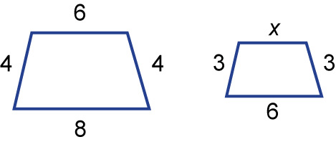
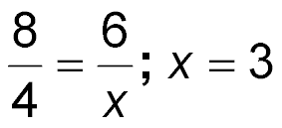
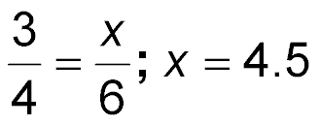
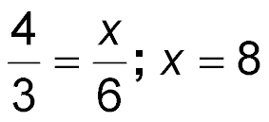
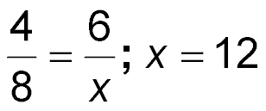
(over Lesson 4-5)
The pair of polygons is similar.
Write a proportion to find the
missing measure and solve.
A.
B.
C.
D.
A
B
C
D

Slide 6


Convert customary and metric units of length, weight or mass, capacity, and time.
unit ratio

Slide 7

Standard 7MG1.1 Compare weights, capacities, geometric measures, times, and temperatures within and between measurement systems (e.g. miles per hour and feet per second, cubic inches to cubic centimeters).

Slide 8
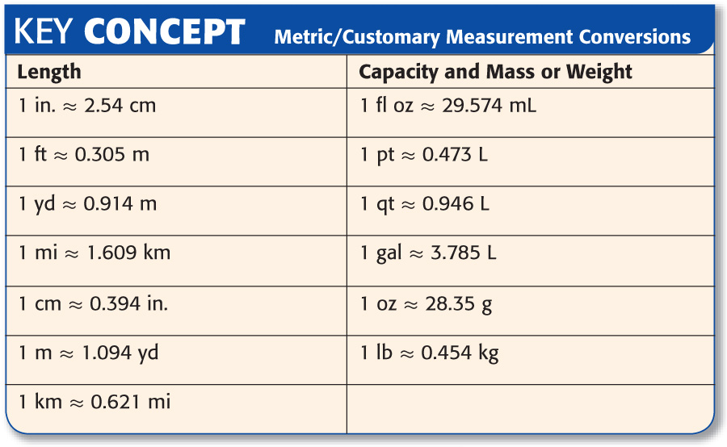
We will handout a set of charts you will need to use.

Slide 9

Convert Larger Units to Smaller Units
Convert 21/2 pounds to ounces.
1 pound = 16 ounces
Pounds are larger than ounces.
When converting from a larger unit to a smaller one MULTIPLY.
Change any fraction to a decimal 1st.
21/2 lbs = 2.5lbs
2.5 lbs • 16 oz = 40 oz

Slide 10
Convert Smaller Units to Larger Units
SHIPPING Cristos is shipping a package of model train parts. The sum of the weights of the parts is 900 grams. What is the weight of the parts in kilograms?
1000gram = 1kilogram
Grams are smaller than kilograms.
When converting from a smaller unit to a larger one DIVIDE.
Change any fraction to a decimal 1st.
There are no fractions to change in this problem.
900g ÷ 1000g = 0.9kg

Slide 11
Convert Between Systems
Convert 10 miles to kilometers. Round to the nearest hundredth.
1 kilometer= 0.621mile
Miles are larger than kilometers.
When converting from a larger unit to a smaller one MULTIPLY.
Change any fraction to a decimal 1st.
There are no fractions to change in this problem.
10mi • 0.621km = 6.21km

Slide 12

Convert 8 meters to centimeters.
Meters are larger than centimeters.
A. 0.08 cm
B. 0.8 cm
C. 80 cm
D. 800 cm
When converting from large to small you must multiply.
A
B
C
D
100cm = 1m

Slide 13
RIBBONS Sydney needs 108 inches of ribbon for wrapping gifts. How many feet does she need?
Inches are smaller than feet.
A. 1.08 ft
B. 9 ft
C. 10.8 ft
D. 36 ft
When converting from small to large you must divide.
A
B
C
D
12in = 1ft

Slide 14
Convert 5 centimeters to inches.
Centimeters are smaller than inches.
A. about 1.97 in.
B. about 12.7 in.
C. about 15 in.
D. about 50 in.
When converting from small to large you must divide.
A
B
C
D
2.54cm = 1in

Slide 15
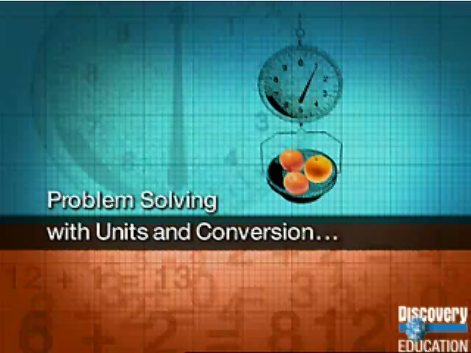

Slide 16
