Slide 1
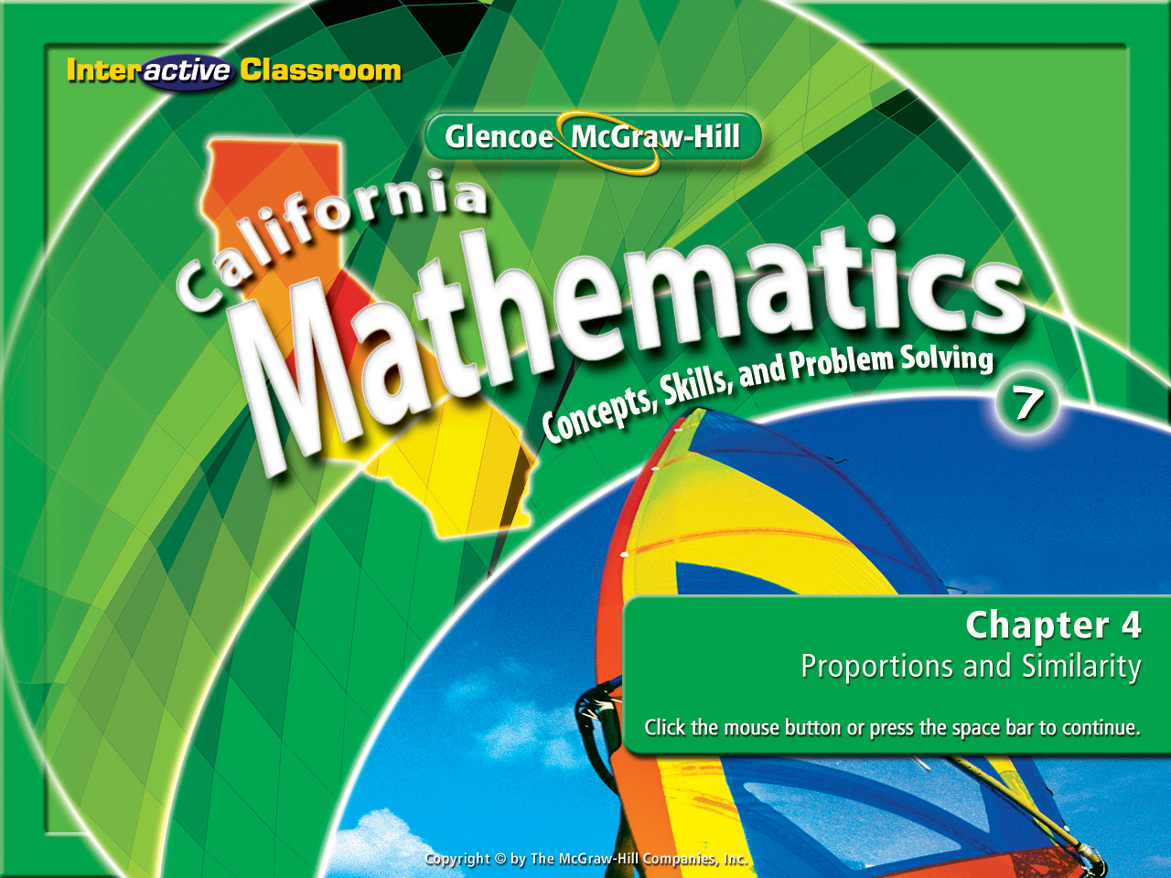
Chapter 4
Lesson 4-7

Slide 2








(over Lesson 4-3)
A train travels 4.4 miles in 4 minutes. At this rate, how many miles will it travel in 58 minutes?
A. 3.3 miles
B. 13.2 miles
C. 52.7 miles
D. 63.8 miles
A
B
C
D

Slide 3

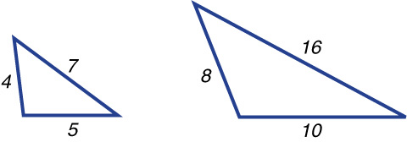


(over Lesson 4-5)
Determine whether the pair
of polygons is similar. Explain your reasoning.
A. Yes; corresponding sides are not proportional.
B. Yes; corresponding sides are proportional.
C. No; corresponding sides are not proportional.
D. No; corresponding sides are proportional.
A
B
C
D

Slide 4

5Min 7-1
(over Lesson 4-6)
Complete. 17 gal = ____ qt
A. 6
B. 36
C. 68
D. 92
Remember:
Small to Large divide by the factor.
Large to Small multiply by the factor.
A
B
C
D

Slide 5

(over Lesson 4-6)
Complete. 13,200 ft = ____ mi
Remember:
A. 0.5
B. 2.5
C. 12
D. 25
Small to Large divide by the factor.
Large to Small multiply by the factor.
A
B
C
D

Slide 6

Convert square and cubic units.

Slide 7

Standard 7MG1.1 Compare weights, capacities, geometric measures, times, and temperatures within and between measurement systems (e.g. miles per hour and feet per second, cubic inches to cubic centimeters).
Standard 7MG2.4 Relate the changes in measurement with a change of scale to the units used (e.g., square inches, cubic feet) and to conversions between units (1 square foot = 144 square inches or [1 ft² ] = 144 in² ], 1 cubic inch is approximately 16.38 cubic centimeters or [1 in³ ] = [16.38 cm³ ]).

Slide 8
Use Your Prior Knowledge
You will need this skill from your math memory tool chest for today’s lesson.
Remember this?
12²
= 12 • 12 = 144
How about this?
5³
= 5 • 5 • 5 = 125

Slide 9
Use Your Prior Knowledge
Take what we did yesterday:
When converting from a larger unit to a smaller one MULTIPLY.
Or
When converting from a smaller unit to a larger one DIVIDE.
And Combine This
12²
= 12 • 12 = 144

Slide 10
Always use your prior knowledge.
Now let’s take on something new!
There’s a reason we taught you what we have.
Doing this will always make new things seem easier.

Slide 11

Convert Units of Area
Complete the conversion. 5.8 m² = ___ cm²
The conversion factor is: 1m = 100cm
Large
x
Small
5.8m² = __cm²
100 x 100 is done 1st to square the answer.
5.8m² x (100cm x 100cm)
5.8m² x 10,000cm²
Answer: 58,000cm²

Slide 12
Convert Units of Area
Complete the conversion. 1296 in² = ___ ft²
The conversion factor is: 12in = 1ft
Small
÷
Large
1296in² = __ ft²
12 x 12 is done 1st in order to square the answer.
1296in² ÷ (12in x 12in)
1296in² ÷ 144in²
Answer: 9ft²

Slide 13
Convert Units of Area
AIR QUALITY Morgan is using an air purifier in a room that he estimates holds about 27 cubic yards of air. How many cubic feet of air will the purifier need to clear?
The conversion factor is: 1yd = 3ft
Large
x
Small
27yd³ = __ ft³
3 x 3 x 3 is done 1st to cube the answer.
27yd³ x (3ft x 3ft x 3ft)
27yd³ x 27ft³
Answer: 729ft³

Slide 14
Convert Units of Area
Convert 7 cubic centimeters to cubic inches.
The conversion factor is: 1in = 2.54cm
Small
÷
Large
7cm³ = __ in³
2.54 x 2.54 x 2.54 is done 1st to cube the answer.
7cm³ ÷ (2.54cm x 2.54cm x 2.54cm)
7cm³ ÷ 16.39in³
Answer: 0.43in³

Slide 15

Complete the conversion. 5 ft² =  in²
Remember:
Small to Large divide by the factor.
A. 60 in²
B. 300 in²
C. 720 in²
D. 3,600 in²
Large to Small multiply by the factor.
A
B
C
D

Slide 16
Complete the conversion: 900 cm² =  m²
Remember:
Small to Large divide by the factor.
A. 0.09 m²
B. 9 m²
C. 90 m²
D. 900 m²
Large to Small multiply by the factor.
A
B
C
D

Slide 17
TOP SOIL Mr. Mitchell is hauling top soil in the bed of his pickup truck. How many cubic yards of top soil can he haul if the bed has a volume of 64 cubic feet?
Remember:
A. 2.37 yd³
B. 7.11 yd³
C. 576 yd³
D. 1,728 yd³
Small to Large divide by the factor.
A
B
C
D
Large to Small multiply by the factor.

Slide 18
Convert 21 square centimeters to square inches.
Remember:
Small to Large divide by the factor.
A. 3.26 in²
B. 8.27 in²
C. 53.34 in²
D. 135.45 in²
Large to Small multiply by the factor.
A
B
C
D

Slide 19
