Slide 1

Chapter 4
Lesson 4-8

Slide 2



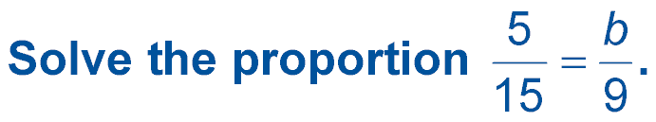




(over Lesson 4-3)
A. 3
B. 15
C. 27
D. 45
A
B
C
D

Slide 3

(over Lesson 4-6)
Complete the conversion 20 cm ≈ ____ in. Round to the nearest hundredth if necessary.
A. 0.78
B. 7.87
C. 78.7
D. 787
A
B
C
D

Slide 4


(over Lesson 4-7)
Complete the conversion 4 ft² = ____ in². Round to the nearest hundredth.
A. 35
B. 58
C. 550
D. 576
A
B
C
D

Slide 5


Solve problems involving scale drawings.
scale drawing
scale model
scale

Slide 6

Standard 7MG1.2 Construct and read drawings and models made to scale.

Slide 7
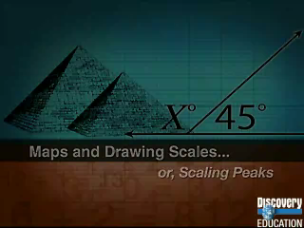

Slide 8
Remember this for today:
The proportion skeleton in a scale drawing can be written as:
inches
feet
inches
feet
model
twins
actual
=
twins
Or
inches
feet
inches
feet
actual
twins
model
=
twins

Slide 9

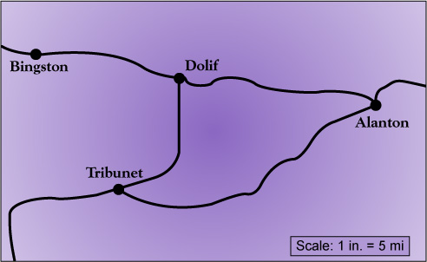
Use a Scale Drawing
MAPS Use the map to find the actual distance from Bingston to Alanton.
1.5 inches
You can use an inch ruler to measure the map actual distance.
The map distance is about 1.5 inches.

Slide 10
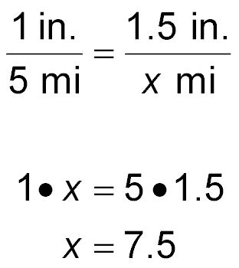
1.5 inches
Create a proportion skeleton.
2) The map scale is one ratio.
3) Find the twins.
4) Cross multiply.
map scale
ratio
actual scale
ratio
Map (in.)
Map (in.)
Actual (mi.)
Actual (mi.)
Find the cross products.
Simplify.

Slide 11
Find the Scale
SCALE DRAWINGS On a scale drawing, a wall is shown as 6 inches. In actual it is 15 feet long. What is the scale of the drawing?
Write a proportion skeleton.
=
Create a ratio that shows the scale measure (6in) to the actual measure (15ft).
6in
15ft
=
Create another ratio showing 1in as the scale measure and x as the actual length of the room.
1in
xft
=

Slide 12
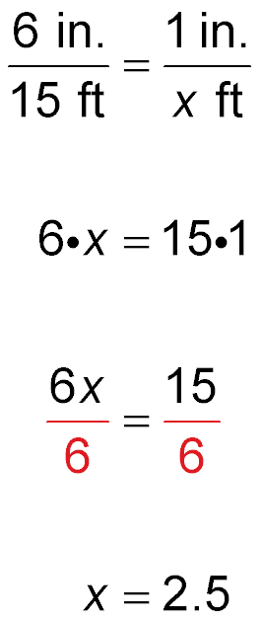
On a scale drawing, a wall is shown as 6 inches. In actual it is 15 feet long. What is the scale of the drawing?
Actual Measures Ratio
Map Scale Ratio
scale drawing length
scale drawing length
wall actual length
equivalent actual length
Find the cross
products.
Multiply. Then use the multiplicative inverse.
Simplify.
Answer: The scale is: 1inch = 2.5feet.

Slide 13

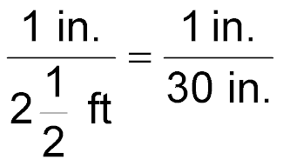
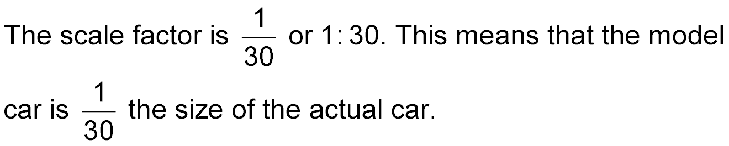
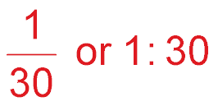
Find the Scale Factor
A drawing of a room has a scale of 1 inch (drawing) = 2.5 feet (actual). Find the scale factor of the drawing.
Convert 2.5 feet to inches.
21/2 ft =12in + 12in + 6in = 30in
The scale factor is 1in : 30in. This means that the drawing
is the size of the actual room.
Answer:

Slide 14

Construct a Scale Model
STATUE OF LIBERTY Auguste Bartholdi created several smaller models of the Statue of Liberty before creating the 152-foot statue that stands in New York Harbor. One such model was only 21 inches tall. What is the scale of this model to the final version?

Slide 15
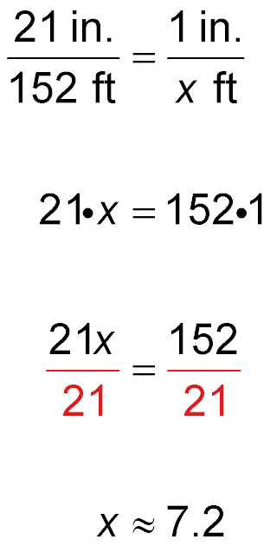
Model Statue:
21 inches tall
Real Statue:
152 feet tall
Determine the scale of the model to the final version.
model height
model scale factor
actual height
model scale height
Cross multiply.
Use the multiplicative inverse.
Simplify.
The scale of the model to the actual statue is:
1 in
7.2 ft

Slide 16

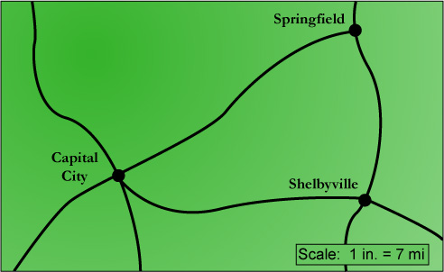
MAPS Use the map to find the actual distance from Springfield to Capital City. The map distance is about 1.4 inches.
1.4 in
A. 7.4 miles
B. 8.5 miles
C. 9.2 miles
D. 9.8 miles
Create a proportion skeleton:
Use the scale as one of the ratios:
A
B
C
D
Find the twins for the second ratio:

Slide 17
SCALE DRAWINGS On a scale drawing the length of a garage is 10 inches. The actual length of the garage is 24 feet. What is the scale of the drawing?
A. 1 inch = 2.1 feet
B. 1 inch = 2.4 feet
C. 1 foot = 2.1 inches
D. 1 foot = 2.4 inches
Create a proportion skeleton:
A
B
C
D
Use the info provided as one of the ratios:
Find the twins for the second ratio:

Slide 18
A drawing of a house has a scale of 1 inch = 2.4 actual feet. Find the scale factor of the drawing.
A. 1 : 22.5
B. 1 : 25.6
C. 1 : 28.8
D. 1 : 30.5
A
B
C
D

Slide 19




