Slide 1

Chapter 4
Lesson 4-9

Slide 2







(over Lesson 4-7)
Complete the conversion 3,500 cm² = ____ m². Round to the nearest hundredth.
Remember:
A. 0.035
B. 0.35
C. 3.5
D. 35
Small to Large divide by the factor.
Large to Small multiply by the factor.
A
B
C
D

Slide 3

(over Lesson 4-7)
Complete the conversion 24 cm² = ____ in². (Use
1 in. = 2.54 cm.) Round to the nearest hundredth.
A. 0.4
B. 2.4
C. 3.72
D. 3.92
Remember:
Small to Large divide by the factor.
A
B
C
D
Large to Small multiply by the factor.

Slide 4


(over Lesson 4-8)
A student is making a model skeleton of the human body. The scale she is using is 0.5 inch = 1 foot. Find the model length for the height that has an actual length of 6 feet.
Remember:
A. 3 in.
B. 5.5 in
C. 6.5 in.
D. 12 in.
Create a proportion skeleton.
Find the twins.
A
B
C
D
Cross multiply.
Use the multiplicative inverse.

Slide 5

(over Lesson 4-8)
A student is making a model skeleton of the human body. The scale she is using is 0.5 inch = 1 foot. Find the model length for the arms that have an actual length of 2.5 feet.
Remember:
A. 0.2 in.
B. 1.25 in.
C. 2.5 in.
D. 5 in.
Create a proportion skeleton.
Find the twins.
A
B
C
D
Cross multiply.
Use the multiplicative inverse.

Slide 6


Find rates of change.
rate of change

Slide 7

Preparation for Standard 7AF3.4 Plot the values of quantities whose ratios are always the same (e.g., cost to the number of an item, feet to inches, circumference to diameter of a circle). Fit a line to the plot and understand that the slope of the line equals the quantities.

Slide 8

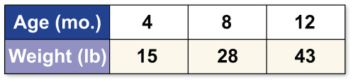
Find a Positive Rate of Change
DOGS The table below shows the weight of a dog in pounds between 4 and 12 months old. Use the information in the table to find the rate of change in the dog’s weight between 8 and 12 months of age.
x
y

Slide 9
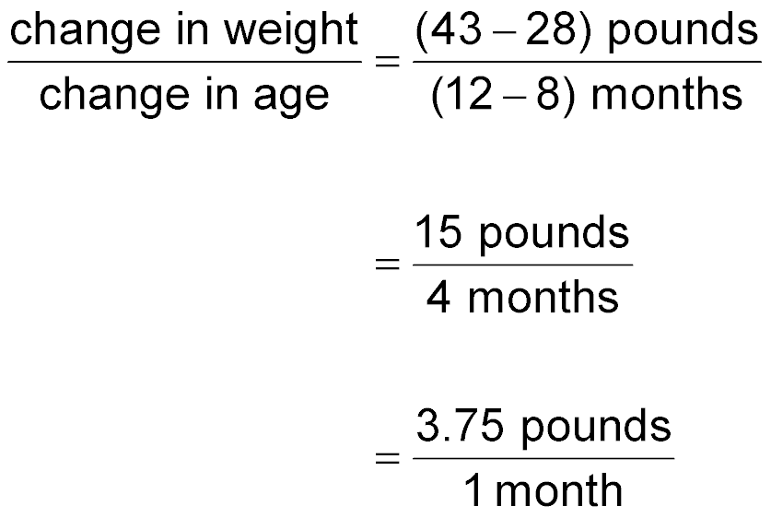
x
y
Find a Positive Rate of Change
y
The dog grew from 28 to 43 pounds from ages 8 to 12 months.
x
y
Subtract to find the change in weights and ages.
x
y
Express this rate as a unit rate.
x
Answer: The dog grew an average of 3.75 pounds per month.

Slide 10
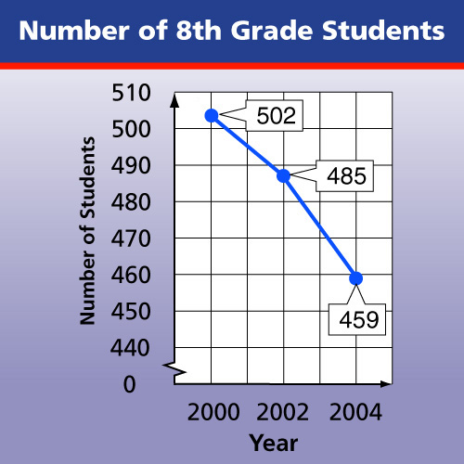
Find a Negative Rate of Change
SCHOOLS The graph shows the number of students in the eighth grade between 2000 and 2004. Find the rate of change between 2002 and 2004.
y
x

Slide 11
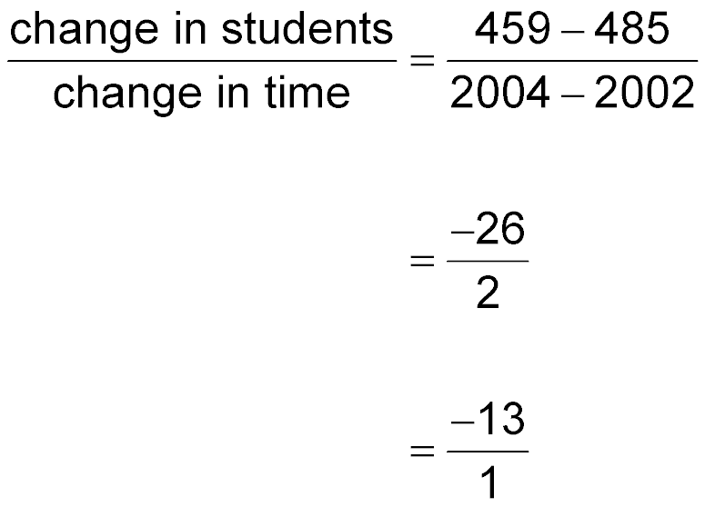
y
Find a Negative Rate of Change
Use the data to write a rate comparing the change in students to the change in time.
x
y
The number of students changed from 485 to 459
from 2002 to 2004.
x
y
x
Simplify.
y
Express as a unit rate.
x
Answer: The rate of change is –13 students per year. The rate is negative because between 2004 and 2002, the number of students decreased. This is shown on the graph by a line slanting downward from left to right.

Slide 12
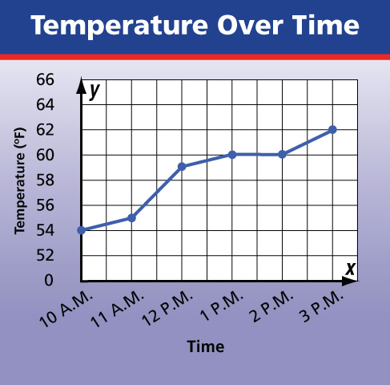
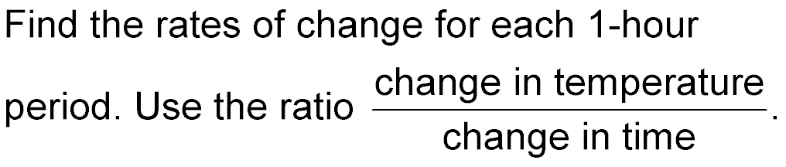
Compare Rates of Change
TEMPERATURE The graph shows the temperature measured on each hour from 10 A.M. to 3 P.M. During which
1-hour period was the rate of change in temperature the greatest?
y
x

Slide 13
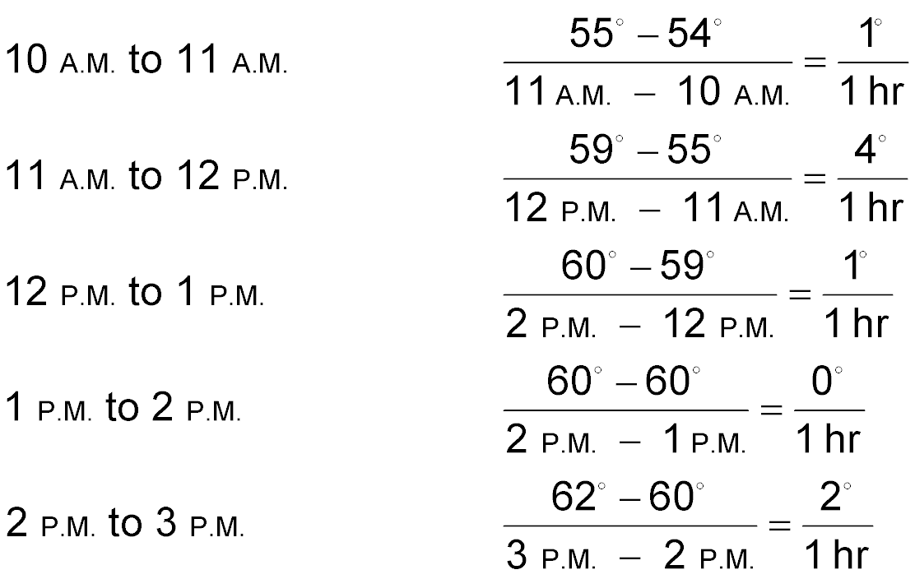
Compare Rates of Change
y
What is the greatest rate of change in temperature?
x
y
x
y
x
y
x
y
x
Answer: The greatest rate of change in temperature is 4° per hour between 11 A.M. and 12 P.M.

Slide 14

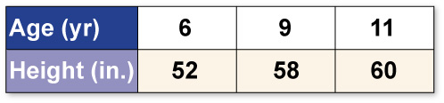
HEIGHTS The table below shows Julia’s height in inches between the ages of 6 and 11. Find the rate of change in her height between ages 6 and 9.
x
y
A. 2 inches per year
B. 2.2 inches per year
C. 2.5 inches per year
D. 3 inches per year
A
B
C
D

Slide 15
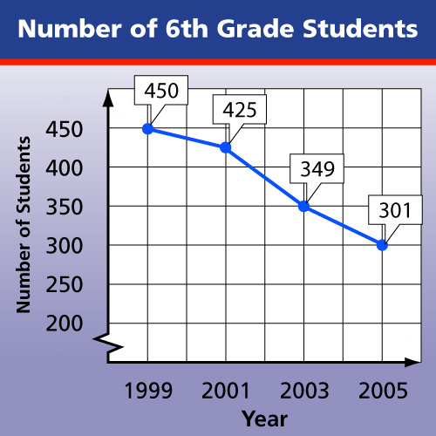
y
SCHOOLS The graph shows the number of students in the 6th grade between 1999 and 2005. Find the rate of change between 2003 and 2005.
x
A. –48 students per year
B. –32 students per year
C. –24 students per year
D. –20 students per year
A
B
C
D

Slide 16
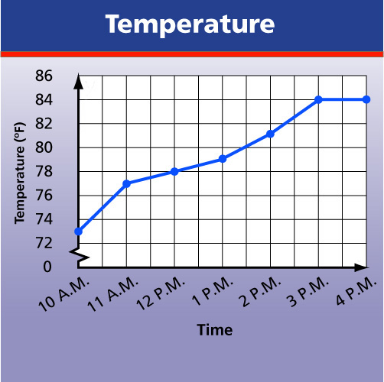
TEMPERATURE The graph shows the temperature measured on each hour from 10 A.M. to 4 P.M. Find the 1-hour time period in which the rate of change in temperature was the greatest.
y
A
B
C
D
x
A. 10 A.M. to 11 A.M.
B. 11 A.M. to 12 P.M.
C. 2 P.M. to 3 P.M.
D. 3 P.M. to 4 P.M.

Slide 17
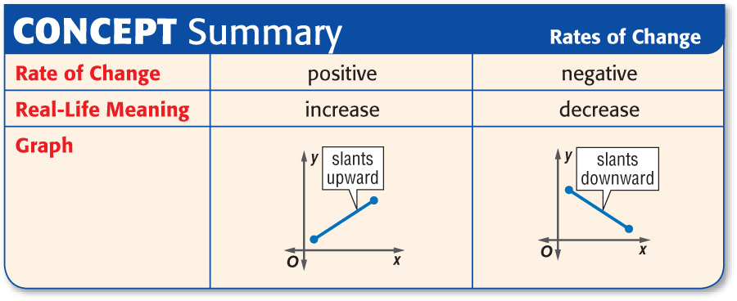

Slide 18
