Slide 1
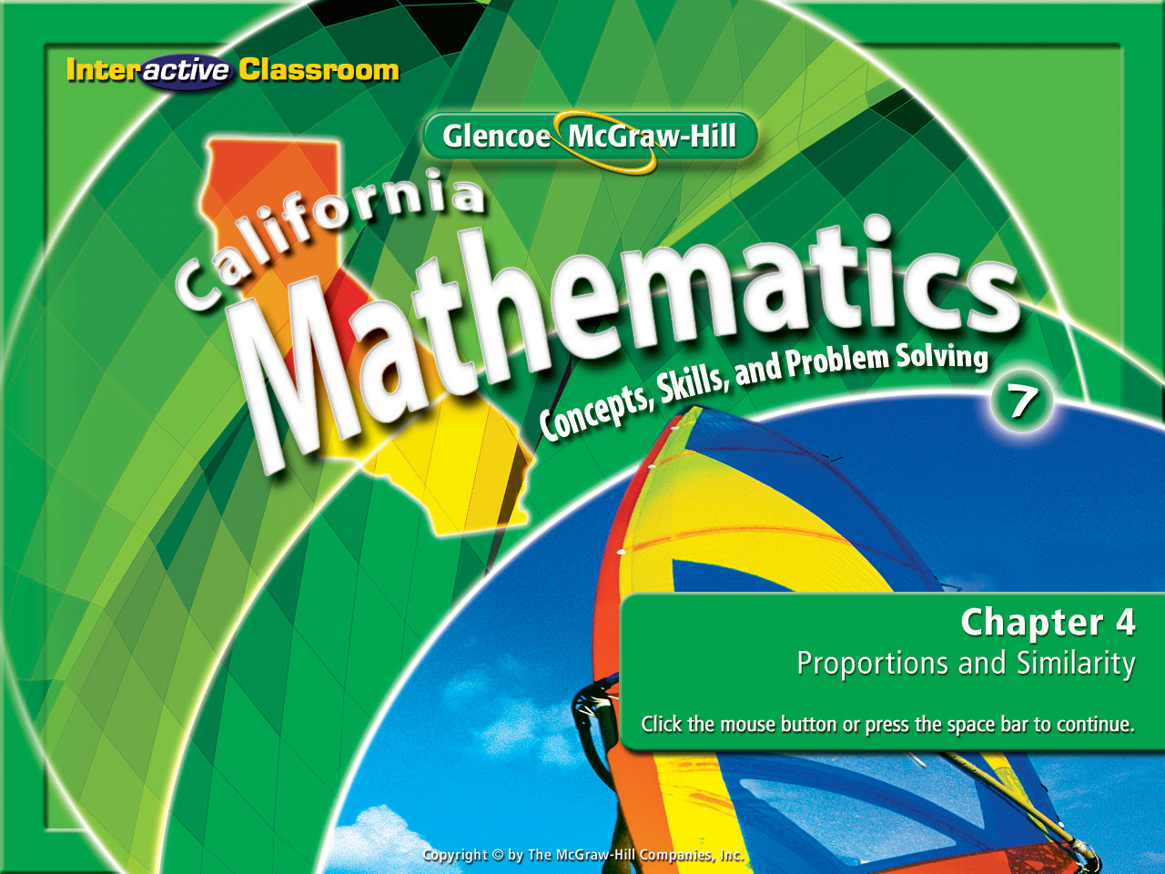



Lesson 3 Menu
Five-Minute Check (over Lesson 4-2)
Main Idea and Vocabulary
California Standards
Key Concept: Proportion
Example 1: Write and Solve a Proportion
Example 2: Real-World Example
Example 3: Write and Use an Equation
Chapter 4
Lesson 4-3

Slide 2







(over Lesson 4-1)
Express the rate as a unit rate: 2,550 people in 5 days
A. 2,555 people/day
B. 2,545 people/day
C. 550 people/day
D. 510 people/day
A
B
C
D

Slide 3

(over Lesson 4-2)
Akira earns $20 for every dog he washes. Is the amount of money he earns proportional to the number of dogs he washes? If so, how much money will he have earned after 10 dog washes?
A. no
B. yes, $100
C. yes, $150
D. yes, $200
A
B
C
D

Slide 4

(over Lesson 4-2)
Al’s Grocery sells soup for $1.25 per can. In their ad, they offer 4 cans of soup for $5.00. Is this a better price for the soup? Why?
A. Yes, there is a $0.25 discount per can.
B. Yes, there is a $0.50 discount per can.
C. No, there is no discount per can.
D. No, $0.25 is added to the price of each can.
A
B
C
D

Slide 5


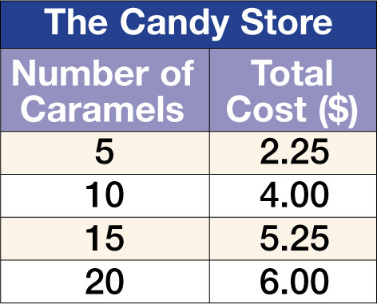
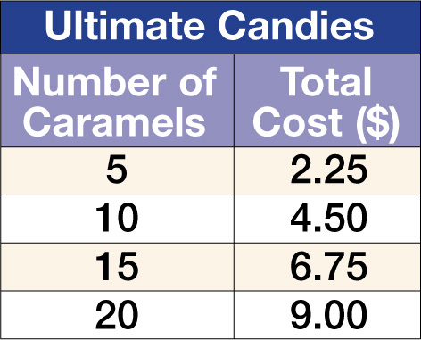
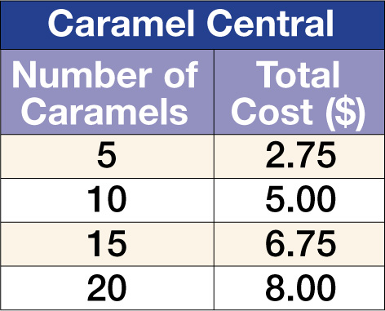
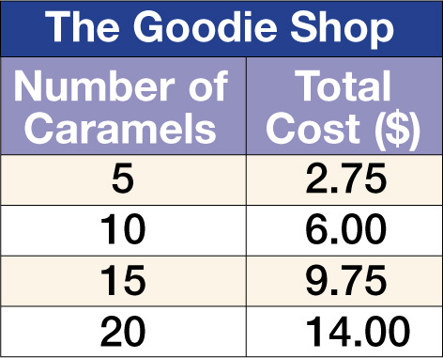

(over Lesson 4-2)
Mrs. Robinson is comparing the price of caramels from several different candy stores. Which store’s pricing guide is based on a constant unit price?
A. B.
C. D.
A
B
C
D

Slide 6


Use proportions to solve problems.
equivalent ratios
proportion
cross products

Slide 7


Standard 7AF4.2 Solve multi-step problems involving rate, average speed, distance, and time or a direct variation.

Slide 8
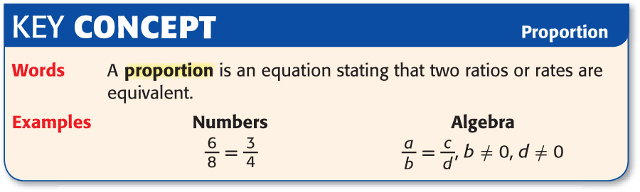

Slide 9
7
9
5
10
10
20
9
12
21
27
2
3
3
4
6
8
4
6
3
4
=
=
=
=
=
The following are examples of
Proportions

Slide 10
4
9
10
20
7
9
22
25
6
7
3
5
3
4
6
8
4
6
7
9
≠
≠
≠
≠
≠
These are not examples of
Proportions

Slide 11
So how come these are proportions?
6
8
3
4
7
9
21
27
2
3
=
=
4
6
=
And these are not proportions?
7
9
22
25
6
7
3
4
4
9
10
20
≠
≠
≠

Slide 12
3
8
7
9
5
7
189
21
27
21
189
40
≠
=
Finding the “Cross Products” will prove whether the two ratios are “Equivalent” or not.
So what determines whether two
fractions form a proportion or not?

Slide 13
Let’s apply this to Algebra
b a y - b e e !

Slide 14


Slide 15

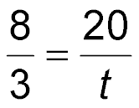
Write and Solve a Proportion
CLOTHING Melvin can decorate 8 T-shirts in 3 hours. At this rate, write and solve a proportion to find the time it will take him to decorate 20 T-shirts.
Write a proportion. Let t represent the time in hours.
shirts
shirts
time
time

Slide 16
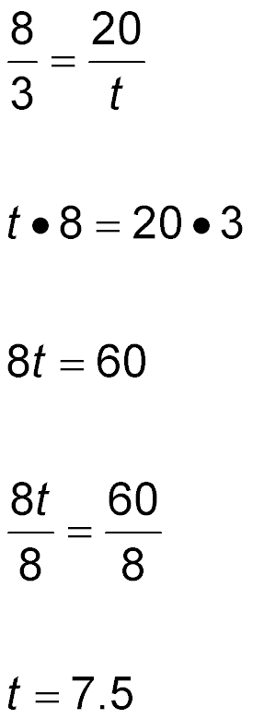
Write and Solve a Proportion
Write the proportion.
Find the cross products.
Multiply.
Divide each side by 8.
Simplify.
Answer: It will take Melvin 7.5 hours to decorate 20 T-shirts.

Slide 17

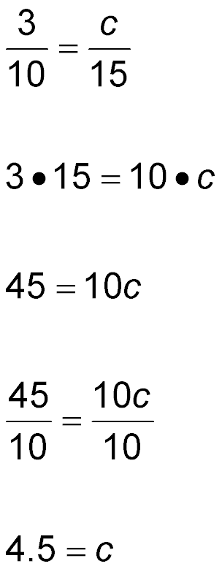
COOKING A recipe serves 10 people and calls for 3 cups of flour. If you want to make the recipe for 15 people, how many cups of flour should you use?
Write a proportion. Let c represent the number of cups of flour needed to serve 15 people.
cups of flour
cups of flour
total people served
total people served

Slide 18
Find the cross products.
Multiply.
Divide each side by 10.
Simplify.
Answer: You will need 4.5 cups of flour to make the recipe for 15 people.

Slide 19

CLOTHING Adrian can decorate 5 T-shirts in 2 hours. At this rate, write and solve a proportion to find the time it will take her to decorate 18 T-shirts.
A. 6.5 hours
B. 7 hours
C. 7.2 hours
D. 7.6 hours
A
B
C
D

Slide 20
COOKING A recipe serves 12 people and calls for 5 cups of sugar. If you want to make the recipe for 18 people, how many cups of sugar should you use?
A. 6.5 cups
B. 6.7 cups
C. 7.2 cups
D. 7.5 cups
A
B
C
D

Slide 21




