Slide 1
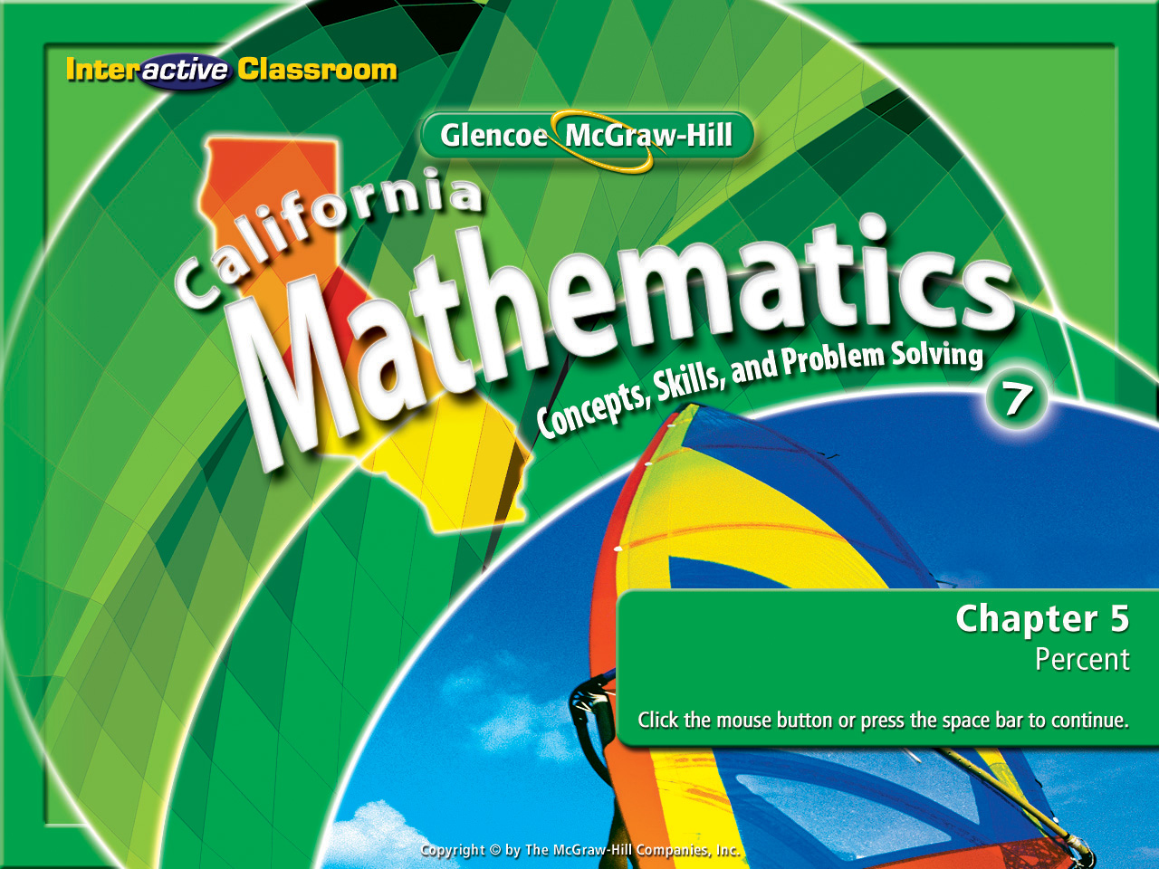
Splash Screen
Chapter 5
Lesson 5-1

Slide 2







(over Chapter 4)
Express the ratio 6 cups to 3 quarts in simplest form.
A. 1:2
B. 1:3
C. 2:1
D. 2:3
A
B
C
D

Slide 3


(over Chapter 4)
Express 400 meters in 16 minutes as a unit rate.
A. 2.5 m/min
B. 25 m/min
C. 40 m/min
D. 64 m/min
A
B
C
D

Slide 4
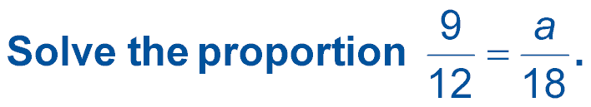

(over Chapter 4)
A. a = 6
B. a = 11.5
C. a = 13.5
D. a = 24
A
B
C
D

Slide 5

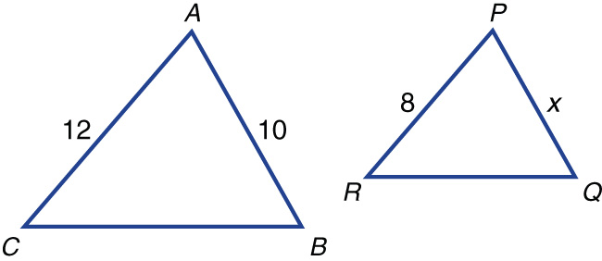

(over Chapter 4)
In the figure, triangle ABC is similar to triangle PQR. What is the missing length?
A.
B.
C.
D.
A
B
C
D

Slide 6


(over Chapter 4)
Find the slope of a line that passes through the points (2, –1) and (1, 2).
A. –3
B.
C. 0
D. 1
A
B
C
D

Slide 7


Write ratios as percents and vice versa.
percent

Slide 8

Standard 7NS1.3 Convert fractions to decimals and percents and use these representations in estimations, computations, and applications.

Slide 9
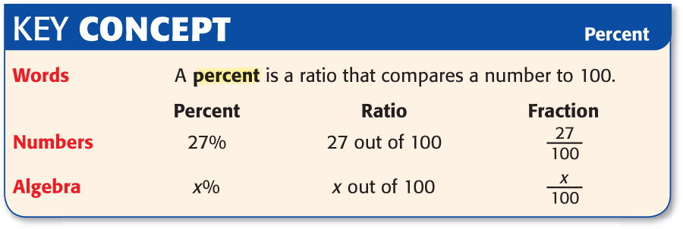

Slide 10
These are ratios:
3
5
9 to 15
6 : 10
Did you know that there is another way to write a ratio?
Shown below is an equivalent ratio to each of the 3 shown above:
60%
On your white board write the math operation used to write 60% as an equivalent ratio to the original 3 above.

Slide 11
Memory
Drives
Knowledge
Every fraction is a percent.
Every percent is a ratio.
Every fraction is a ratio.
Earn a Win
by
Remembering

Slide 12


Write Ratios as Percents
POPULATION According to a recent census, 13 out of every 100 people living in Delaware were 65 or older. Write this ratio as a percent.
13 ÷ 100 = .13 or 13%
Whay 1: divide the numerator by the denominator.
Whay 2: know that anything over 100 is already a percent.
There are two whays
to do this:
13/100 = 13%
Answer: 13 out of every 100 = 13%

Slide 13
Write Ratios as Percents
BASEBALL In 2005, Manny Ramirez has gotten on base 40.9 times for every 100 times at bat. Write this ratio as a percent.
Answer: 40.9 out of 100 = 40.9%

Slide 14

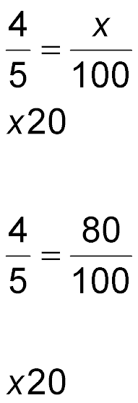
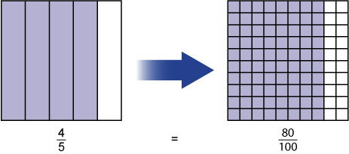


Write Fractions as Percents
TRANSPORTATION About 4 out of 5 commuters in the United States drive or carpool to work. Write this ratio as a percent.
×20
×20
Answer: So, 4 out of 5 equals 80%.

Slide 15
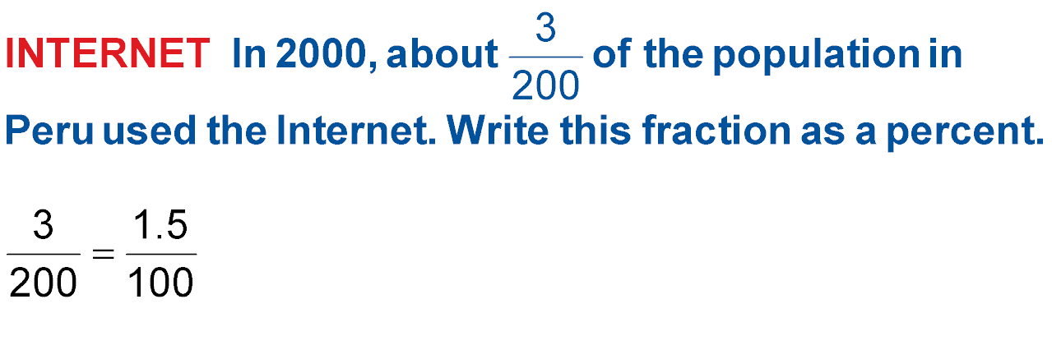
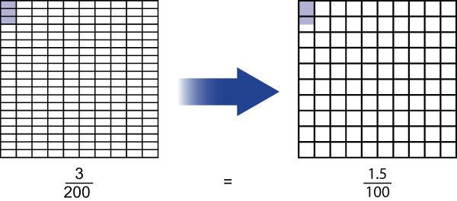
Write Fractions as Percents
÷2
÷2
Answer: So, 3 out of 200 equals 1.5%.

Slide 16
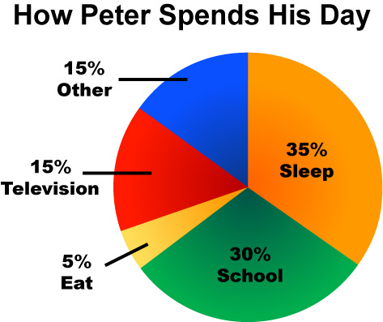
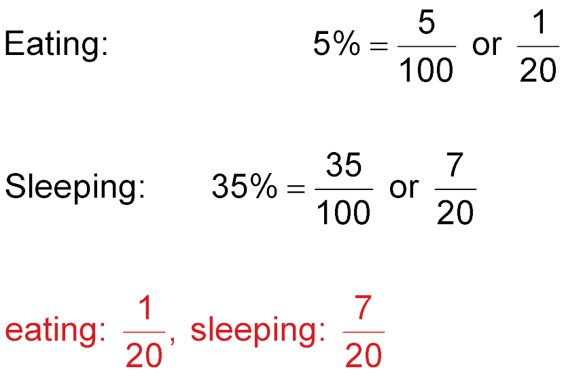
Write Percents as Fractions
SCHEDULE The circle graph shows an estimate of the percent of his day that Peter spends on each activity. Write the percents for eating and sleeping as fractions in simplest from.
Answer:
;

Slide 17

LIBRARY At the Booktown Library, 59 out of every 100 users is 12 or under. Write this ratio as a percent.
A. 28%
B. 43%
C. 59%
D. 120%
A
B
C
D

Slide 18
BASKETBALL Last season, Janelle made 68 baskets for every 100 tries. Write this ratio as a percent.
A. 56%
B. 68%
C. 74%
D. 100%
A
B
C
D

Slide 19
TRANSPORTATION About 3 of 5 students at Wilder Elementary ride the bus to school. Write this ratio as a percent.
A. 3%
B. 15%
C. 60%
D. 72%
A
B
C
D

Slide 20

A. 53%
B. 61%
C. 87%
D. 122%
A
B
C
D

Slide 21
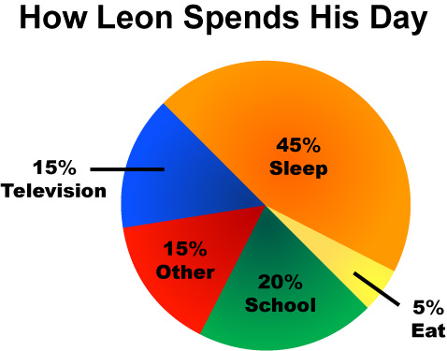
SCHEDULE The circle graph shows an estimate of the percent of his day that Leon spends on each activity. Write the percent for school as a fraction in simplest form.
A.
B.
C.
D.
A
B
C
D

Slide 22
