Slide 1
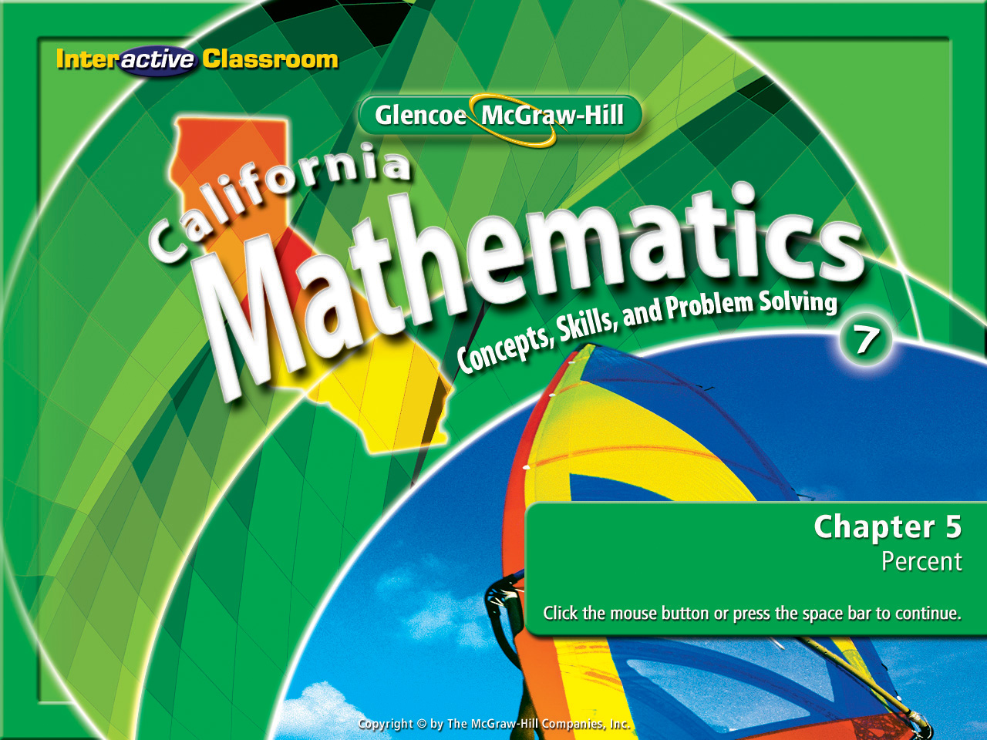
Splash Screen
Chapter 5
Lesson 5-2

Slide 2

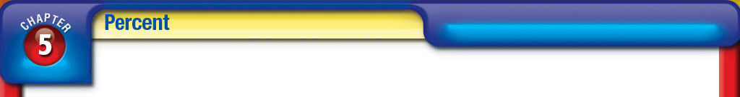






(over Chapter 4)
The U.S. Bank Tower in Los Angeles, California, is 1,018 feet tall. About how many meters tall is the building?
Use the conversion factor:
1 foot = 0.305 meters
A. 31 m
B. 290 m
C. 310 m
D. 3,338 m
Step 1: small to large (divide by the factor)
Step 2: large to small (multiply by the factor)
A
B
C
D
Step 3: Ask: “Is the answer logical?” If you started with a small measurement the answer must be smaller, if you started with a larger measurement the answer must be larger than what you started with.
Step 4: If the answer is not logical, do the opposite operation.

Slide 3

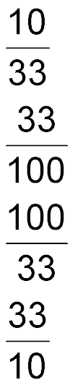

(over Lesson 5-1)
Write 33% as a fraction in simplest form.
A.
B.
C.
D.
A
B
C
D

Slide 4



(over Lesson 5-1)
A. 0.57%
B. 5.7%
C. 57%
D. 570%
A
B
C
D

Slide 5

(over Lesson 5-1)
Write the ratio 9:20 as a percent.
A. 2.2%
B. 4.5%
C. 22%
D. 45%
A
B
C
D

Slide 6

Write percents as fractions and decimals and vice versa.

Slide 7

Standard 7NS1.1 Read, write, and compare rational numbers in scientific notation (positive and negative powers of 10), compare rational numbers in general.
Standard 7NS1.3 Convert fractions to decimals and percents and use these representations in estimations, computations, and applications.

Slide 8
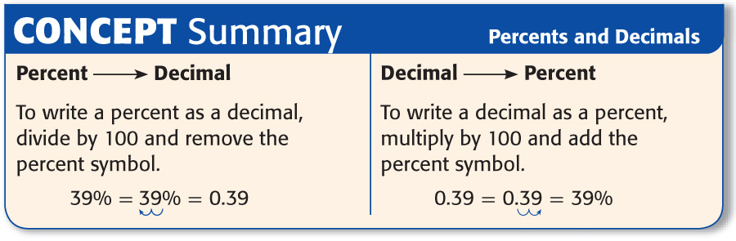

Slide 9
Watch carefully as we review an old skill you were taught a few years back.
Change 52/100 to a decimal:
.
0
5
2
100
5 2
. 0 0
-5 0 0
52
100
=
.52
2 0 0
-2 0 0
0 0 0

Slide 10

Percents as Decimals
Write 52% as a decimal.
52% = 52%
Locate the decimal & move it two places to the left (this represents dividing 52 by 100).
= 0.52
Remove the percent symbol & place a decimal point (.).
Answer: 0.52

Slide 11
Percents as Decimals
Write 245% as a decimal.
245% = 245%
Locate the decimal & move it two places to the left (this represents dividing 245 by 100)
= 2.45
Remove the percent symbol & place a decimal point (.).
Answer: 2.45

Slide 12
Watch carefully as we review another old skill you were taught a few years back.
Change .52 to a whole number:
100
x.52
.52 = 52
2
0
0
5
0
0
x
5 2 0 0
.
.

Slide 13
Decimals as Percents
Write 0.3 as a percent.
0.3 = 0.30
Move the decimal two places to the right to represent multiplying .30 by 100.
= 30%
Remove the decimal & add the % sign.
Answer: 30%

Slide 14
Decimals as Percents
Write 0.71 as a percent.
0.71 = 0.71
Move the decimal two places to the right to represent multiplying .70 by 100.
= 71%
Add the percent symbol.
Answer: 71%

Slide 15

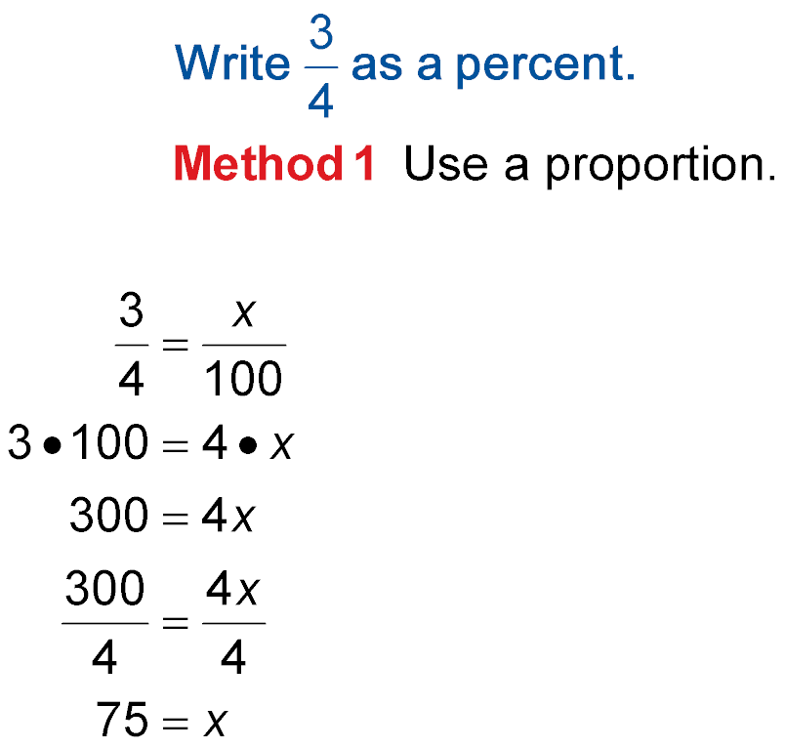
Fractions as Percents
Write as a percent.
Method 1 Check to see if the divisor of the fraction is a factor of 100. If so, use a proportion to find it’s equivalent.
3 ● 100 = 4 ● x
Find the cross products.
Use the “Multiplicative Inverse”.
x = 75

Slide 16
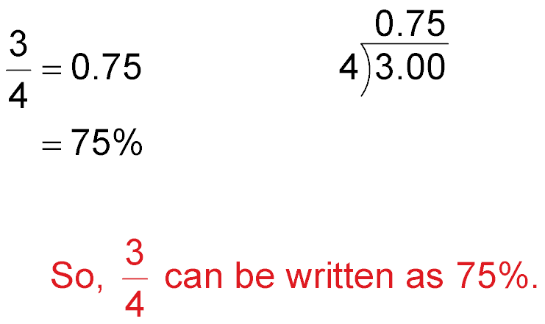
Fractions as Percents
Method 2 Convert the fraction to a decimal. Then change the decimal to a percent.
–28 20 –20 0
Answer:

Slide 17


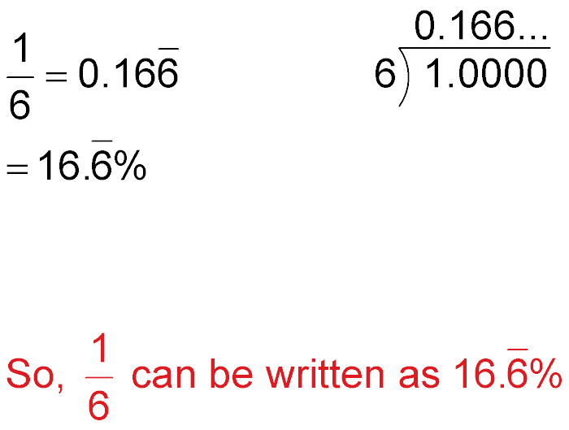
Fractions as Percents
–6 40 –36 40 –36 4
Answer: .

Slide 18


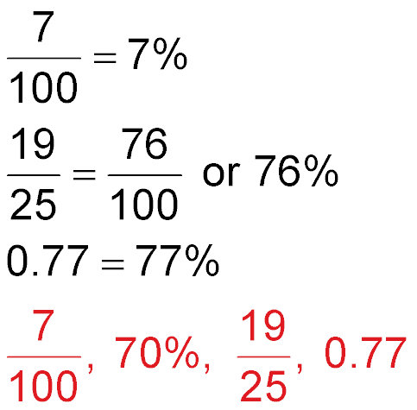
Order Numbers
70%
Answer:

Slide 19

Write 28% as a decimal.
A. 28
B. 14
C. 0.28
D. 0.14
A
B
C
D

Slide 20
Write 135% as a decimal.
A. 1.35
B. 13.5
C. 65
D. 135
A
B
C
D

Slide 21
Write 0.91 as a percent.
A. 9.1%
B. 91%
C. 191%
D. 910%
A
B
C
D

Slide 22
Write 1.65 as a percent.
A. 1.65%
B. 16.5%
C. 165%
D. 1,650%
A
B
C
D

Slide 23

A. 15%
B. 25%
C. 32%
D. 40%
A
B
C
D

Slide 24
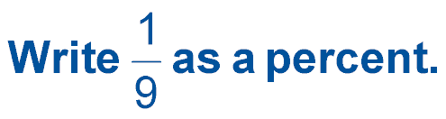
A. 0.9%
B. 1.19%
C. .1%
D. 1.11%
A
B
C
D

Slide 25
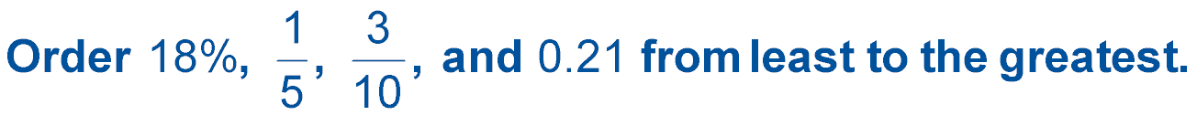
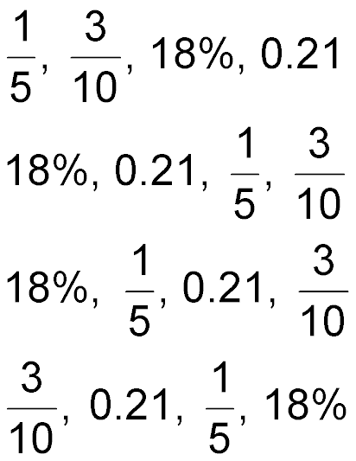
A.
B.
C.
D.
A
B
C
D

Slide 26
